Slide 1
Unit III - ABATTOIR PRACTICES AND ANIMAL BY-PRODUCTS TECHNOLOGY
Department of Livestock Products Technology
Bihar Veterinary College
Bihar Animal Sciences University
Patna-800014 (Bihar)

Slide 2
Abattoir by-products
India have vast livestock resources (535.82 million).
More than 100 million animals are slaughtered every year in 3,900 licensed & authorized slaughter houses besides around 26,000 unauthorized slaughter houses.
Slaughter rate for cattle as a whole is 20%, for buffaloes it is 41%, pigs 99%, sheep 30% and 40% for goats.
Besides meat a large quantity of by-products are produced , it includes every part of a slaughtered animal except dressed carcass

Slide 3
Cont…
Meat is the primary products of livestock industry and constitute majority of economic value. The key to the greater profit is to earn higher returns on by products
The quantity of animal by-products available for utilization can be estimated by subtracting the dressing percentage from 100.
The yield from meat animals during the slaughter process of non-edible outputs ranges from 20 to 30% of the live weight for beef, pork and lamb and from 5 to 6% of the live weight of chickens.

Slide 4
Cont….
The income from by products ranges form 7-12% of total income of slaughter
By-products are generated by slaughterers, processors, wholesalers, retailers and renderers
If the animal by-products are not effectively utilized, a valuable source of potential revenue is lost and increasing cost of disposal of this products
Non utilization of animal by-products create a major aesthetic and catastrophic public health problems

Slide 5
Cont…
Some of the by-products are organs, such as kidney, brain, liver, heart, lungs and intestinal tract, gullets and sweet bread, stomach, blood, bones, hooves, horns, hair and bristles, hide and skin, etc.
Animals, which die at abattoir prior to slaughter, or those animals or parts of animals, which have failed to pass meat inspection as, fit for human consumption, are also included in the by-products.
Ears, lips, snouts, teeth, foetus, gall bladder, trimmings, fleshing and dew claws are also listed under by-products.

Slide 6
Cont….
Organs such as kidney, brain, liver, heart and tongue are classified as edible by-products while the others are classified as inedible by-products.
The basic factors making the deviation between edible and inedible products are determined by the purchasing power of the consumer, his food habits, religious taboos and customs.
On the border line between these two extremes is a small group of organs which depending upon the food customs and purchasing power of the consumer may be considered either edible or inedible.

Slide 7
Approximate yield (% of live weight) of meat by-products from large animals (Buffalo and Cattle)
Meat (bone less) | 28%
Bone, head and feet | 22%
Paunch content and waste | 16%
Hide | 7.5%
Other offal (udder tail etc.) | 4%
Blood | 3.14%
Casings | 2%
Lung, Oesophagus | 2%
Fat | 1.71%
liver | 1.42%
Stomach | 0.71%
Heart | 0.42%
Tongue | 0.28%
Spleen | 0.28%
Kidney | 0.14%

Slide 8
Classification of abattoir by-products
According to origin
a. Principal by-products: These are directly harvested from the animals.
e.g. hide and skin, blood, bones, hooves and horns
b. Secondary by-products: These are derived from principal by-products.
e.g. blood meal, fibrin, haemoglobin, blood albumin, serum, plasma and so on from blood; fat yields glycerin and soap; bones yield gelatin and nitroglycerine, hides yield leather shoes, bags, belts, clothing, etc.

Slide 9
Cont…
2. According to use as a food
Edible by-products: liver kidney, heart, brain, intestine, thymus, tongue, spleen, meat trimmings, fat etc.
Inedible by-products: hide, skin, ear, lips, snout, gall bladder, fetus, hoofs, horn hair, bristles etc.

Slide 10
Cont…
3. According to ultimate use
Agricultural by-products: meat meal, bone meal, fertilizers, etc.
Industrial by-products: Gelatin, glue, casings, etc.
Pharmaceutical by-products: Insulin, pepsin, biochemicals, hormones, etc.

Slide 11
Advantages of utilization of abattoir by-products
It protects the environment from pollution
Ensures better returns to the livestock producers
Helps in supply of highly nutritive feed for more productive livestock
Helps in setting up of secondary rural industry
Generate new employments
Increase the crop production

Slide 12
Requirements for profitable processing of abattoir by-products
Ensure adequate supply of raw material collection
Provision of cheap and satisfactory storage facilities for perishable materials
Development of practical commercial processes for manufacturing of derived products
Availability of potential market
Technical training of personnel

Slide 13
Plan and layout of abattoir by-products utilization plant
In our country due to huge livestock density, at least one animal byproducts processing plant at each 50km range is necessary
Consideration during establishing of abattoir by-products utilization plant:
1. It should be adjacent to the slaughter house or a part of the same building connected through gravity pipe or passage
2. Should be away from inhabited area
3. Should be provision of overhead rails from slaughter house to the by-products plant

Slide 14
Cont….
4. Should have own screened drainage system
5. Should have separate clean (exit point) and unclean (inlets) area
6. Smooth concrete floor, wall and ceiling (floor slope of ½” per ft. is recommended).
7. Should have a hide/skin, salting room, renderers, tripery, manure bunker, store etc.
8. Open and well ventilated to prevent humidity build up
9. The equipments to be installed should cope up with by-product or offal processing.

Slide 15
Abattoir by-products utilization plant
Three main section should be there:
1. Hide/skin section with salt store
2.Tripery/Gut processing section with cleaning tables, water taps etc.
3. Carcass utilization plant with renderer, bone digester, fat settling tank and adjoining milling room and store.
Besides boiler, worker lockers, amenities and adjacent manure pit are other important requirements.

Slide 16
Cont….
The boiler should be of suitable capacity keeping in view the availability of raw material; and consumption of renderer.
The requirement of steam has been worked out to be 1.25 lb per lb of raw material to be processed.

Slide 17
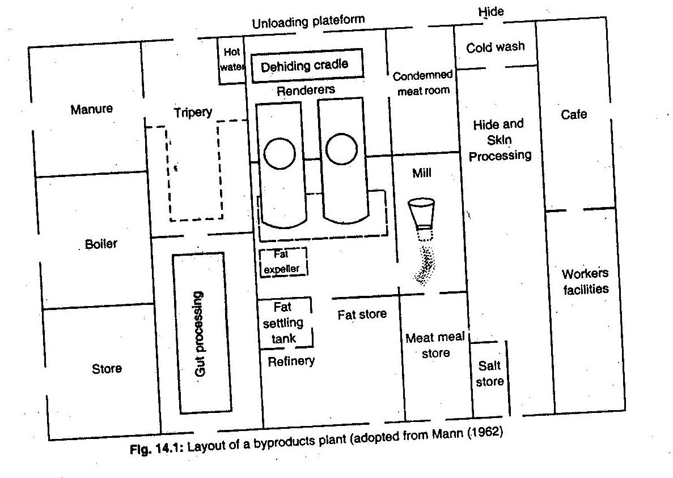

Slide 18
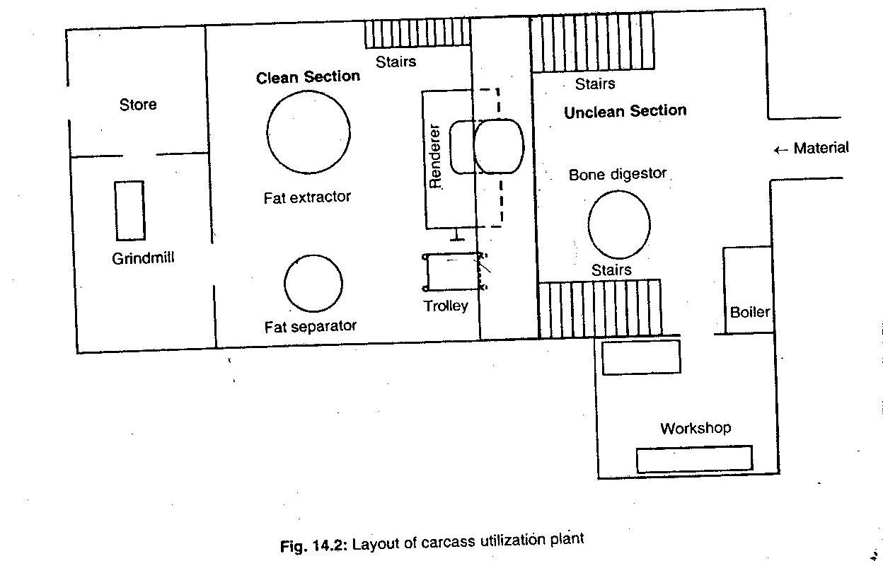

Slide 19
Dead/fallen animals
Large animals are die due to natural causes such as disease etc.
Condemned materials from slaughter house is also available
It is necessary to hygienically dispose the fallen animals to avoid decomposition and formation of obnoxious gases
Transport of fallen animals is done using road transport mode such as bullock cart or tractor trolleys

Slide 20
Cont…
The floor of the vehicle is should be bedded with straws and made free from any projection, otherwise bruising of the hide or skin will be there, lowers the cost of materials
The transport of the condemned animals should be in closed vehicle to by-products plant
The vehicle may be labeled as carrying as inedible animals by-products

Slide 21
Utilization of dead/fallen animals
Raw material for carcass utilization plant
Carcass pieces, bones, heads, feets, lungs, trachea, spleen, intestine (without contents), trimmings, genitals, udder, foetus, tripes
Not includes hoofs, horns, hair, blood, stomach or intestinal contents

Slide 22
Composition of various stock feeds
Meat meal: Protein- >55%
Protein and minerals- 85%
Moisture 7%
Crude fat 8%
Phosphorus <4.5%
Carcass meal (meat cum bone meal)
Protein <55%
Phosphorus >4.5
Bone meal (steamed)
Protein 7%
Calcium 32.5%
Phosphorus 15%

Slide 23
Thank You

