Slide 1
BIOPSY & CYTOPATHOLOGY -As rapid diagnostic test
Dr Kaushal Kumar
Assistant Professor and Head
Department of Veterinary pathology
Bihar Veterinary College,
Bihar Animal Sciences University, Patna, Bihar

Slide 2
CYTOLOGY ?
“Branch of science that is concern with structure and functions of animal or plant cell”
CYTOPATHOLOGY ?
“It deals with interpretation of cells from animal body that either exfoliate/desquamate from epithelial surface or are obtained from tissue through biopsy ”

Slide 3
Diagnostic cytology=Cytopathology
Application in diseases diagnosis:
Diagnosis and prognosis of Neoplasm
Identification of benign neoplasm
Diagnosis of specific infection
e.g., Demonstration of rotavirus antigen in desquamated cells in diarrhoeic feces
Cytogenetics
Employed for chromosomal studies, including karyotyping and aberrations in chromosomes.

Slide 4
Diagnostic cytology
Exfoliative cytopathology
Effusions
Scrapping
Biopsy
Aspirational
Touch impression
Interventional

Slide 5
Exfoliative cytopathology General consideration
Principle: Neoplastic cells are less cohesive than others so are shed into fluid and secretions.
Collection of exfoliated cells is usually a bloodless type of biopsy.
exfoliative cell cytology permits the diagnosis of cancer at its earliest possible stage.
can be employed as a screening procedure for early diagnosis and treatment with low cost.
It should be an adjunct to and not a replacement for biopsy and histopathology.

Slide 6
Exfoliative cytopathology
Collection of specimens
Effusions: plural,pericardial,peritoneal
Scrapping: exposed lesion/excised biopsy
Touch impression: draining lesion/exposed lesion/excised biopsy
Absence of tumour cell does not exclude the presence of neoplasm ie inconclusive

Slide 7
Biopsy General consideration
Defined as the removal of tissue from a living animal for examination.
Histopathological examination of biopsy material can distinguish between types of cancer and is valuable in deciding a prognosis.
Biopsies are usually performed under local or general anesthetics.

Slide 8
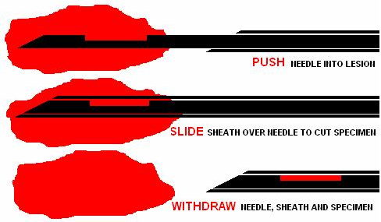
Biopsy
Collection of specimens
Aspirational-FNAC/FNAB
Interventional –Trucut Needle Biopsy

Slide 9
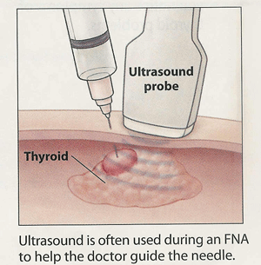
FNAC
A fine needle aspiration is most often done on swellings or lumps located just under the skin
• cysts (fluid-filled lumps) • nodules or masses (solid lumps) • enlarged lymph nodes
Recommended by -
Ultra sound.
CT scan
mammogram

Slide 10
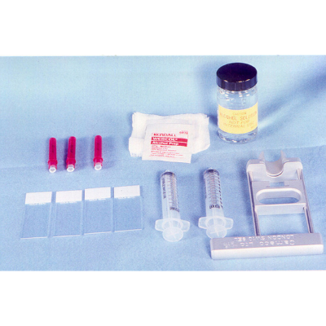
Equipment's :-
Disposable syringe.
Glass slides.
alcohol sponges.
4. 1-2 ml , 1-2% Lidocane / local anesthesisa.

Slide 11
ASPIRATION BIOPSY CYTOLOGY ( ABC ) OR
FINE NEEDLE ASPIRATION CYTOLOGY (FNAC)
Economical.
Minimizes patients discomfort
Avoids unnecessary surgical procedure
Steps involved:
Aspiration
SMEARING
DIAGNOSIS

Slide 12
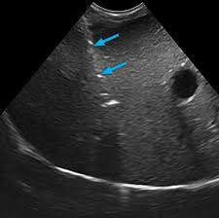
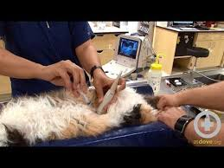
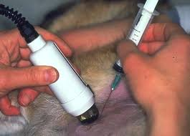
USG guided Biopsy

Slide 13
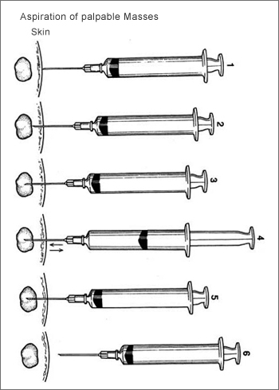
Negative aspiration technique

Slide 14
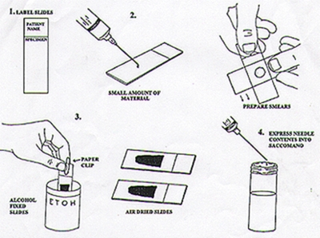
SMEARING
I – Parallel slide tech.
- tongue shape.
- monolayer forms.
- better for fixation and screening
II- Pull technique
2 slides.
acceptable
III Lift technique.
2 slides
least desirable.

Slide 15
Fixation of the specimen
Air dry - for Romanowsky stains (Wright’s or Giemsa and methylene blue)
Fix while wet –for Papanicolaou’s stains with (equal amounts of ether and 95% ethyl alcohol)
Staining:
The two most commonly used stains are
Wright’s & Giemsa stain and
Papanicolau stain

Slide 16
Diagnosis
Non septic
Normal
Sample Inflammatory
Abnormal septic
Non-neoplatic
Non inflammatory Benign
Neoplastic
Malignant

Slide 17
CANCER
BENIGN MELIGNANT

Slide 18
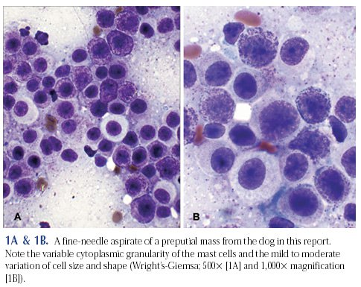
Mast Cell Tumor

Slide 19
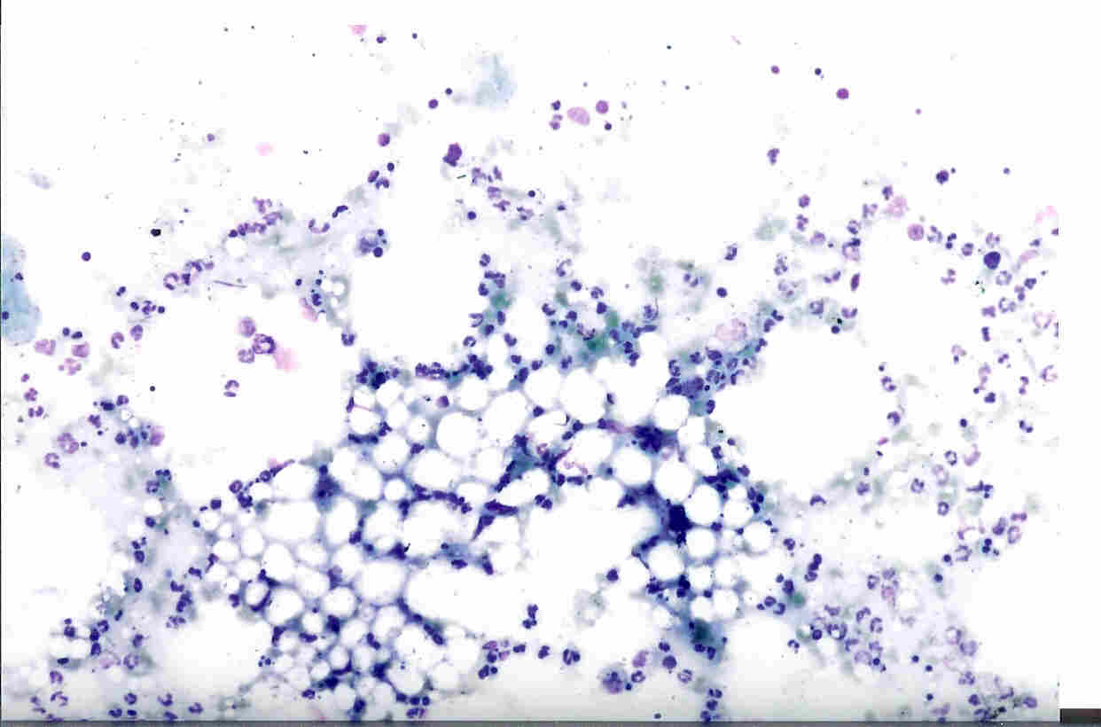
Lipoma

Slide 20
QUESTION?

