Slide 1
BRUCELLOSIS
Brucellosis is an infectious and important zoonotic bacterial disease of animals caused by Brucella sp. and characterized by abortion in late gestation and formation of granulomatous lesions in genital organs, joints and fetal liver.

Slide 2
Incidence
1863 – Marstion was described Brucellosis in the islands of Malto.
1887 – Sir Robert Bruce found the bacilli from Spleen of infected soldier. Later on they isolated in the pure cult( Micrococcus mellitensis)
1897 – Bange isolated and identification of organism in aborted cow fetuses and fetal membrane & named the organism Brucella abortus.
( Bang Disease)
1913 – Traum isolated & identification of Brucella suis in pigs
1951 – Bubdle and Boyes isolaed Brucella ovis in rams
1968 – Charnecael isolated Bruella canis in dogs

Slide 3
Etiology ( 7 species till now in the world)
Brucella abortus ( pathogenic strains in India is 544) in America it is 2308.The vaccine stain in India Cotton strain 19 ( S19). & in America is RB 51. Live vaccine (Br. is an intracellular organism) kill vaccine is not effective.
Br. ovis
Br. meletensis – 16 M in India vaccine strain Rev-1
Br. canis
Br. suis
Br. neotomiea (wood rat)
Br. maris ( marine animal)

Slide 4
Resistance to physical & chemical agents
In 60oc temp. for 10 mint the organism can not survive, pasteurization of milk kill the Brucella.
Every disinfectant & detergents are lethal to Br.
Low pH is lethal to Br & Direct sunlight is lethal.
The organism can be store at 4-8oc upto 1 yr.

Slide 5
Prevalence
The prevalence of Brucellosis throughout the world.
In India, the prevalence rate from 6.6 % in M.P 60% and North Eastern state.

Slide 6
Many Names of Brucellosis
Human Disease
Malta Fever
Undulant Fever
Mediterranean Fever
Rock Fever of Gibraltar
Gastric Fever
Animal Disease
Bang’s Disease
Enzootic Abortion
Epizootic Abortion
Slinking of Calves
Ram Epididymitis
Contagious Abortion

Slide 7
HOST RANGE and TRANSMISSION
Brucella abortus : cattle, buffalo, select wildlife
Brucella melitensis : sheep, goats and bovines
Main source of infection
 uterine discharge of infected animals
 aborted foetus
 infected semen
Spreads mainly through
 ingestion of contaminated food and water
 Artificial Insemination
 tail splashing of urine - conjunctival route
 veterinary activities
Rural poor zoo sanitary conditions

Slide 8
IMPORTANT OUTCOME OF INFECTION
Sexually mature animals only affected
Initial exposure infection during: in pregnancy

Slide 9
We regard brucellosis as
the World’s most Widespread
of all Zoonoses
&
it has Enormous Impact on
the Animals Industry

Slide 10
Species | Biotype | Animal Hosts | First Described
B. melitensis | 1-3 | Goats, sheep, camels | Bruce, 1887
B. abortus | 1-6, 9 | Cows, Camels, Yaks, buffalo | Bang, 1897
B. suis | 1-5 | Pigs (biotypes 1-3), wild hares (biotype 2), caribou and reindeer (biotype 4 ), rodents (biotype 5) | Traum, 1914
B. canis | - | Canines | Carmichel and Bruner, 1968
B. ovis | - | Sheep | Van Drimmelen, 1953
B. neotomae | - | Rodents | Stoenner and Lackman, 1957
B. pinnipediae and B. cetaceae or B. Maris (provisional) | - | Mink whales, dolphins, porpoises (pinnipediae), seals (cetaceae) | Ewalt and Ross, 1994
Non-zoonotic ??

Slide 11
BRUCELLOSIS
Pathogenesis
Ingestion, Inhalation
Enter through intact or abraded skin or conjunctivae
Congenital infection
Bacteria multiply in regional lymph nodes
Travel through lymphatics

Slide 12
BRUCELLOSIS
Pathogenesis
Affinity with female and male reproductive organs
Localize in lymph nodes, spleen, liver, joints, bones
Proliferates intracellularly
High affinity with erythritol in placenta and foetus
Abortions in animals in late gestation

Slide 13
In case of cow, the site of predilection is placental trophoblast. It contain erythrotol, higher affinity to erthotol direct the organism to replicate the trophoblast( outer layer of blastocyst).
The increase hydrophobicity of the outer membrane protein causes the utilization of the hydrophobic nutrients of the trophblast.
The placental trophoblast will secrete some hormones like cortisol, PGF2alfa, Estrogen and other steroid hormone.
The increase amount of estrogen, PGF2 alfa coupled with decrease amount of progesterone, terminate the pregnancy 5-7 month of gestation.

Slide 14
Clinical signs
Clinical signs
Cattle
Abortion in 7th and 8th months of gestation
Persistent infection in cows exposed after puberty
Pigs
Transmission through coitus.
Abortion in 2nd and 3rd months of gestation
Orchitis in infected boars
Localization in other tissues like skeleton more common

Slide 15
Clinical signs
Sheep and goats
Transmission same as cattle
Abortion in ewes
Orchitis, epididymitis in male sheep and goats.
Dogs
Caused by B. canis
Transmitted by exposure to uterine discharges or aborted fetuses or by coitus.
Abortion in 50 days of gestation
Male dogs – orchitis / epididymitis.
Horses
B. abortus + Actinomyces bovis

Slide 16
BRUCELLOSIS
Characteristic symptoms
Orchitis
Accumulation of fluid in scrotum
Abortion in late gestation (7-9 month) 3rd trimester of pregnancy.
Retention of placenta

Slide 17
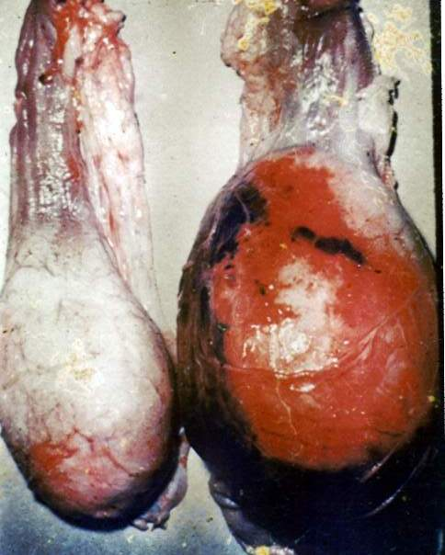
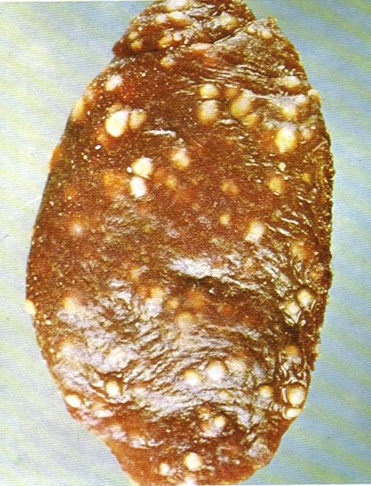
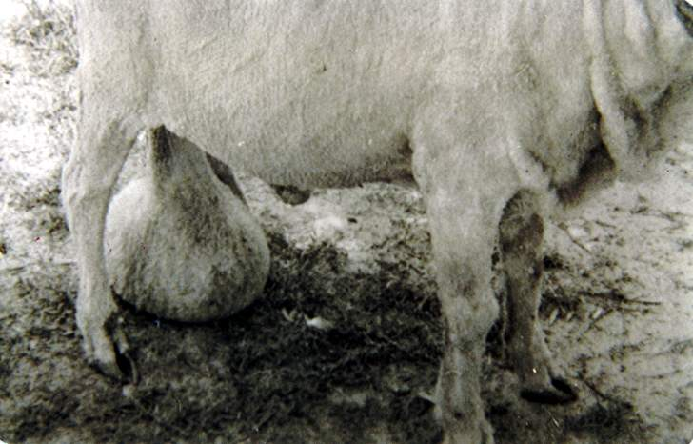
BRUCELLOSIS
Macroscopic features
Oedema of chorion, thickened
Oedema of foetus, serosan-guinous fluid in body cavity
Pneumonia, necrotic foci in liver
Enlargement of scrotum in males
Induration of mammary gland in cows

Slide 18
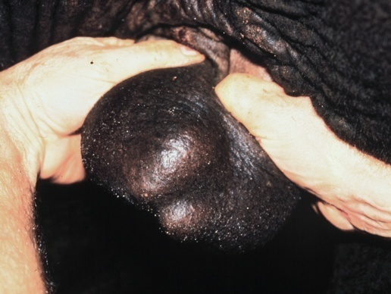
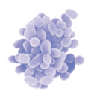
Orchitis

Slide 19
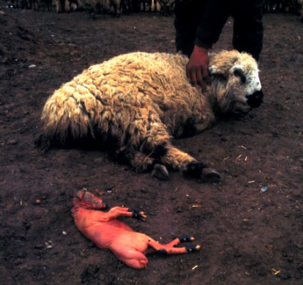
Abortion

Slide 20
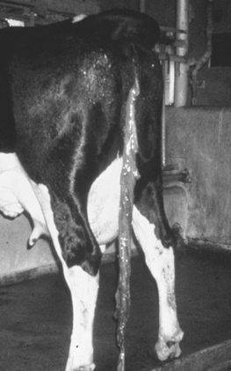
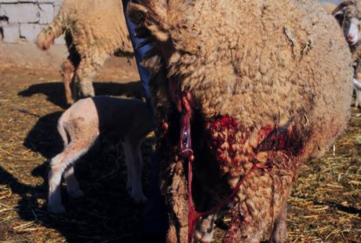
Retained Placenta

Slide 21
BRUCELLOSIS
Microscopic features
Infiltration of phagocytic cells, epithelioid cells and lymphocytes surrounded by fibrous tissue proliferation
Fetal broncho pneumonia
Organism in chorionic epithelial cells
In males, proliferation of fibrous tissue compresses or replaces epididymis

Slide 22
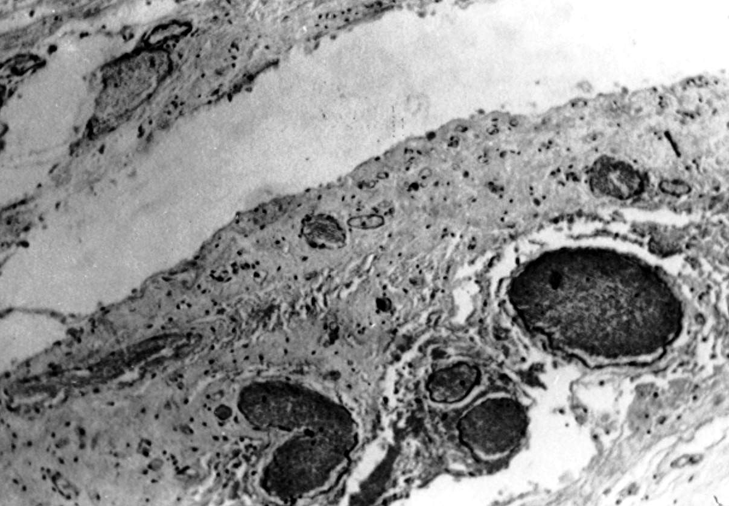
BRUCELLOSIS
Diagnosis
Symptoms and lesions
Milk ring test (MRT)
Immunodiagnostic tests- CFT, SAT, ELISA, DIA
Isolation of bacteria
Demonstration of organisms in tissue sections using special stains

Slide 24
Simple agglutiation test cannot differentiate B. abortus and B. Melinensis.
Agglutinin absorption tecnique is required to defferetiate B. abortus & B. melitensis.

