Slide 1
Class Lecture
Butter Products
Dr. Sanjeev Kumar
Associate Professor
Department of Dairy Technology
SGIDT, Patna-14

Slide 2
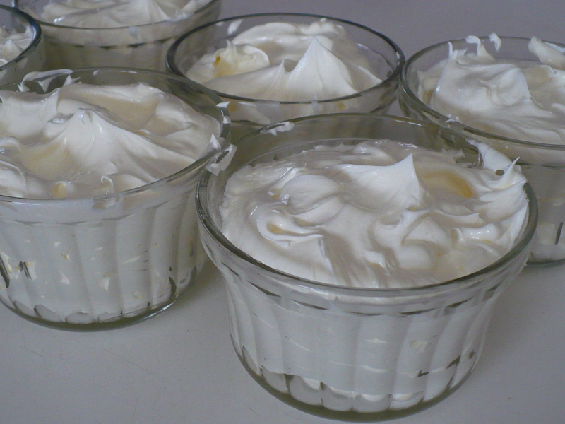
WHIPPED BUTTER
Butter is whipped to incorporate either nitrogen gas or air
PURPOSE:
To spread easily even when chilled
To ↑ volume
According to “US legal requirement” , it should contain at least 25% butterfat.

Slide 3
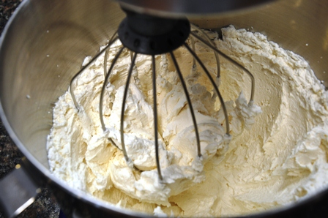
WHIPPED BUTTER
Butter is softened to 20 – 24°C for easy working
At this stage color and salt are added
Product is whipped to get the desired over-run (50 to 100%)
Packed and stored at refrigerated temperature
Caloric value less than butter (butter fat around 45 to 50%)

Slide 4
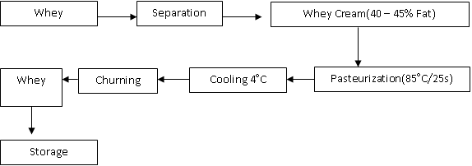
WHEY BUTTER
Made from whey separated from curd during the making of cheese
Cheesy flavor
Less shiny & deeper yellow color
May contain residual starter cultures from cheese batch, and added casein
FLOW CHART

Slide 5
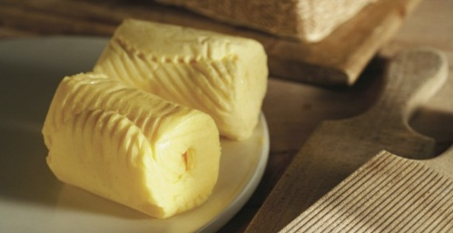
Minimum ash content compared to others
Soft texture & more porous
Less hard and more spreadable
Used commercially in baked goods and in making candies
WHEY BUTTER

Slide 6
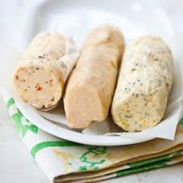
FLAVORED BUTTER
Flavorings added to enhance taste
Natural flavorings :- Dry onion powder, red chilly powder, pepper powder and ginger powder
Mix after butter preparation
Mixed strain starter of Streptococcus diacetylactis and Lactococcus or / Lactococcus cremoris, grown in a skim milk or whey medium,
Adjusted to pH 3.5 and steam distilled

Slide 7
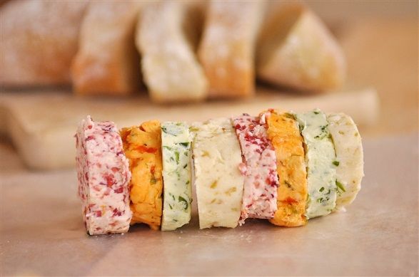
Flavor concentrates are encapsulated through spray drying technology using malt dextrin (flavor enhancer)
Add 0.07-0.14% distillate (approx. 2000 mg diacetyl/kg) during working
Lipase and esterase - natural butter flavors
FLAVORED BUTTER

Slide 9
Class Lecture
Fat Spreads
Dr. Sanjeev Kumar
Associate Professor
Department of Dairy Technology
SGIDT, Patna-14

Slide 10
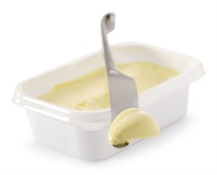
FAT SPREADS
Dairy Spreads:- fat source is milk fat
Non-dairy Spreads:- Vegetable fat with or without milk fat as source of fat
1. Low fat spreads: Fat percent ( 40 to 60% )
2. Reduced fat spread: Fat percent (60 – 70%)
USES
Direct consumption along with sandwiches, salads etc.,
Confectionery industry
Bakery Industry

Slide 11
Manufacture of Fat Spreads
Preparation of the water phase and fat phase
Emulsion preparation
Filling
Pasteurisation
Crystallization

Slide 12
DIFFERENCE- BUTTER & MARGARINE
BUTTER | MARGARINE
Made from animal fat | Made from vegetable oils
More saturated fats (51%) | More mono-unsaturated fats (8%)& poly-unsaturated fats(37%)
No trans-fat | Contains trans-fat
Types: Cultured, sweet, raw, whipped cream | Types:- blended, hard low fat, low spread

Slide 13
MAKHAN
Butter with natural culture flavor from yogurt
Raw whole milk heated to 90°C and cooled down to 45°C
Culture added , milk incubated in Terracotta pot Handi or Matka at 45°C overnight
Milk turns into Dahi (Yogurt)
Process to make Makhan is called 'Manthan‘
Manthani tied by rope to fixed post

Slide 14
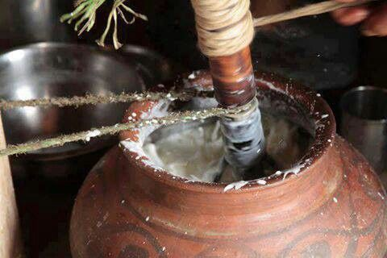
Wooden churner stick 'Phirni' inserted in Dahi
Phirni rotated back and forth by pulling on a rope wrapped around the Phirni.
Manthan takes place during early cool morning hours.
In about 10 to 20 minutes of continuous churning, butter-fat 'breaks' from yogurt as butter-globules.
Butter-globules clump together to make lumps of Makhan that float on top
Makhan skimmed off leaving behind Chaach
Heavier (more fat) the milk, lower should be the temperature of Dahi to make Makhan

Slide 15
Uses of butter
Direct consumption
In the preparation of sauces
As a cooking medium
In the baking and confectionary industries
In ice-cream , butter oil and ghee manufacturing
In production of reconstituted milk

