Slide 1
Class Lecture
Butter
(Definition & Legal standards)
Dr. Sanjeev Kumar
Associate Professor
Department of Dairy Technology
SGIDT, Patna-14

Slide 3
DEFINITION
As per FSSAI (2011),
Butter means the fatty product derived exclusively from milk of cow and/or buffalo or its products principally in the form of water-in-oil type of an emulsion.
The product may be with or without added common salt and starter cultures of harmless lactic acid and/or flavour producing bacteria.
Table butter shall be obtained from pasteurised milk and/or other milk products which have undergone adequate heat treatment to ensure microbial safety.
It shall be free from animal body fat, vegetable oil and fat, mineral oil and added flavour. It shall have pleasant taste and flavour free from off flavour and rancidity.
It may contain permitted food additives.
It shall conform to the microbiological requirements of the regulation.

Slide 4
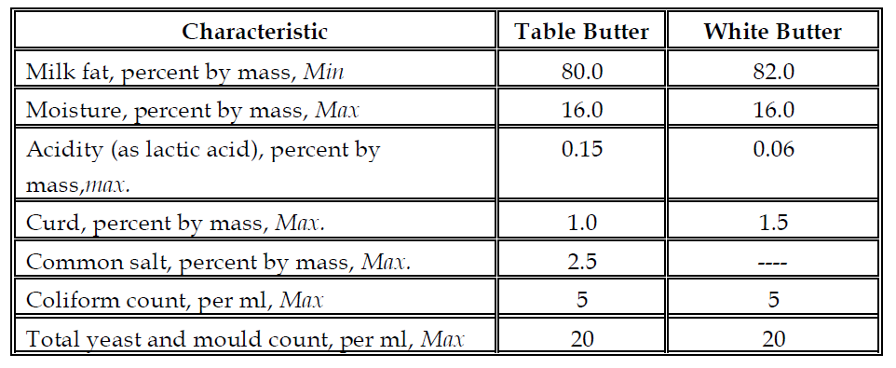
FSSAI Standards for Butter
Note: Where butter is sold or offered for sale without any indication as to whether it is table or desi butter, the standards of table butter shall apply.
BIS standards for pasteurized butter

Slide 5
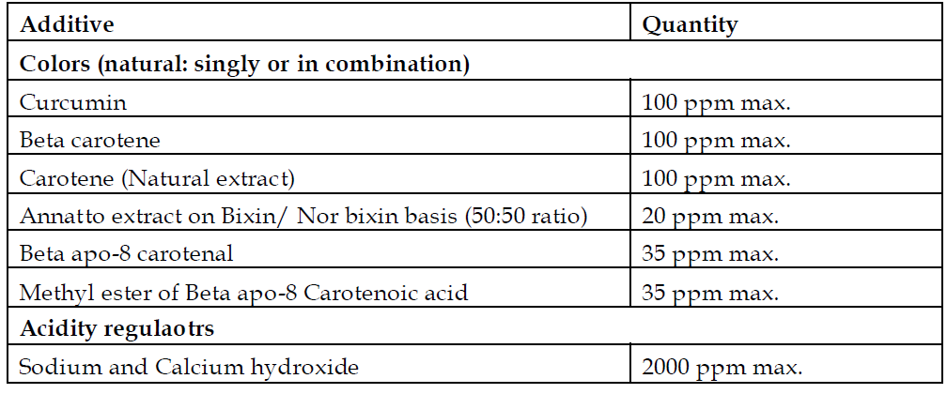
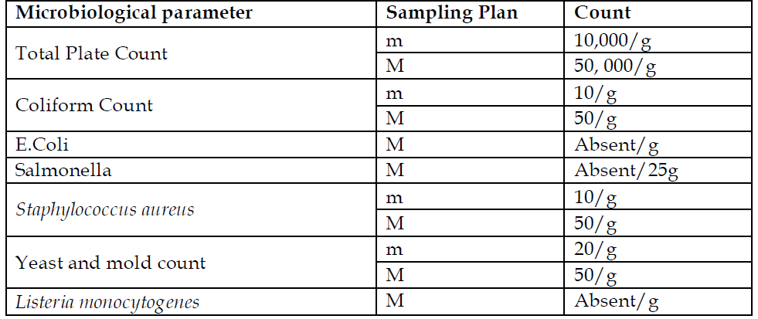
Permitted food additives in butter as per FSSR
Microbiological requirements of pasteurized butter (FSSAI, 2011)
m, M denotes standard sampling procedure as given by FSSAI, 2011

Slide 6
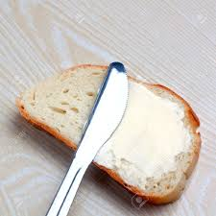
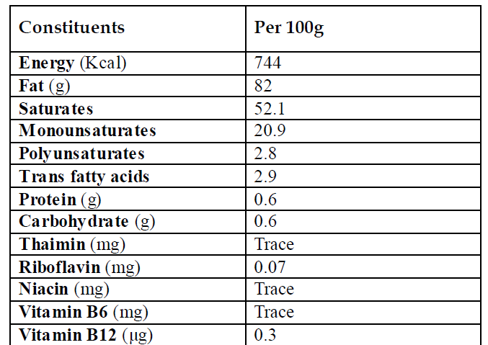
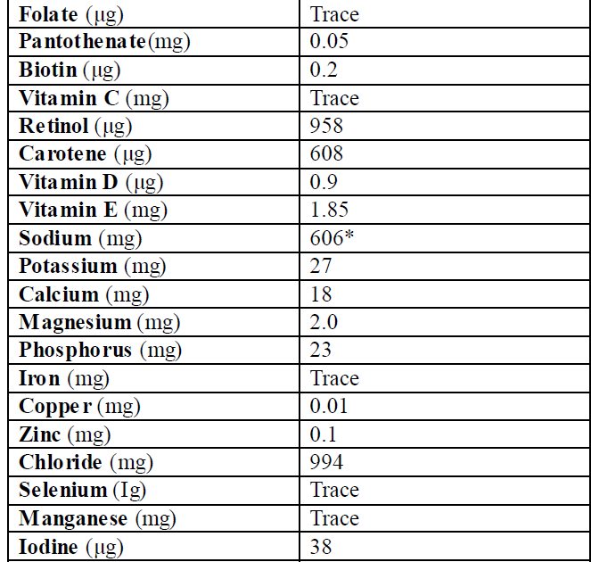
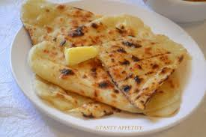
Nutritional composition of butter

Slide 7
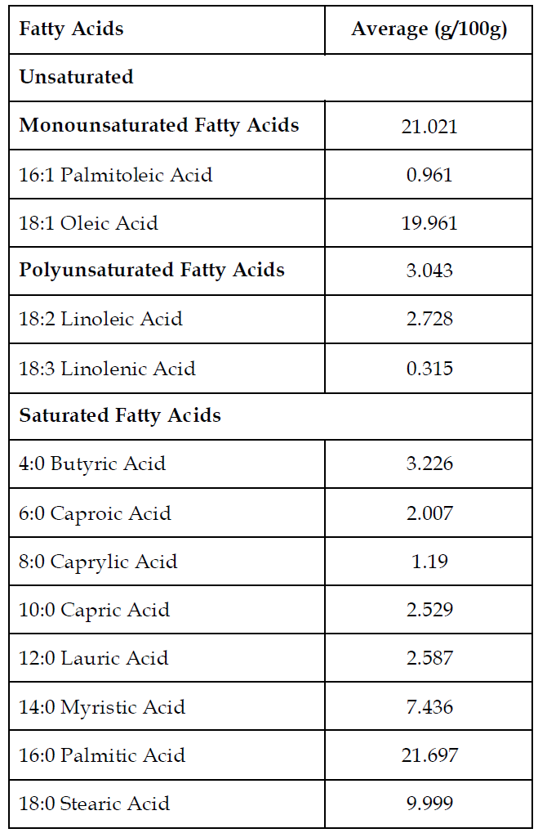
Fatty acid composition of butter

Slide 8
Classification
A. Classification based on acidity of cream used for butter making:
Sweet cream butter: pH of ≥6.4
Mildly acidified butter: pH in the range of 5.2 to 6.3
Sour cream butter : pH ≤ 5.1
B. Classification based on salt content
Salted butter
Unsalted butter
C. Classification based on end use (as followed by BIS):
Table Butter
White Butter
D. Classification based on the manufacturing practice (as followed by FSSAI):
Pasteurized cream butter/ Pasteurized Table butter
Desi butter

Slide 9
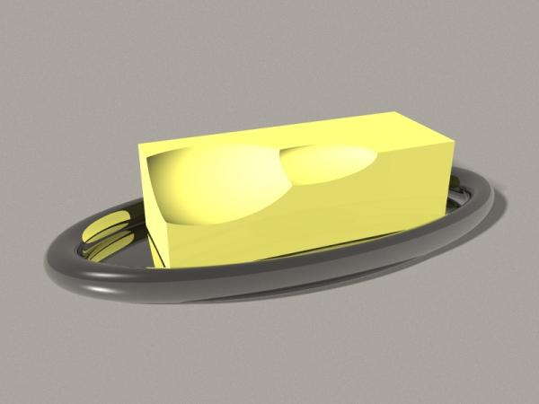
Composition of Butter
Sr no. | Constituent | Percentage
1 | Butter fat | 80.0 – 83.0
2 | Moisture | 15.5 – 16.0
3 | Salt | 0 - 3.0
4 | Curd | 1.0 -1.5

