Slide 1
Class Lecture
CONTINUOUS BUTTERMAKING, OVERRUN & YIELD
Dr. Sanjeev Kumar
Associate Professor
Department of Dairy Technology
SGIDT, Patna-14

Slide 2
CONTINUOUS BUTTERMAKING

Slide 3
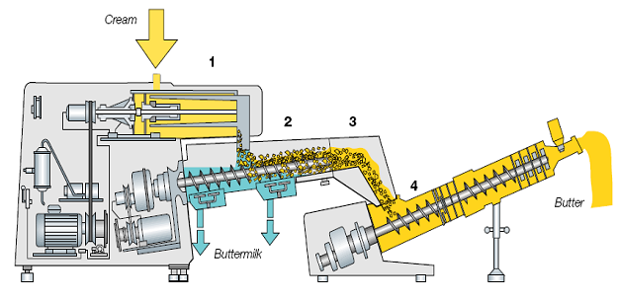
PRINCIPLES:- 1. CHURNING PROCESS
High speed beaters destabilize fat emulsion
Eg., Fritz process
Churning cylinder (600-800 rpm)
Separation section
Squeeze drying
Second working section

Slide 4
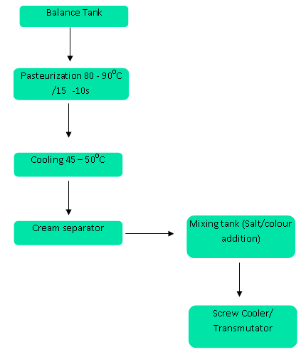
2. Concentration & Phase reversal process
Cream (35-40%) concentrated in special cream separator to 80-82% fat
After that mechanical action to cause phase reversal
Eg. Alfa – Laval process
Note: cream destabilized during cooling & mechanical working

Slide 5
3.EMULSIFICATION PROCESS
Process involves:-
Eg. Cherry Burrel’s process
Cream destabilised before cooling & working steps
Separate to 88-90 % fat
Standardize to composition of butter
Chilling & working into butter
Pasteurize fat concentrate
Destabilize cream fat

Slide 6
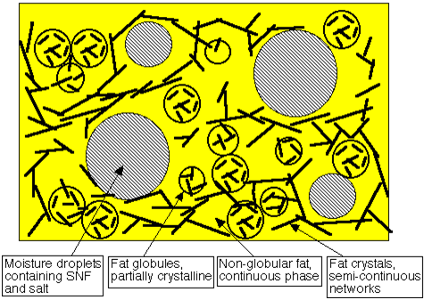
RHEOLOGY
Science of deformation and flow of matter
Butter on application of force undergoes permanent deformation
Fat exists in form of liquid & intact globules

Slide 7
Overrun
increase in the amount of butter made from the given amount of fat
caused by the presence of moisture , curd eTC in butter
% OR = B-F x 100
F
Where,
OR= Overrun in butter(%)
B = Butter made (kg)
F = Fat in churn (kg)
Factors affecting overrun:-
1)Inaccuracy in weight or fat test of milk
2)Fat losses in skim/buttermilk
3)Mechanical fat losses
4)Unavoidable fluctuations in fat content of butter
5)Weight allowance in butter packs or cream or butter
6)Handling losses

Slide 8
Yield
Y = F x (100 + %OR )
100
Where,
Y = Yield of butter (kg)
F = Fat content of cream (kg)
%OR= % Overrun in butter (avg. 20- 22%)

Slide 9
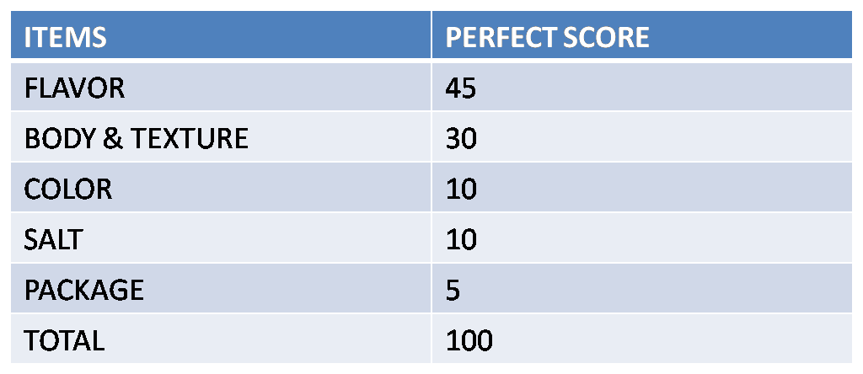
JUDGING AND GRADING OF BUTTER
SCORE CARD
B. EXAMINATION PROCEDURE
JUDGING :- Temper butter to 16°C
SAMPLING :- sample plug taken by butter trier

Slide 10
OBSERVATIONS :-
Note aroma / odour of butter sample
Examine colour
Examine body & texture :- press ball of thumb against sides of plug until shows break
Observe for free moisture
Chew it till meltdown
Examine undissolved salts, if any
Note taste & smell , also after-taste
C. Characteristics of HIGH GRADE BUTTER
Neat , clean package in appearance
Properly dissolved salt
Uniform colour
Firm & waxy body
Close-knit texture
Mildly , sweet , clean pleasant flavour

