Slide 1
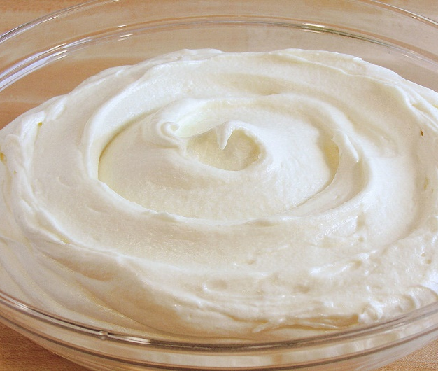
Class Lecture
CREAM SEPARATION
Dr. Sanjeev Kumar
Associate Professor
Department of Dairy Technology
SGIDT, Patna-14

Slide 2
PURPOSE OF CREAM SEPARATION:
To obtain a fat-reduced or fat-free milk
To concentrate milk fat for the production of high-fat products
To standardize the fat content of milk
To recover fat from milk

Slide 3
PRINCIPLE OF SEPARATION OF CREAM
Based on the fact that milk fat is lighter than skim milk portion.
At 16°C (60°F) , the average density of milk fat is 0.93 and skim milk 1.036.

Slide 4
METHODS OF CREAM SEPARATION
GRAVITY METHOD
CENTRIFUGAL METHOD

Slide 5
COMPARISON OF METHODS
PARTICULARS | GRAVITY METHOD | CENTRIFUGAL METHOD
NATURE OF FORCE CAUSING SEPARATION | GRAVITATIONAL | CENTRIFUGAL
SPEED OF SEPARATION | EXTREMELY SLOW | PRACTICALLY INSTANTANEOUS
DIRECTION OF MOVEMENT PARTICLES | VERTICAL | HORIZONTAL
BACTERIOLOGICAL QUALITY OF PARTICLES | LOW | HIGH
FAT % OF CREAM | 10-25 | 18-25(can be controlled)
FAT % OF SM | 0.2 or above | 0.1 or below

Slide 6
GRAVITY METHOD
Fat has a tendency to rise , when milk is allowed to stand for sometime.
The velocity (V), or rate at which the fat globules rise, is given by the following equation, derived from stroke’s law:
V= 2g (ds – df) r²
9 ƞ
Where, g is acceleration due to gravity,
ds is density of skim milk,
df is density of fat,
r is radius of fat globule,
ƞ is viscosity of skim milk.

Slide 7
FACTORS AFFECTING THE RATE OF RISE OF CREAM IN GRAVITY METHOD
SIZE OF FAT GLOBULES( in globule size, es velocity)
TEMPERATURE(increase in temperature, increases velocity)
CLUMPING(increase in ‘r’, increases velocity)
ADDITION OF ADHESIVES(increases the rate of fat globule size)

Slide 8
CENTRIFUGAL METHOD
Milk is fed to centrifugal cream separator, where it is subjected to centrifugal force in such a way that skim milk is forced to the periphery while the fat portion towards the centre.
Stroke’s law applied to centrifugal separation is as follows:
Where, ds is density of skim milk,
df is density of fat,
r is radius of fat globule,
ƞ is viscosity of skim milk,
N is r.p.m.,
R is bowl radius
K is constant
V= K.R.N² (ds – df) r²
ƞ

Slide 9
FACTORS AFFECTING FAT % OF CREAM
POSITION OF CREAM SCREW
(CREAM SCREW IN OR SKIM MILK SCREW OUT , HIGHER FAT % IN CREAM AND VICE VERSA)
In
RATE OF MILK INFLOW,
es fat% in cream
In TEMPERATURE OF MILK, es fat% in cream
In
FAT % IN MILK,
es fat% in cream
In
SPEED OF BOWL,
es fat% in cream
In AMOUNT OF SKIM MILK OR WATER ADDED TO FLUSH THE BOWL,
es fat%in cream

Slide 10
FACTORS AFFECTING FAT LOSS IN SKIM MILK
1) in Temperature of milk, es losses.
2) in Speed of bowl, es losses.
3) in rate of milk inflow, es losses
4)Position of the cream screw (fat separation of more than 50%, more losses)
5) Mechanical condition of the machine
( unsatisfactory condition, more losses)

Slide 11
6) Size of fat globules (Greater the no. of fat globules of less than 2 micron size, higher losses)
7) in Degree and temperature at which milk is agitated before separation, es losses.
8) in Presence of air in milk, es losses.
9) in Acidity of milk, es losses.

Slide 12
YIELD OF CREAM (kg): C= M*(fm-fs)
(fc-fs)
YIELD OF SKIM MILK(kg): S= M*(fc-fm)
(fc-fs)
Where,
C is weight of cream (kg),
S is weight of skim milk (kg),
M is weight of milk (kg),
fc is fat % of cream ,
fm is fat % of milk,
fs is fat % of skim milk

