Slide 1
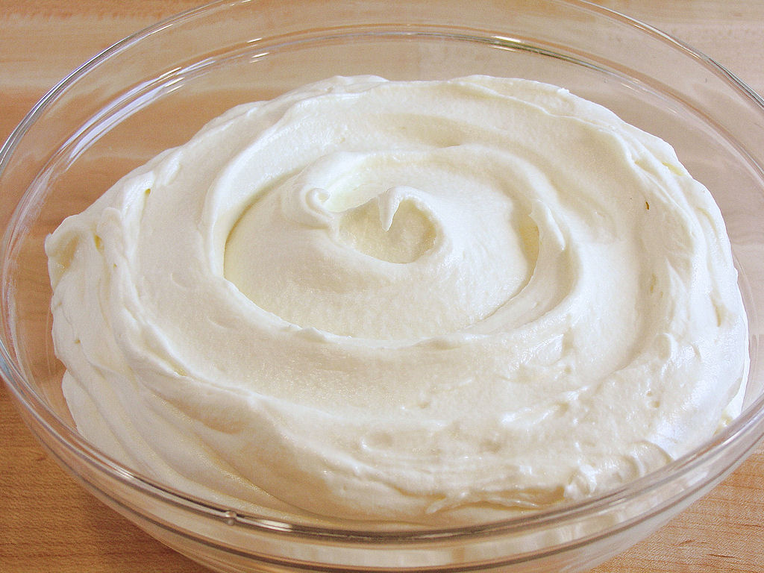
Class Lecture
DEFECTS IN CREAM
Dr. Sanjeev Kumar
Associate Professor
Department of Dairy Technology
SGIDT, Patna-14

Slide 2
RELATION BETWEEN MICROBIOLOGICAL QUALITY AND INTERPRETATION
RESULTS | INTERPRETATION
High count and high Coliforms | Inadequate heat treatment and or Unhygienic manufacture and or storage at high temperature.
High count but low Coliforms | Good hygiene but storage at high temperature
Low count but high Colifoms | Poor hygiene in manufacture but storage at low temperature less than 5°C
Low count and low Coliforms but high Moulds | Good hygiene except aerial contamination in dairy
Low count and low Coliforms but high yeasts | Good hygiene except contamination from fruits, directly or indirectly
Low count and low Coliforms but high aerobic spores | Cream made from milk having a high spore count

Slide 3
FLAVOUR DEFECTS IN MARKET CREAM
Name of Defect | Causes | Prevention
Cooked | Excessive heating of cream during pasteurization. | Proper heating of cream during pasteurization
Highly acid/sour | i. Using sour milk for separation ii. Acid development in cream | (i). Using fresh, sweet milk for preparation (ii). Neutralization of cream.
Oxidized/oily/Metallic/ Tallowy | Fat oxidation due to direct contact of milk with copper or iron, exposure of milk or cream to sunlight, etc. | i. Proper tinning of milk or cream holding vessels, or using aluminium alloy or stainless steel as contact surface ii. Vacuum pasteurization of cream
Rancid | Fat hydrolysis due to lipase action in milk or cream | Inactivating lipase by proper pasteurization of milk and cream

Slide 4
MISCELLANEOUS DEFECTS
IN MARKET CREAM
FEATHERING IN COFEE CREAM
CAUSES:
1. Excessive homogenisation pressure.
2. Using sour cream.
3. Addition of salts.
PREVENTION:
1. Proper homogenisation pressure.
2. Using sweet cream.
3. Avoiding addition of salts.

Slide 5
FLAVOUR DEFECTS IN MANUFACTURING CREAM
Defects | Causes | Prevention
Barny | (i). Poor ventilation of milking byre/barn (ii). Not keeping milk properly covered during production | (i). Proper ventilation of milking byre/barn (ii). Keeping milk properly covered during production
Bitter | (i). Intake of bitter weeds by milch animals (ii). Lipase activity during (raw) cream separation (iii). Growth of Proteolytic bacteria in cream | (i). Eradication of off ending weeds. (ii). Checking lipase activity by avoiding the ‘danger zone(38-49⁰C) in cream separation. (iii). Storage of cream at 5⁰C(40⁰F) or below to check bacterial growth.

Slide 6
Defects | Causes | Prevention
Cheesy | Growth of Proteolytic bacteria leading to casein break down. | Storage of cream at 5⁰C(40⁰F) or below to check bacterial growth.
Coarse-acid/sour | Uncontrolled acid development in cream | Storage of cream at 5⁰C(40⁰F) or below to check acid development
Cooked , Feed and weed Rancid Oxidized etc. | Feeding of milk tainting feeds and weeds within 3 hours before milking. | (i). Avoid Feeding of milk tainting feeds and weeds soon milking (ii). Eradication of milk tainting weeds. (iii). Vacuum pasteurization of cream

Slide 7
Defects | Causes | Prevention
Fruity | Development of by-products of growth of certain un-desirable micro-organisms | Storage of cream at 5⁰C(40⁰F) or below to check microbial growth.
Utensil | Using dirty utensils | Using well cleaned utensils
Yeasty | Growth of lactose fermenting yeasts | Storage of cream at 5⁰C(40⁰F) or below to check yeast growth

Slide 8
JUDGING AND GRADING OF CREAM
1. Check for serum separation
2. Check for sediment at bottom
3. Observe for general appearance and cleanliness
4. Take note of cream plug
5.Secure sample for bacterial count
6. Determine viscosity
7. Check for organoleptic properties
8. Determine fat % and titratable acidity
9. Test for defects

Slide 9
uses of cream
For direct consumption as table /coffee /whipping cream.
In the preparation of special dishes.
In the production of plastic, frozen and cultured cream.
In the manufacture of butter, cheese, ice cream, butter oil and ghee (INDIA).
For creaming of cottage cheese.

Slide 10
Thank you

