Slide 1
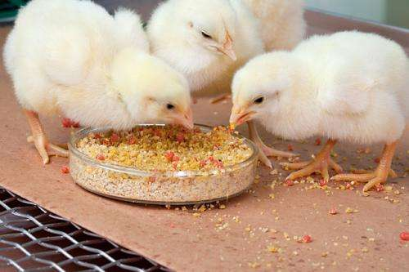
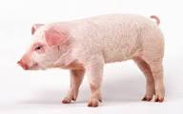
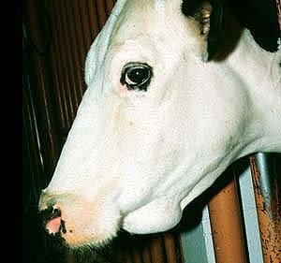
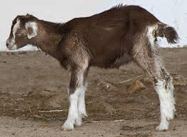
Genus : Eimeria
(Coccidia)
Dr. AJIT KUMAR
HoD
Department of Parasitology
Bihar Veterinary College
Bihar Animal Sciences University
Patna-800014
Image source: Google image

Slide 2
Phylum- Apicomplexa Class – Sporozoea
Members of sporozoea class are parasitic and spore forming.
Phylum Apicomplexa has apical complex ( polar ring, conoid, micronemes, rhoptries , Micropores and subpellicular tubules ).
Both asexual ( Schizogony) and sexual ( Gametogony) types of reproduction present.
Members produce spores by means of sporogony.

Slide 3
Phylum- Apicomplexa Class – Sporozoea
Sub-classe :- Coccidia
Order - Eucoccidiida
Family - Eimeriidae,
Cryptosporididae
and
Sarcocystidae

Slide 4
Family- Eimeriidae Genus- Eimeria
Organisms commonly called coccidia.
Intracellular parasite found in the epithelial cells of intestine of vertebrates in which both asexual and sexual reproduction takes place.
Highly host specific as well as organ/location specific parasite.
Direct life-cycle.
Locomotion by gliding.

Slide 5
Family- Eimeriidae Genus- Eimeria
Unsporulated oocysts comes out of the infected host through faces .
Sporulation of unsporulated oocyst occurs outside the host in environment.
Sporulated oocyst is the infective stage for the host.

Slide 6
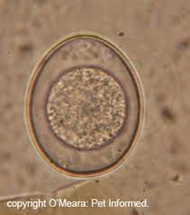
Genus- Eimeria
Unsporulated oocysts
Usually spherical, sub-spherical, ellipsoidal and oval shaped.
Usually bilayered, transparent and clearly visible.
A small pore called micropyle may be present at narrower end which is often covered by a polar cap or micropylar cap.
A nucleated mass (sporont) is found mostly at the center.
Image source: Google image

Slide 7
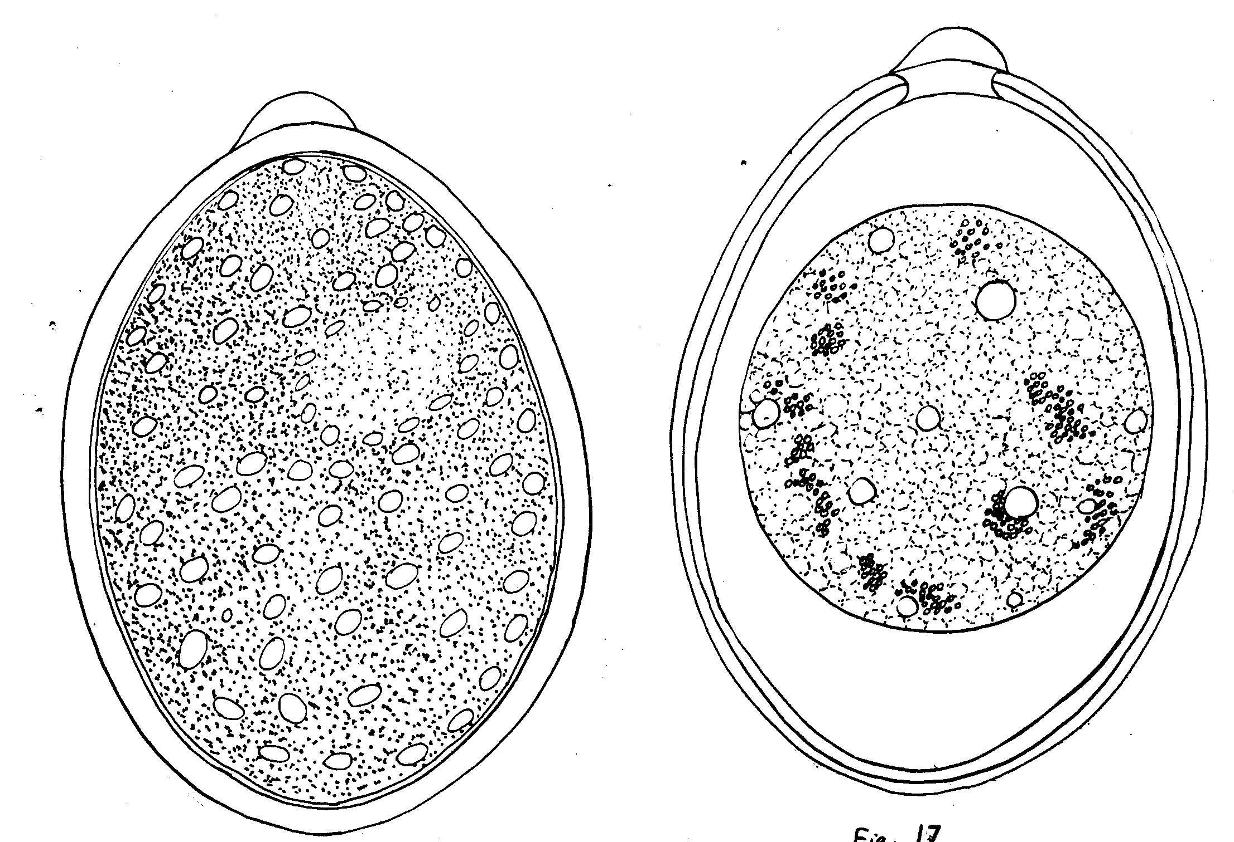
Genus- Eimeria
Unporulated oocysts
Unsporulated oocysts comes out of the infected host through faces .
Sporulation of unsporulated oocyst occurs outside the host in environment.
Micropyle
Polar cap

Slide 8
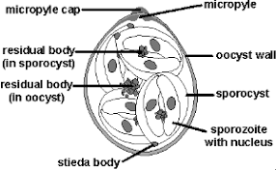
Genus- Eimeria
Sporulated oocysts
Sporogony occurs outside the host.
Sporulated oocysts are the infective stages of the parasites.
Time taken for sporulation can also helped as an aid to identification of species.
Sporulated oocyst contains different number of banana–shaped sporozoites, sporocyst residium and stieda body.
Each sporulated oocyst contains four sporocysts and each sporocyst contains two sporozoites.

Slide 9
Eimeria species found in poultry
Species | Site in host | Disease
Eimeria tenella | Caecum | Caecal coccidiosis
Eimeria necatrix | Small intestine | Intestinal coccidiosis
Eimeria brunetti | Rectum | Rectal coccidiosis
E. acervulina | Small intestine | Intestinal coccidiosis
E. maxima | Small intestine | Intestinal coccidiosis
E. mitis | intestine | Intestinal coccidiosis
E. parecox | Small intestine | Intestinal coccidiosis

Slide 10
Eimeria species found in Cattle & buffalo
Species | Remarks
E. zuernii | Winter cocidiosis, Most common & pathogenic
Eimeria bovis | most common
E. bareillyi | found in Water buffalo
E. alabamensis
E. bukidnonensis | Biggest species among Eimeria speceis of cattle & buffalo
E. canadensis

Slide 11
Eimeria species found in sheep
Species | Remarks
E. ovina | Most common & Pathogenic
E. Intricata | Largest coccidian species of sheep.
E. granulosa | Egg or urn- shaped oocyst
E. ahsata | Dome shaped micropylar cap
E. crandalis
E. gilruthi | Found in abomasum of Sheep & goat

Slide 12
Eimeria species found in goat
Species | Remarks
E. arloingi | Most common
E. caprina
E. hirci
E. ninakohlyakimovae
E. gilruthi | Found in abomasum of Sheep & goat

Slide 13
Eimeria species
Species | Final host | Site in host
E. debliecki | Pig | -do-
E. leuckarti | Equines | -do-
E. trunctata | Geese | Kidney
E. Stiedae ( Leeuwenhoek observed first parasitic protozoa i.e. Eimeria stiedae from the gall bladder of rabbit) | Rabbit | Liver

Slide 14
Coccidian species of Dog & cat
Species | Final host
Isospora canis | Dog
Isospora ohioensis | -do
Neosopra caninum | -do-
Sarcocystis cruzi | -do-
Isospora felis | Cat
Isospora rivolata | -do-
Toxoplasma gondii | Dog & cat

Slide 15
Genus: Eimeria
Location: An intracellular parasite found in
the epithelial cells of the intestine .
Infective stage – Sporulated oocyst
Transmission:ingestion of sporulated oocyst
along with food or water

Slide 16
Life-cycle of Eimeria
Life-cycle inside the host :-
Host gets infection by the ingestion of
sporulated oocysts through feed and water.
Three phases occurs inside the host :-
Excystation - Cyst walls rupture and release sporozoites enter in the alimentary canal in the presence of CO2, bile and trypsin.
Sporozoites penetrate the intestinal epithelial cells and form rounded trophozoites.

Slide 17
Genus: Eimeria
Schizogony – Trophozoites multiply by means of schizogony (multiple fission) and form schizonts containing numerous elongated merozoites.
Schiozonts rupture and released merozoites invade neighbouring cells and continue 2nd generation schizogony.

Slide 18
Genus: Eimeria
Syngamy – Merozoites form male (microgametocyte) and female gametocytes ( macrogametocytes).
Microgametocytes and macrogametocytes form microgamets and macrogametes, respectively.

Slide 19
Genus: Eimeria
Flagellated microgamete (motile) are released from the ruptured host cells and fertilized the macrogametes.
After fertilization zygote is formed which transformed into unsporulated oocysts and passed out through the faces of the infected host.

Slide 20
Genus: Eimeria
Outside the host in the environment :-
Unsporulated oocysts became sporulated outside the host in environment in the presence of O2, suitable temperature and moisture.
At the temperature of 29-30 degree Celsius with sufficient air and moisture, the sporulation occurs within 1-3 days.

Slide 21
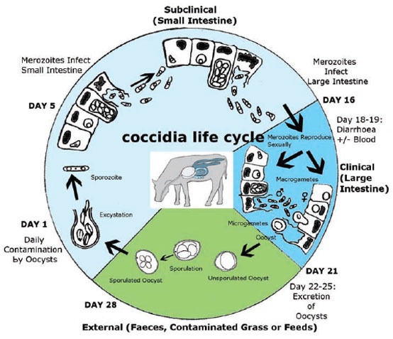
Life-cycle of Eimeria
Image source: Google image

Slide 22
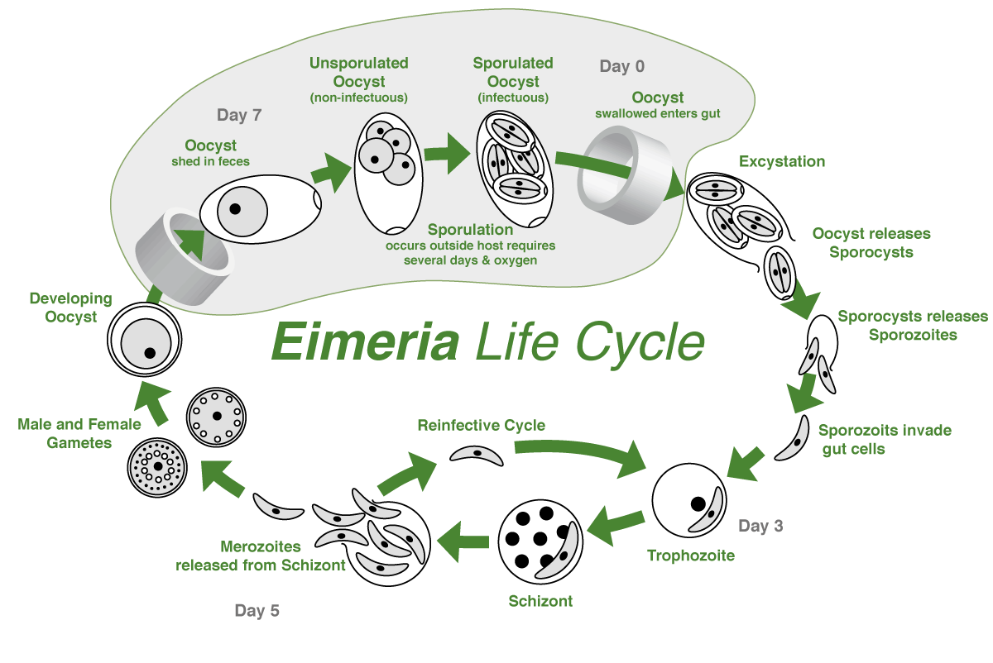
Life-cycle of Eimeria
Image source: Google image

Slide 23
Genus: Eimeria
Coccidiosis is regarded ubiquitous in poultry management.
It is considered as a man made dieses since overcrowding and unhygienic conditions encourage it.
Young animals /birds are most susceptible and adults act as carrier.
Three types of coccidiosis occurs in poultry-
Caecal coccidiosis
Rectal coccidiosis
Intestinal coccidiosis

Slide 24
Genus: Eimeria
Caecal coccidiosis - caused by Eimeria
tenella.
It occurs mostly in young birds of 3-7 weeks of age.
Petechial haemorrhage found in enlarged caecum on 4th day after infection.
Lumen of caeca filled with consolidated and dark-brown to blackish caseous mass ( caecal core) containing feaces, necrosed cellular debris and blood.

Slide 25
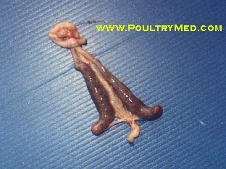
Genus: Eimeria
Haemorrhages in caecum
Image source: Google image

Slide 26
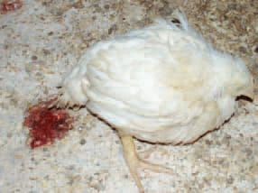
Genus: Eimeria
Caecal core is characteristic lesions of ccaecal coccidiosis.
Symptoms – dropping, stop feeding but may continue to drink water, bloody diarrhoea (red diarrhoea), anaemia and death.
Image source: Google image

Slide 27
Genus: Eimeria
Rectal Coccidiosis – caused by Eimeria
brunetti.
Affected birds showed white fluidy droppings mixed with blood and mucus casts, severe dehydration, reduced body weight and lack of appetite.

Slide 28
Genus: Eimeria
Intestinal coccidiosis- caused by E. necatrix, E. acervulina, E. maxima and E. mivati.
Generally older birds are affected and chronic form is common.
In E. necatrix, submucosal haemorrhage is found mainly in the middle part of the small intestine.

Slide 29
Genus: Eimeria
Intestinal coccidiosis
The small intestine is markedly swollen, haemorrhage and is filled with clotted or unclotted blood.
Pin–point to pin-head sized greyish white spots are found in small intestine.
Symptoms-
Watery diarrhoea with blood ( E. nectarix), Chronic watery diarrhoea without blood ( E. acervulina).

Slide 30
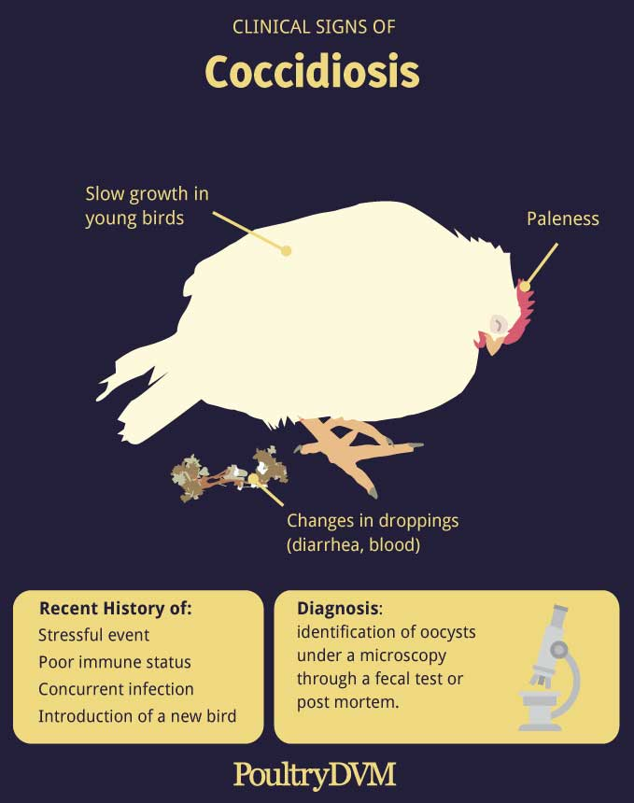
Genus: Eimeria
Image source: Google image

Slide 31
Coccidiosis in calf
Winter coccidiosis
Caused by Eimeria zuernii
Occurs in winter season.
Symptoms-
Foul smelling diarrhoea with or without blood, abdominal pain, soiled hind quarter, anorexia, unable to stand up etc.
Infected young calves die due to heavy loss of blood.

Slide 32
Genus: Eimeria
Diagnosis :
On the basis of symptoms ( Bloody diarrhoea etc.).
Microscopic examination of faces revealed double walled unsporulated oocysts with nucleated mass.
P.M. findings- Diagnosis of coccidiosis in chickens is best accomplished by post-mortem examination of a few affected birds because of major pathogenic effect usually occurs prior to oocysts shed in faeces.

Slide 33
Genus: Eimeria
Diagnosis :
Image source: Google image

Slide 34
Genus: Eimeria
Diagnosis :
2.5 % Potassium dichromate solution are used for sporulation of unsporulated oocysts in Lab.
K₂Cr₂O₇ solution prevents the bacteria from destroying the oocysts and also provides oxygen to the oocysts for their development.

Slide 35
Eimeria species
Treatment – A number of drugs available which are used either singly or in combinations along with feed or water :-
Sulphadiminine (@120-250 ppm), Amprolium (@ 62.5-125 ppm), Diclazuril (1-5 ppm), Toltazuril (25 ppm ) and Semiduramicin are other anticoccidial drugs.
Ionophorus antibiotics i.e. Monensin (@100-125 ppm), Lasalocid 9@100-125ppm) and Salinomycin (@50-70 ppm).

Slide 36
Eimeria species
Treatment :
Amprolium prevents cocidia from utilizing thiamine by blocking thiamine receptors and effective against first generation trophozoites and schizonts.
Coccidiosis in poultry is man made disease and self limiting disease.
Shuttle and rotation programme adopt in use of anticoccidial drugs in poultry to prevent drug resistance.

Slide 37
Eimeria species
Control :
By Chemotherapy- Anticoccidial drugs are used as a chemotherapy and chemoprophylactic to control infection.
By adopting good managemental practices likes -
Litter should kept dry.
Feeding and water troughs should be kept such a height that they can not be contaminated by droppings.

Slide 38
Eimeria species
Control :
Good ventilation in shed to reduce moisture and sporulation of oocysts.
Overcrowding should be avoided.
Clean feed and water should be provided.
High proteinous feed along with vitamin Vitamin-A, Vit- K etc.) are beneficial for treating/controlling coccidia infection.

Slide 39
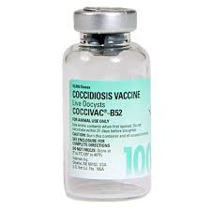
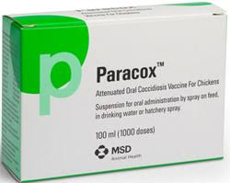
Eimeria species
By Vaccination:
Coccivac (Contains 8 Eimeria species), immucox, Nobilis, Paracox-5, COXABIC and Livacox (E. tenella).
COXABIC is the first developed subunit vaccine comprises a purified protein isolated from gametocytes of E. maxima By Abic, Israel.
Image source: Google image

Slide 40
Eimeria species
Vaccination:
Coccivac , immunocox and Nobilis are live unattenuated vaccines.
Livacox, and paracox are live attenuated vaccines. Attenuation is done by selection for precocious

Slide 41
THANK YOU

