Slide 1
Energy yielding reactions
Dr. Abhishek Thakur
(Assistant Professor)
College of Fisheries, Kishjanganj
BASU, Patna

Slide 2
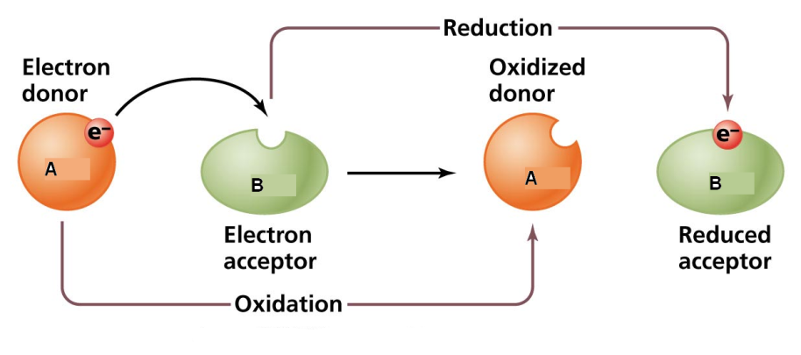
Oxidation – Reduction
Oxidation is the removal of electrons (e⁻) from an atom or molecule, often produces energy.
A loses an electron to molecule B.
Molecule A is oxidized.
Molecule B has undergone reduction.
The pairing of these reactions is called oxidation – reduction.

Slide 3
Substrate-Level phosphorylation
ATP is generated when a high-energy ➔ is directly transferred from a phosphorylated compound (a substrate) to ADP.
Carbon skeleton and the ➔ of a typical substrate:
C – C – C ~ ➔ + ADP → C – C – C + ATP

Slide 4
Oxidative phosphorylation
Electrons transferred from organic compounds to electron carriers (usually to NAD⁺) are passed through a series of different electron carriers to molecules of oxygen (O₂)
This process occurs in the plasma membrane of prokaryotes
Inner mitochondrial membrane of eukaryotes series of electron carriers used in oxidative phosphorylation is called an electron transport chain (Figure)
The transfer of electrons releases energy which is used to generate ATP through chemiosmosis.

Slide 5
Photophosphorylation
Only in photosynthetic cells.
Organic molecules, are synthesized with the energy of light.
Converting light energy to the chemical energy of ATP and NADPH.
In turn, are used to synthesize organic molecules.
Electron transport chain is involved.

Slide 6
Biochemical pathways of energy production
Sequence of enzymatically catalyzed chemical reactions occurring in a cell is called a biochemical pathway.
Carbohydrate catabolism
Microorganisms oxidize carbohydrates as their primary source of cellular energy.
Breakdown of carbohydrate molecules to produce energy
Great importance in cell metabolism. Glucose the most common microorganisms use two general processes: respiration and fermentation. Both start with glycolysis.
Respiration of glucose typically occurs in three principal stages: glycolysis the Krebs cycle and the electron transport chain.
1. Glycolysis is the oxidation of glucose to pyruvic acid with the production of some ATP and energy containing NADH.
2. The Krebs cycle is the oxidation of a derivative of pyruvic acid carbon dioxide with the production some ATP, energy-containing NADH.
3. In the electron transport chain, NADH and FADH₂ are oxidized
Energy is used to generate a considerable ATP.

Slide 7
Glycolysis
Glycolysis, the oxidation of glucose to pyruvic acid, is usually the first stage in carbohydrate catabolism.
Glycolysis is also called the Embden-Meyerhof path-way. splitting of glucose, a six-carbon sugar, into two three carbon sugars then oxidized, releasing energy, atoms are rearranged to form two molecules of pyruvic acid.
A net production of two ATP molecules by substrate level phosphorylation. Glycolysis does not require oxygen
Glycolysis consists of two basic stages, a preparatory stage and an energy conserving stage.
1. First, in the preparatory stage two molecules of ATP are used as a six carbon glucose molecule is phosphorylated, restructured split into two three carbon compounds
2. The energy conserving stage the two three carbon molecules are oxidized to two molecules of pyruvic acid two molecules of NAD⁺ are reduced to NADH and four molecules of ATP
There is a net gain of two molecules of ATP for each molecule of glucose that is oxidized.

Slide 8
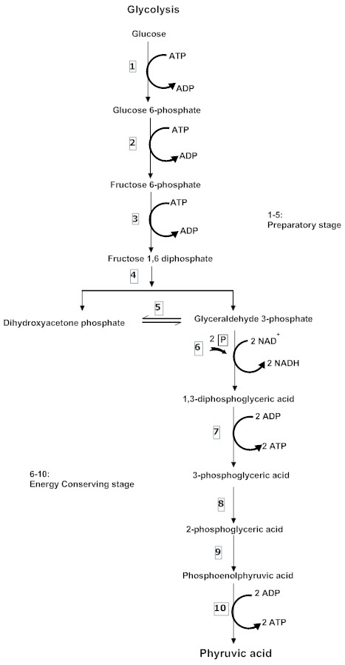

Slide 9
Pentose phosphate pathway (Hexose monophosphate shunt)
It produces intermediate pentoses that act as precursors in the synthesis of
(1) nucleic acids
(2) Glucose from carbon dioxide in photosynthesis
(3) Certain amino acids.
Twelve molecules of NADPH produced from each molecule of glucose pentose phosphate pathway yields a net gain of only one molecule of ATP. Bacillus subtilis, E. coli
Enter doudoroff pathway
Entner-Doudoroff pathway produces two molecules of NADPH and one molecule of ATP for use in cellular biosynthetic reactions.
Found in some gram-negative bacteria, Rhizobium, Pseudomonas, Agrobacterium

Slide 10
Respiration
Respiration ATP-generating process in which molecules are oxidized final electron acceptor is an inorganic molecule.
the operation of an electron transport chain. In aerobic respiration the final electron acceptor is O₂, in anaerobic respiration inorganic molecule
The Krebs cycle
Pyruvic acid In a preparatory step, lose one molecule of CO₂ become a two-carbon compound decarboxylation
The two-carbon compound, acetyl group, attaches to coenzyme A as acetyl coenzyme A (acetyl CoA)
NAD⁺ is reduced to NADH.

Slide 11
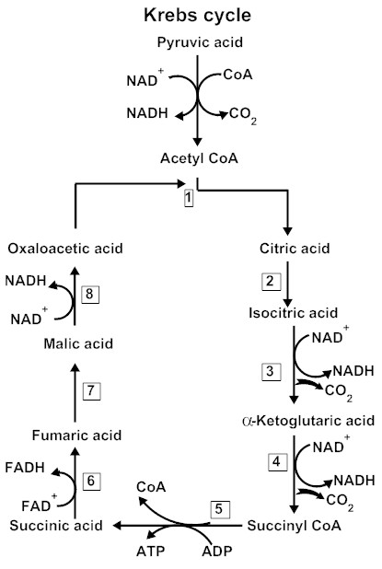

Slide 12
Electron transport chain
Consists of a sequence of carrier molecules capable of oxidation and reducation. there is a step wise release of energy used to drive the chemiosmotic generation of ATP.
Three classes of carrier molecules flavoproteinsare cytochromes, ubiquinones (or coenzyme A)

Slide 13
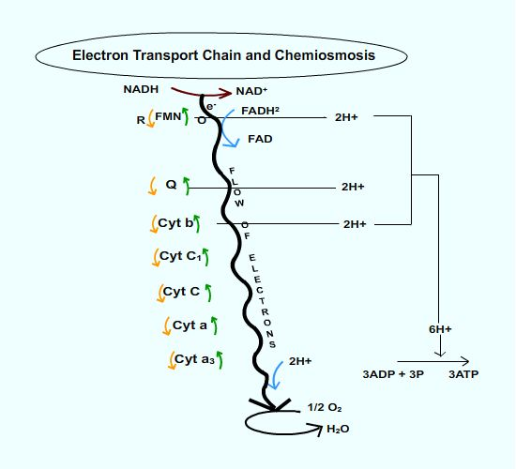

Slide 14
Anaerobic respiration
Final electron acceptor is an inorganic substance other than oxygen (O₂).
Pseudomonas and Bacillus, can use a nitrate ion (NO⁻₃)
To a nitrite ion (NO⁻₂), nitrous oxide (N₂O), or nitrogen gas (N₂). Desulfovibrio use sulfate (SO₄²⁻)
To form hydrogen sulfide (H₂S).
Anaerobic respiration by bacteria using nitrate and sulfate as final acceptors is essential for the nitrogen and sulfur cycles

Slide 15
Fermentation and Biosynthetic Pathways

Slide 16
Fermentation and Biosynthetic Pathways
Releases energy from sugars or other organic molecules, such as amino acids, organic acids, purines, and pyrimidines.
Does not require oxygen.
Does not require use of the Krebs cycle or an electron transport chain.
Uses an organic molecules as the final electron acceptor.
Produces only small amounts of ATP

Slide 17
Lactic acid Fermendation
Glucose + 2ADP + 2P —> 2 Lactic acid + 2 ATP
Streptococcus and Lactobacillus - these microbes produce only (mostly) lactic acid, - homolactic (or homofermetative). Lactic acid fermentation in food spoilage. process can also produce yogurt from milk, sauerkraut from fresh cabbage, pickles from cucumbers.
Alcohol Fermentations
Alcohol fermentation is carried a number of bacteria & yeasts.
Organisms that produce lactic acid other acids or alcohols are known as heterolactic (or heterofermentative); often use the pentose phosphate pathway.
Glucose + ADP + P —>Lactic acid + Ethanol + CO₂+ ATP

Slide 18
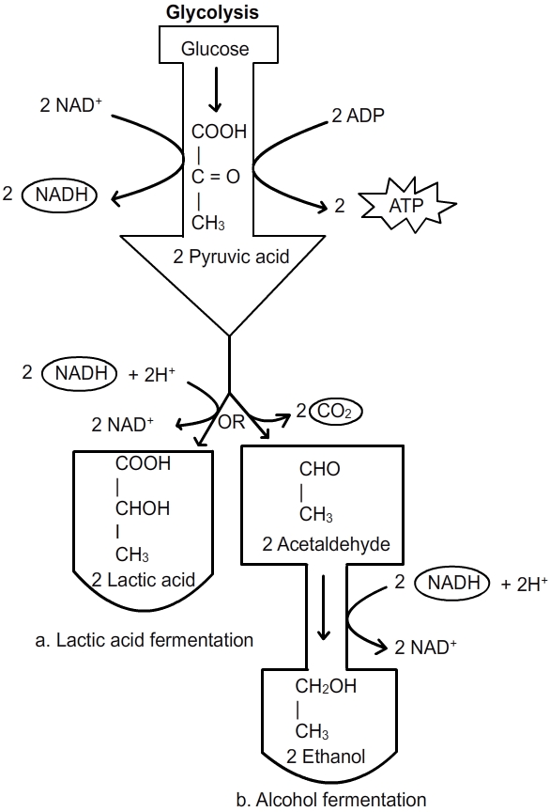

Slide 19
Biosynthesis of Polysaccharides
Microorganisms synthesize sugars and polysaccharides. The carbon atoms required to synthesize glucose are derived from the intermediates produced during glycolysis, Krebs cycle and from lipids or amino acids. Bacteria may assemble it into the more complex polysaccharides.
Biosynthesis of Lipids
Lipids vary in chemical composition, cells synthesize fats by joining glycerol and fatty acids.
The glycerol portion of the fat is derived from dihydroxyacetone phosphate; fatty acids, are built up when two carbon fragments of acetyl CoA are successively added to each other.
Biosynthesis of Amino acids and proteins
Amino acids are required for protein biosynthesis. E.coli, contain the enzymes for the synthesis of all the amino acids.
Other microbes require that the environment provide preformed amino acids.

Slide 20
Bacterial Photosynthesis
Photosynthesis is the conversion of light energy from the sun into chemical energy. The chemical energy is then used to convert CO₂ to more reduced carbon compounds.
Cyanobacteria, algae, and green plants
Photosynthesis can be summarized as follows:
6CO₂ + 12 H₂O + Light energy ➔ C₆H₁₂O₆ +6O₂ + 6H₂O
Photosynthesis in two stages. First stage - light reactions; light energy is used converts ADP and P to ATP.
The electron carrier NADP is reduced to NADPH.
Second stage - dark (light-independent) reactions; electrons are used along with energy from ATP to reduce CO₂ to sugar.

Slide 21
Thank You

