Slide 1
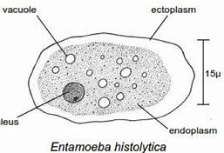
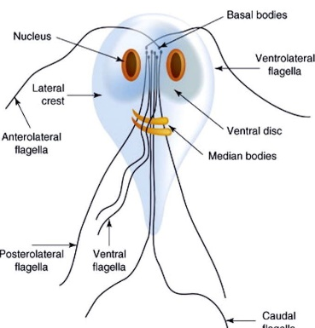
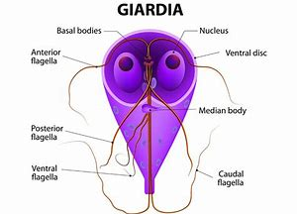
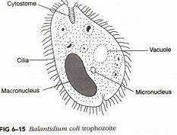
Entamoeba,
Hexamita, Giardia & Balantidium coli
Dr. AJIT KUMAR
HoD
Department of Parasitology
Bihar Veterinary College
Bihar Animal Sciences University
Patna-800014
Image source: Google image

Slide 2
Sub-Phylum: Sarcodina Family: Endamoebidae
Family members are called parasitic amoebae which occur in the digestive tract of vertebrates and invertebrates.
Movement by Pseudopodia.
Holozoic type of nutrition.
Binary fission type of asexual reproduction.
Encystment is common feature.

Slide 3
Family: Endamoebidae Genus : Entamoeba
Location: Digestive tract.
Usually form cyst.
Cysts have 1-8 nuclei depending upon the species.

Slide 4
Genus: Entamoeba
Species | Host | No. of nucleus present inside cyst
Entamoeba histolytica | Man, dog, cat, monkey, pig etc. | Quadrinucleated cyst
Entamoeba coli | Man, dog, monkey, pig etc. | 8-nucleated cyst
Entamoeba bovis | Cattle | Uninucleated cyst

Slide 5
Entamoeba histolytica
It is a zoonotic protozoan parasite.
Mainly two developmental stages are found :- Trophozoite and Cyst.
Trophozoite :-
Size about 10-60 µm.
It has clear ectoplasm and granular endoplasm.
Endoplasm of trophozoite contain food vacuoles containing ingested erythrocytes and a vesicular nucleus
Trophozoites move by finger-like pseudopodia.
Presence in freshly dysenteric stool.
Image source: Google image

Slide 6
Entamoeba histolytica
Cyst :
Trophozoite discharges undigested food and condenses into a spherical mass called cyst.
Usually Round in shape and 5-15 µm in size.
Young cyst contains 1-4 chromatoid bars, glycogen vacuoles and single nucleus whereas Mature cyst contains four nuclei without chromatoid bars and glycogen vacuoles.
Resistant to averse condition.
Sensitive to desiccation, putrefaction and temperature above 400C and below -500C

Slide 7
Entamoeba histolytica
Transmission:
through cysts contaminated food or water , as trophozoites do not survive more than 30 minutes after passing with stools.
Eating of raw and uncleaned vegetable usually in the form of salad.
Eating of food contaminated by flies, use of night soil polluted water etc.

Slide 8
Entamoeba histolytica
Life- cycle:-
Hosts get infection by the ingestion of cysts.
Excystment occurs in the intestine in the presence of trypsin enzyme and released metacystic form.
Meatcystic form undergo nuclear and cytoplasmic division and form eight nucleated daughter trophozoites which migrate to the large intestine and grow into full size and invade the bowel mucosa.

Slide 9
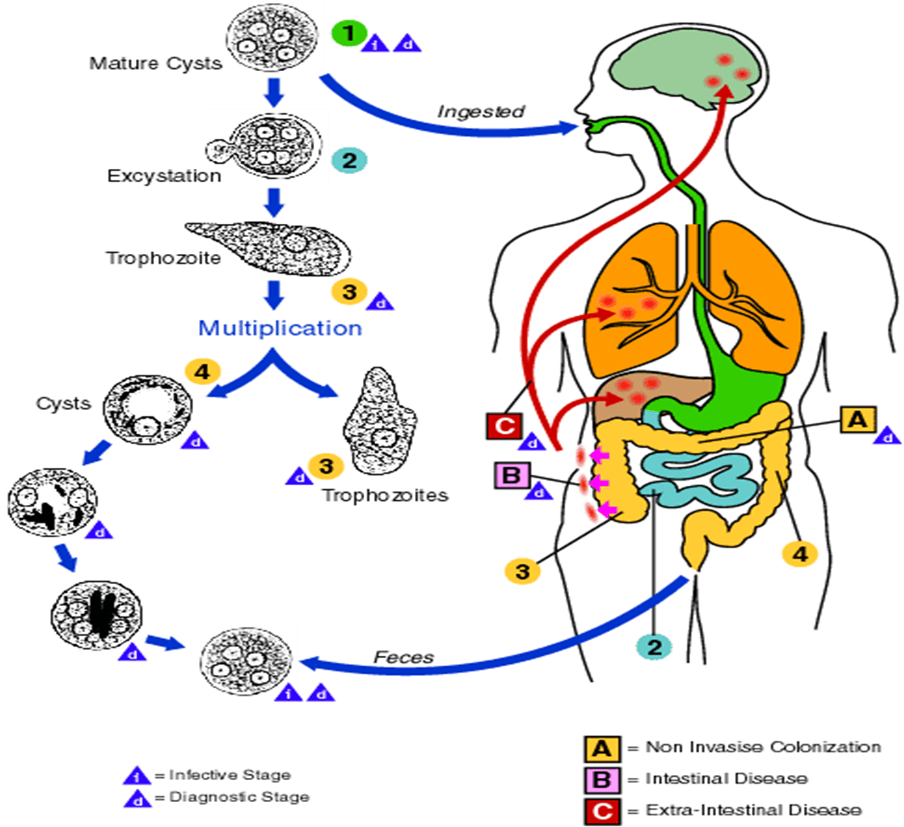
Life-cycle of Entamoeba histolytica
Image source: Google image

Slide 10
Entamoeba histolytica
Pathogenesis:
Pathogenesis depends on various factors like strain variation, presence of Escherichia coli or Aerobactor aerogenes , nutritional status of hosts, concurrent disease, immunity etc.
Parasites penetrates the intestinal wall by the lysis of the epithelium by the action of phosphohydrloae release by liposomes.
Amoebae multiply and invade mucosa to produce inverted flask shaped ulcers.
Amoebae may reach other body parts like liver where it may produce inflammation and abscesses.

Slide 11
Entamoeba histolytica
Symptoms:
Acute amoebic dysentery- faces consists of almost entirely blood and mucus with amoebae, abdominal pain, with straining.
Chronic dysentery – recurrent dysentery, occasional abdominal pain, nausea, irregular bowels, headache, flatulence etc.

Slide 12
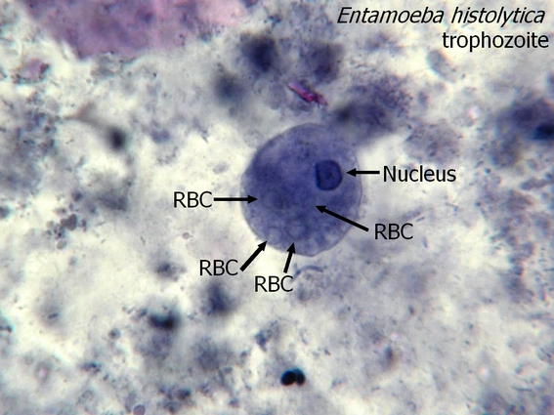
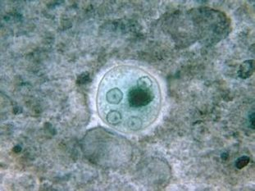
Entamoeba histolytica
Diagnosis :-
On the basis of symptoms like faeces with blood and mucus, abdominal pain etc.
Microscopic examination of faeces reveals for the presence trophozoites (in diarrhoeic faeces) or quadrinucleated cysts (Entamoeba histolytica) or eight nucleated cysts (Entamoeba coli).
2 % iodine is also used for clearly detection of cysts.
Four nucleated
cyst
Image source: Google image

Slide 13
Entamoeba histolytica
Treatment :
Metronidazole , Tinidazole etc.
Control :
Adoption of proper sanitation, personal hygiene, proper disposal of sewage and night soil, avoidance of faecal contamination of food and water, supply of clean drinking water etc..

Slide 14
Family: Hexamitidae
Genus: Hexamita and Giardia
Both have two similar nuclei.
Hexamita sp. cause Inectious catarrhal interitis in birs.
Giardia :-
Two developmental stages - trophozoite and cyst.
Trophozoite :
Pyriform to elliptical in shape and bilaterally symmetrical.
Anterior end is rounded and posterior end is pointed.
A large adhesive disc is present on the ventral side whereas dorsal side convex.
It has two anterior nucleus, two median axostyle and eight flagella arranged in two pairs
Image source: Google image

Slide 15
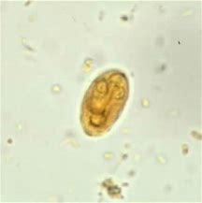
Genus: Giardia
Cyst:
Cysts are oval or elliptical in shape with 2 or 4 nuclei and a number of fibrillar remnants of the trophozoite organelles.
Image source: Google image

Slide 16
Genus: Giardia
Species | Hosts | Location
Giardia intestinalis or Giardia lamblia | Man, monkey and pig | Upper digestive tract
G. canis | Dog
G. bovis | Ox
G. cati | Cat
G. caprae | Goat

Slide 17
Genus: Giardia
Life-cycle : – Direct
Reproduction :- By binary fission
Transmission:
through the ingestion of cysts contaminated food or water.

Slide 18
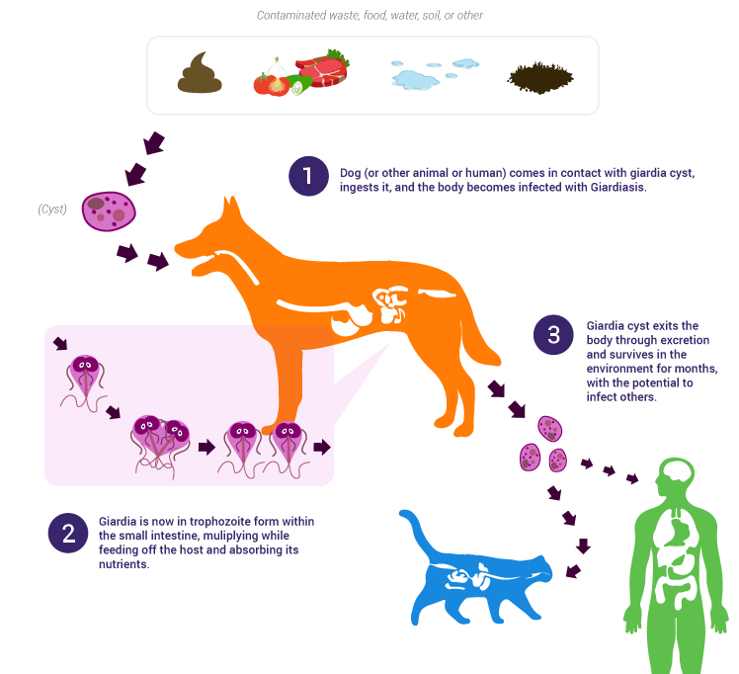
Life-cycle of Giardia
Image source: Google image

Slide 19
Giardia
Pathogenesis:
Chronic diarrhoea in man especially children.
Interference in fat digestion which results deficiency in the fat soluble vitamins.
Clinical signs :
Giardiosis (beaver fever) results diarrhoea, dysentery and steatorrhoea (fats comes with stool) and deficiency of fat soluble vitamin.

Slide 20
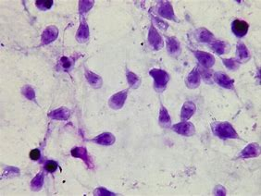
Giardia
Diagnosis:
Microscopic faecal examination reveals oval or elliptical shaped cyst contain 2 or 4 nuclei.
Trophozoite stage may be found in diarrhoeic stool.
Treatment:
Metroniodazole,Tinidazole, Fenbendazole, Chloroquine etc.
Control:
Good hygiene and proper sanitation.
Trophozoites
Image source: Google image
Cyst

Slide 21
Hexamita meleagridis
Morphology
Pyriform shaped, two similar nuceli, out of eight flagella, six flagella anteriorly directed in two groups of three in each and two caudal flagella, two axostyles but adhesive disc absent.
Host and location
It occurs in the duodenum and small intestine of young turkey, peafowl, quail, partridge, duck and also chicken.
Transmission
Organisms transmitted through contaminated feed and drinking water.

Slide 22
Hexamita meleagridis
Diagnosis
Examination of intestinal contents or scraping of small intestine of sacrificed birds to microscopic detection of living Hexamita organisms.
Treatment
Nithiazide @ 0.02 percent in drinking water/ Furazolidone @ 0.01 percent in feed / Oxyteracycline drugs are used in treatment.
Control
Adoption of hygienic measures

Slide 23
Hexamita meleagridis
Pathogenesis
Young turkey up to two months of age are most susceptible whereas old birds act as symptomless carrier.
It causes catarrhal enteritis in the small intestine and intestinal contents become thin, watery and foamy. Myriad of Hexamita are occur in the bulbous area of caeca.
Clinical signs
Hexamitosis disease is known as Infectious catarrhal enteritis ion turkey poults.
Symptoms include foamy and watery diarrhoea, loss of body weight, nervousness and death of affected birds.

Slide 24
Phylum: Ciliophora
Balantidium coli
Highly organized protozoan having two dissimilar nuclei.
A large macronucleus responsible for cytoplasmic activities of the organisms and a small vesicular micronucleus concerned with reproductive process.
Locomotion: by cilia.
Reproduction: Asexual reproduction by transverse binary fission and sexual reprocess by conjugation.

Slide 25
Balantidium coli
Host: Pig, dog, cattle, monkey and man.
Location: large intestine ( caecum and colon).
Two developmental stages: Trophozoite and cyst
Trophozoite
Active motile stage and 50-60µm in length.
At the anterior end funnel shaped peristome which leads to cytopharynx or mouth.
Two dissimilar nuclei i.e. macronucleus kidney shaped and micronucleus lies in the notch of macronucleus.
Two contractile vacuoles one at each end.
An excretory organelle i.e. cytopyge present at the posterior end of the organism.
Cytopyge
Image source: Google image

Slide 26
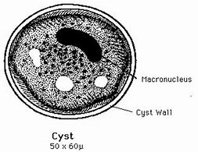
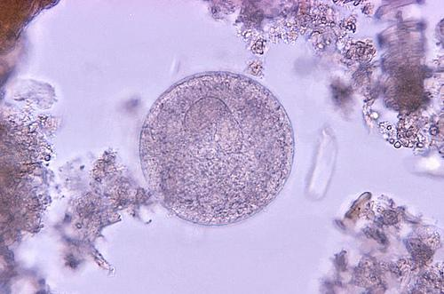
Balantidium coli
Cyst:
Ovoid to spherical in shape, double walled, yellowish in colour and 40-60 µm in diameter.
Cysts are formed both inside and outside the host body.
Image source: Google image

Slide 27
Balantidium coli
Transmission:
Pig is considered as primary hot and in it B. coli exists as commensal in the large intestine of most pigs.
Pig is probable the persistent source of infection for man, cattle etc.
Hosts get infection through the ingestion of contaminated food and water with cyst of B. coli.

Slide 28
Balantidium coli
Pathogenesis and symptoms:
In pigs normally it is non-pathogenic but occasionally invade the mucosa and producing superficial to deep ulcer with enteritis. It produces diarrhoea and dysentery with hemorrhage.
In man, B. coli produce superficial to deep ulcer associated with enteritis. The initial lesions may resemble those produce by Entamoeba histolytica but do not show the similar tendency to enlarge or spread.

Slide 29
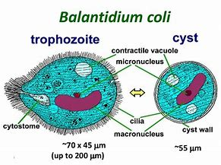
Balantidium coli
Diagnosis:
Microscopic faecal examination reveals cysts.
Trophozoite stage may be found in diarrhoeic stool.
Treatment:
Tetracycline, Metronidazole etc.
Control:
Good hygiene and proper sanitation.
Proper disposal of faces of pig and man.
Cyst
Image source: Google image

Slide 30
THANK YOU

