Slide 1
Dr. Abhishek Thakur (Assistant Professor) College of Fisheries, Kishjanganj BASU, Patna
Enzymes

Slide 2
Enzymes
Enzymes can speed up a chemical reaction with­out being altered.
Enzymes are biological catalysts. Each acts on a specific substance. The specificity of enzymes is made possible by their structures.
Enzymes are generally large globular proteins that range in molecular weight from about 10,000 to several million.
Enzymes are extremely efficient. The turnover number is generally between 1 and 10,000 and can be as high as 500,000.

Slide 3
Enzyme Classification based on type of chemical reaction catalyzed
Class | Type of Chemical Reaction Catalyzed | Examples
Oxidoreductase | Oxidation-reduction in which oxygen and hydrogen are gained or lost. | Cytochrome oxidase, lactate deydrogenase
Transferase | Transfer of functional groups, such as an amino group, acetyl group, or phosphate group | Acetate kinase, alanine deaminase
Hydrolase | Hydrolysis (addition of water) | Lipase, sucrose
Lyase | Removal of groups of atoms without hydrolysis | Oxalate decarboxylase, isocitrate lyase
Isomerase | Rearrangement of atoms within a molecule | Glucose-phospahte isomerase, alanine racemase
Ligase | Joining of two molecules (using energy usually derived from breakdown of ATP) | Acetyl-CoA synthetase, DNA ligase.

Slide 4
Enzyme Components
Some enzymes consist entirely of proteins, most consist of both a protein portion called an apoenzyme; nonprotein component called a cofactor. Together they form a holoenzyme
The cofactor can be a metal ion or a complex organic molecule called a coenzyme.
Many coenzymes are derived from vitamins.

Slide 5
Mechanism of Enzymatic Action
1.The surface of the substrate contacts the active site of the surface .
2.Enzyme-substrate complex.
3.Substrate molecule is transformed breakdown of the substrate molecule, combination with another sub­strate molecule.
4.The transformed substrate molecules-the products of the reaction are released from the enzyme molecule because they no longer fit in the active site of the enzyme.
5. The unchanged enzyme is now free.

Slide 6
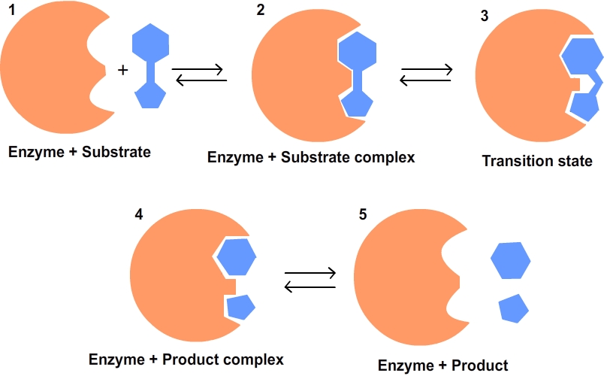
Factors Influencing Enzymatic Activity
Temperature
pH
Substrate concentration
Inhibitors
Feedback Inhibition

Slide 7
Thank You

