Slide 1
Class Lecture
Fat Spreads
Dr. Sanjeev Kumar
Associate Professor
Department of Dairy Technology
SGIDT, Patna-14

Slide 2
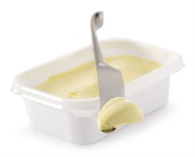
FAT SPREADS
Dairy Spreads:- fat source is milk fat
Non-dairy Spreads:- Vegetable fat with or without milk fat as source of fat
1. Low fat spreads: Fat percent ( 40 to 60% )
2. Reduced fat spread: Fat percent (60 – 70%)
USES
Direct consumption along with sandwiches, salads etc.,
Confectionery industry
Bakery Industry

Slide 3
Manufacture of Fat Spreads
Preparation of the water phase and fat phase
Emulsion preparation
Filling
Pasteurisation
Crystallization

Slide 4
DIFFERENCE- BUTTER & MARGARINE
BUTTER | MARGARINE
Made from animal fat | Made from vegetable oils
More saturated fats (51%) | More mono-unsaturated fats (8%)& poly-unsaturated fats(37%)
No trans-fat | Contains trans-fat
Types: Cultured, sweet, raw, whipped cream | Types:- blended, hard low fat, low spread

Slide 5
MAKHAN
Butter with natural culture flavor from yogurt
Raw whole milk heated to 90°C and cooled down to 45°C
Culture added , milk incubated in Terracotta pot Handi or Matka at 45°C overnight
Milk turns into Dahi (Yogurt)
Process to make Makhan is called 'Manthan‘
Manthani tied by rope to fixed post

Slide 6
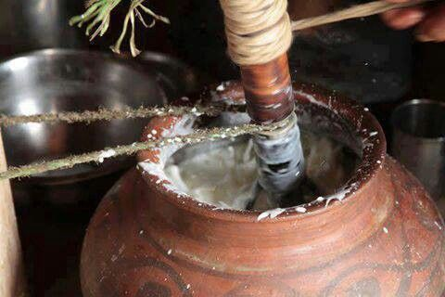
Wooden churner stick 'Phirni' inserted in Dahi
Phirni rotated back and forth by pulling on a rope wrapped around the Phirni.
Manthan takes place during early cool morning hours.
In about 10 to 20 minutes of continuous churning, butter-fat 'breaks' from yogurt as butter-globules.
Butter-globules clump together to make lumps of Makhan that float on top
Makhan skimmed off leaving behind Chaach
Heavier (more fat) the milk, lower should be the temperature of Dahi to make Makhan

Slide 7
Uses of butter
Direct consumption
In the preparation of sauces
As a cooking medium
In the baking and confectionary industries
In ice-cream , butter oil and ghee manufacturing
In production of reconstituted milk

