Slide 1
GLANDERS
Synonyms: Farcy; Malleus
Glander and Farcy Act, 1899

Slide 2
Etiology
Burkholderia mallei (Pseudomonas mallei, Malleomyces mallei, Actinomyces mallei.
Characteristics:
Gram negative coccobacilli, non motile

Slide 3
Hosts Horses, Donkeys and Mules Can also effect: Carnivores, goats and Humans. Swine and cattle are resistant. * Can be transmitted to humans by Direct contact with infected animals or inhalation. Route of Entry Ingestion, Can also be by Inhalation.

Slide 4
Clinical Manifestation Incubation period- 6 days to 2-6 weeks
Can be acute, chronic or latent
Chronic form in horses
Acute form in donkeys and mules
Acute form
Fever, cough, dyspnea, thick nasal discharge,
ulcers
Lymph node and vessel involvement
Death

Slide 5
Chronic form
Coughing, malaise, fever, weight loss
Nasal discharge and ulcers, skin nodules
Lymph node and vessel involvement (Farcy pipes)
Swelling of joints and leg edema
Latent form
May be few symptoms
Nasal discharge
Orchitis common

Slide 6
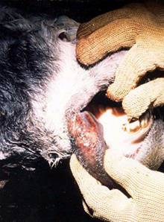
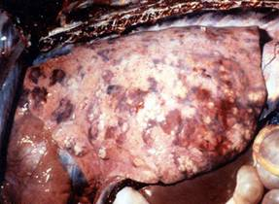
LESIONS
Ulcers, nodules, stellate scars in upper respiratory tract
Pneumonia
Miliary nodules (lung, liver, kidney, spleen) FARCY
Swollen lymph nodes
Necrosis in internal organs.

Slide 7
Manifestation in Humans Generalized symptoms Fever, malaise, muscle aches, chest pain
Forms of infection
Localized cutaneous (Nodules ,Erythema and ulceration of skin)
Pulmonary (Pneumonia, pulmonary abscesses, pleural effusion)
Septicemia (Fever, chills, myalgia, chest pain, rash)
Chronic form (Farcy i.e. Multiple abscesses on Muscles, joints, spleen, liver).
GLANDERS = A BIOLOGICAL WEAPON

Slide 8
DIAGNOSIS
Isolation from Blood, sputum, urine or skin lesions.
Mallein test
Intradermo-palpebral (0.1 ml PPD) Swelling 1-2 days later, purulent discharge from inner canthus, rise in temp.
Ophthalmic (few drops): severe conjunctivitis (6-12 h ) in positive cases.
Subcutaneous test: 2.5 ml diluted mallein s/c –within 24 h firm painful swelling, pyrexia (104⁰F).
Strauss reaction:
Intra peritoneal inj. of positive clinical material in male guinea pigs –severe localised peritonitis & orchitis.
Test is not specific for glanders only.

