Slide 1
OEDEMA
By : Dr Sonam Bhatt
Asstt Professor
Veterinary Medicine
UNIT-1

Slide 2
Abnormal or excessive accumulation of fluid in the interstitial tissue spaces and serous cavities.

Slide 3
ETIOLOGY
Decreased plasma oncotic pressure
Increased hydrostatic pressure
Increased capillary permeability
Obstruction to lymphatic flow.

Slide 4
Decreased plasma oncotic pressure
Hypoalbuminemia or hypoproteinemia
Most common cause of generalized symmetric edema
2. Increased hydrostatic pressure in capillaries and veins
caused by chronic (congestive) heart failure or obstruction to venous return
symmetric pulmonary edema in acute heart failure

Slide 5
3. Increased capillary permeability
Endotoxemia
Part of the allergic response
Vasculitis
Damage to the vascular endothelium
4. Obstruction to lymphatic flow
Tumors or inflammatory swelling
Congenital in inherited lynphatic obstruction edema in Ayrshire and Hereford calves

Slide 6
Pathophysiology

Slide 8
CLINICAL SIGNS
Accumulation of edematous transudate in
subcutaneous tissues – anasarca
peritoneal cavity - ascites
pleural cavities - hydrothorax
pericardial sac - hydropericardium

Slide 9
Anasarca in large animals is usually confined to the ventral wall of the abdomen and thorax, the brisket
Edema of the limbs is uncommon in cattle, sheep, & pigs but is quite common in horses when the venous return is obstructed or there is a lack of muscular movement
Local edema of the head in the horse is a common lesion in African horse sickness and purpura hemorrhagica

Slide 10
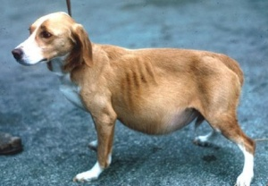
Edematous swellings are soft, painless, and cool to the touch and pit on pressure.
In ascites there is distension of the abdomen & fluid can be detected by a fluid thrill on tactile percussion, fluid sounds on succussion, & by paracentesis
In pleural cavities and pericardial sac- restriction of cardiac movements, embarrassment of respiration, and collapse of the ventral parts of the lungs

Slide 11
Muffled heart & respiratory sounds
Presence of fluid may be ascertained by percussion and thoracocentesis or pericardiocentesis
Pulmonary edema is accompanied by respiratory distress; outpouring of froth from the nose
Cerebral edema- severe nervous signs of altered mentation

Slide 12
Thrombophlebitis is a common cause of localized edema, particularly of the head in horses and cattle with thrombophlebitis of both jugular veins.

Slide 13
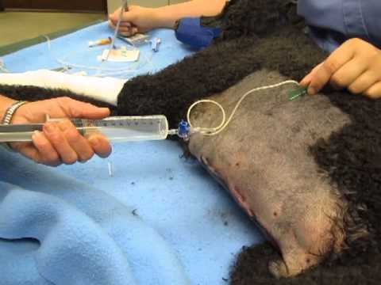
CLINICAL PATHOLOGY
Cytologic examination of a sample of fluid -----presence & absence of inflammatory cells
Thoracocentesis or abdominocentesis ---------differentiation of fluid accumulation
Conjunction with measurement of serum albumin concentration & mean central venous pressure

Slide 14
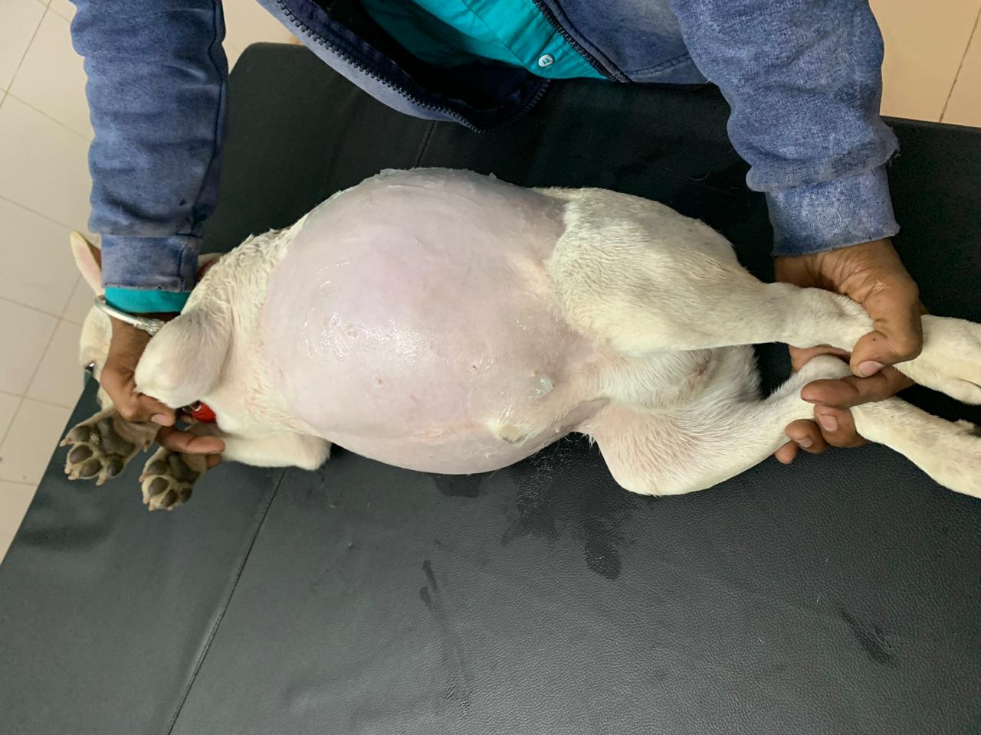
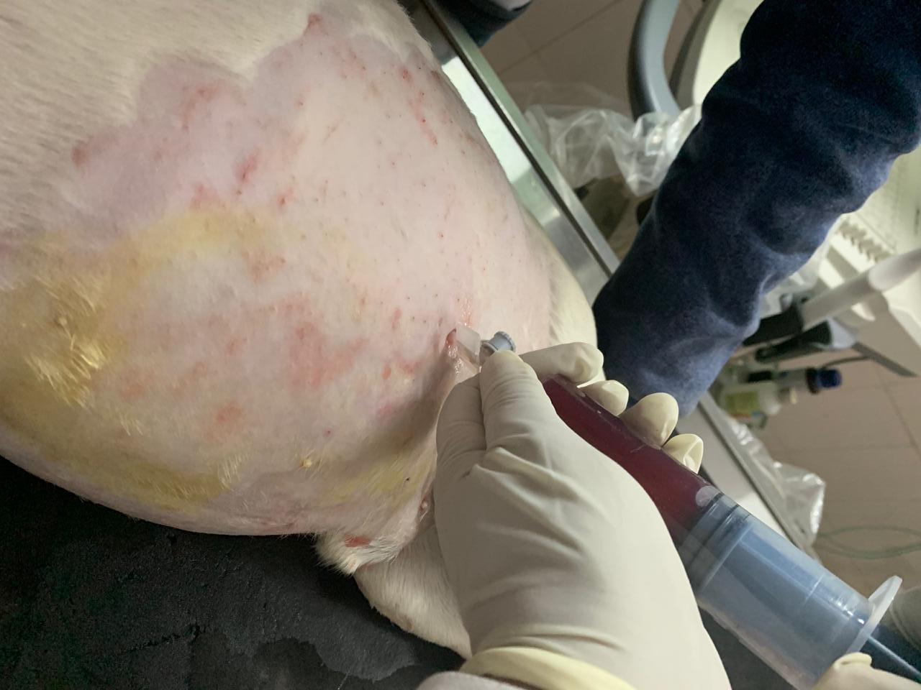

Slide 15
TREATMENT
TREATMENT
Correction of cause
Hypoalbuminemia…… administration of colloids such as plasma or Dextran
Parasitic gastroenteritis…. appropriate anthelmintic
Obstructive edema…..removal of the physical cause & increased permeability edema ……. resolution of the cause of endothelial damage

Slide 16
Ancillary nonspecific measures - restriction of the amount of salt in the diet and the use of diuretics
Aspiration of edema fluid is rarely successful and is not routinely recommended but usually provides temporary relief because the fluid rapidly accumulates
Notes:
Diuretics may relieve effects of pressure temporarily, but the primary cause needs to be addressed for a satisfactory outcome

