Slide 1
Unit 3 “ZOONOTIC DISEASES” (Credit Hours 3+1=4)

Slide 2
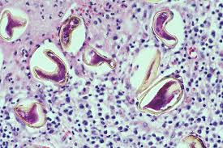
Paragonimiasis

Slide 3
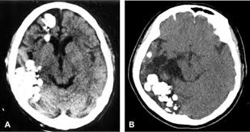
Introduction
Paragonimus is a lung fluke, infects the lungs of humans
Infected by eating an infected raw or undercooked crab or crayfish
CNS cases (when parasite eggs travels to CNS) are more serious but less frequent

Slide 4
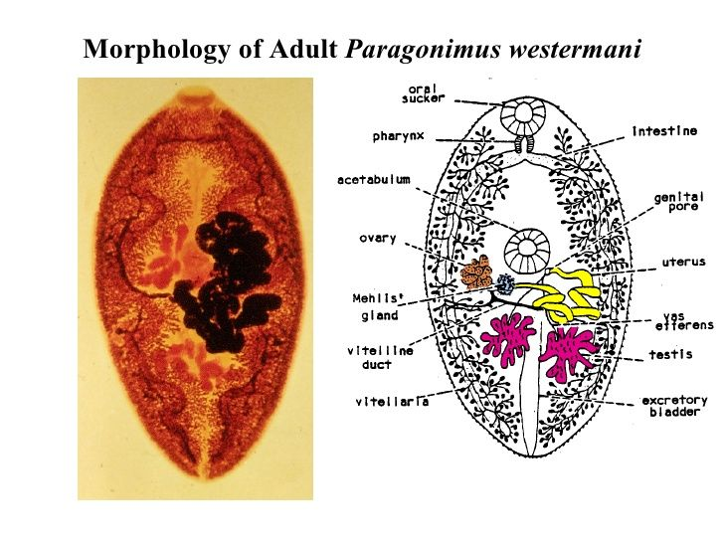
Etiology
Causative agent is genus- Paragonimus
Among the more than 10 species reported to infect humans, the most common is P. westermani (oriental lung fluke)
Notes:
The adult parasites are reddish brown and ovoid, measuring 7.5-12 mm by 4-6 mm.

Slide 5
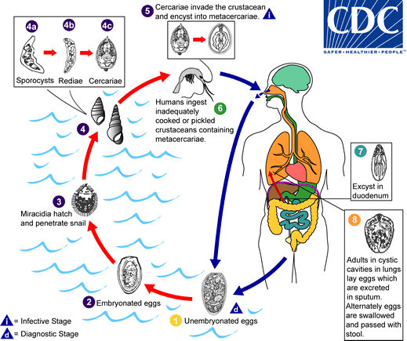
Life cycle
Notes:
The eggs are excreted unembryonated in the sputum, or alternately they are swallowed and passed with stool . In the external environment, the eggs become embryonated , and miracidia hatch and seek the first intermediate host, a snail, and penetrate its soft tissues . Miracidia go through several developmental stages inside the snail : sporocysts , rediae , with the latter giving rise to many cercariae , which emerge from the snail. The cercariae invade the second intermediate host, a crustacean such as a crab or crayfish, where they encyst and become metacercariae. This is the infective stage for the mammalian host . Human infection with P. westermani occurs by eating inadequately cooked or pickled crab or crayfish that harbor metacercariae of the parasite . The metacercariae excyst in the duodenum , penetrate through the intestinal wall into the peritoneal cavity, then through the abdominal wall and diaphragm into the lungs, where they become encapsulated and develop into adults (7.5 to 12 mm by 4 to 6 mm).

Slide 6
Disease in Human
Incubation Period: 2-15 days
light infections: No symptoms
Infection can result in an acute syndrome
Cough
Abdominal pain
Discomfort
Low grade fever
Long term infection mimic- bronchitis or TB
(with coughing up of blood tinged sputum)

Slide 7
Diagnosis
The infection is usually diagnosed by identification of Paragonimus eggs in sputum
Left: Eggs of Paragonimus sp. taken from a lung biopsy stained with hematoxylin and eosin (H&E). These eggs measured 80-90 µm by 40-45 µm.
Right: P. westermani adult, this approximately 1cm long fluke is viewed under magnification.
CDC

Slide 8
Treatment
Drug of choice : Praziquantel
Adult or pediatric- 25 mg/kg
(Orally three times per day for 2 consecutive days)
In cerebral disease:
A short course of corticosteroids may be given with the praziquantel to help reduce the inflammatory response around dying flukes.
Alternative: Triclabendazole, adult or pediatric dosage
(10 mg/kg orally once or twice)

Slide 9
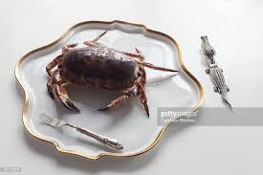
Prevention & Control
Never eat raw freshwater crabs or crayfish.
Cook crabs and crayfish for to at least 145°F (~63°C).
Travelers should be advised to avoid traditional meals containing
undercooked freshwater crustaceans

