Slide 1
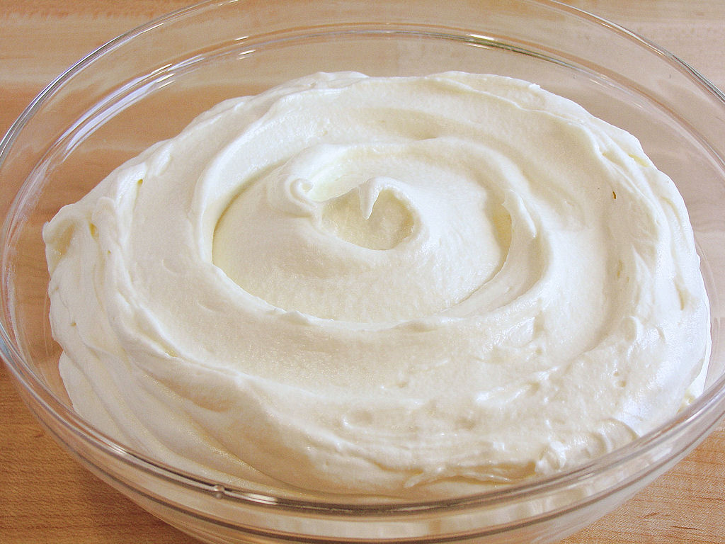
Class Lecture
PHYSICO-CHEMICAL PROPERTIES OF CREAM
Dr. Sanjeev Kumar
Associate Professor
Department of Dairy Technology
SGIDT, Patna-14

Slide 2
PHYSICO-CHEMICAL PROPERTIES OF CREAM
VISCOSITY
WHIPPING QUALITY
ACIDITY
SPECIFIC GRAVITY

Slide 3
VISCOSITY
Viscosity may be defined as the resistance offered by a liquid to flow
Consumer judges the ‘richness’ of cream from its viscosity

Slide 4
FACTORS AFFECTING VISCOSITY OF CREAM
FAT %: ( in fat %, es η)
2)TEMPERATURE: ( in temperature, es η)
3)SEPARATION TEMPERATURE: ( in separation temperature, es η)

Slide 5
4) HOMOGENISATION :
single-stage homogenisation increases viscosity in direct relation to pressure used;
double-stage homogenisation reduces viscosity.
5 ) COOLING : slow cooling increases viscosity
6) AGEING : increases viscosity
7) CLUMPING : greater the degree of clumping, the greater the viscosity

Slide 6
WHIPPING QUALITY
Whipping refers to the beating of cream to produce froth or foam (emulsion of gas/air in a liquid).
The most satisfactory fat content for production of whipping cream is 30-35%
The optimum aging period is 24 hours at 4°C
Homogenization, acidity and stabilizers in cream reduces the whip-ability of cream

Slide 7
TITRATABLE ACIDITY (TA in %LA)
Inverse relation between % fat and % titratable acidity as shown below:
%Titratable Acidity of cream= %serum in cream * % TA of milk
%serum in milk
OR
%TA of cream = 100- % fat in cream * % TA of milk
100- % fat in milk

Slide 8
Specific gravity
Specific gravity of cream is inversely proportional to fat%
FAT PERCENTAGE | SPECIFIC GRAVITY
0.025 | 1.037
4 | 1.032
6 | 1.030
10 | 1.025
20 | 1.013
30 | 1.004
40 | 0.995

