Slide 1
Physiology of Nervous System

Slide 2
History of Research on Nervous system
460 -379 B.C. | Hippocrates discuss the epilepsy as disturbance of brain and also indicated that the brain is involved with sensation and is seat of intelligence.
335-280 B.C. | Herophilus, also known as father of anatomy, believes that ventricles are seat of human intelligence.
1764 | Domenico F.A. Cotugno, describes the spinal, subarachnoid and cerebrospinal fluid and reported that ventricular and spinal fluids are connected.
1800 | Samuel Von Sonmering identifies black material in the midbrain and called it “ substantia nigra”.
1811 | Julien Jean Legallois discovers respiratory centre in medulla.
1838 | Robert Remak suggests that nerve fibre and nerve cell are joined.
1840 | Adolphe Hannover discovers the ganglion cell of retina.
1851 | Heinrich Muller is first to describe the coloured pigments in retina.
1900 | M. Lewandowsky coins the term blood – brain barrier.

Slide 3
1903 | Ivan Pavlov coins the word, conditioned reflex.
1906 | Golgi and Cajal won nobel prize for describing structure of nervous system.
1906 | Sir Charles Scott Sherrington publishes, “ The integrative action of the nervous system that describes the synapse and motor cortex.
1911 | Allvar Gullstrand was awarded Noble Prize for describing optics of eye.
1911 | George Barger and Henry Dale discover nor epinephrine.
1961 | George Von Bekesy, was awarded Nobel Prize for his work on cochlea.

Slide 4
Nervous System
Nervous system is the body’s chief co-ordinating agency exerting control over almost all the body functions.
Nervous system specializes in Irritability and conduction.
Irritability is the ability to receive and respond to the messages from the external and internal environments.
Conduction is the ability to transmit messages to and from the coordinating centers.

Slide 5
Central nervous system / somatic nervous system
Autonomic nervous system/ Vegetative nervous system
SNS PSNS

Slide 6
Terminologies
Neuron / nerve cell is the functional unit of nervous system
Nerve fibre is axon surrounded by myelin sheath.
Nerve is a group of nerve fibres from many neurons closely enveloped in the connective tissues, which connects central nervous system.
Nucleus is the cluster of several nerve cell bodies in CNS.
Ganglion is the collection of neuron bodies outside CNS in the peripheral nervous system, enclosed in the connective tissue sheath. They are also present along the course of several nerves.
Glial Cell / Neuroglia : are connective tissue cells of the brain. Their number is about 10 times more than neurons.

Slide 7
Function of central Nervous system
Biological machinery for integration and co-ordination of body functions.
Regulates internal environment , behaviour of the organism with in the external environment.
Sensory systems of the body relays information about external environment (Ex. Sound, sight, smell, taste, temp. and touch) to the higher centers of brain.
CNS - conduction of impulses.
CNS - responsible for contraction of skeletal muscles.
Behavior of animal
Regulates endocrine system and thus controls metabolism and growth functions of the body.

Slide 8
Development of Central Nervous System
During embryonic stage CNS develops from a simple tube of ectoderm,
the primitive neural tube.
The cells lining it becomes the nervous tissue of the brain and spinal cord.
The canal becomes distended to form the ventricles of the brain and central canal of the spinal cord.

Slide 9
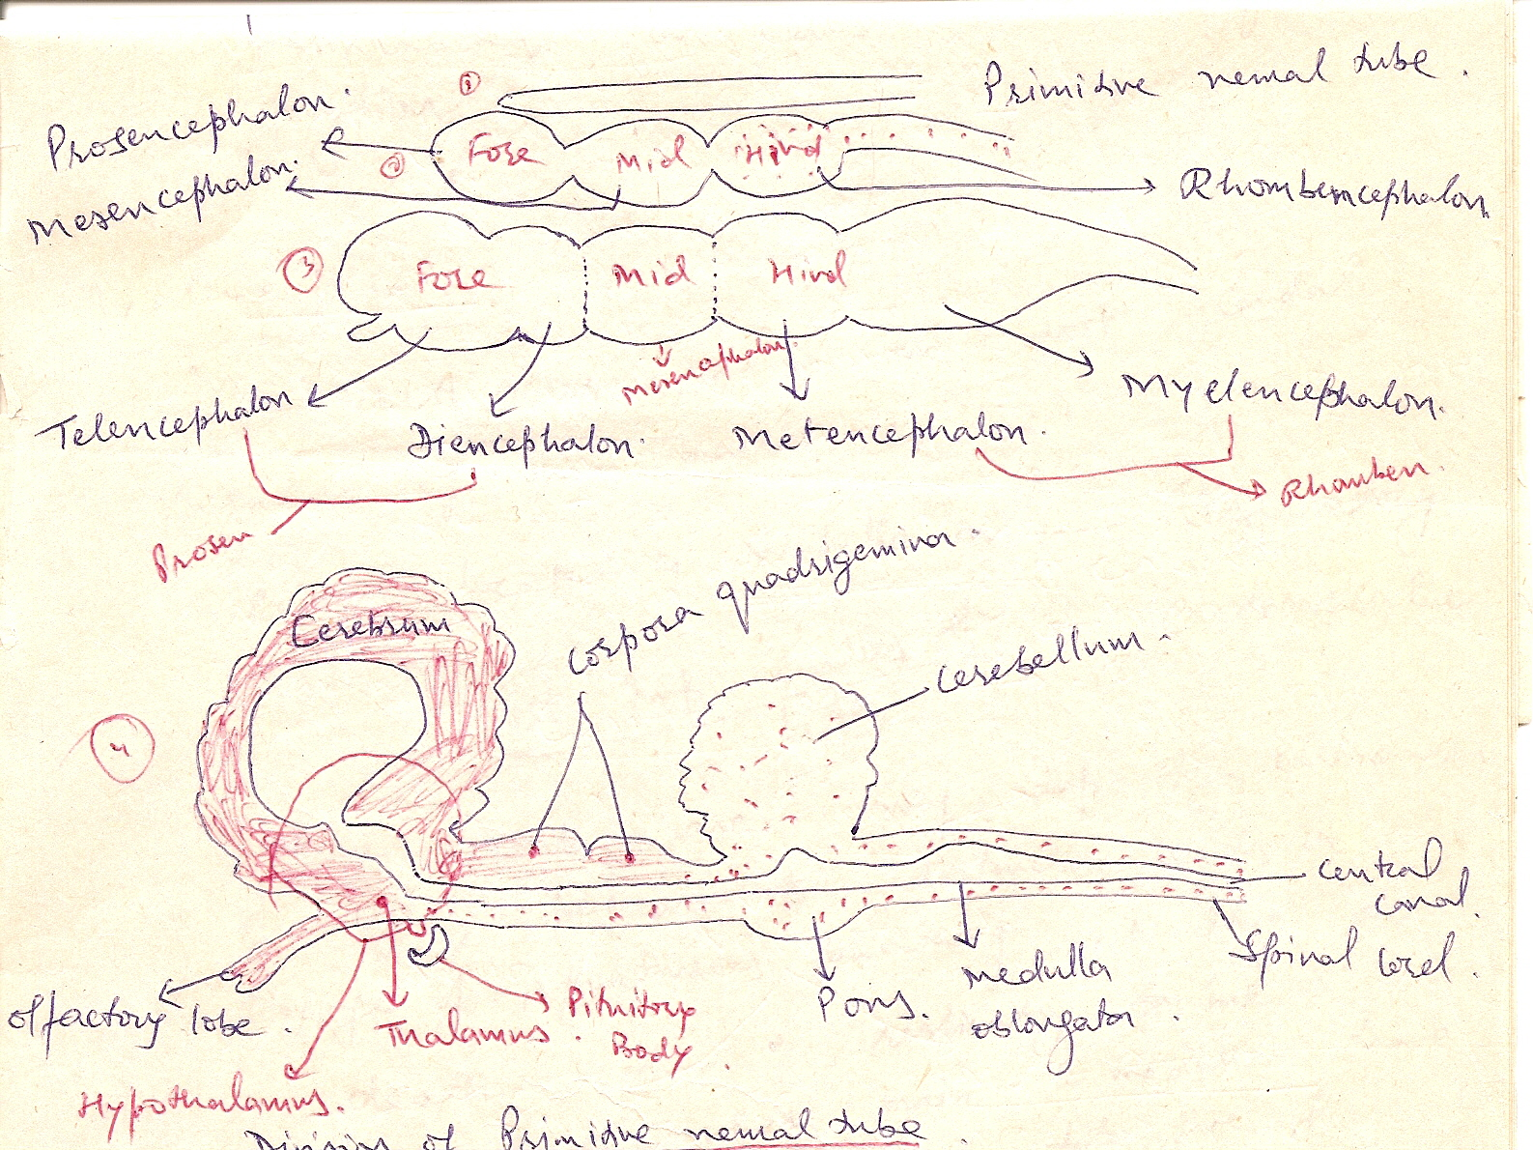

Slide 10
Development of Central Nervous System
Prosencephalon Diencephalon
(Fore brain) Telencephalon
Mesencephalonen (Mid brain)
Rhombphalon metencephalon
(Hind brain)
Myelencephalon

