Slide 1
Rabbit Production and Management
Dr. R. R. K. Sinha

Slide 2
Zoological Classification:
Class: Mammalia
Super order: Glires
Order: Lagomorpha
Family: Leporidae (Hares, Rabbits)
Genus: Oryctolagus
Species: Cuniculus
All domestic rabbits originated from the European wild rabbits. Today Europe accounts for 85% of total world output. China comes next.

Slide 3
Common terms related to rabbits:
Doe: - A mature female rabbit used for breeding.
Buck: - A mature male rabbit used for breeding.
Kit: - A young rabbit whose eyes are not yet opened.
Bunny: - A young rabbit below 20 weeks of age.
Fryer: - 10 to 12 weeks old rabbit ready for market.
Roaster: - Culled rabbit.
Kindling: - Act of parturition.
Litter: - Kits born in a single kindling.
Weaner: - A newly weaned rabbit.
Fur: - Wool.
Pelt: - Skin.
Rabbitry: - Place where domesticated rabbits are kept.
Caecotrophy/Capropargy: - Consumption of own feceal matter.
Broiler: - Rabbits which grow very fast for meat purpose (2kg body wt. In just 12 weeks).

Slide 4
Fostering: - Transfer of bunny/bunnies to another doe for nursing usually due to death of original doe or abandoning of young rabbit.
Tattooing: - Identification marks put in the ear of rabbit with tattoo ink and punch.
Cannibalism: - Eating of own bunnies by mother doe after kindling, noted usually due to inadequate water supply to pregnant doe.
Nest box: - A wooden box to be kept in the cage of pregnant doe, 5-6 days prior to kindling.
Shearing: - Cutting wool from rabbit at an interval of 85-90 days. When it grows to the length 4-6 cm.
Matting: - If shearing is not done in time, staple get entangled with each other, which is called as matting.
Rabbits are chiefly nocturnal, although they are sometimes seen in the day time. They have acute senses of smell & hearing. They feed on wide variety of vegetation.

Slide 5
Rabbit production system: -
It differs from country to country but there are 3 main systems of production:
The backyard small scale rabbitry: A few female and one or two male rabbits are kept in a house built rabbitry and are fed on greens, weeds and vegetables kitchen scraps. It provides enough meat to supplement the family need.
The small commercial rabbitry: It may have the 10-50 breeding does in a purpose built rabbitry. The aim of this type of rabbit production is to sell rabbit meat for profit. Rabbits are usually fed on concentrate as well as bulky leafy vegetables.
Large commercial rabbitry: This type is more common in Europe & U.S. there are some examples of large rabbit units in the tropics, but to support such rabbitry it is necessary to have reliable market outlets for the carcasses, source of good quality commercial feed and expert veterinary services.

Slide 6
Breeds of rabbits:
There are many breeds of domestic rabbits in the world and all have different qualities. There are 38 breeds and 87 varieties of rabbits which are recognised and well established worldwide. These breeds/varieties vary in colour, size, type of hair coat and other characteristics.
For wool production: - Angora rabbit is reared for wool production. It is usually white & albino but some coloured varieties have been developed for the utilization of colour wool. Normally the main demand of Angora wool is of white colour and long staple of uniform dying & processing.
The following strains/breeds of Angora rabbit are commonly being reared by Indian farms-

Slide 7
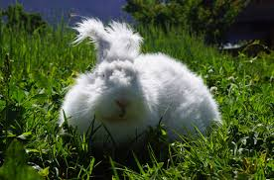
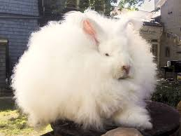
German Angora: - Origin Germany, wool yield 700-1000gm/year, white fine quality, 2-4% guard hair, adult body weight 3-4kg.
British Angora: - origin U.K., wool yield 400-600gm/year, white lustrous fine quality, guard hair 2-4%, adult body weight 2.5-4.5kg.

Slide 8
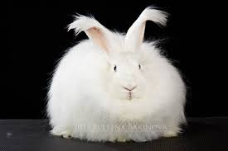
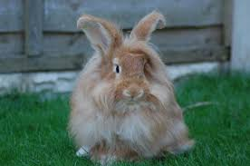
Russian Angora: - Origin Russia, 300-400gm/year, white, medium fine wool, 10-20% guard hair, body wt. 3.5-5.5kg.
Crossbred Angora: - Origin India, well adapted to Indian conditions, wool yield 500-600gm/year, wool is white, medium fine, guard hair is of 4-8%, adult body wt. 3-5kg.

Slide 9
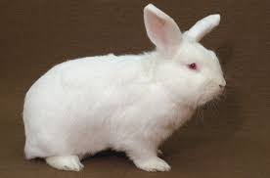
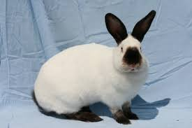
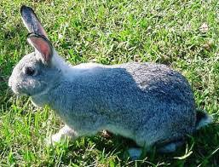
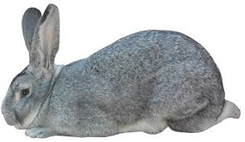
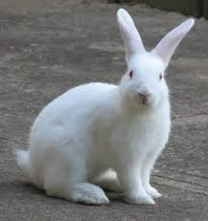
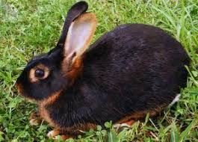
For meat/Fur skin production: - The most common breeds for this purpose are New Zealand white, White Californian, Soviet Chinchilla, Grey Giant, White Giant, Black Brown, Dutch, Argente Champagne etc. The adult body weight of these breeds ranges from 3-6kg in females & 2.5-5.5kg in males.
Black Brown
New Zealand white
White Californian
Soviet Chinchilla
Grey Giant
White Giant
Black Brown

Slide 10
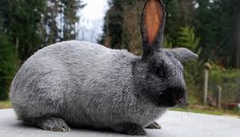
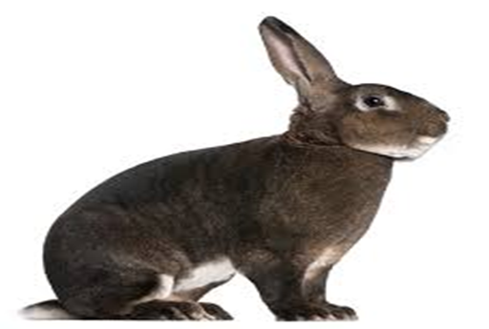
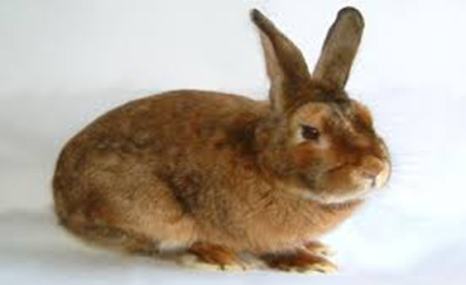
Dutch
Argente Champagne
The Rex and Satin breeds of rabbit are mainly raised for quality fur skin and meat production. In our country, at the CSWRI, Garsa (Kullu) the following meat breeds were experimented for meat & fur skin production.

Slide 11
New Zealand White- Imported from UK.
Soviet Chinchilla- Imported from Russia.
White Giant- Imported from Russia.
Grey Giant- Imported from Russia.
These breeds after adaptation and production performance were sent for various research and development purposes in southern, western & eastern states of A.P, Karnataka, T.N, Kerala, Maharashtra, Nagaland, Meghalaya and Assam.
For biological research and Laboratory purposes: - New Zealand White, Californian, Dutch, Black Brown breeds are primarily being used.

Slide 12
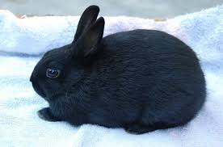
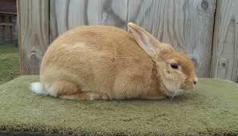
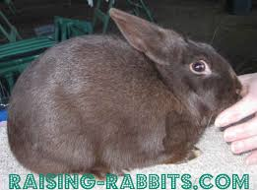
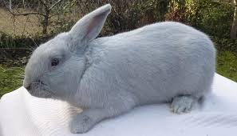
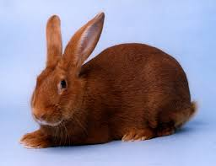
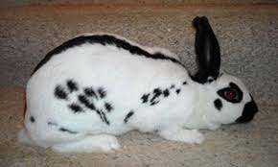
For fancy/hobby purposes: - The most important breeds under this class are Polish, Palmino, Havana, Beveren, New Zealand Red, English Spot white, Dutch etc. These animals are lighter in weight and very fancy to look.
Polish
Palmino
Havana
Beveren
New Zealand Red
English Spot white

Slide 13
Commercial characters of rabbits | Backyard producers | Commercial producers
Young born per Litter | 4-9 | 6-12
Young reared per litter | 3-5 | 6-8
No. Of litter per Doe per year | 3-4 | 5-8
No. Of young reared per Doe per year | 9-20 | 30-60
Weaning weight per litter at 8 weeks | 3-6 kg | 9-14 kg
Live wt. Gain (No. Of weeks to reach 2kg body wt.) | 12-24 weeks | 8-10 weeks
Feed conversion ratio | 5:1 to 4:1 | 4:1 to 3:1

Slide 14
Housing:
The success of rabbit production depends on suitable site & design of houses. Rabbit needs housing for protection and preventing them from running away. Rabbit is burrowing animal and has sharp reflexes.
Housing premises should provide adequate shade of trees & peaceful environment free of strong winds.
Shelter must provide protection from inclement weather and predators like dogs, cats, snakes, bats etc.
Rabbits can be housed in several ways depending on finance availability and climate. Rabbits are reared individually or in colonies. An enclosed shed with hutches kept on racks or cages hung from ceiling with wires are elaborate housing.

Slide 15
A hutch is small built up structure of wood and chicken mesh.
The floor of hutch may be made up of stronger mesh or solid sheets bedded with straw otherwise locally available materials like tree twinges and woven splits bamboo.
The roof of hutch should be sloping made of asbestos sheet/grass thatch. Gunny bags or mats should be kept hanging on sides of hutches without affecting ventilation to provide protection from rain, wind and sun.
Wire mesh floor is preferred over solid bedding materials as the droppings falls down and it keeps cage clean, free from ammonia odour and fly.
Rabbits can also be housed in thatch roofed mud huts with hard mud floor attached with small yard.

Slide 16
In colony raising, usually 10 or more in colony hutches or on floor in deep litter are reared.
The floor can be wire mesh or hard floor with bedding materials.
The floor space is 1.5-2.0sqft. or 0.45-0.65sq.m./adult rabbit.
However, advanced pregnant does, usually from 1 week prior to kindling until weaning of bunnies should be isolated from flocks.
Major problem of colony raising specially on deep litter is higher risk of coccidiosis and maintenance of hygiene.
In western countries cages or hutches are fabricated with wire netting.
They are installed in single, two or three tier system.
They are costly but space saving.
Such cages are usually in commercial rabbitary.
The wire mesh of 12.5x12.5mm size of 16 or 14 gauge specifically used for bottom of cages.

Slide 17
Colony cage specification
No. Of rabbits raised together | Cage specification | Total floor area (m²)
10 | 2x2 | 4
15 | 2x3 | 6
20 | 2x4 | 8
25 | 2x5 | 10
30 | 2x6 | 12
Breeding cages specification for rabbits
Size of rabbits Small (2.5-4.5kg) Medium (4.5-5.5kg) Large (5.5 & above) | Specification of cages (cm)
 | Breeding cage (pair) |  |  | Single doe/buck cage
 | Length | Width | Height | Length | Width | Height
 | 100 | 80 | 55 | 85 | 60 | 55
 | 125 | 80 | 60 | 105 | 60 | 60
 | 145 | 80 | 65 | 125 | 60 | 65

Slide 18
Waterers: - Earthen ware, concrete, glass & plastic pots are commonly used waterers in backyard rabbitries.
In modern commercial rearing inverted water bottles of polypropylene materials are more popular.
The water bottle is big enough to fulfil 24 to 48 hrs of water supply.
Feeders: - Normally L or J shape feeders with bottom mesh are used which eliminate dust in the feed.
These feeders are called self cleaning feeders & used for feed concentrate in the form of pellets.
Feeders are raised from bottom of cage to avoid spoilage & wastage of food.

Slide 19
Environmental requirement of rabbit:
Temperature: - The comfortable zone of temperature for maximum production is 10° to 26°C if temperature is more than 28°C and above decreases feed consumption and increases water intake. Due to which-
Growth rate slowed down in growers.
Productive efficiency in females adversely affected with reduced fertility and temporary sterility in males.
Humidity: - Rabbits are sensitive to low humidity. Comfortable humidity ranges from 55 to 70%.
Ventilation: - Ventilation requirement depends upon weather, cage type and population density. Free movement of air is always needed in rabbitary especially in hot weathers. Air must be free from dust and smoke.
Light: - About 8hrs in males and 16hrs in females exposure to light is must for sexually active and fertile. For growing rabbits, 1-2 hrs additional artificial light is sufficient.

Slide 20
Sanitation for disease prevention:
Sanitation is the most important management to prevent disease incidence.
Daily cleaning of cages/hutches, feeders & waters should be done to ensure sanitary conditions.
Water supplied should be treated with common sanitizers to reduce microbe load.
Removal of manure, soiled bedding, contaminated food or feed and supplying contamination free roughage/feed reduce disease emergence in rabbitry.
Isolation of sick animals and treatments is also equally important.

Slide 21
Breeding:
Selection of rabbits for breeding: -
Selection of Buck: - Buck selection is important or rather more important than doe because it mates with no. Of does and its character will be inherited to many off springs. Apart from individual selection bucks should be selected whose sibs and collateral relatives have good commercial characters.
A buck should be in good physical conditions with well developed testes and health.
Its growth must be good & should not be fatty.
Best time to select a buck is when they weight 2.8 to 3.0kg.
Selection of doe: - young does are to be selected to replace aged does.
A breeding doe should have minimum 8 teats.
It should be in good physical condition, healthy & well grown.
She should have good commercial characters.
They can be best selected when their body weight is around 2 to 3 kg.

Slide 22
Breeding: - Inbreeding should be avoided by purchasing/exchanging bucks from other herds. Mating of bucks and doe from different breeds is adopted to improve commercial character of herd.
Patterns of breeding: - There are 3 basic patterns of breeding depending upon the frequency of mating of does and bucks.
Extensive breeding: -
In this system backyard rabbitary farmers aim to produce about 4 litter/doe/year.
In this system weaning is carried out at 7 week and mating is done in the week immediately after weaning.
This breeding cycle takes about 85 to 90 days.
Semi intensive breeding: -
Rabbits keepers in this system aim to get 5 to 6 litter/doe/year.
Weaning is done at 5 weeks and breeding cycle is completed within 65 to 70 days.
This system is suitable for small commercial rabbitary.

Slide 23
Intensive breeding: -
Large commercial rabbitries follows this breeding systems.
In this system weaning is done at 2 weeks.
In the third week from kindling doe is mated and within 45 to 50days breeding cycle is completed.
This system can produce more than 7 litters/doe/year.
It should only be practiced by professionals maintaining skills, quality nutrition and standard management.
Mating: -
The sign of oestrus in doe includes red & swollen vulva, restlessness, raising of tail and acceptability of buck.
First mating should be done at 20-24 weeks of age.
For mating doe should be taken to buck cage to avoid fighting in herd.
After successful mating buck falls off to the side with scream.

Slide 24
Breeding and selection for optimum production: - It depends on the purpose of production i.e. whether rabbits are kept for meat/fur/wool production.
Broiler rabbits: -
Broiler rabbits are reared for meat production.
The main important traits considered during selection are growth, weight, FCR, kindling%, no. Of kindling/year and mortality.
For achieving these objectives maximum weightage is given to weight gain and less mortality.
Approx rabbits should gain 30 to 35gm/day.
Males: -
He should be from known pedigree record.
They should be active, potent and known for producing large litter size.
He should not have any genital abnormalities.

Slide 25
Females: -
They should be prolific, possessing good mothering ability, more no. Of kindling with more no. Of live bunnies borned.
She should weigh around 2 to 2.5 kg at maturity i.e. in 5 to 6 months.
Bunnies should weigh between 300-350 gm.
She should come into heat soon after furrowing.
Wool rabbits: -
Selection is based on wool quality & quantity.
Important wool parameters are fineness of fibre, staple length, modulation, true fibre etc.
Angora (German) produces around 700-800 gm of wool/year with good quality fibre.

Slide 26
Productive features of rabbitry: -
By analyzing the records of productivity features financial status of commercial rabbit unit can be known. The important aspects are-
Pre-weaning & post weaning mortality % should be low.
Interval between 2 litters should be less.
Rate of occupancy of breeding cages should be higher because it indicates fast breeding & production of more litter.
No. Of rabbits produced/ breeding cage /year should be more.
Margin over feed expanse / year should be higher.
Note: - Average achievements of all animals in the unit are more important than higher performance of some individuals from business point of view.

Slide 27
Pregnancy, kindling and care:
Pregnancy: - the gestation period in rabbit is 30-32 days.
Pregnancy diagnosis: -
Test mating: It is also called layman’s method in which doe is subjected to mating and acceptability of buck is tested.
Usually pregnant does will not accept the buck.
Palpation: Developing embryos in pregnant doe can be easily felt after 12 to 14 days of mating.
The embryos beads are around 1 to 2 cm at this stage.
Embryos can be felt by exerting gentle pressure with thumb and fore fingers on either side of uterus.
Further during late pregnancy i.e. 4th and 5th week, abdomen of doe gets swollen with teats.

Slide 28
False pregnancy:
In case doe doesn’t conceive after mating.
Sometimes she may develop false pregnancy.
She will refuse to accept male.
After 15 to 20 days she will start pulling her fur to built nest which is observed at the stage of 24 to 28 days in actual pregnant doe.

Slide 29
Management of pregnant doe: -
pregnant doe should be kept separately in breeding cage to adopt new housing for kindling.
Before 5 to 6 days of kindling pregnant does should pull some fur from her rump, sides and around her teats which indicates good mothering ability.
During last 10 to 15 days of pregnancy feeding of doe must be gradually increased by 20 to 25 gm additional feed for the growth of embryos and development of mammary glands.
Proper feeding also helps to increase birth weight of bunnies and milk production of mother.
Kindling care: -
Naturally kindling usually takes place in the night.
Does become restless, moves to and Fro, jumps and licks the genitalia.

Slide 30
After delivery mother licks them & dries.
If bunnies are delivered outside nest box then they should be put together in the nest to avoid mortality due to cold.
For two kindling and if the vices persists, they should be culled.
Cannibalism: -
In some cases it can be observed that doe, eats her young rabbits, which is called cannibalism.
The reason may be shortage of water before kindling, improper bedding or disturbance during kindling. In such cases does can be watched

Slide 31
Management of young rabbits: -
Management of bunnies with care is important aspect to reduce pre-weaning mortality.
Bunnies live & grow for first 2 to 3 weeks only on mother’s milk.
If the baby rabbit are hungry or feeling too hot, they start climbing the nest with restlessness to come out.
Bunnies open their eyes at 10 to 12 days of age and start crawling.
From 15 to 20 days young rabbits starts chewing grass and eating concentrate along with suckling.
On an average doe and her litter may drink about 4 to 5 litres of water/day.

Slide 32
Fostering: - Taking bunnies to another doe for rearing is fostering. This is because of following reasons-
Real mother of bunnies may die or abandon young ones.
In exceptional cases, if litter size is more than 8.
Sometimes, two or more does may kindle at the same time with unequal size of litter.
Proper method may increase chances of success of fostering with following techniques-
Bunnies should be taken to another doe for fostering within a week.
The age of young rabbits to be fostered should be nearly same as that of foster mother’s own litter with not more than 3 days difference.

Slide 33
The transfer of young ones to mother’s cage be done in her absence. Further rub the nesting materials to the young rabbit from foster mother’s nest to have own litter smell. Leave them for 6 to 8 hrs in her litter in her absence and bring back the foster mother to her cage. Then darken the cage and let them undisturbed till next day.
Hand rearing: -
In case of non-acceptance of young rabbits by foster mother.
They can also be reared by feeding cow’s milk.
The protein content of cow’s milk is raised to 10% by adding calcium casemate with proportion of 1:20.
Bunnies can be fed this warm milk with bottles @ 5ml/day/bunny during 1st week, 15ml & 25ml in 2nd& 3rd week.
Total quantity should be divided into two times daily.

Slide 34
Management of breeders: -
For optimum productive performance breeders should be managed during growing stages after weaning.
Managing breeding bucks: -
The bucks selected as breeding bucks should be housed in separate hutches/cages to avoid fighting.
Further they should be adequately fed with quality ration to mature quickly but at the same time fattiness must be checked.
Managing breeding does: -
The does selected for breeding can be reared in groups in large cages.
They should be separated and housed singly prior one month of their first mating. This will avoid false pregnancy.

Slide 35
Managing broiler rabbits: -
Broiler rabbits can be reared in groups in large hutches/colony cages but males and females should be reared separately to avoid fighting.
Castrations is rarely practiced as it slow down the growth & lowers carcass quality, which is unique feature in rabbits.
They should be fed quality feed for appropriate growth with quality meat. Daily feed requirement is 150-200gm.
Managing wool rabbits: -
Wool producing rabbits should be managed to obtain quality wool.
Feed required daily is 100-200gm of concentrate & 200-250gm greens with 1 litre of water.
Manage to prevent spoilage of wool due to soiled or skin infections like mange.

Slide 36
Feeding of rabbits:
Rabbit is real herbivore and continuous eater taking one to two meals /hour.
It is caprophagious animal.
They produce dry hard pellet faeces during daytime and softer and small pellets in the night. Feed stuff for rabbits can be classified into following categories-
Roughages: Which includes hay, bamboo leaves, banana leaves, cesbania leaves and some equal type stuff.
Greens: Grasses, vegetables scrap, legumes, Lucerne, Berseem, Clover etc. tubers sweet potatoes, onion, guinea, Napier, Para grasses.
Concentrate: Most of cereals, animal products and agro industrial by products.
Compounds: usually complete pelleted feed.

Slide 37
Nutritive requirements: - Rabbit prefer high fibre diet offered as hay or greens. Around 15% roughage in the form of greens is adequate.
Nutrients required as laboratory animal:
Nutrients | Composition
Crude protein | 12-17%
Fat | 3-5%
CHO | 45-55%

Slide 38
Nutrients required as commercial animal:
Nutrients | Maintenance | Growth/Gestation/Lactation
M.E. (Kcal/kg) | 2100 | 2500
CP (%) | 17 | 21
Fat (%) | 2 | 3-5
CF (%) | 14 | 10-12
Ca (%) | 0.7 | 1.8
P (%) | 0.5 | 0.7
Salt (%) | 0.25 | 0.50
Vitamin A (IU/kg) | 7000 | 7500
Vitamin E (mg/kg) | 40 | 50
Vitamin K (mg/kg) | 2 | 2

Slide 39
Daily feed and water requirements:
Water:
Adult rabbit: 150-500ml/day (Approx. 10ml/100g body weight)
Lactating Does: 1000-2000ml.
Age (Weeks) | Peleted feed/day (Diameter 4mm & 15-28mm) in gm
6-12 | 60-90
13-24 | 120-140
25 & above | 160-190
Lactating does | 300-370

Slide 40
Feeding care:
Any feed, whether concentrate or roughages should always be fresh to possible extent. Succulent greens should be fed with minimum gap or delay.
Concentrate and hay should be stored in dry and cool environment. Hay can be stored up to 1 year but concentrate should not be stored more than 1.5 to 2 months.
Feeding should be done in most clean conditions with specific timing.
Wastage should be controlled by filling feeders to the half of their depth.
Feeders should be scrapped and thoroughly cleaned by applying disinfectant at least once a week.
In case of domestic food waste or homemade feed is fed in the wet form, the feeders must be cleaned daily.

Slide 41
Health care of rabbit:
For productive & efficient rabbit keeping, health care is one of the important aspect of rabbit management.
Detection of disease: - To recognise sick individuals the following conditions should be noted.
Animal movement: -Healthy individuals will make easy, free and pleasant movements. While resting there will be no huddling. Dullness, difficult breathing and stiffy movements indicate sickness.
Eyes: - Sunken, dull, depressed and discharge from eyes exhibits illness.
Coat: - Patches of hair loss, dull colour, wrinkles, loose folds of skin are sign of infections.
Pulse and temperature: - Elevated or lowered pulse than 140 to 150/min. & body temperature of 38°C and above are important symptoms of diseases.

Slide 42
Feed and water intake: - Off feed or reduced feed intake is one of the most important sign of disease. In some serious infections animals may even stop drinking water also.
Faeces: - Pelleted with black colour are normal faeces. More soft, watery, too hard with change in colour like white, reddish etc. indicates disease emergence.
Discharges: - Any abnormal discharge from eyes, nostril, mouth, anus, teats and genitals will indicate illness.
Growth and weight: - Retarded or slow growth, underweight are indications of ill health.
Swelling and sores: - swelling on body and sores (damages) on skin are sign of sickness.
Disease prevention: - Effective management for prohibiting disease emergence involves the following precautions-

Slide 43
Purchasing rabbits from reliable breeder: - fresh stock should be purchased from known and reliable breeder having good health history.
Follow quarantine schedule: - Quarantine or isolation houses should be constructed and used for new animals suspected for infections and contagious diseases to control spread of infections.
Standard housing: - The houses must be constructed following high standards in respect of floor space, ventilation; to avoid old, dampness draft and insects.
Sanitation and hygiene: - Follow appropriate sanitation and hygiene measures to keep the environment germ free or with minimum possible low levels of microbes.
Immunization and medication programme: - adopt and advocate required vaccination depending on disease prevalence along with preventive medication.

Slide 44
Feeding care: - Follow quality, contamination free (microbes, toxins and anti nutritional factors)feed and adequate feeding practices.
Timely isolation and treatment: - The sick individuals should be attended immediately to isolate and treat them effectively.
Disposal of dead animals: - Dead animals must be immediately removed and properly disposed off after post mortem and diagnosis of disease.

