Slide 1
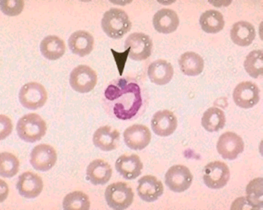
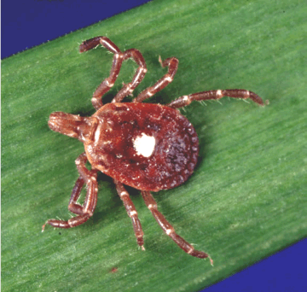
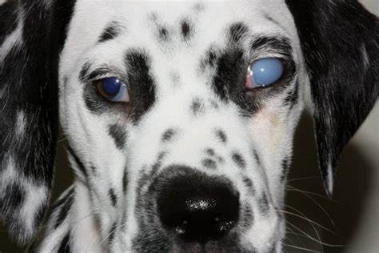
Rickettsiales
Dr. AJIT KUMAR
HoD
Department of Parasitology
Bihar Veterinary College
Bihar Animal Sciences University
Patna-800014
Image source: Google image

Slide 2
Order : Rickettsiales Genus: Anaplasma
Anaplasma species appear as small (0.2-0.5 µm in diameter), round, dark red bodies with no cytoplasm and with a light halo may found around them inside the erythrocytes.
One erythrocytes may occasionally have more than one organisms.

Slide 3
Genus: Anaplasma
Species | Definitive host | Location | Transmission/ Vector
Anaplasma marginale | Cattle | usually near the margin of RBCs | Various species of ticks, flies, contaminated surgical instruments etc.
Anaplasma centrale | -do- | In the centre of RBCs | -do-
Anaplasma ovis | Sheep and goat | RBC | -do-

Slide 4
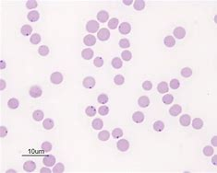
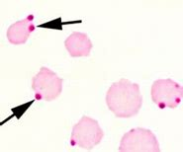
Anaplasma marginale
Anaplasma marginale found on or near the margin of erythrocytes in stained blood films.
Image source: Google image

Slide 5
Anaplasma marginale
Transmission:
Transmitted through various species of ticks (transovarian transmission), biting flies and even mosquitoes (mechanical transmission) help in transmission of anaplasmosis.
Disease can also be transmitted mechanically by infected blood contaminating the hypodermic needle, use in mass vaccination and castration, ear tagging and dehorning instruments.
Source of infection is always the blood of an infected animal.

Slide 6
Life- cycle of A. marginale
Image source: Google image

Slide 7
Anaplasma marginale
Disease : Anaplasmosis or gall sickness
Pathogenesis & Symptoms:
Anaplasmosis is a disease of adult cattle and clinical anaplasmosis is mostly seen in cattle above 18 months of age.
Younger animals are susceptible to infection but clinical symptoms do not occur.

Slide 8
Anaplasma marginale
Pathogenesis & Symptoms:
Anaplasma organisms infected erythrocytes are engulfed (erythrophagocytosis) by the cells of reticuloendothelial system (Spleen and bone marrow) and cause extra vascular haemolysis leading to anaemia.
Symptoms include fever, anorexia, anaemia, jaundice and may be abortion in pregnant cows.

Slide 9
Anaplasma marginale
Treatment :
Oxytetracycline @6-10 mg/kg b.wt i/m is drug of choice in treatment of anaplasmosis.
Amvac and Anaplaz vaccines have been prepared against Anaplasma marginale.

Slide 10
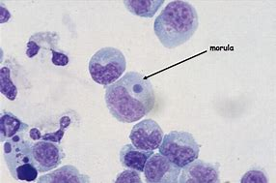
Order : Rickettsiales Genus: Ehrlichia
It is small pleomorphic gram negative coccoid intracytoplasmic inclusion bodies found in circulating leucocytes.
Organisms may occur singly or generally in compact colonies as morula in the cytoplasm of leucocytes.
Image source: Google image

Slide 11
Order : Rickettsiales Genus: Ehrlichia
Species | Definitive host | Location | Vector
Ehrlichia canis | Dog | Monocyte | Rhipicephalus sanguineus (Brown dog tick)
Ehrlichia ewingi | Dog | Neutrophil
Ehrlichia chaffeensis | Dog and human | Monocyte

Slide 12
Order : Rickettsiales Genus: Ehrlichia
Transmission:
• It is transmitted transtadially by the tick and also through infected blood transfusion.
Image source: Google image

Slide 13
Order : Rickettsiales Genus: Ehrlichia
Pathogenesis & symptoms:
Ehrlichia canis causes disease in dog known as canine rickettsiosis or tracker dog disease or canine typhus or canine haemorrhagic fever or tropical canine pancytopenia or emerging silent tick born disease of dog or AIDS of the canine world.
Puppies may remain as carrier for a long time. Stress, immunological depression and concurrent with other infections may precipitate the disease.
Symptoms includes undulating temperature, anaemia, polyarthritis, thrombocytopenia, corneal opacity, renal failure, clotting abnormalities leading to epistaxis, haematuria, haematemesis and haemorrhagic diarrhoea.

Slide 14
Genus: Ehrlichia
Corneal opacity in E. canis infected dog
Image source: Google image

Slide 15
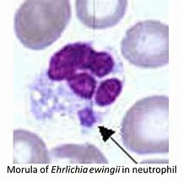
Order : Rickettsiales Genus: Ehrlichia
Diagnosis :
Microscopic examination of stained blood smear revealed morula stage of Ehrlichia in leucocytes.
Ehrlichia canis commonly found in mixed infection with Babesia canis or Hepatozoon canis.
Persistence and duration of ehrlichiosis is usually unnoticed by the owner for long time due to variability in clinical signs.
Morula of E. canis in monocyte
Image source: Google image

Slide 16
Order : Rickettsiales Genus: Ehrlichia
Treatment :-
Doxycycline and Oxytetracycline are used in treatment of ehrlichiosis.

Slide 17
THANK YOU

