Slide 1
Rinderpest
Rinderpest is characterized by high fever, lachrymal discharge, inflammation, hemorrhage, necrosis, Erosions of the epithelium of the mouth and of the digestive tract, profuse diarrhea, and death.
The “four D’s” of Rinderpest:
Depression
Diarrhea
Dehydration
Death
Notes:
LLL

Slide 2
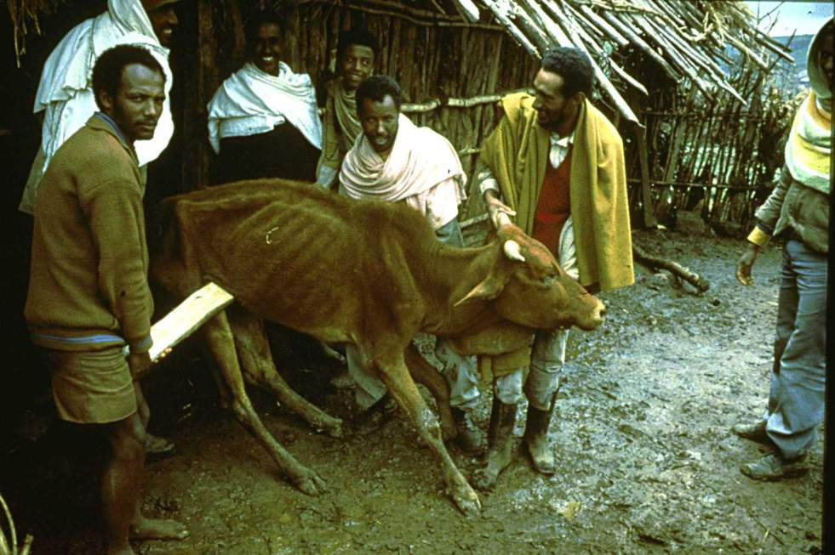
Rinderpest
Notes:
LLL

Slide 3
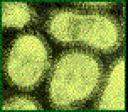
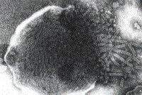
Rinderpest
The virus is relatively fragile and is immunologically related to viruses that cause -
Canine Distemper,
Measles, and
Peste des Petits Ruminants
& Equine infuenza recently described in Austerlia.
Notes:
Image by Dr Suzanne Burnham

Slide 4
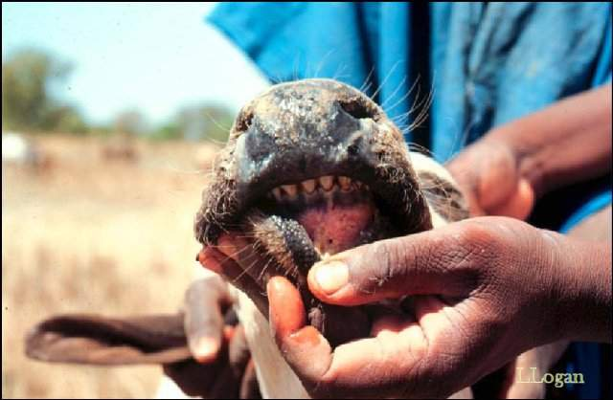
Also known as “cattle plague”
Rinderpest is a mucosal disease
Notes:
Photo courtesy of Dr Linda Logan

Slide 5
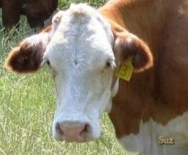
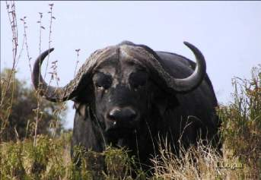
Host Range
All cloven-hoofed animals are susceptible (not all are clinical)
Most clinical cases occur in cattle and water buffalo
Notes:
The host range is very broad.
Many wild ungulates have serological evidence of infection but are not known to sustain clinical disease. It is almost certain that wildlife do not serve to maintain the infection continuously for any length of time. In the absence of infection in domestic livestock, the disease dies out after some time in wildlife, depending on the size of the population. In the case of the 1.5 million wildebeest in the Serengeti National Park it took two to three years for the virus to disappear.
Wildlife species are valuable sentinels – indicators of infection circulating covertly in cattle.

Slide 6
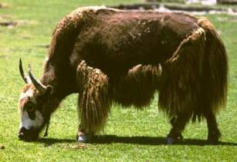
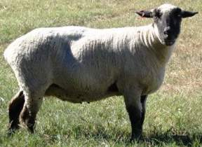
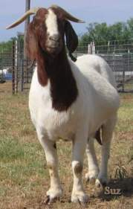
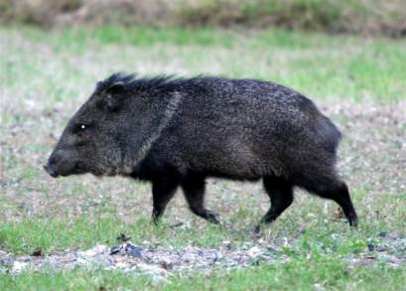
Host Range
Sheep, goats, and yak are mostly subclinical
http://www.geo.arizona.edu/dgesl/research/regional/asian_monsoon_dynamics/yak.htm
Notes:
http://www.geo.arizona.edu/dgesl/research/regional/asian_monsoon_dynamics/yak.htm

Slide 7
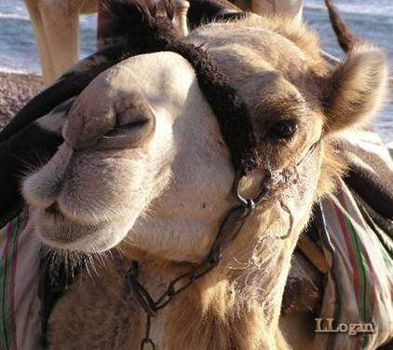
Host Range
Camels – asymptomatic infections only

Slide 8
Host Range – Wild Animals
Most cloven-footed wild animals such as bison and deer
Antelope
Wildebeest
Eland
Giraffe
Hippopotamus
Gazelle
Warthog

Slide 9
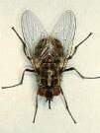
Transmission
Aerosol
Vectors –Tabanids*
Ingestion
Fomites
Krinsky, W.L. (1976) Animal disease agents transmitted by horse flies and deer flies (Diptera: Tabanidae). Journal of Medical Entomology 13(3): 225-275
Notes:
Krinsky, W.L. (1976) Animal disease agents transmitted by horse flies and deer flies (Diptera: Tabanidae). Journal of Medical Entomology 13(3): 225-275

Slide 10
Transmission
There is no vertical transmission, arthropod vector, or carrier state. This makes Rinderpest virus an ideal virus to be targeted for eradication.

Slide 11
Incubation period
Varies with strain of RPV, dosage, and route of exposure (3-15 days)
Normally a range of 3-9 days (can be as short as 3-4 days in experimental infection; also, can be as long as 10-15 days with virus of low virulence)
Duration: 2 or more weeks

Slide 12
Pathogenesis
Inhaled/ Ingestion
Upper Respiratory infectio
Vermia
Target cell ( Lymphocyes & Alimentary Mucosa)
Signs & Lesions.

Slide 13
*Virus is present
in blood and secretions
BEFORE
symptoms appear

Slide 14
General Clinical signs
Fever
Depression
Nasal & lachrymal secretion
Congested mucosas
Mucosal erosions
Severe diarrhea
Leukopenia
Death

Slide 15
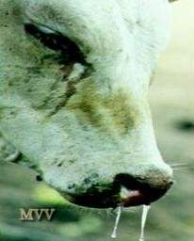
Clinical Signs in cattle
The case definition of rinderpest is ocular and nasal discharges with any two of the additional signs:
fever
erosions in the mouth
diarrhea
dehydration
death

Slide 16
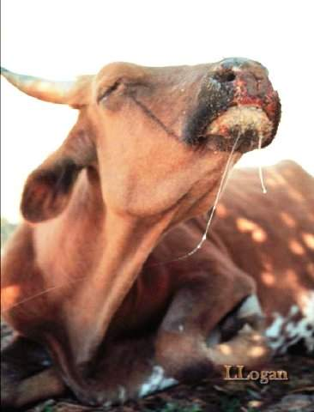
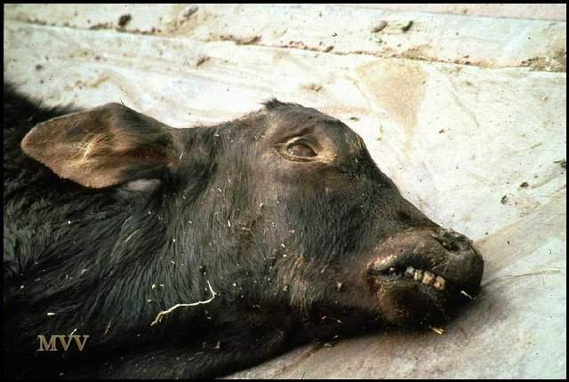
Clinical signs in cattle
Two major forms of disease
Acute or Classic form
Peracute form
Notes:
The behaviour of rinderpest in the population which it is affecting is every bit as characteristic as the clinical signs, lesions and pathology it induces. It is important to stress that field investigations must consider it necessary to take all available information into account.
The behaviour of rinderpest in the population which it is affecting is every bit as characteristic as the clinical signs, lesions and pathology it induces. It is important to stress that field investigations must consider it necessary to take all available information into account.

Slide 17
Clinical Signs in cattle (Peracute Form)
Most often found in highly susceptible young and newborn animals
No prodromal signs
High fever (104-107 °F)
Congested mucous membranes

Slide 18
Clinical Signs in cattle (Acute Form)
Acute (classic) form characterized by pyrexia, erosive stomatitis, gastroenteritis, dehydration, and death
Four stages
Incubation period
Febrile period
Mucous membrane congestion
Gastrointestinal signs

Slide 19
Clinical Signs in cattle (Acute Form)
Fever - 104 to 107°F (40-42°C)
Serous oculo-nasal discharge
Leukopenia
Depression
Anorexia
Constipation followed by diarrhea
Oral erosions
Notes:
Erosions in the mouth
http://www.fao.org/ag/againfo/programmes/en/grep/dis-cli.html#1

Slide 20
Clinical Signs in cattle (Acute Form)
Decreases in fever and viral titer
Diarrhea (may be watery or hemorrhagic)
Dehydration, emaciation
Prostration and death 6 to 12 days after onset of illness

Slide 21
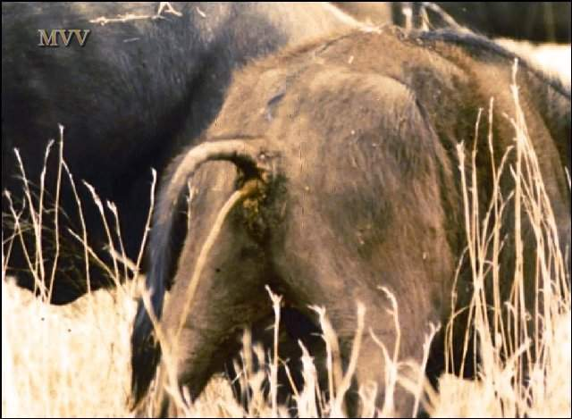
Clinical Signs
“Shooting” diarrhea
Notes:
MVV

Slide 22
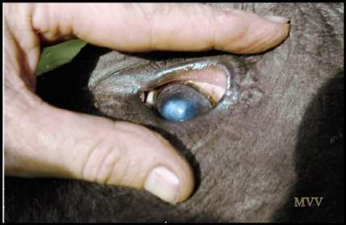
Clinical Signs
In Africa this also includes corneal opacity which has been associated with rinderpest in buffalos and lesser kudus but has also been noted in calves together with dermatitis.

Slide 23
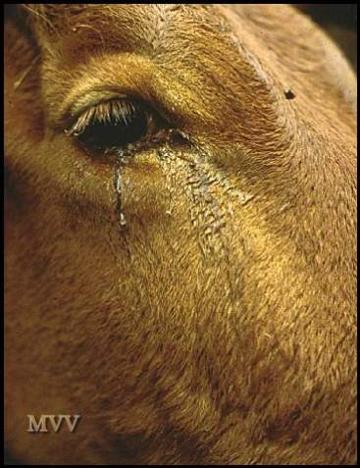
Clinical Signs
Early
serous ocular discharge (Epiphora)
Notes:
After a period of depression, the first physical sign indicating rinderpest is the appearance of clear ocular discharge (lachrymation, epiphora or ‘tearing’) - the Maasai refer to the cattle crying. Clear nasal discharge is frequently present at the same time.
MVV
The tears are a potent source of virus, RNA and virus antigens.
MVV

Slide 24
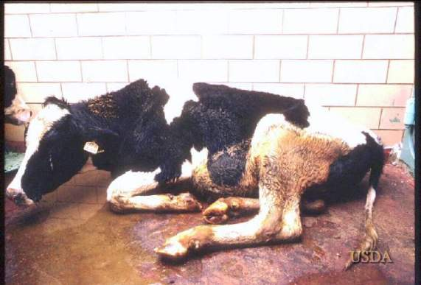
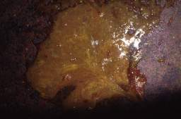
Clinical Signs
Depression
Diarrhea
Dehydration
Death
Notes:
USDA images

Slide 25
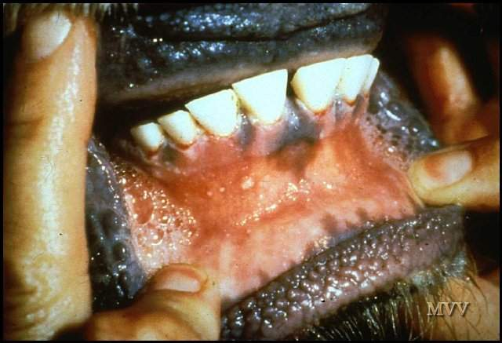
Clinical Signs
Early focal mucosal erosions
Notes:
Lesions are seen at an early stage inside the lips as blanched areas over which the epithelium becomes necrotic and subsequently erodes to leave shallow pits. MVV

Slide 26
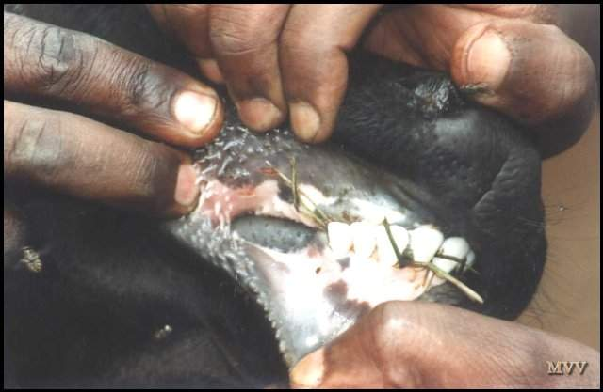
Clinical Signs
Early erosions – rinderpest or trauma ?
Notes:
Such early lesiopns as these may be difficult to differentiate from trauma.lesions caused by abrasive fodder and handling of the tongue.
MVV

Slide 27
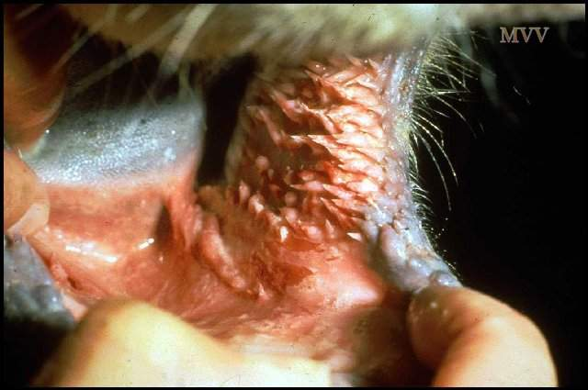
Clinical Signs
Inflammation and necrosis of cheek papillae
Notes:
Necrosis of the cheek papillae is advanced in this case and there also erosions on adjacent buccal mucosa.
MVV

Slide 28
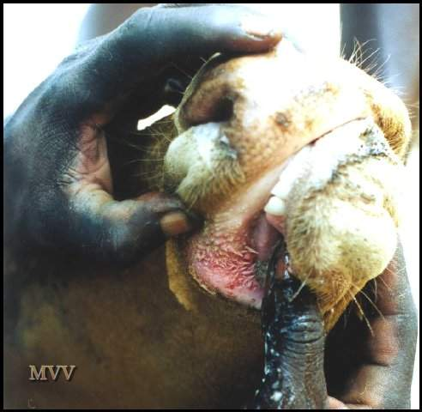
Clinical Signs
Inflammation of cheek papillae
Notes:
The earliest erosions in the mouth are usually seen on the cheek papillae which become first blanched and then reddened as inflammation proceeds and the surface epithelium becomes necrotic and sloughs off..MVV

Slide 29
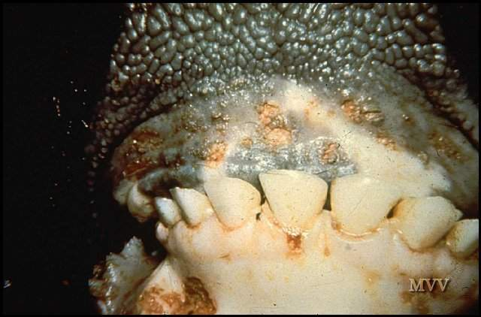
Clinical Signs
Mucosal erosions – “cigarette burns”
Notes:
At first punctate, the lesions tend to enlarge. The erosions here are overlain with necrotic epithelium. There is also a deeper lesion on the gum margin next to a central incisor tooth - a classic site for erosions. MVV

Slide 30
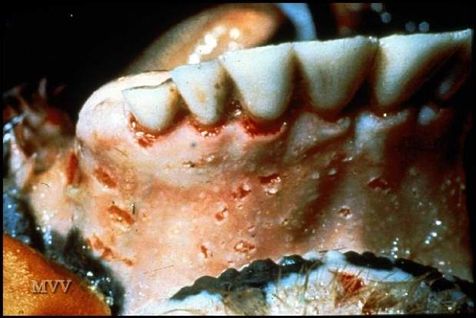
Clinical Signs
Shallow
erosions
in the mouth
Note how these
have a sharp
margin
Notes:
http://vein.library.usyd.edu.au/links/exoticdiseases/rinderpest.html
Another view of discrete, punctate erosions and clearly visible deep erosions around the roots of the incisor teeth.
(van Vuuren)
Image contributed by CSIRO Australian Animal Health Laboratory via FAO, also used by van Vuuren.

Slide 31
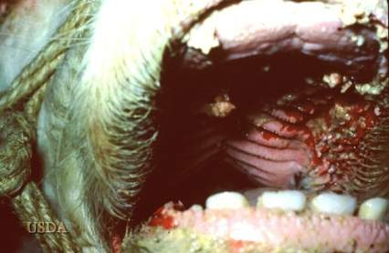
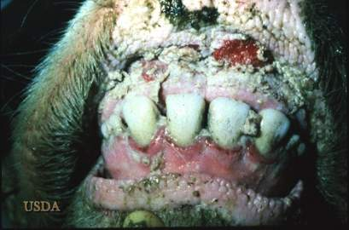
Notes:
USDA

Slide 32
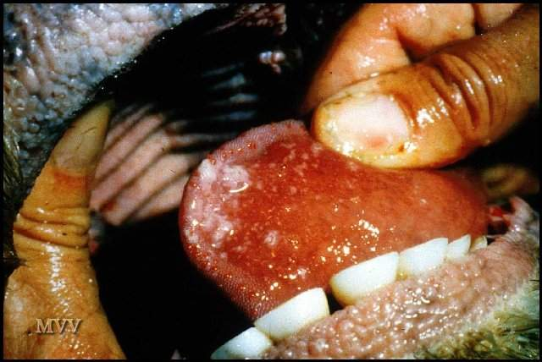
Clinical Signs
Erosion under the tongue
Notes:
Lesions are only infrequently seen under the tongue, almost never on its dorsal surface. MVV

Slide 33
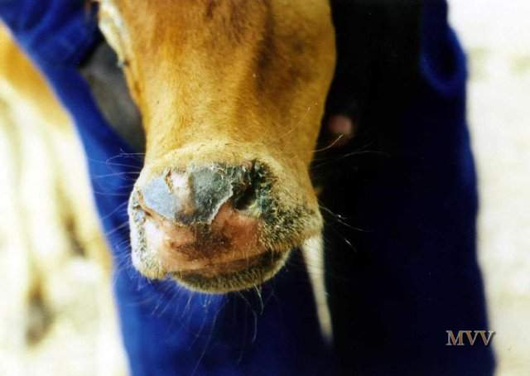
Convalescence
muzzle skin sloughing
Notes:
Peeling of the muzzle epithelium is proceeding in this animal which is well on the road to recovery.
MVV

Slide 34
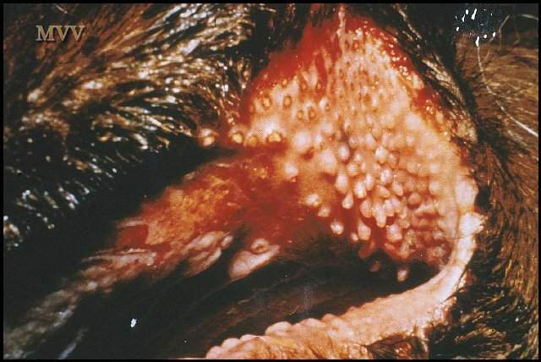
Convalescence
eroded cheek papillae
Notes:
The cheek papillae have completely eroded away and this remains clearly visible. MVV

Slide 35
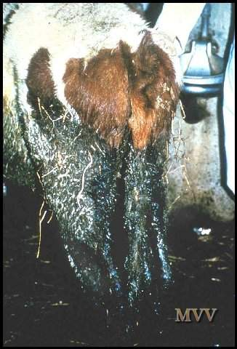
Clinical Signs
Profuse diarrhea and dysentery
Notes:
Diarrhoea can be copious and very liquid. On occasion the faeces may resemble pink water and be passed as a ‘shooting’ stream.
Erosions in the colon and rectum cause tenesmus. MVV

Slide 36
Dehydration, emaciation and collapse
Notes:
The loss of protein and fluid causes rapid dehydration and weight loss. Within days cattle can become too weak to stand. Such animals rarely recover.
Heavy losses were experienced in the Ethiopian Highlands in 1988.
Image can be found at: http://post.queensu.ca/~forsdyke/images/rindpst1.JPG
MVV

Slide 37
Dehydration and death
Notes:
Death results primarily from dehydration.
MVV

Slide 38
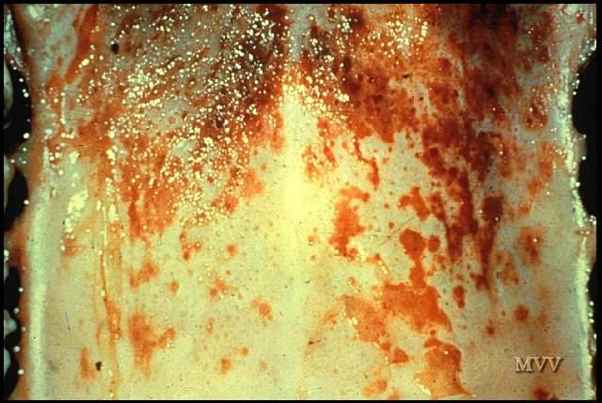
Lesions
Eroded hard palate
Notes:
Extensive erosion of the hard and soft palate is common. MVV

Slide 39
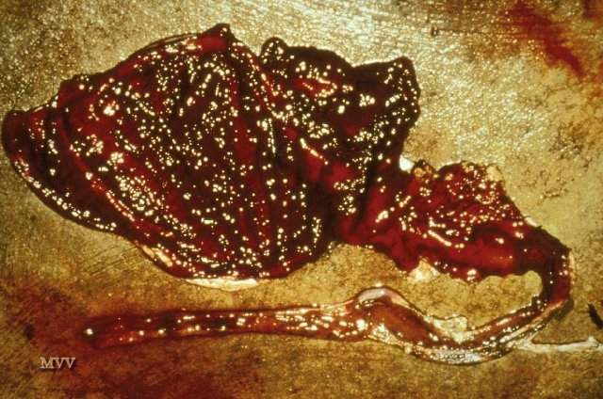
Lesions
Gastro-enteritis
Notes:
GROSS PATHOLOGY
Intense oedema and haemorrhage of the abomasum and duodenum is a frequent finding. Erosions may also be seen on the pillars of the rumen.
MVV

Slide 40
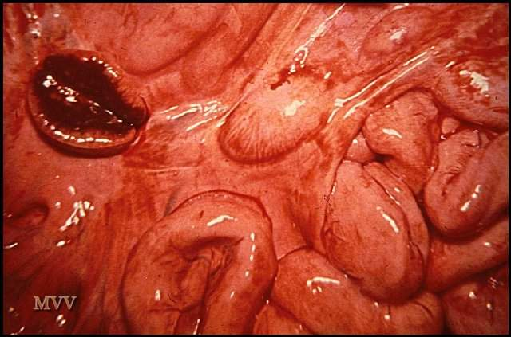
Lesions
Hemorrhagic mesenteric lymph nodes
The virus is lymphotropic as well as epitheliotropic. Lymph nodes throughout the body are at first swollen, oedematous and haemorrhagic, as seen here. Later they become pale and shrunken. The spleen is similarly affected.
Notes:
The virus is lymphotropic as well as epitheliotropic. Lymph nodes throughout the body are at first swollen, oedematous and haemorrhagic, as seen here. Later they become pale and shrunken. The spleen is similarly affected.
MVV

Slide 41
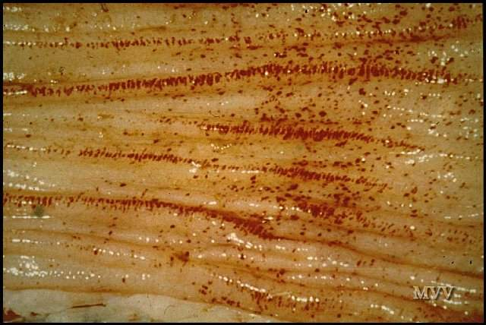
Lesions
Petaechial haemorrhages can be found on the mucosal surface throughout the intestines but in the large intestine they tend to be aligned along the surface of the longitudinal folds.
Linear petaechial haemorrhages in colon
Notes:
Petaechial haemorrhages can be found on the mucosal surface throughout the intestines but in the large intestine they tend to be aligned along the surface of the longitudinal folds.
MVV

Slide 42
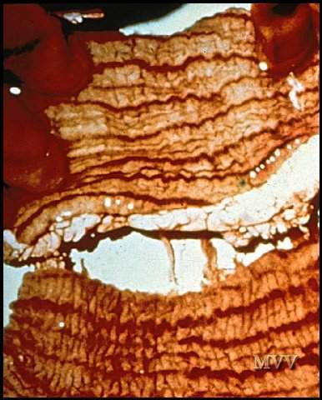
Lesions
The petaechial haemorrhages enlarge and become confluent along the longitudinal folds. After death these stripes become blackened and give rise to the characteristic (but not pathognomic) ‘zebra striping’.
“Zebra striping” in the colon
Notes:
The petaechial haemorrhages enlarge and become confluent along the longitudinal folds. After death these stripes become blackened and give rise to the characteristic (but not pathognomic) ‘zebra striping’.
MVV

Slide 43
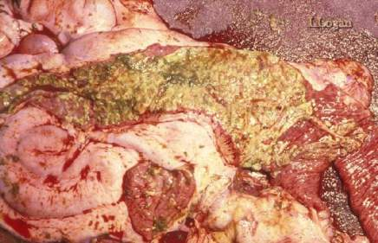
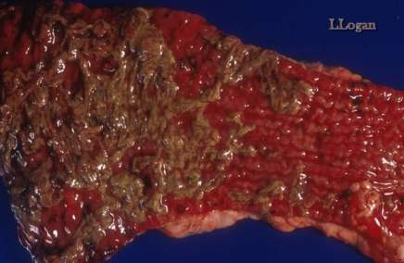
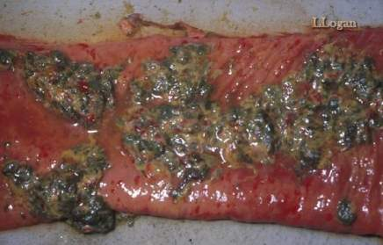
Lesions
Virus replicates in intestinal epithelium and kills it dead, creating horrendous ulcers”
Notes:
LLL “Virus replicates in intestinal epithelium and kills it dead, creating horrendous ulcers”

Slide 44
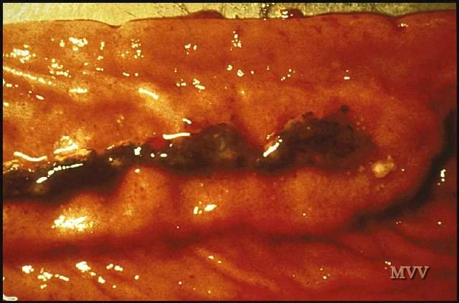
Lesions
Hemorrhagic Peyer’s patches
Oedema and necrosis of the Peyer’s patches is a common feature. Later they are shrunken and may be frankly necrotic.
Notes:
Oedema and necrosis of the Peyer’s patches is a common feature. Later they are shrunken and may be frankly necrotic.
MVV

Slide 45
Diagnosis
Samples:
Conjunctival Fluid
Intestinal contents or feces
Whole blood
Lymphoid tissue, lung, intestine
Serum
A definitive diagnosis require laboratory confirmation based on detecting viral antigens, the presence of microscopic lesions, and by isolating and identifying the virus. Laboratory confirmation depends on the collection of suitable samples from a group of animals, preferably in the febrile stage with oral lesions rather than from animals already dying, with profuse diarrhea.
Notes:
A definitive diagnosis require laboratory confirmation based on detecting viral antigens, the presence of microscopic lesions, and by isolating and identifying the virus. Laboratory confirmation depends on the collection of suitable samples from a group of animals, preferably in the febrile stage with oral lesions rather than from animals already dying, with profuse diarrhea.

Slide 46
Differential Diagnosis
Bovine virus diarrhea
Mucosal disease
Infectious bovine rhinotracheaitis
Malignant catarrhal fever
Vesicular stomatitis
Foot-and-mouth disease

Slide 47
Differential Diagnosis
Salmonellosis
Necrobacillosis
paratuberculosis
Bluetongue / EHD
Mycotic Stomatitis
Notes:
LLL

Slide 48
Diagnostic Tests
Antigen Detection
Antibody Detection
Histopathology
Blood should be collected in both serum and EDTA tubes. Swabs of clear tears, necrotic debris from gums and aspiration biopsies from superficial lymph nodes are also recommended.
Virus isolation requires samples of spleen, lymph node and/or tonsils from a freshly euthanized animal
Notes:
Blood should be collected in both serum and EDTA tubes. Swabs of clear tears, necrotic debris from gums and aspiration biopsies from superficial lymph nodes are also recommended.
Virus isolation requires samples of spleen, lymph node and/or tonsils from a freshly euthanized animal

Slide 49
RINDERPEST
Synonym : Cattle plaque
Definition
Acute, highly contagious viral disease of cattle characterized by high fever, necrotic stomatitis, gastroenteritis, diarrhoea and high mortality caused by morbillivirus
In India "Hill Zebu cattle" are more susceptible than "Plain zebu cattle". This disease is characterized by necrosis, and erosions of the mucosa in the respiratory and digestive tracts.
Etiology
Morbillivirus
The virus is antigenically closely related to the viruses of canine distemper, PPR of sheep and goats and measles of humans.
Incidence

Slide 50
Incidence
The disease has been the foremost cause of death in cattle in most African and Asian countries including India
Rinderpest has not been reported since June 1995 in Indian suncontinent
The seriousness of disease madeto start first Veterinary College in 1762 at Lyons, France.
Susceptibility
Mainly cattle and buffaloes, but also reported in sheep,goat and pigs
Reported in deer, antelope, wild buffaloes, wild boars, bushbuck, warthogs and giraffe
Mortality is 100 % in exotic breeds and 20-50 % mortality in indigenous breeds

Slide 51
Transmission
Incubation period is 2 to 3 days in experimental inoculation and in contact infection is 6 to 9 days
Virus excreted in body secretions
Ingestion of contaminated feed and water
Inhalation (or) mechanical transmission

Slide 52
Pathogenesis
The virus is inhaled in infected droplets
It penetrates through the epithelium of upper respiratory tract and multiplies in the tonsils and regional lymph nodes
From here it enters the blood in mononuclear cells which disseminate to other lymphoid organs, lungs and epithelial cells of mucous membranes
Rinderpest virus has a high degree affinity for lymphoid tissue and mucous membrane of alimentary tract
Pronounced destruction of lymphocytes in tissues and it is responsible for marked leucopoenia
Focal necrotic stomatitis and enteritis are the direct result of viral infection and replication in the epithelial cells in the alimentary tract.
Death is usually from severe dehydration but in less acute cases, death may be from activated latent parasitic or bacterial infections
These infections aggravate because the animal is immunosuppressed as a result of destruction of lymphoid organs by the virus
Clinical Signs

Slide 53
The course of the disease comprises of 4 stages.
I stage : Incubation period
2-9 days. It depends according to the strain and dose of the virus.
The virus multiplies rapidly in the lymphoid tissue, lungs, bone marrow and intestines.
Active proliferation of the virus in the tissue results in fever.
II stage : Prodromal phase
There is first rise in temperature - 105-107°C (41-42°C) and lasts for about 3-5 days until the appearance of lesions in the mouth.
Animal shows depression, restlessness and anorexia.
Muzzle is dry, starry coat and initial constipation noticed, Leucopenia with onset of fever and persists till death.

Slide 54
III stage : Mucosal phase
Mouth lesions on the inner lips and adjacent gums. Visible mucous membranes are congested.
The mouth lesions are greyish foci with necrotic centers and shallow erosions with bleeding.
Ulcers with bran like deposits noticed. Smacking as in FMD is not common. Animal is restless and shows excess thirst.
Temperature is high and recedes after that diarrhoea begins.
Rapid dehydration, marked weakness and severe progressive emaciation leads to death.

Slide 55
IV stage : Diarrhoeic phase
About three days after the appearance of the mucosal ulcers fever regresses and profuse diarrhoea develops.
The dark fluid faeces often contain mucus, necrotic debris and blood. Dehydration and wasting soon become evident.
Severely affected animals may collapse and die within 12 days of the onset of clinical signs.
In surviving animals convalescence lasts several weeks.

Slide 56
V stage : Convalescent phase
Mouth lesions start healing. Rapid regeneration of the affected epithelium noticed.
Slow recuperation of general health. Mortality in cattle, sheep and goats and pigs is 90%.

Slide 57
Clinical Signs
Fever (104-105 ⁰F), restlessness, dryness of the muzzle and constipation
Other signs include photophobia, excessive thirst, starry coat, retarded rumination, anorexia and excessive salivation
Rashes may develop in those parts of the body where the hair is fine in nature
Mucous membrane of lips, gums and tongue revealed small vesicles resembling bran like deposits
'Shooting diarrhoea' with foetid odour
Dehydration
Marked leucopoenia with drop in lymphocyte count

Slide 58
Gross lesions
Virus produce lesions in the oral mucosa after settling in the cells following a viremic state
Fore stomach are free
Abomasum reveals necrotic foci and haemorrhagic streaks more seen at the pyloric region.
Folds of abomasum are thick and oedematous
If the disease progress, abomasal mucosa shows irregular ulcers of different size.
The virus has got affinity for lymphoid tissue and in the intestine, peyer's patches are swollen and ulcerated
Duodenum and ileum revealed streaks of haemorrhages and erosions

Slide 59
In the large intestine, ileo caecal valve may be markedly swollen
Linear haemorrhages on the folds of mucosa of rectum appear like 'Zebra marking' which is pathognomonic in Rinder pest
Lesions are more severe in large intestine with ulceration and diphtheitic patches
Liver: Chronic passive congestion resulting from cardiac and pulmonary complications
Petechiae and erosions in the larynx
Tracheal haemorrhages
Alveolar and interstitial emphysema
Subepithelial and subendocardial haemorrhages
Petechiae and erosions may be seen in the bladder and vagina
Purulent conjunctivitis and ulceration of cornea may be noticed
In sheep and goat, mouth lesions are usually not seen

Slide 60
Microscopic lesions
Epithelial surface reveals ulcers, haemorrhages, oedema, necrosis and leucocytic infiltration along with multinucleated cells
Eosinophilic cytoplasmic inclusion bodies form in the mucosal epithelial cells and giant cells. Intranuclear inclusion bodies are rare.
Diagnosis
Symptoms and lesions
Complement fixation test (CFT)
Agar Gel Precipitation Test (AGPT)
Virus isolation and diagnosis on tissue cultures
Using specific cDNA probes, isolates of rinderpest and PPR viruses can be differentiated presently
Polymerase chain Reaction (PCR)
Eradicated science

