Slide 1
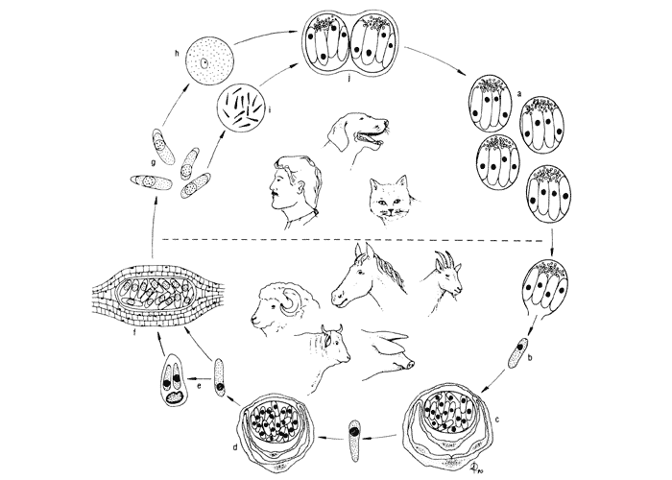
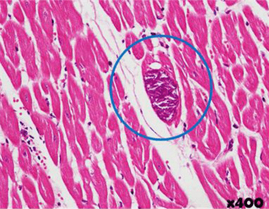
Sarcocystis
Dr. AJIT KUMAR
HoD
Department of Parasitology
Bihar Veterinary College
Bihar Animal Sciences University
Patna-800014
Image source: Google image

Slide 2
Family: Sarcocystidae
Salient features :
Members are tissue cyst forming coccidia.
Heterogeneous parasites.
Sexual stage found in final host and asexual stage is found in intermediate hosts.
Genus: Toxoplasma, Sarcocystis, Neospora, Besnoitia and Hamondia.

Slide 3
Sarcocystis spp.
Name derived from the Greek words Sarkos means flesh and Kystis means cyst.
It is a tissue cyst forming coccidia.
Sexual stages found only in definitive hosts which is carnivores and asexual stages occur only in the intermediate host.

Slide 4
Sarcocystis spp.
Definitive (Final ) host:- Usually Dog, cat and Man
Intermediate host :- Cattle, buffalo, sheep, goat, pig, horse
Location – Found in small intestine of final host and muscle of intermediate hosts.

Slide 5
Sarcocytsis species
Species | Definitive host | Final host
Sarcocystis cruzi | cattle | Dog
S. hominis | cattle | man
S. tenella | Sheep | Dog
S. gigantiea | Sheep | Dog
S. capracanis | Goat | Dog
S. hircicanis | Goat | Dog
S. fusiformis | Water buffalo | Dog
S. miescheriana | Pig | Dog

Slide 6
Sarcocytsis species
Species | Definitive host | Final host
S. suihominis | Pig | Man
S. porcifelis | Pig | Cat
S. neurona | Horse | Opposum
S. gigantiea | Sheep | Dog
S. capracanis | Goat | Dog
S. fusiformis | Water buffalo | Dog
S. miescheriana | Pig | Dog

Slide 7
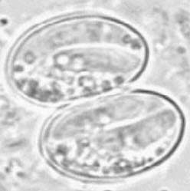
Sarcocystis spp.
Each sporulated oocyst contains two sporocysts and each sporocyst contains four sporozoites.
Sporulation occurs inside the host.
Image source: Google image

Slide 8
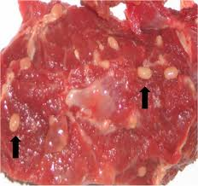
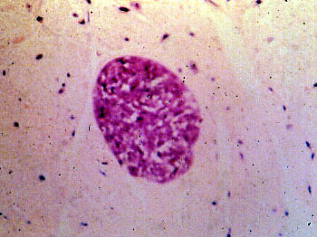
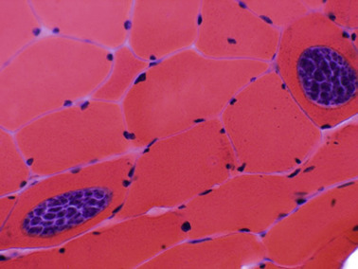
Sarcocystis spp.
Different stages of Development:-
Sarcocyst- Terminal asexual stages found encysted primarily in the striated muscles of intermediate hosts.
Metrocysts ( mother cells)- Immature sarcocysts contain globular parasites called metrocysts.
Bradyzoites (zoites)- Metrocysts form banana- shaped bradyzoites by endodyogeny type of asexual repooroducxtion.
Image source: Google image

Slide 9
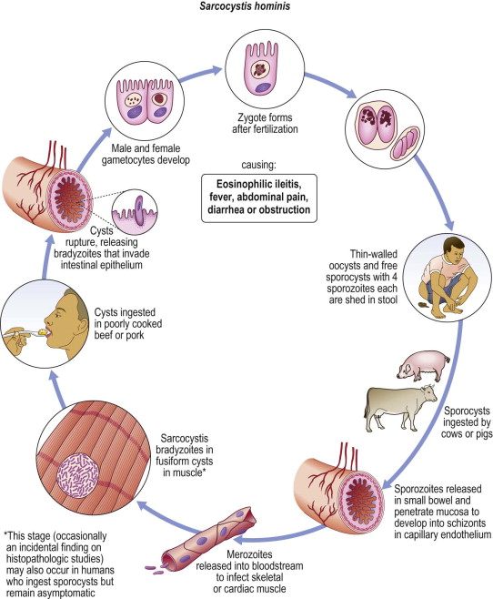
Life-cycle of Sarcoystis sp.
Image source: Google image

Slide 10
Infective stages of Sarcocystis spp.
Infective stage for definitive hosts –
Cyst containing bradyzoites.
Infective stage for Intermediate host-
Sporulated oocysts.

Slide 11
Transmission of Sarcocystis spp.
Transmission of infection :-
Final hosts get infection by the ingestion of sarcocysts or bradyzoites containing meat.
Intermediate hosts get infection by the ingestion of sporulated oocysts containing feed and water.

Slide 12
Life- cycle of Sarcocystis spp.
Final hosts get infection by the ingestion of sracocyst or bradyzoityes containing meat. of infected intermediate host.
Bradyzoites are liberated from the sarcocysts after digestion by the G.I. juices.
Bradyzoites enter lamina propia of villi and small intestine and form micro - and macrogamonts.

Slide 13
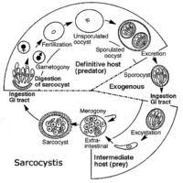
Life-cycle of Sarcocystis spp.
Image source: Google image

Slide 14
Sarcocystis spp.
Fusion of micro and macrogamets results formation of oocyst which sporulated in the intestine and free sporocyst are passed with faces of the infected hosts.
Intermediate host get infection by the ingestion of sporulated oocysts containing feed and water.

Slide 15
Sarcocystis spp.
After excystation, sporozoites are released and enter capillaries of the different organs.
Sporozoites after schizogony process form merozoites which transform into sarcocysts in the muscles cells of tongue, heart, diaphgram etc.

Slide 16
Sarcocystis spp.
Pathogenesis & Symptoms –
Sarcocystis cruzi is the most pathogenic species in cattle.
Symptoms include anorexia, fever, marked loss of hair at the end of the tail often in cattle, submandibular oedema, exophthalmia, haemorrhages on the serous surface of viscera, neurolical signs, Lymphadenopathy enlargement of lymph nodes, cysts in myocardium, oesophagus, tongue and masseter muscles and abortion in breeding stock.
It caused disease in cattle is known as Dalmeny disease in Canada, USA and UK.

Slide 17
Sarcocystis spp.
Pathogenesis & Symptoms –
Sarcocystis tenella is most pathogenic species of sheep which caused abortion, myositis, encephalomyelitis and dog sitting posture in lamb.
Sarcocystis neurona causes a serious neurological disease of horses called Equine Protozoal Myeloencephalitis (EPM) which leads ataxia, muscular weakness etc.

Slide 18
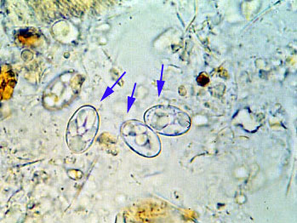
Diagnosis of Sarcocystis spp.
In final host:
Microscopic examination of faeces revealed sporocyst containing four sporozoites.
Image source: Google image

Slide 19
Diagnosis of Sarcocystis spp.
In intermediate host:-
On the basis of clinical signs like anorexia, fever, abortion, dog sitting posture in lambs etc.
P.M. examination :- By digesting striated muscles in Pepsin–HCl revealed sarcocysts on microscopic examination or naked eyes.
Other serological tests like CFT, IFAT, ELISA etc.
Molecular test like PCR.
Image source: Google image

Slide 20
Sarcocystis spp.
Treatment :-
Use of prophylactic anticoccidials may prevent or minimize sarcocystis infection in the intermediate hosts.
Amprolium in calves, Salinomycin in sheep and Halofuginone in goats reduced or prevent acute sarcocystosis.

Slide 21
Sarcocystis spp.
Control :-
Raw or undercooked meat or offal should not be fed to dog.
Man should consume properly cooked meat.
Dogs and cats should not be entered inside animal premises.
Epm vaccine contains in vitro cultured merozoites, chemically inactivated used against S. neurona in horse.

Slide 22
THANK YOU

