Slide 1
Class Lecture
TYPES OF CREAM SEPARATORS
Dr. Sanjeev Kumar
Associate Professor
Department of Dairy Technology
SGIDT, Patna-14

Slide 2
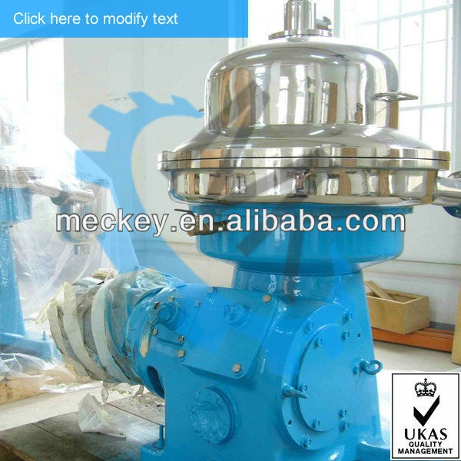
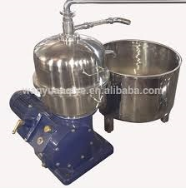
DIFFERENT TYPES OF SEPARATORS
WARM MILK SEPRATOR
SEMI ENCLOSED SEPARATOR

Slide 3
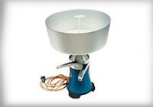
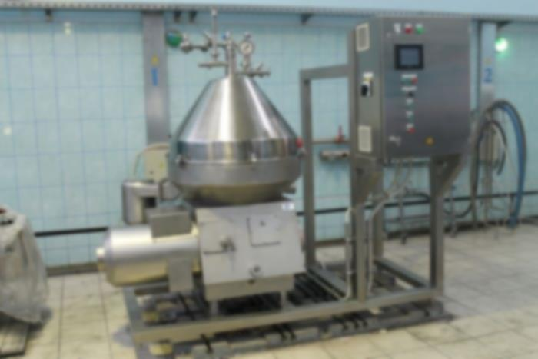
COLD MILK SEPARATOR
POWER DRIVEN SEPERATOR

Slide 4
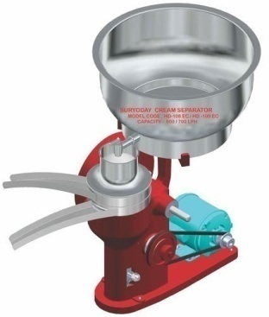
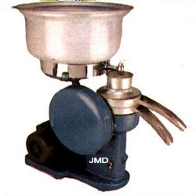
HAND DRIVEN SEPARATOR
OPEN BOWL SEPARATOR

Slide 5
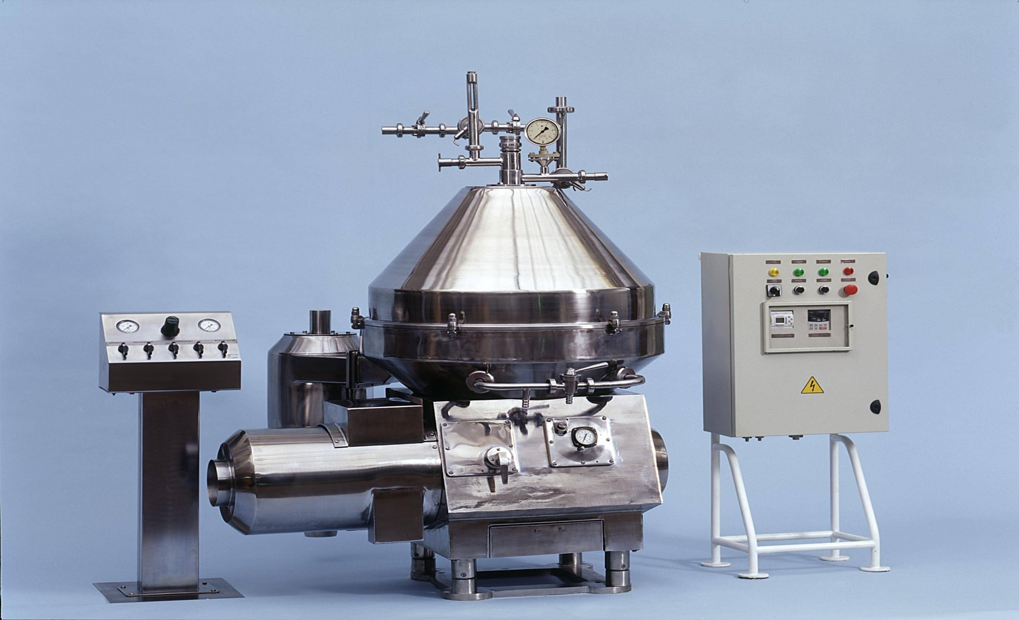
HERMATICALLY SEALED SEPARATOR

Slide 6
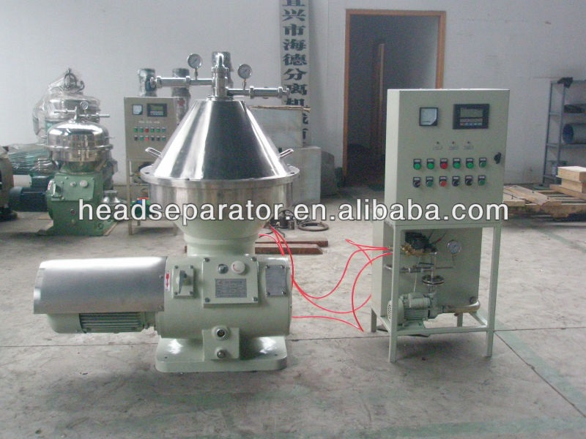
SELF CLEANING SEPARATOR

Slide 7
Fat recovered in cream
%fat recovered in cream= kg fat in cream * 100
kg fat in milk
Fat lost in skim milk
% fat lost in skim milk= kg fat in skim milk * 100
kg fat in milk
= fc-fm * fs * 100
fc-fs fm

