Slide 1
Veterinary Clinical Pathology
Dr. Kaushal Kumar
Assistant Professor and Head
Department of Veterinary pathology
Bihar Veterinary College,
Bihar Animal Sciences University, Patna, Bihar

Slide 2
Topics
A
Different Anticoagulants used in Haematology
B
Interpretation of blood test/ Haematology
C
Blood smear examination and its interpretation

Slide 3
What is clinical pathology?
It covers a wide range of laboratory functions and is concerned with the diagnosis, treatment, and prevention of disease.
It supports the diagnosis of disease using laboratory testing of blood and other bodily fluids, tissues, and microscopic evaluation of individual cells.

Slide 4
Importance/Role of Clinical Pathology
“No wonder that drug is a wonder than diagnosis of a doctor”

Slide 5
Types of specimens used in clinical pathology
Blood (Blood is used in many tests. Blood can either be examined
as a "whole,"
as plasma (the fluid left when red and white blood cells are removed),
or as serum (a clear fluid that separates from blood when it clots).
Urine
Sputum/phlegm
Faeces
Other body fluids (like plural fuid, bone marrow spinal fluid, joint fluid, Rumenal fluid etc)

Slide 6
Anticoagulant (An agent that is used to prevent the formation of blood clots)
The common anticoagulants used are
Ethylenediamine tetra acetic acid ( Na or K salt of EDTA),
sodium citrate and
heparin.
Sodium oxalate
Potassium oxalate
CPD (citrate phosphate dextrose) /ACD (acid citrate dextrose ) solution
Sodium fluoride and thymol (10:1)

Slide 7
EDTA
Recommended for routine hematology. It prevents blood from clotting by binding or chelating (binding) the calcium ions from the blood (calcium ions are necessary for blood to clot). Blood collected into EDTA is used for routine haematology tests.
Trisodium citrate
It is used to collect blood for coagulation studies. Samples must be gently mixed immediately after collection. Trisodium citrate chelates calcium ions from the blood (calcium ions are necessary for clotting).
Amount required: 10mg for 10ml blood
Heparin
A poor anticoagulant for blood cell studies.(may cause leukocyte clumping and interfere its stainability ) Used for some specialized blood biochemistry and blood pH studies. Heparin prevents blood coagulation by inhibiting the action of thrombin. Thrombin is an activated coagulation protein that converts fibrinogen to fibrin.
Amount required: 1-2 mg (0.2ml of 1%sol^{n}) for 10ml blood
Amount required: 10mg for 10ml blood

Slide 8
Haematology
It is the study of the cells and proteins found in blood.
A complete blood count consists of the following tests:
Hemoglobin determination
Hematocrit /PCV reading
Total Erytherocyte count
Erytherocytic indices
Erytherocytic Sedimentation Rate
Total leukocyte count
Differential leukocyte count

Slide 9
Hematological tests
General consideration /
Principle of test
Methods
Interpretation

Slide 10
HEMOGLOBIN DETERMINATION or Hemoglobinometry
It is the measurement of the concentration of hemoglobin in the blood
Measured in gm/dl of blood
Methods are
Cyanmethemoglobin (automated )method
Acid Hematin Method(Haden-Hausse and Sahli-Hellige methods )

Slide 11
HEMOGLOBIN DETERMINATION by Cyanmethemoglobin method
This procedure is based on the oxidation of hemoglobin and formation of methemoglobin in the presence of alkaline potassium ferricyanide.
Methemoglobin reacts with potassium cyanide to form cyanmethemoglobin, which has maximum absorption at 540 nm.
The color intensity measured at 540 nm is proportional to the total hemoglobin concentration.

Slide 12
HEMOGLOBIN DETERMINATION by cyanmethemoglobin method
Hb+ ferricyanide metheoglobin
Cyanide ions
Cyanmethemoglobin
Stable red compound
Measured calorimetrically
Intensity is directly proportional to amount of Hb in the sample

Slide 13
Steps of cyanmethemoglobin method
Place 5 ml of Drabkin solution in a test tube
Get 0.02ml of blood in shalis pipette
Place it in Drabkin reagent through rinsing it
Mix and let it stand for 8-10 min
Read in spectrophotometer at 540 nm
Drabkin's reagent: sodium bicarbonate ( alkaline ), potassium ferricyanide, and potassium cyanide

Slide 14
HEMOGLOBIN DETERMINATION By Haden-Hausse /Sahli-Hellige methods
Principle: Blood is mixed with dilute (N/10) hydrochloric acid. This process hemolyzes the red cells, disrupting the integrity of the red cells’ membrane and causing the release of hemoglobin, which, in turn, is converted to a brownish-colored solution of acid hematin.
The acid hematin solution is then compared with a color standard.

Slide 15
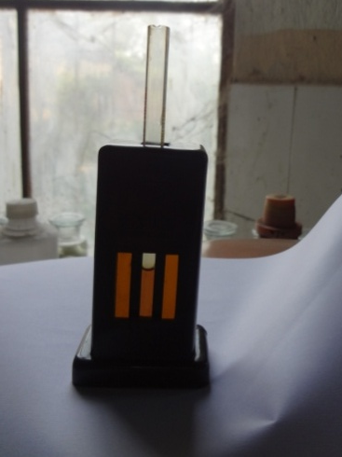
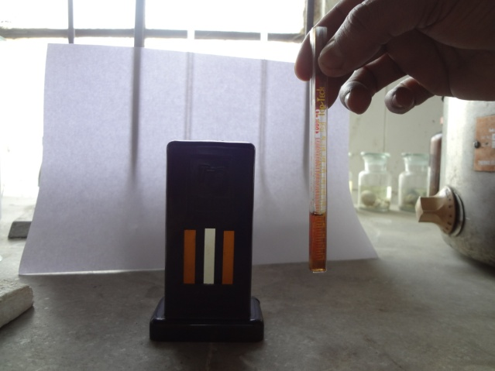
Instruments required for Sahli methods

Slide 16
Interpretation of Hb detrmination
Hemoglobin values are affected by Age, Sex, Pregnancy, Disease, and Altitude.
Below-normal hemoglobin values:
During pregnancy, gains in body fluids cause the red cells to become less concentrated, causing the red cell count to fall. Since hemoglobin is contained in red cells, the hemoglobin concentration also falls.
Disease may also affect the values of hemoglobin. For example, iron deficiency anemia may drop hemoglobin values from a normal value of 14 grams per 100 milliliters to 7 grams per 100 milliliters.
Above-normal hemoglobin values: may occur when dehydration develops. Changes in altitude affect the oxygen content of the air and, therefore, also affect hemoglobin values. At higher altitudes there is less oxygen in the air, resulting in an increase in red cell counts and hemoglobin values. At lower altitudes there is more oxygen, resulting in a decrease in red cell counts and hemoglobin values.
Normal range for haemoglobin determinations are as follows:
Dog :12-18gm/dl
Cattle :10-15gm/dl

Slide 17
Packed cell volume(Hematocrit)
The hematocrit or packed cell volume (PCV) determines the percentage of red blood cells (RBCs) in whole blood.
Two Methods:
1. Wintrobe method
2. Microhematocrit method
Both methods call for the blood to be centrifuged, and the percentage of packed red cells is found by calculation

Slide 18
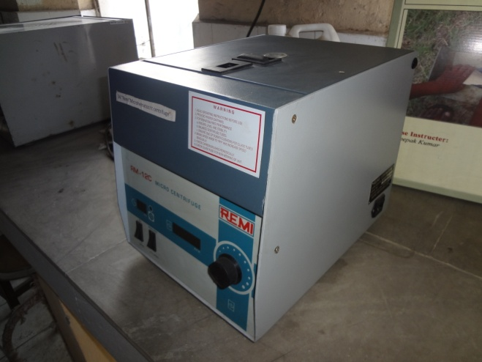
Equipment required for PCV estimation
Wintrobe method Microhematocrit method
Centrifuge Machine
Wintrobe tube
Special Wintrobe tube pipette
Microhaematocrit Centrifuge Machine
Microhematocrit reader
Plane capillary tube

Slide 19
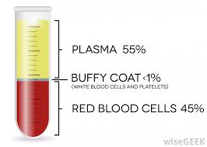
Methods for PCV determination
Use a suitable centrifuge at an rpm that could provide a sufficient centrifugal force adequate to provide maximum packaging
Wintrobe method
3000-4000 rpm for 30 min(dog and Horses)
for 60 min(cattle ,pig,sheep,goat)
Microhematocrit method
10,000-13,000 rpm for 5 min for all
15,000-16,000 rpm for 2 min for all

Slide 20
Interpretation of PCV
The normal hematocrit value
Dog is 45(40% to 52%);
Cattle35(24% to 47%);
Below normal- medical conditions such as anemia and leukemia may be present.
Above-normal- hematocrit determinations indicate medical conditions like dehydration, such as occur in severe burn cases. Haemoconcentration in fasting and some cachectic diseases condition.
It is inadvisable to interpret the PCV of young animal by using adult normal range.

Slide 21
Interpretation of PCV
Age influences the normal PCV range
Dog
As pup starts to ingest solid food PCV begins to increase
Cattel
PCV and Hb are higher at birth but are reduced as soon as the calf begins to nurse(input of iron is low in diet)
Age | PCV
3week | 32%
2-4 month- | 32-45%
4-6month- | 35-52%
6-8 month | 41-55%
Age | PCV | Hb
Birth | 42 | 15
2 month | 35 | 11
24 month | 32 | 10

Slide 22
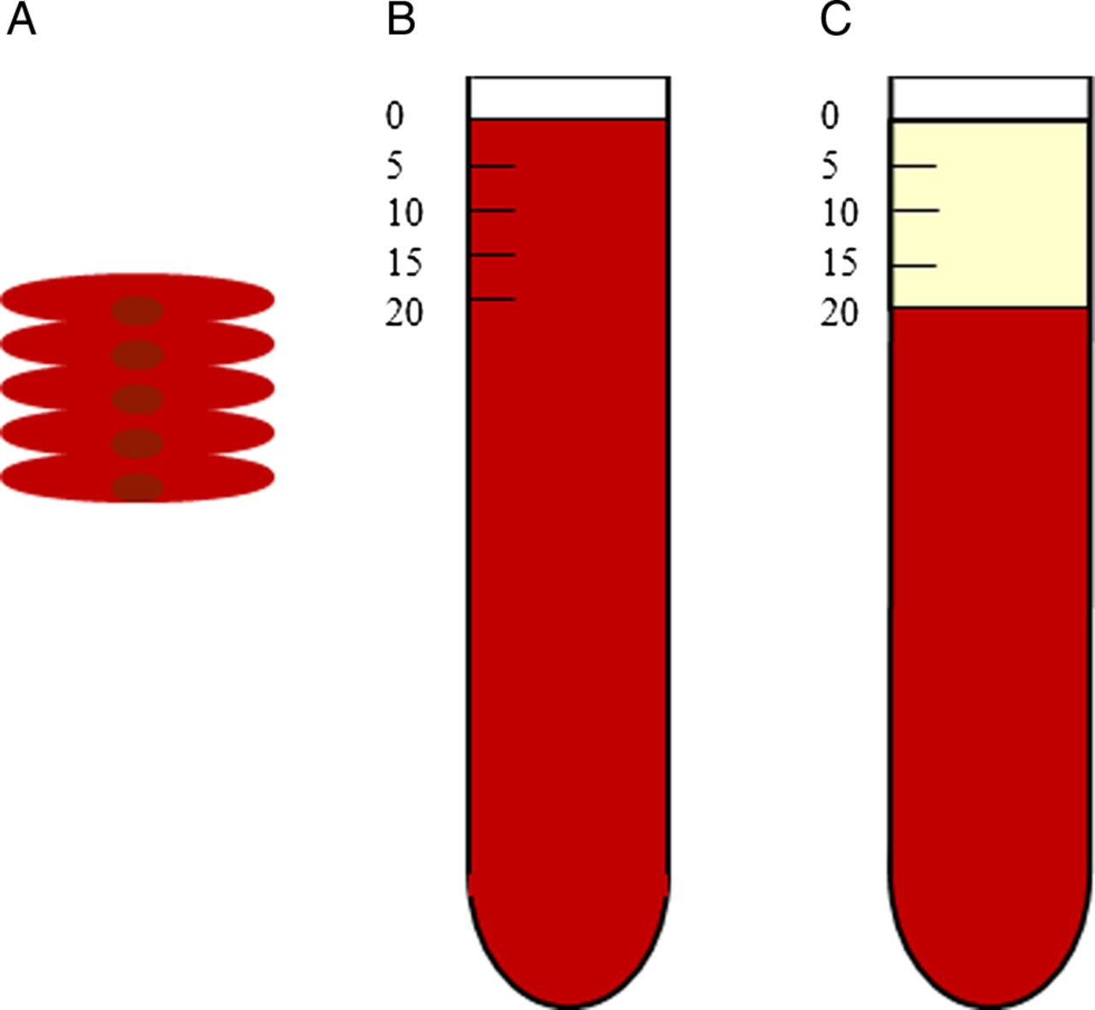
Erytherocyte Sedimentation Rate
Ubiquitously used technique in medicine as a marker of systemic illness.
Principle:
The test involves placing anticoagulated whole blood into an upright test tube and monitoring the rate at which red blood cells (RBC) fall over time and measured in millimeters.

Slide 23
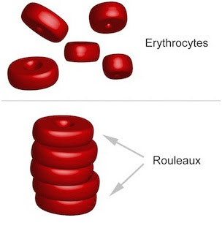
ESR-Principle
Plasma protein (especially fibrinogen) adhere to the RBC membrane and nutralizes the surface negative charges promoting cell adherence and rouleaux formation.
ESR is directly proportional to Wt. of a cell aggregate. & indirectly proportional to surface area

Slide 24
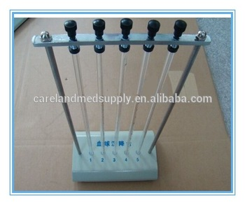
Methods Of ESR estimation
(It uses the same wintrobe hematocrit tube (previously used for PCV)and the numbers on left of the scale down 0 to10cm is used. And it is possible to correct the ESR according to a correction chart developed by wintrobe and Landsberg).
1. Wintrobe Method
2.Westergren Method
(most commonly used method of performing the ESR)
westergren tube: Total length-300mm
Diameter -2mm
Capacity-1ml
Graduation-0to200at1mm interval

Slide 25
Interpretation of ESR
Normal ESR Value:
Horses: 50(25-60)mm at 30min
Dog: 15(8-25)mm at 1 Hr
Cattle: 2(2-4)mm at 24Hr
Tendency for rouleaux formation varies tremendously among different species- Horses- Intense rouleaux formation
Dog/cat- moderatly
Ruminants-Absent in health
Non specific test for inflammatory processes.
It is used as monitoring tools for response to treatment in condition in which it is raised (TB,AID)

Slide 26
Interpretation of ESR
Used extensively in human medicine and canine practice.
It is not diagnostic of any one disease.
Serves as guide to prognosis
Normal ESR value doesn`t exclude the possibilities of diseases process.
General condition where ESR increases-
Infections
Skin infection
Tissue injury,
Malignant tumour
Pregnancy(Anaemia,cholesterolemia & increased Fibrinogen
Negative ESR—Low plasma protein Concentration
Liver diseases
Poor Nutrition

Slide 27
When a patient has a lower than normal hemoglobin, it is important to determine whether red blood cells are of normal size and if they have a normal concentration of hemoglobin. These measurements, known as erythrocyte or red blood cell indices, provide important information about various types of anemias.

Slide 28
Erythrocyte or red blood cell indices
Mean corpuscular volume (MCV)
Measures the mean or average size of individual red blood cells.
Mean corpuscular hemoglobin (MCH)
Measures the amount, or the mass, of hemoglobin present in one RBC.
Mean corpuscular hemoglobin concentration (MCHC)
Measures the proportion of hemoglobin in the RBC in percentage.
The hemoglobin is divided by the hematocrit and multiplied by 100 to obtain the MCHC.
To obtain the MCV, the hematocrit is divided by the total RBC count.
It is obtained by dividing the hemoglobin by the total RBC count.
The results are reported in percentages(%)
The results are reported in picogram (pg)
The results are reported in femoliters (fl)

Slide 29
Interpretation of erytherocytic indices
Normal values for erythrocyte indices of a healthy Dog are:
MCV values are higher in newborns and infants
80-98 fl (femoliters)
MCH -:17-31 pg (picograms)
MCHC: 32-36%
Abnormal erthryocyte indices are helpful to classify types of anemia.
Normal MCV, MCH and MCHC --- normocytic, normochromic anemia
--- most often caused by acute blood loss
Decreased MCV, MCH, and MCHC --- microcytic, hypochromic anemia
--- most often caused by iron deficiency
Increased MCV, variable MCH and MCHC --- macrocytic anemia
most often caused by Vitamin B12 deficiency (due to pernicious anemia) and folic acid deficiency

Slide 30
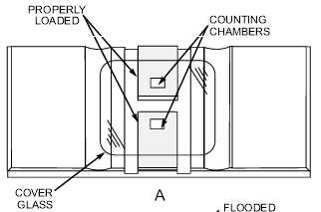
COUNTING BLOOD CELLS
you will need
A Microscope with light source
and an instrument called a Hemacytometer with coverglass.

Slide 31
Hemocytometer counting chamber

Slide 32
Loading the counting chamber.
After discarding the first 3 drops, load (charge) the counting chamber of the hemacytometer by gently touching the tip of the pipette against the edge of the cover glass and the surface of the counting chamber
& Allow 3 minutes for cells to settle

Slide 33
LOADING HEMACYTOMETER: A. Hemacytometer properly loaded; B. Hemacytometer improperly loaded.

Slide 34
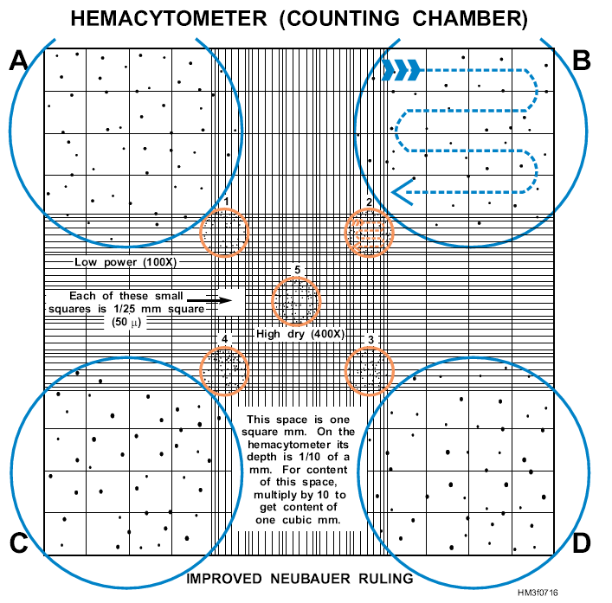

Slide 35
Calculation of Cell Counting
TEC
The sum of the cells counted in the
5 small square X 10,000
= total Erytherocyte / microliter
TLC
The sum of the cells counted in the
4 Corner square X 50
= total Leukocyte / microliter

Slide 36
Interpretation of TEC
The TEC is elevated in
Hemoconcentration & dehydration
Stress
High altitude
Cardiovascular Diseases
The TEC is decreased in
Anaemia
Hemoolysis
CRF
Haemorrhage
Failure of bone marrpow production
NOTE: TEC is a part of CBC and is must be used along with Hb Conc. And Haemtocrit to determine if a patient has anamia, polycythemia, dehydration , or response to treatment related to those conditions. RBC usually rises or falls along with Hb or hematocrit.

Slide 37
TWO measurements of white blood cells are commonly done in a CBC
The total number of white blood cells in a microliter (1x10⁻⁹ liters) of blood, reported as an absolute number of "X" thousands of white blood cells, and
2. The percentage of each of the five types of white blood cells. This test is known as a differential or "diff" and is reported in percentages.

Slide 38
Interpretation of TLC & DLC
Normal values for total WBC and differential in adult DOG are:
Total WBC: 10,000 - 12,000 per cubic millimeter
Bands or stabs: 3 - 5 %
Differential count :
WBC | Relative Value | Absolute Value
Neutrophils | 60-75 | 6000-7500
Eosinophils | 2-10 | 200-1000
Basophils | 0-2 | 0-200
Lymphocytes | 10-30 | 1000-3000
Moncytes | 2-12 | 200-1200
To make an accurate assessment, consider both relative and absolute values. For example a relative value of 70% neutrophils may seem within normal limits; however, if the total WBC is 20,000, the absolute value (70% x 20,000) would be an abnormally high count of 14,000.

Slide 39
Instant Feedback:
It is important to consider both the relative and absolute values of various types of white blood cells when interpreting a WBC differential count
True
False

Slide 40
Interpretation of TLC & DLC
The numbers of leukocytes changes with age and during pregnancy
Leukocytosis- (due to an increase in one of the five types )
Neutrophilic leukocytosis = neutrophilia
Lymphocytic leukocytosis = lymphocytosis
Eosinophilic leukocytosis = eosinophilia
Monocytic leukocytosis = monocytosis
Basophilic leukocytosis = basophilia
1. In response to an acute infection, trauma, or inflammation, white blood cells release a substance called colony-stimulating factor (CSF).
2. leukocytosis of a temporary nature, must be differentiated from leukemia, where the leukocytosis is both permanent and progressive.
3. Therapy with steroids modifies the leukocytosis response.

Slide 41
Instant Feedback:
Corticosteroids can mask infection by suppressing the inflammatory response and the release of WBCs.
True
False

Slide 42
Leukopenia occurs when the WBC falls below 5,000. Viral infections, overwhelming bacterial infections, Protozoan infection and bone marrow disorders can all cause.
Leukocytes: critical low and high values
A WBC of less than 500 places the patient at risk for a fatal infection.
A WBC over 30,000 indicates massive infection or a serious disease such as leukemia.

Slide 43
Differential Leukocyte Count
One must be able to identify the different types of white blood cells
This knowledge can be gained only by extensive, supervised practice

Slide 44
To perform a differential count,
The following materials are required:
1. Plain glass microscope slides, clean and dry
2. Wright-Giemsa stain solution
3. Staining containers
4. Deionized or distilled water
5. Microscope with light source
6. Immersion oil
7. Blood cell counter
Differential Count Procedure
DLC is done in 4 steps:
Make the blood smear
Stain the cells
Count the cells
Report the count

Slide 45
Interpretation of TLC & DLC
WBC | Some general interpretations
Neutrophils | A severe infection with a good response of the bone marrow. The greater the “shift to the left” (increase in immature neutrophils), the more severe the infection
Eosinophils | in parasitic infections and allergic conditions
Basophils | Non-significant; sometimes assoc. with eosinophilia
Lymphocytes | indicates healing
Moncytes | indicates activity in the infected area, In case of tuberculosis
The percentage of eosinophils, lymphocytes, and monocytes generally decreases in acute infections

Slide 46
THANKS

