Slide 1
Viruses
Dr. Abhishek Thakur
(Assistant Professor)
College of Fisheries, Kishjanganj
BASU, Patna

Slide 2
Characteristics of viruses
Viruses may be regarded as exceptionally complex aggregations of nonliving chemicals or exceptionally simple living microbes.
Because viruses are inert outside living host cells but once viruses enter a host cell, they become active and starts multiplication occurs.
Therefore viruses can be termed as obligatory intracellular parasites.
Viruses contain a single type of nucleic acid(either DNA or RNA) & a protein coat, sometimes enclosed by an envelope.
A complete, fully developed viral particle composed of nucleic acid surrounded by a coat is called a Virion.

Slide 3
Characteristics of viruses
Host range:
It refers to the spectrum of host cells in which a virus can multiply.
They are host specific, that infect invertebrates, vertebrates, plants, fungi and bacteria.
Most viruses infect specific types of cells of only one host species.
Host range is determined by the specific attachment site on the host cells’ surface.
Size:
Viral size is measured by electron microscopy.
Range from 20 nm to 300 nm in length.

Slide 4
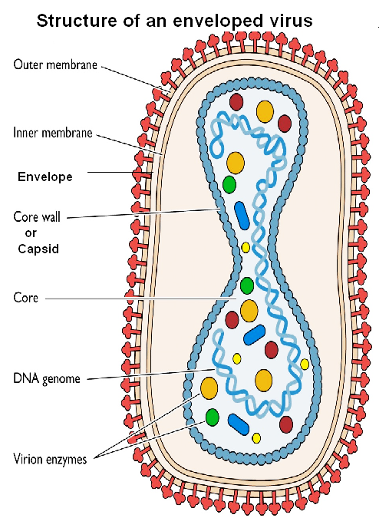
Viral Structure
Nucleic acid
Single kind of nucleic acid
(either DNA or RNA)
Can be single stranded
or double stranded
Can be
linear or circular
Capsid and Envelope

Slide 5
Viral Structure
Capsid and Envelope
The nucleic acid of a virus is surrounded by a protein coat called the capsid.
Each capsid is composed of protein subunits called capsomeres, which can be a single type of protein or several types.
The capsid of some viruses is enclosed by an envelope consisting of lipids, proteins and carbohydrates.
Some envelopes are covered with carbohydrate – protein complexes called spikes.

Slide 6
Morphology
On the basis of their capsid architecture
Helical viruses
Polyhedral viruses
Enveloped viruses
Complex viruses

Slide 7
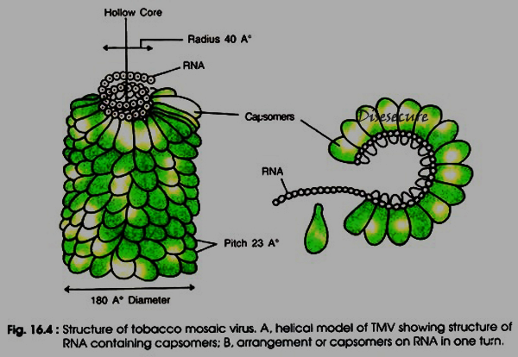
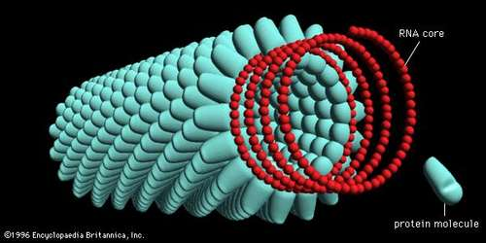
Morphology
Helical viruses - These resemble long rods, and their capsids are hollow cylinders surrounding the nucleic acid. Eg.Tobacco mosaic virus.

Slide 8
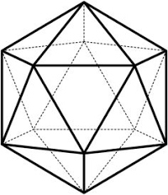
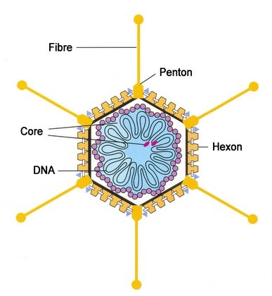
Morphology
2. Polyhedral viruses – These have many sides and usually the capsid is an icosahedron. Eg. Adenoviruses.

Slide 9
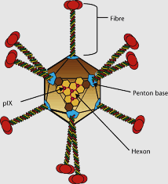
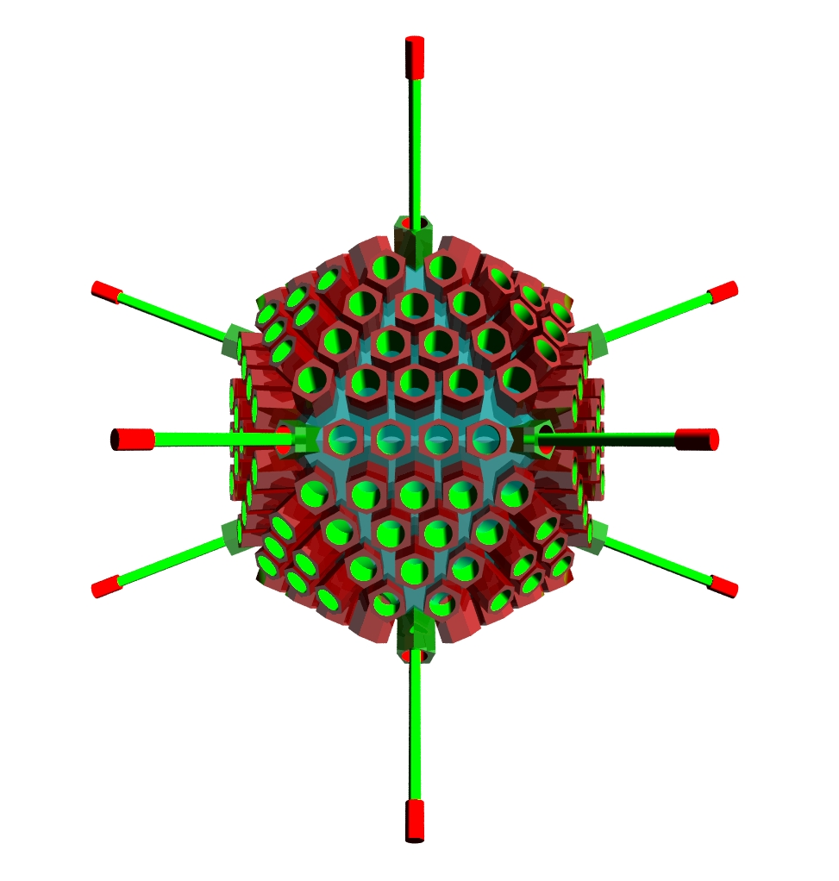
Adenovirus
Adenovirus are medium sized (70-90nm) unenveloped, icosahedral, double stranded virus .
There are more than 50 serotype of human adenoviruses which are divided into six groups (A-F) on the basis of on the basis of genomic homology.

Slide 10
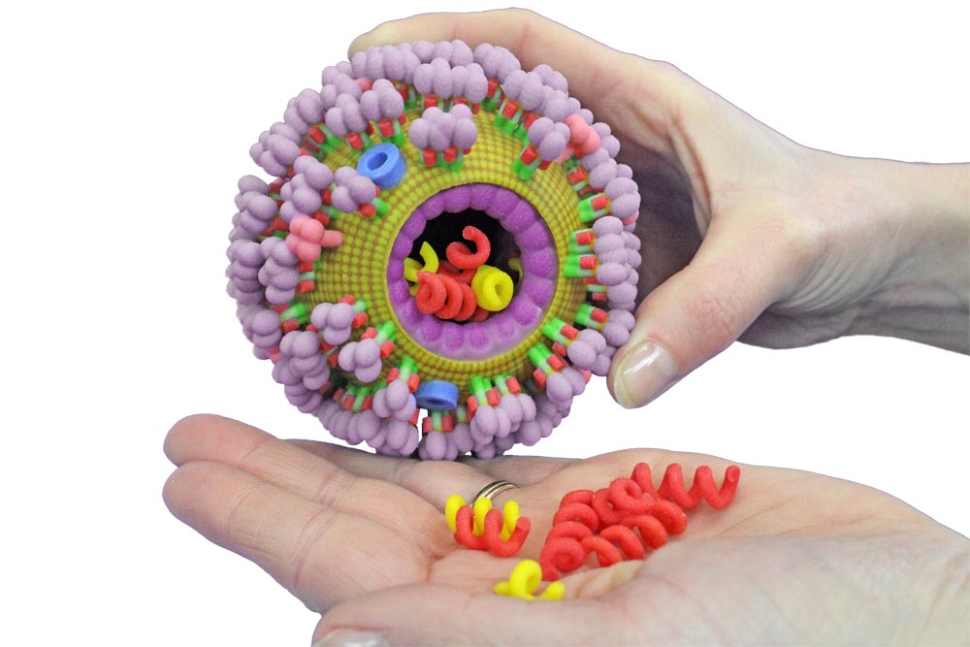
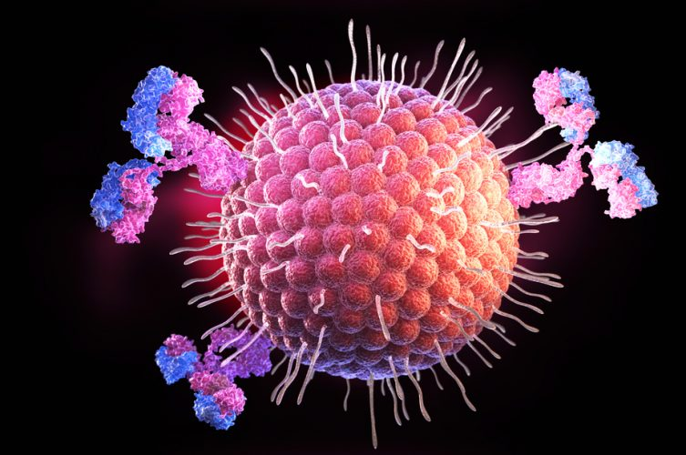
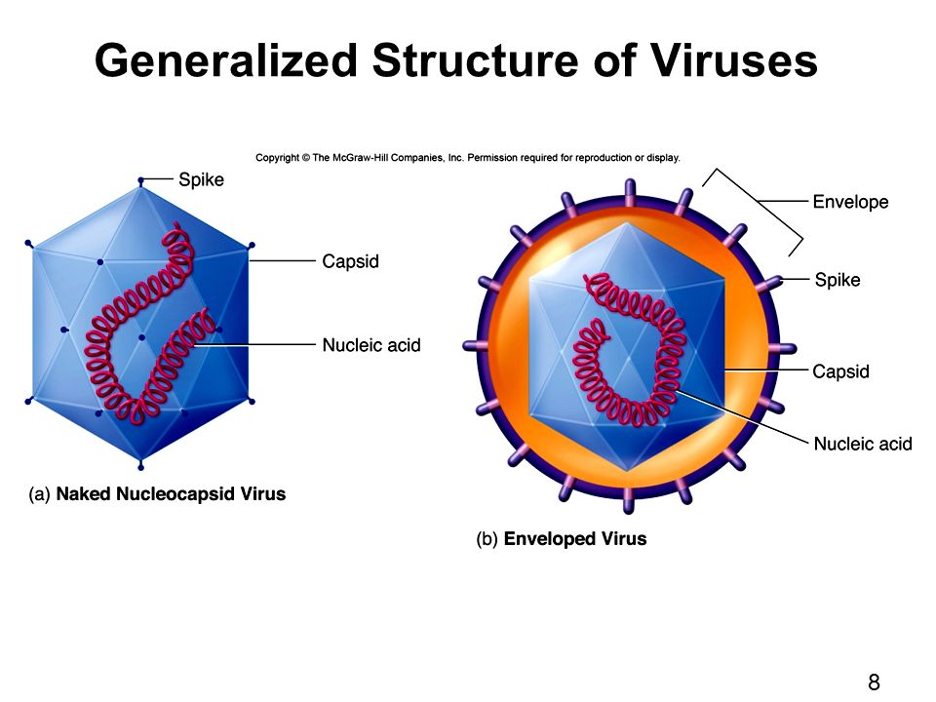
Morphology
3.Enveloped viruses - covered by an envelope and are roughly spherical but highly pleomorphic. There are also enveloped helical viruses (influenza virus) and enveloped polyhedral viruses (herpes virus).

Slide 11
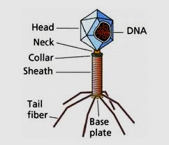
Morphology
4.Complex viruses - These have complex structures, eg. Many bacteriophages have a polyhedral capsid with a helical tail.

Slide 12
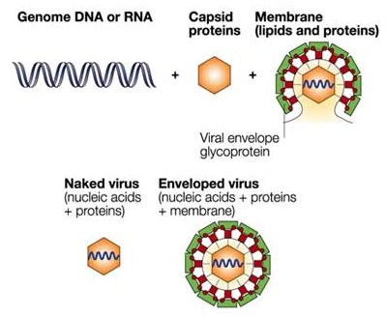
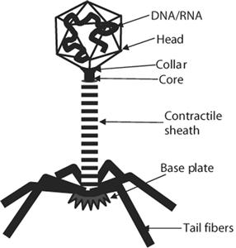
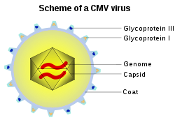
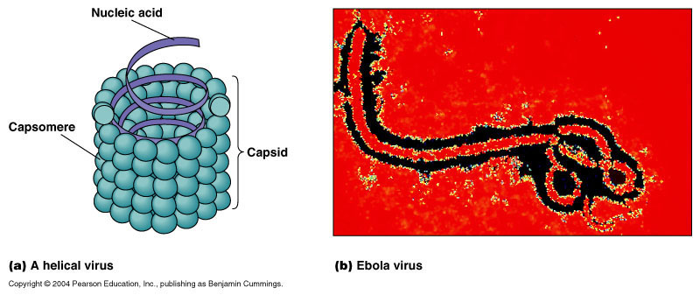

Slide 13
Virus Symmetry
The capsids of virions have one of two symmetries – helical or cuboid
Helical Symmetry:
Nucleocapsids form rigid, highly elongated rods or flexible filaments.
In addition to classification as flexible or rigid and as naked or enveloped, helical nucleocapsids are characterized by length, width, pitch of the helix, and number of protomers per helical turn.
The most extensively studied helical virus is tobacco mosaic.

Slide 14
Virus Symmetry
Icosahedral Symmetry:
An icosahedron is a polyhedron having 20 equilateral triangular faces, 30 edges and 12 vertices .

Slide 15
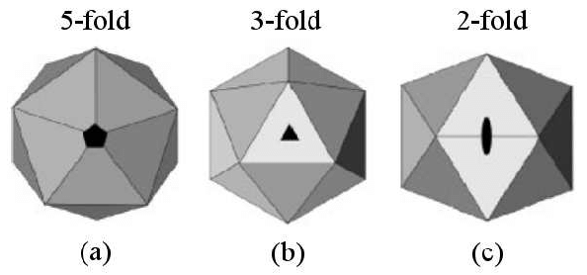

Slide 16
Taxonomy of Viruses
Viruses are classified on the basis of type of nucleic acid, morphological class and presence or, absence of an envelope
Virus family names end in --------- viridae and genus names end in ------- virus

Slide 17
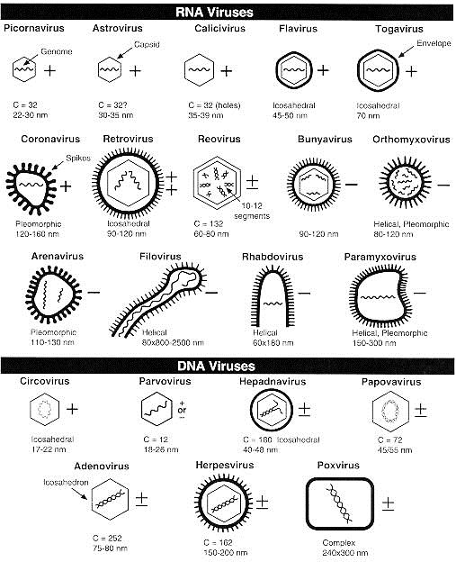

Slide 18
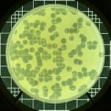
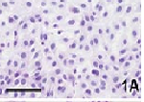
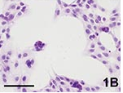
Growth of viruses in the laboratory
Bacteriophages can be cultivated by plaque assay.
Plaque assay mixes bacteriophages with host bacteria and nutrient agar.
After several viral multiplication cycles, the bacteria in the area surrounding the original virus are destroyed. The area of lysis is called a plaque.
Each plaque originates with a single viral particle.
The concentration of viruses is expressed as plaque-forming units (pfu)

Slide 19
Growth of viruses in the laboratory
Cultivation of some animal viruses requires whole animals
Some of them cultivated in embryonated eggs
cell cultures

Slide 20
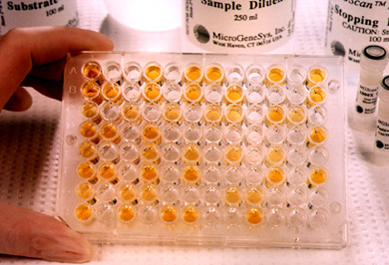
Viral identification
Serological or Immunological tests are used to identify viruses.
Viruses may also be identified by techniques like polymerase chain reaction (PCR) methods, restriction enzyme fragments, appearance of host cells following infection and electron microscopy.

Slide 21
Multiplication of viruses
Viruses invade a host cell and direct the host’s metabolic machinery to produce viral enzymes and components.
Multiplication cycle of viruses can be divided into five distinct stages, namely:
Attachment
Penetration
Biosynthesis.
Maturation and
Release.
Phages can multiply by two mechanisms:
Lytic cycle - results with the lysis and death of the host cell
Lysogenic cycle - host cell remains alive in the lysogenic cycle.

Slide 22
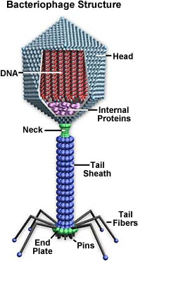
Lytic cycle of T – even bacteriophage
Attachment
Penetration
Biosynthesis
Maturation
Release
The time from phage attachment to
release is known as burst time and is usually
from 20 to 40 min.

Slide 23
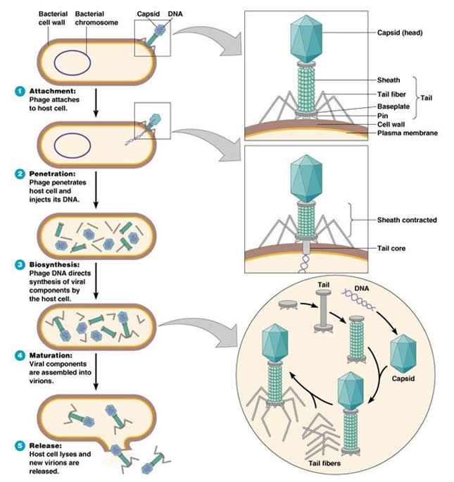

Slide 24
Lysogenic cycle of Bacteriophage
phages begin a lysogenic cycle by incorporating their DNA into the host cell’s DNA
During this state, called lysogeny, the phage remains latent.
Upon penetration into a bacterial cell, the linear phage DNA becomes a circle. The circular DNA of the phage may recombine with and become part of the circular bacterial DNA. The inserted phage DNA is called a prophage.
Every time the host cell replicates the bacterial chromosome, the prophage DNA also gets replicated.
The prophage remains latent within the progeny cells. Under some circumstances, or due to the action of UV light or certain chemicals excision of phage DNA occurs which initiates the lytic cycle.

Slide 25
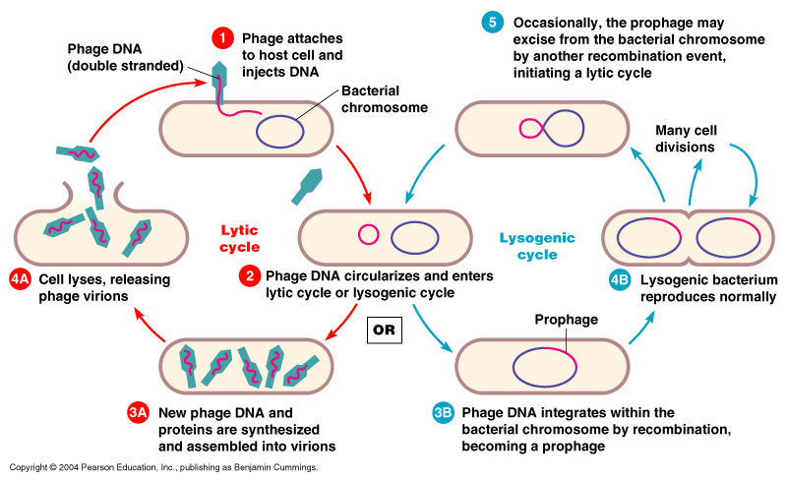

Slide 26
Multiplication of Animal viruses
Animal viruses attach to the plasma membrane of the host cell and penetration occurs by endocytosis
uncoated by either viral or host cell enzymes
DNA is released into the copies of DNA are synthesised
Capsid protein is synthesised
After maturation, viruses are released
Budding, Naked viruses are released through ruptures in the host cell membrane

Slide 27
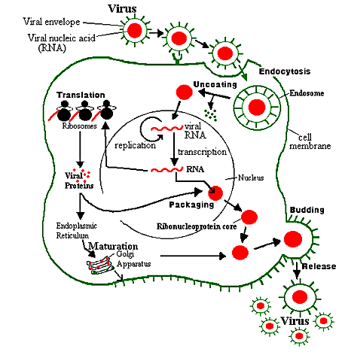

Slide 28
Thank You

