Slide 1
Autacoids
Dr. Nirbhay Kumar
Asstt. Professor & Head
Deptt. of Veterinary Pharmacology & Toxicology
Bihar Veterinary College, Bihar Animal Sciences University, Patna

Slide 2
Autacoids
The term ‘autacoid’ is derived from Greek words – ‘autos’ meaning self and ‘akos’ meaning remedy or healing substance.
Autacoids are locally acting hormone like substances produced by a wide variety of cells in the body, having intense biological activity which act briefly at the site of synthesis and release (i.e. on adjacent cells).

Slide 3
Autacoids contd…
Autacoids are also known as tissue hormones or local hormones. These are formed, released and inactivated within tissues.
They are usually vasoactive and mediators of inflammation.
Autacoids differ from hormones in following ways:
(i) Hormones are produced by specific cells; and
(ii) They are transported through circulation to act on distant target tissues.

Slide 4
Classification of Autacoids
Classification based on chemical structure:
Amine autacoids: Histamine, 5-Hydroxytryptamine (5-HT) or Serotonin.
Lipid derived autacoids: Eicosanoids {Prostaglandins, Leucotrienes (LTs) and Thromboxanes (TXs)}, Platelet activating factor (PAF).
Peptide autacoids: Plasma kinins (Bradykinin and Kallidin), Angiotensin, Vasoactive Intestinal Polypeptide (VIP) and Substance P.

Slide 5
Classification of Autacoids contd…
Classification based on origin:
Precursor molecules in plasma: Bradykinin, Kallidin and Angiotensin.
Preformed & stored in the cell: Histamine, 5-HT, VIP and Substance P.
Precursor molecules in cell membrane phospholipids: Prostaglandins, LTs and PAF.

Slide 6
Histamine (Tissue Amine)
It is an amine present in a variety of animal tissues, venoms, bacteria and certain plants (e.g. stinging nettle).
The amine is involved in inflammations, anaphylaxis, allergies and certain types of drug reactions, and it regulates gastric secretion.

Slide 7
Synthesis, Storage & Catabolism of Histamine
Chemically, histamine is β-imidazolylethylamine.
It is synthesized from the decarboxylation of amino acid histidine by a specific enzyme, histidine decarboxylase.
This enzyme is present in all cell types that contain histamine.
Histamine is widely distributed throughout mammalian tissues.

Slide 8
Synthesis, Storage & Catabolism of Histamine contd…
It is generally accepted that most of histamine stored within the body is synthesized locally.
Dietary histamine & histamine produced by enteric bacteria are disposed off rapidly after absorption into the portal circulation and contribute little or nothing to tissue storage sites.
In the animal body, histamine (basic) is found complexed with heparin (acidic) and protein in the granules of mast cells.

Slide 9
Catabolism of Histamine
The catabolism of histamine includes ring methylation (to form N-methylhistamine) catalyzed by N-methyltransferase and oxidative deamination catalyzed by diamine oxidase (histaminase) forming imidazolylacetic acid and its riboside.
The metabolites of histamine are pharmacologically inert and are excreted in urine.

Slide 10
Histamine Stores
Mast cell pool | Non-mast cell pool
Made up of mast cells (connective tissue) and basophils (blood). Turnover of histamine is slow. The mast cell pool represents the histamine that participates in inflammatory responses, allergic phenomena, shock, some adverse drug reactions and other forms of cellular insult. Effect of histamine liberating drug 48/80 – complete emptying of storage granules & release of histamine. | Made up of histaminocytes localized in GI tract, CNS, dermis and other organs. Fast turnover. It is synthesized and released continuously rather than being stored. Functions: CNS – Neurotransmitter GIT – Control of gastric secretion. Resistant to histamine releasing drugs such as compound 48/80.

Slide 11
Histamine Receptors
Selective Agonist | H₁ | H₂ | H₃
 | 2-methylhistamine | 4-methylhistamine | a-methylhistamine
Selective Antagonist | Chlorpheniramine | Ranitidine | Thioperamide
Distribution In The Body And Actions Mediated | Smooth muscle (GIT, RT & uterus): Contraction. Blood vessels: Endothelium-Vasodilatation & increased capillary permeability. Smooth muscle- Vasoconstriction. Afferent nerve endings: stimulation (itching & pain) Ganglionic cell: Stimulation. Adrenal medulla: Release of catecholamines Brain: Transmitter function. | Gastric glands: Acid secretion. Blood vessels: Dilatation. Heart: + ve inotropy + chronotropy Brain: Transmitter function. | Brain: Inhibition of histamine release (sedation). Lung, spleen, skin, gastric mucosa: ↓ histamine content. Primarily serves as autoreceptors controlling histamine release from neurons in brain.

Slide 12
Pathophysiological Functions of Endogenous Histamine
HCl secretion in the stomach.
Released from mast cells following Ag - Ab interactions during hypersensitive reactions (Type-1 hypersensitivity).
Neurotransmitter in CNS: Regulates water intake, body temperature, release of ADH, blood pressure and pain perception.
Regulates GI tone and motility : helps to maintain normal peristalsis.
Released in extensive tissue damage: Mediates local circulatory response to injury and inflammatory reactions.
Play an essential role in the process of tissue growth and repair because these tissues contain high concentrations of histamine.

Slide 13
Histamine Release
Various factors are responsible for release of histamine from mast cells:-
Tissue damage by trauma, stings, venoms, proteolytic enzymes etc.
Antigen – antibody reactions involving IgE antibodies.
Some drugs like tubocurarine, morphine, atropine, polymyxin B, vancomycin etc. release histamine without an immunological reaction.

Slide 14
Pharmacological Effects of Histamine
[1]. Blood Vessels:
Marked dilatation of smaller blood vessels including arterioles, capillaries and venules. Constrictor effect on large blood vessels.
In rabbits, histamine is a “pressor agent” as a result of pronounced constriction of blood vessels.
Histamine Shock:
Intense dilatation of capillary bed → Increase in capillary permeability.
The dilated arterioles, capillaries and venules that tag large volumes of blood and reduce venous return to heart and thus the cardiac output.
Histamine release during allergic or anaphylactic reactions.
The condition may cause death due to vascular shock as seen in acute surgical or haemorrhagic shock.

Slide 15
Pharmacological Effects of Histamine contd…
Triple Response:
Histamine produces a characteristic triple response in skin following intradermal injection. It consists of the following:-
A localized red spot : due to intense capillary dilatation developing within a few seconds and attaining maximum hue within a minute.
Wheal : Localized oedema fluid forming a wheal in about 90 seconds due to exudation of fluid from capillaries and venules; and
Flare (Diffuse redness) : i.e. redness in the surrounding area due to arteriolar dilatation mediated by axonal reflex.

Slide 16
Pharmacological Effects of Histamine contd…
[II]. Non-vascular smooth muscles:
Acute bronchial constriction (via H₁ receptors) in most of the species. However, guinea pigs are exceptionally sensitive and even minute doses of histamine can evoke bronchoconstriction leading to death.
Tracheal relaxation in cat (both H₁ & H₂), bronchial relaxation in sheep (H₂) and uterine relaxation in rat (H₂) but uterus is generally contracted in other species.
[III]. Exocrine glands: ↑ gastric acid secretion (due to H₂ receptors).
[IV]. Sensory nerve endings: Nerve ending stimulation→ Itching & pain.
[V]. Autonomic ganglia and adrenal medulla: Adrenaline release, ↑ B.P.
[VI]. C.N.S.: Histamine does not penetrate blood brain barrier.

Slide 17
Medical Uses of Histamine
Histamine has no therapeutic application, but used in experimental pharmacology.
Clinical applications in human include –
(i) Use of histamine as a test agent for achlorhydria.
(ii) Used in diagnosis of phaechromocytoma, and
(iii) Used for production of triple response to evaluate integrity of sensory innervations and circulatory competency.

Slide 18
Antihistamines
Drugs used to antagonize the effects of histamine liberation. The antihistamines act as competitive antagonists of histamine at receptor sites.
The antihistamines of clinical value in veterinary medicine are H₁ antagonists.
H₁ Antagonists: These are the drugs which competitively antagonize actions of histamine at H₁ receptors. These are also known as Conventional Antihistaminics.

Slide 19
Classification of H₁ antagonists
Drug | Trade Name
First Generation Ethanolamines : Diphenhydramine HCl Ethylene diamines : Pyrilamine maleate Alkylamines : Chlorpheniramine maleate Pheniramine maleate Piperazines : Hydroxyzine HCL Phenothiazines : Promethazine HCl Piperidines : Cyproheptadine HCl | Benadryl (Parke-Davis) Histosol Jeet (Alembic), Avil (Intervet) Atarax (UCB Pharma) Phenergan (Rhone Poulenc) Practin (Merind)
Second Generation Piperazines : Cetirizine HCl Piperidines : Loratadine HCl Fexofenadine HCl Terfenadine HCl | Cetzine (Glaxo) Loridin (Cadila) Allegra (Hoechst) Terin (Wockardth)

Slide 20
H₁ antihistaminics
Highly Sedative : Diphenhydramine, Promethazine & Hydroxyzine.
Moderately Sedative : Pheniramine and Cyproheptadine.
Mildly Sedative : Chlorpheniramine and pyrilamine
Non- Sedative : Second generation antihistaminics.

Slide 21
H₁ antihistaminics contd…
Cetirizine:
It is a metabolite of hydroxyzine (1st generation antihistaminic) with marked affinity for peripheral H₁ receptors.
It penetrates blood brain barrier poorly, so is very less sedative.
It attains high and longer lasting concentration in skin, which may be responsible for its superior efficacy in urticaria/ atopic dermatitis.
It is indicated in upper respiratory allergies, pollinosis, urticaria and atopic dermatitis; also used as adjuvant in seasonal asthma.

Slide 22
H₁ antihistaminics contd…
Cyclizine, Meclizine, Promethazine, Diphenhydramine (Anti-motion sickness):
These agents have prophylactic value in milder types of motion sickness; should be taken one hour before starting journey.
Promethazine can also be used in morning sickness, drug induced and post-operative vomiting, radiation sickness.
H₁ receptors mediate emesis in emetic centre.

Slide 23
H₁ antihistaminics contd…
Clinical Uses :
In allergic and anaphylactic reactions.
In bronchial asthma, laminitis, azoturia and pulmonary emphysema in horses.
In asthma, bloat, acetonaemia, gangrenous mastitis, metritis and retained placenta.
In the treatment of skin affections like dermatitis, pruritis and eczema (their mild local anaesthetic action helps in pruritis).

Slide 24
H₂ antihistaminics
These drugs block the effects of histamine that are mediated through H₂ receptor stimulation, such as increase in gastric acid secretion and increase in heart rate and automaticity of auricles and ventricles.
The H₂ antagonists also act as competitive antagonists of histamine for H₂ receptors.
The H₂ antagonists : Cimetidine, Ranitidine, Famotidine, Roxatidine, Nizatidine etc.
These drugs are of value in the treatment of peptic ulcer in man and animals.

Slide 25
5-Hydroxytryptamine (5-HT) or Serotonin
Serotonin was the name given to the vasoconstrictor substance which appeared in serum when blood clotted.
Enteramine was the name given to the smooth muscle contracting substance present in enterochromaffin cells of gut mucosa.

Slide 26
Source of 5-HT
5-HT is formed and localized in three essential pools in the body:
Enterochromaffin cells of intestine (about 90%).
Small number of neurons in CNS and mast cells of rodents (rat, mice, hamsters) along with histamine and heparin.
Blood platelets.
In addition to the endogenous 5-HT reserve, it is also found in invertebrates and plants (banana, pear, pineapple, tomato, stinging nettle etc).
In the pineal gland, 5-HT is converted to melatonin after acetylation and methylation.

Slide 27
Role of endogenous 5-HT
Neurotransmitter in brain in tryptaminergic nerves. Its deficiency causes depression and excess causes excitement.
It is a precursor molecule of melatonin hormone.
It helps to regulate the tone and motility of GIT.
Platelet 5-HT serves as one of the mediators of blood clot formation.

Slide 28
Synthesis, storage and degradation of 5-HT
5-HT is synthesized from dietary tryptophan in a two stage chemical reaction:-
(i) Tryptophan is hydroxylated by the enzyme tryptophan-5-hydroxylase to give 5-hydroxytryptophan (5-HTP).
(ii) 5-HTP is then decarboxylated to yield 5-HT.
Like catecholamines, 5-HT is also stored in storage granules and its uptake is also inhibited by Reserpine.
Enzymes like MAO, dehydrogenase and aldehyde reductase help to metabolize 5-HT.

Slide 29
Synthesis and Destruction of 5-HT

Slide 30
5-HT Receptors
Four families of 5-HT receptors comprising of total 14 receptor subtypes:-
5-HT₁ {Five subtypes i.e. 5-HT_{1A}, _{1B, 1C, 1D, 1E}}: Autoreceptors; inhibit serotonergic neural activity in brain. Functions are neural inhibition and vasoconstriction.
5-HT₂ {Three subtypes i.e. 5-HT_{2A}, _{2B, 2C}}: CNS and peripheral sites (esp. vascular and visceral smooth muscles, platelets and ANS neurons). Effects are vasoconstriction, intestinal, bronchial and uterine contraction and platelet aggregation.

Slide 31
5-HT Receptors contd…
5-HT₃ {No subtype}: Peripheral Nervous System – Emesis, gut peristalsis, bradycardia, transient hypotension, apnoea, pain, itching etc.
5-HT₄₋₇:
(i) 5-HT₄: (No subtype) Enteric nervous system. Mediate intestinal secretion and augments peristalsis.
(ii) 5-HT₅: Two subtypes i.e. 5-HT_{5A, 5B}
(iii) 5-HT₆: No subtype.
(iv) 5-HT₇: No subtype.
Not much is known about 5-HT₅₋₇

Slide 32
Pharmacological effects of 5-HT
[I]. C.V.S.:
Vasoconstriction on major arteries and veins.
Activation of 5-HT receptors in endothelial cells and local release of EDRF and prostaglandins.
Triphasic Response (produced by Rapid i.v. infusion of 5-HT):-
(a) An initial fall of systemic arterial B.P. accompanied by paradoxical bradycardia caused mainly by reflex chemoreceptor stimulation (Bezod – Jarisch Effect).
(b) A short period of pressure effect; and
(c) A prolonged fall in systemic B.P. attributed to a vasodilator effect in the vascular bed of skeletal muscle.

Slide 33
Pharmacological effects of 5-HT contd…
[II]. Gastrointestinal tract (GIT):
5-HT increases motility of small intestines and inhibits the motility of stomach and large intestines.
[III]. Respiratory tract (RT) and Uterus:
Constriction of bronchi and uterine contraction.

Slide 34
5-HT Antagonists & Uses
LSD, Ergot alkaloids, Methysergide,
Cyproheptadine : Antiallergic and antipruritic; appetite enhancer in children and helps to gain body weight.
5-HT has negative effect on hunger centre and positive effect on growth hormone secretion),
Ketanserin,
Clozapine (effective in schizophrenia),
Risperidone
The therapeutic value of 5-HT antagonists in veterinary medicine is not yet established.

Slide 35
Eicosanoids (PG, PGI, TXA & LT)
The biologically active substances that are derived from 20 carbon polyunsaturated fatty acids (mainly arachiodonic acid) which share a prefix ‘eicosa’ (means twenty) are termed eicosanoids.
These include prostaglandins (PG), prostacyclins (PGI), thromboxane (TXA) and leucotrienes (LT).

Slide 36
Synthesis of Eicosanoids

Slide 37
Synthesis of Eicosanoids
Every cell in the body is capable of synthesizing eicosanoids.
Arachiodonic acid from the phospholipids of cell membrane and tissue triglycerides by the action of the enzymes phospholipases and acylhydrolases are released for synthesis of eicosanoids.
Several factors are associated with activation of these enzymes which include physiological, pharmacological and pathological stimuli.
Other autacoids like angiotensin and kinins activate acylhydrolases and promote PG synthesis.

Slide 38
Prostaglandins
Two American Gynaecologists, Kurzrok and Lieb, in 1930, reported that human semen contained a substance which was found to contract isolated uterine and other smooth muscle strips and caused a fall in blood pressure in animals.
The active principle was termed ‘prostaglandin’, thinking that it was derived from prostate gland.

Slide 39
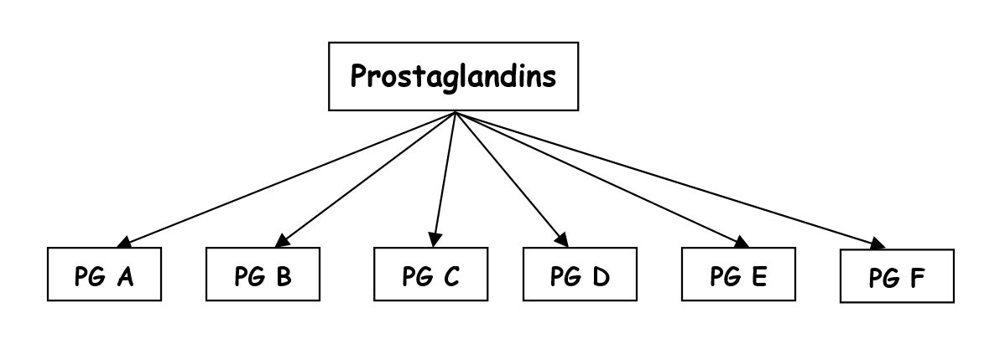
Classification of Prostaglandins (PGs)

Slide 40
Classification of Prostaglandins
The classification of PGs is according to substituents on the cyclopentane ring of prostaglandin molecule. Some newer PG related compounds are PGG, PGH, PGI (prostacyclin) and thromboxane.
The PGs are further categorized as mono, di or triunsaturated depending on the number of double bonds in the side chains. This classification appears as a subscript to the letter.
Examples are –
PGE₁ → one double bond.
PGE₂ → two double bonds.
PGE₃ → three double bonds.

Slide 41
Cyclooxygenase (COX)
Metabolizes arachiodonic acid to its PG derivatives.
Two major isoforms : COX-1 and COX-2.
COX-1:
Constitutive. Synthesizes the small amounts of PGs that participate in normal physiologic functions.
Have protective actions on GI mucosa.
Inhibition of COX-1 activity : Loss of GI protection of mucosal epithelial cells.

Slide 42
Cyclooxygenase (COX) contd…
COX-2:
Not constitutive; rather it is inducible in nature.
Bacterial lipopolysachharide and certain inflammatory cytokines & growth factors induces synthesis of COX-2.
Participate in inflammatory reactions.

Slide 43
Other Eicosanoids
Prostacyclin (PGI₂):
It is a potent vasodilator.
Exerts antiaggregatory activity on blood platelets.
PGI₂ has a very brief half life of 2-3 minutes.

Slide 44
Other Eicosanoids contd…
Thromboxane A₂:
It is synthesized in platelets (thrombocytes).
Thromboxane A₂ plays an important physiological role as :-
a vasoconstrictor and
pro-aggregatory in thrombus formation.

Slide 45
Other Eicosanoids
Leucotriene:
It is synthesized in lung, platelets and white blood cells by metabolism of arachiodonic acid via lipoxygenase pathway.
Leucotrienes are thought to be chemotactic in nature for leucocytes and participate in inflammatory responses.

Slide 46
Functions of Eicosanoids
Prostacyclin: Antagonist of prostaglandins and thromboxane A₂ on blood platelets.
Prostaglandins & Prostacyclins: Promote vasodilatation and regulate tone of vasculature and control blood flow in the vital organs.
TXA₂: A potent vasoconstrictor.

Slide 47
Functions of Eicosanoids contd…
Prostaglandins & Leucotrienes: Released during allergic reactions and contribute to the bronchoconstriction and other signs.
Prostacyclin: Controls renal blood flow, urine formation, renin secretion and checks the action of ADH.

Slide 48
Functions of Eicosanoids contd…
Prostaglandins in semen may have a role in facilitating conception following coitus.
They also help in termination of pregnancy at the term.
PGF₂α elaborated by uterus (mare, cow, sow & ewe) functions like luteolytic hormone and used for synchronizing oestrous.
Aspirin, antagonist of PGF₂α inhibits uterine contractions during parturition by interfering with prostaglandin synthesis.

Slide 49
Functions of Eicosanoids contd…
PGs & LTs are produced during tissue injury are responsible for reactions of inflammations. Increase in vascular permeability, oedema and leukocyte infiltration and potentiate the pain inducing effect of bradykinin.
Leucocytes release leucotrienes which help in migration of leucocytes.

Slide 50
Clinical Uses of Eicosanoids
PGF₂a analogues (Dinoprost, Tiaprost) are used for:-
Oestrous synchronization (cow, ewe, goat, buffalo etc.)
Induction of oestrous in anoestrous animals.
Expulsion of mummified foetus; and
Expulsion of pus in pyometra.

Slide 51
Clinical Uses of Eicosanoids contd…
Therapeutic abortion in human females – PGE₂ analogue (Dinoprostone) is used for abortion during first trimester.
Impotency – PGE₁ analogue (Alprostadil) may be used in the treatment of impotency.
Maintenance of patent Ductus Arteriosus: PGE₁ analogue (Alprostadil) is used in the treatment of congenital malformations of the heart in neonates.

Slide 52
Platelet Activating Factor (PAF)
PAF is another autacoid derived from membrane phospholipids, and is therefore related to the eicosanoid family.
Whereas the eicosanoids are formed from a wide variety of cell types, PAF is synthesized principally by platelets, endothelial cells and circulating leucocytes.

Slide 53
Functions of PAF
Mediator of thrombin-induced platelet aggregation (by forming TXA₂).
Contributes to the reactions of inflammation (increased vascular permeability, oedema, pain, infiltration of leucocytes and release of lysosomal enzymes).
PAF is the most potent agent known to increase vascular permeability.
Although PAF lowers blood pressure due to its relaxing effect on vascular smooth muscle, it markedly contracts smooth muscle of the gut, stomach, uterus and peripheral airways of the lungs.

Slide 54
Functions of PAF contd…
PAF is considered to be one of the most active endogenous activators of PGs and related eicosanoids. Thus, biological roles of PAF are often linked to those exhibited by the eicosanoid family.
Role in ovulation, implantation and parturition. In absence of PAF, ovulation does not occur.
After fertilization, the embryo produces PAF which helps in implantation of the blastocyst.
At the time of parturition, PAF aids in increasing uterine contractions. Just before parturition, PAF is found in the amniotic fluid (released from foetal lungs).
Despite the wealth of physiologic and pathophysiologic activities proposed for PAF, pharmacologic manipulation of PAF synthesis and receptors is at a preliminary stage. The clinical significance of PAF antagonists is currently unknown for veterinary medicine.

Slide 55
Cytokines
In response to certain inflammatory and immunological stimuli, many types of mammalian cells produce one or more of a variety of small proteins termed cytokines.
Cytokines have a vital role in the initiation and regulation of various inflammatory and immunological responses.
The important cytokines include:
Tumour necrosis factor-a (TNF-a)
γ-Interferon, and
Interleukins (ILs).
Currently, monoclonal antibodies raised against these specific proteins represent the primary pharmacotherapeutic intervention relevant to the area of cytokines.

Slide 56
Polypeptides
The pharmacologically active polypeptides include –
Angiotensins
Kinins
Substance P and
Vasoactive Intestinal Polypeptide (VIP).
The polypeptides have a variety of extremely potent effects.

Slide 57
Angiotensins
Angiotensin is a blood borne polypeptide that serves as a circulating link between the kidney and systemic haemodynamic control systems.
It is formed from angiotensinogen. It exists as angiotensin I, angiotensin II and angiotensin III.
Angiotensin II is a powerful vasoconstrictor having 40 times the potency of NE and causes blood pressure to rise due to direct action on vascular smooth muscles.
Angiotensin is not a mediator of inflammation. It is discussed here because of its chemical relationship to the kinins. Its activation is terminated rapidly in blood. Its half life is less than one minute.

Slide 58
Synthesis of Angiotensins

Slide 59
Renin Angiotensin Aldosterone System
The system has homeostatic role in maintaining haemodynamics and water and sodium balance.
Secretion of renin from the juxtaglomerular cells, which is stimulated by renal as well as extrarenal factors.
Renal factors: Reduced renal blood flow and lowered Na⁺ concentration in upper tubular fluid.
Extrarenal factors: Enhanced sympathetic outflow as a result of reduced blood volume, cardiac output and blood pressure, causing release of NE from sympathetic nerve endings.
NE activates β₁ adrenergic receptors on juxtaglomerular cells causing renin secretion.

Slide 60
Renin Angiotensin Aldosterone System contd…
Prostacyclin also causes release of renin.
Renin accelerates formation of angiotensins, which cause intense vasoconstriction and increase in blood pressure.
Angiotensin also promotes aldosterone secretion, which helps in Na⁺ retention and increase in the volume of extracellular fluid.
The vasoconstriction also contributes to Na⁺ retention. The antagonists of the system [Angiotensin Converting Enzyme (ACE) antagonists] are used as vasodilators in renal hypertensive human subjects (captopril, enalpril etc).

Slide 61
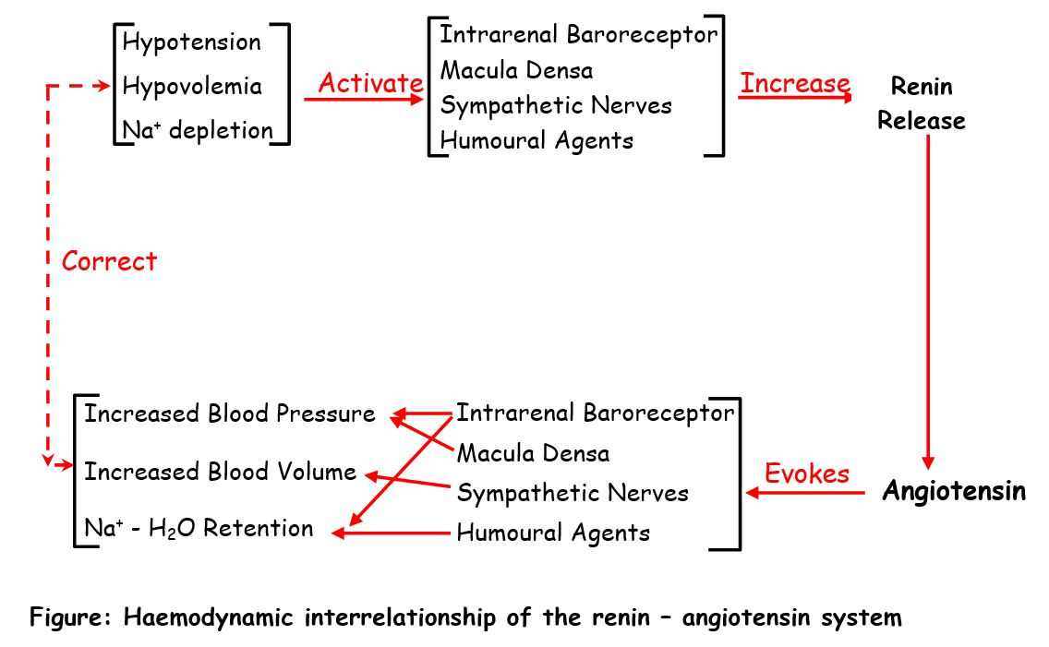
Renin Angiotensin System

Slide 62
Plasma Kinins
Bradykinin & Kallidin: Mediates pain (nociception) and inflammatory responses; regulates B.P., haemodynamics and fluid & electrolyte balance.
Bradykinin is a nonapeptide while Kallidin is a decapeptide.
Prekallikreins (found in plasma, GIT and pancreas) are activated to kallikreins by the Hageman factor (factor XII) or plasmin, and others such as tissue damage, contact with glass, collagen and skin, pH changes etc. which disrupt normal haemodynamics.
The kallikreins are present in plasma, exocrine glands (pancreas & salivary) and other organs.
These are proteinases which convert a high molecular weight kininogen to bradykinin and a low molecular weight kininogen to Kallidin.

Slide 63
Kallikrein – Kininogen – Kinin System

Slide 64
Pathophysiological and pharmacological actions of kinins
The kinins are responsible for production of pain sensation during tissue injury.
They cause hypotension (about 10 fold more potent than histamine) following marked peripheral vasodilatation and increase in permeability in the minute blood vessels with oedema formation as seen with histamine.
The kinins also mediate inflammatory responses.
They cause constriction of non-vascular smooth muscles (intestine, uterus, bronchi) causing pain.
Renal effects of kinins are opposite to those of renin angiotensin system (increase of urine volume & excretion of Na⁺)

Slide 65
Vasoactive Intestinal Polypeptide (VIP)
VIP is present in small intestine and also widely distributed in peripheral nerves and the CNS.
Although, VIP exerts multiple pharmacological actions in different tissues, its physiologic relevance remains questionable.

Slide 66
Substance P
Substance P was first extracted from horse intestine and brain.
It is an endecapeptide.
It has some bradykinin like action and is a potent stimulator of the gut.
Apart from VIP and substance P, several other vasoactive peptides of which the actions in pathophysiologic states are less known, are Eledoisin, Physalamin, Coerulein, Colostrokinin, Urokinin and kinins of wasp and hornet venoms.

Slide 67
Thank You

