Slide 1
History of Anaesthesia
Dr.Kumari Anjana Assistant Professor Deptt. of Veterinary Pharmacology & Toxicology
Bihar Veterinary College, Bihar Animal Sciences University, Patna

Slide 2
Before discovery of anesthetics

Slide 3
Before 1846
Few drugs/plant product used to remove pain-
Alcohol
Opium
Hyoscine
Cannabis
Cocaine
Other method /non-drugs method used to remove pain-
Cold
Concussion
Carotid compression
Nerve compression
Hypnosis

Slide 4
1846
1846 - Oliver Wendell Holmes coined the term Anaesthesia.
It originates from the Greek word an- “without” and “aisthesis” refers to the inhibition of sensation.

Slide 5
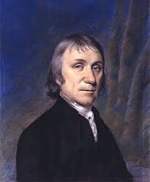
1776 - first anaesthetic, nitrous oxide gas (laughing gas) was discovered by Priestly.
Nitrous oxide
Priestly

Slide 6
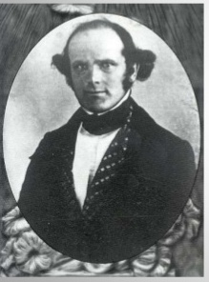
Nitrous oxide Anaesthesia
1844- Nitrous oxide was first used as an anaesthetic by a dentist Horace Wells (Hartford, USA) for removal of a tooth in a human.
Sir Humphry Davy (British chemist) suggested its use in painless surgery.
Sir Humphry Davy

Slide 7
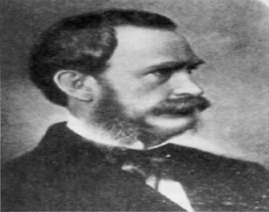
1540 - Synthesized and named “sweet oil of vitriol” by Valerius Cordus. Frobenius renamed it “ether”. 1818- Anaesthetic effect of ether was discovered by C W Long. 1846-- Ether anaesthesia was first publicly demonstrated in by William T G Morton in “Ether Dome” at Massachusetts General Hospital (Boston, USA).
Ether Anaesthesia
William T G Morton
The Ether Dome, Boston, Massachusetts

Slide 8
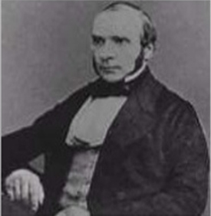
John Snow : 1st Anaesthesiologist
1st anaesthetist: Used ether and Chloroform as surgical anesthetics.
He designed an apparatus to safe administration of ether anaesthesia to the patients and also designed a mask to administer chloroform anaesthesia.
Chloroform anaesthesia became famous, when He administered chloroform to Queen Victoria when she gave birth to the child.
John Snow

Slide 9
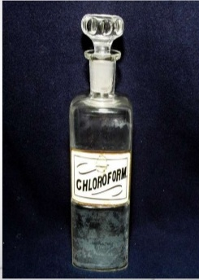
Chloroform Anaesthesia
1847- Chloroform anaesthesia was introduced by James Young Simpson (Scottish obstetrician) and became very popular due to its pleasant odour.
Despite of the high toxicity and mortality rate the use of chloroform in surgery remained for nearly 100 years.

Slide 10
1872--Chloral hydrate was the first intravenous anaesthetic.
1903--Barbiturates were introduced.
1929--Cyclopropane was discovered and remained in extensive use for next 30 years.
1935--Thiopentone was introduced as general anaesthetic by Lundi.
1956--introduction of halothane, a non-flammable anaesthetic, revolutionized the inhalation anaesthesia.

Slide 11
Anaesthesia in 21st Century

Slide 12
Thank You

