Slide 1
Drugs that affect the Cardiovascular System
Presented by:-
Dr.Archana
Assistant Professor_cum_Jr .Scientist
Deptt.Of Pharmacology & Toxicology
Bihar Veterinary College, Patna

Slide 2
DRUGS ACTING ON CARDIO VASCULAR SYSTEM
* Cardiac glycosides * Antiarrhythmic drugs
* Vasodilators * Antihypertensive agents
* Haematinics * Coagulant
* Anticoagulants

Slide 3
CARDIAC GLYCOSIDES
These are the glycosides naturally obtained from certain plants and contain active principles which act specifically on the failing heart and make them normal. That’s why, they are called cardiac glycosides. All the cardiac glycosides have cardio tonic property.
Cardiac glycosides are of plant origin :
Name of the plant | Part of the Plant | Glycosides
Digitalis lanata | Leaves | Digitoxin,Gitoxin & Digoxin
Digitalis purpurea | Leaves | Digitoxin,Gitoxin & Gitalin
Strophanthus gratus | Seed | Strophanthin G (Ouabain)
Strophanthus kombe | Seed | Strophanthin K
Urgenia maritima | Bulb | Proscillaridin A

Slide 4
CARDIOTONICS
Cardiac tonic are those agents which improves the functional capacity of cardiac muscle, it has powerful action on myocardium and has great value in the treatment of cardiac failure, oedema of cardiac origin & cardiac asthma.
Eg – Digitalin, Digoxin, Ouabain etc.

Slide 5
CARDIOTONIC & CARDIOSTIMULANT :
Cardiotonics
(i) They increase force of myocardial con­traction, but not heart rate.
(ii) Increase the myocardial efficiency be­cause the total myocardial oxygen con­sumption is not altered.
(iii) They inhibit Na⁺ – K⁺ – ATPase enzyme and thereby slowly increase the cardiac contractility. Their duration of action is long.
(iv) In congestive heart failure (CHF) patient, they reduce the heart size by increasing the cardiac tone.
(v) They are mainly used to treat CHF.
Cardiostimulants
(i) They increase both force of myocardial contraction and heart rate.
(ii) They decrease the myocardial efficiency because the total myocardial oxygen consumption is increased
(iii) They act on their specific receptors to increase heart rate and force of contrac­tion quickly. Their duration of action is short.
(iv) They have no effect on cardiac tone and size.
(v) They are mainly used to treat heart block.

Slide 6
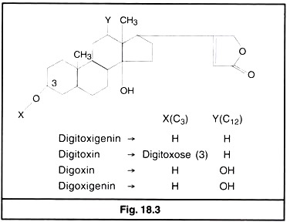
CHEMICAL NATURE & PROPERTIES OF GLYCOSIDES
* Cardiac glycosides are the combination of a sugar portion and aglycone (genin)
The aglycone is chemically similar to steroids with an unsaturated lactone ring attached at C-17. the various sugars are linked to alglycon at C-3 position .It is the pharmacologically active portion of the glycosides.
* The sugars modify the water and lipid solubility of the glycoside molecule and, thus affect its potency and duration of action.

Slide 7
PHARMACOLOGICAL ACTION OF GLYCOSIDES
Cardiac glycosides have the positive ionotropic effect on heart. They increase the force of contraction of myocardium & Decrease in heart rate.
Its main action in congestive heart failure.
Digitalis increases cardiac output & diuresis hence relief in oedema.
Digitalis decreases the cardiac filling pressures ,venous and capillary pressures & heart size .

Slide 8
Sequence associated with CHF
Increase the force of contraction of myocardium.
Decrease in heart rate.
Increase in cardiac output.
Decrease in blood volume.
Reduction in venous congestion.
Increase in renal blood flow.
Diuresis and relief in oedema.
Return of heart size to normal.
All these can be explained on the basis of +ve ionotropic effect of cardiac glycosides.

Slide 9
MECHANISM OF ACTION
Cardiac glycosides inhibits the Na⁺, K⁺– AT Pase system(Na⁺– K⁺ pump) located on the surface of myocardial cell membrane, and thus interfere with the Na⁺Ca²⁺ exchange resulting into intracellular accumulation of Ca²⁺ therefore more of Ca²⁺ ions are made available to interact with contractile protein causing increase in force of contraction of myocardium as a whole. Na⁺, K⁺– AT Pase is the pharmacological receptor of cardiac glycosides.

Slide 10
Continued…
Cardiac glycosides inhibit Na/K adenosine triphosphatase, the “sodium pump” which causes more Na to remain inside myocardial cells
Increased intracellular Na stimulates Na/Ca exchange that brings more Ca inside heart cells to increase the force of contraction
Cardiac glycosides also stimulate the vagus nerve which decreases heart rate

Slide 11
CLINICAL USES
Malfunctioning of heart.
Congestive heart failure
Atrial fibrillation
Cardiac oedema
Cardiac asthma
Commonly used glycosides are digitoxin, digoxin and Oubain.
Oubain is the most potent therefore used in emergency therapy, however is ineffective orally.
NOTES :-
* In ruminant parenteral digitalization is needed as the glycosides are ineffective after oral dosing. ( inactivation in rumen & reticulum)
* It is rarely used in cat because of inducing emesis by stimulating vomiting centre in CNS.

Slide 12
ANTIARRYTHMIC DRUGS
Antiarrhythmic agents, also known as cardiac dysrhythmia medications, are a group of drugs that are used to suppress abnormal rhythms of the heart.

Slide 14
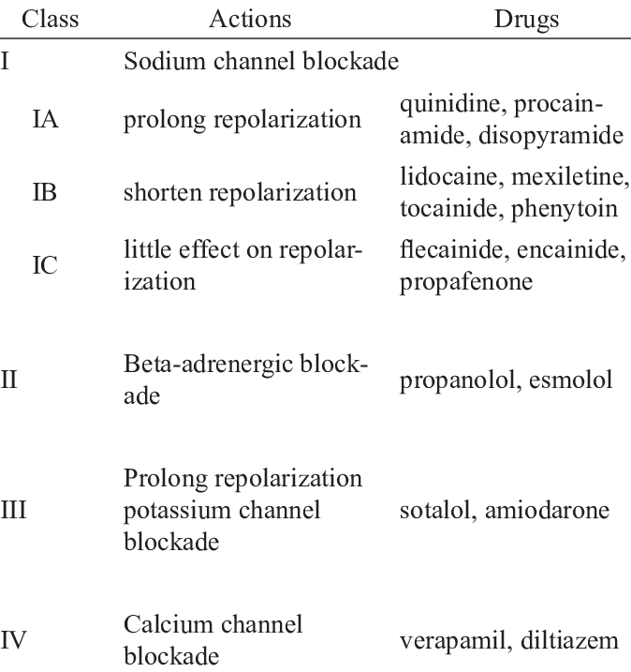
Classification of antiarrhythmic drugs

Slide 15
DIGITALIZATION
Administration of cardiac glycoside is known as digitalization.
3 types of digitalization in practice
Intensive digitalization
½ of calculated dose given immediately
¼ of calculated dose given 6 hr later
1/8 of calculated dose given every 4-6 hr
Rapid digitalization-
given in 3 divided dose at 6 hr interval.
Slow digitalization-
given in 5 divided dose at 10 hr interval.

Slide 16
Vasodilators & Antihypertensive drugs
Vasodilators are a group of medicines that dilate blood vessels, which allows blood to flow more easily.
The drugs which causes B.P to fall is known as hypotensive or antihypertensive drugs.
Use – hypertension, Heart failure, Angina
In vety. Practice theses drugs are of limited use.

Slide 17
Drug Classes Used to Treat Hypertension
Diuretics-
Thiazides: Hydrochlorothiazide,
High ceiling: Furosemide
K+ sparing: Spironolactone, triamterene
Sympatholytic drugs
Centrally acting: Clonidine, methyldopa
ß-adrenergic blockers Propranolol, metoprolol
α – adrenergic blockers Prazosin, phentolamine
ß and α – adrenergic blockers Labetolol and carvedilol
Direct acting vasodilator drugs- Hydralazine and minoxidil, Diazoxide & nitroprusside
Calcium antagonist drugs- Verapamil & diltiazem
Angiotensin-converting enzyme inhibitor and angiotensin
Captopril, lisinopril., enalapril
Angiotensin receptor blocking drugs Losartan, candesartan

Slide 18
HAEMATINICS (Anti-anaemic)
A hematinic are the drugs that required for the formation of blood cells in the process of hematopoiesis, and are used in he treatment of anaemia.
Substances required for formation of blood
■ Iron ■ Folic Acid
■ Copper ■ Vitamin B12 ■ Cobalt
Erythropoietin- It is a glycoprotein hormone produced by the renal peritubular cells.

Slide 19
COAGULANT
These are substances which promote coagulation and used for arresting haemorrhage.
Locally acting haemostatics
Natural or Physiological haemostatics eg: Thrombin, Thromboplastin, Fibrin, Fibrinogen
Synthetic local haemostatics eg: Absorbable gelatine sponge, oxidized cellulose, Astringents
Systemic bloods coagulant
eg : Whole blood, Vitamin K, Protamine sulphate, Epsilon Amino Caproic Acid (EACA), Tranexamic Acid

Slide 20
ANTICOAGULANT
These are drugs used to prevent blood clotting.
Classification based on use in vitro or in vivo
In vitro anticoagulant
(i) Sodium oxalate (ii) Sodium citrate
(iii) Sodium EDTA
In vivo anticoagulant
(i) Heparin- used parenterally
(ii) Coumarin derivatives- used orally. Eg-warfarin, phencoumon

