Slide 1
HERPESVIRIDAE
VMC 605

Slide 2
Bovine Herpesvirus
Preferred Scientific Name
bovine herpesvirus 1
International Common Names
English: infectious bovine rhinotracheitis virus
English acronym
BoHV-1
IBRV
Taxonomic Tree
Domain: Virus
Group: "ssDNA viruses"
Group: "DNA viruses"
Order: Herpesvirales
Family: Herpesviridae
Genus: Varicellovirus
Species: bovine herpesvirus 1

Slide 3
Classification
Three subfamily:
α (Alphaherpesvirinae),
β (Betaherpesvirinae),
γ (Gammaherpesvirinae)
Alphaherpesvirinae: a lot of hosts, short reproductive cycle, effective cells (infected ones) destroying, latent form of existence in ganglia.
Simplexvirus (HSV-1, HSV-2) , Poikilovirus.

Slide 4
FAMILY | GENUS | SPECIES | DISEASE
Herpesviridae
Subfamily Alphaherpesvirinae Prototype – Hepes simplex virus 1 | Simplex Virus | Bovine herpes virus 1 (BoHV-1) | Infectious Bovine Rhinotracheitis (IBR) Infectious Pustular Vulovovaginitis Infectious Balanoposthitis Rhinotracheitis Abortion
 |  | Bovine herpes virus 2 (BoHV-2) | Bovine mammilitis Pseudo-lumpy skin disease
 |  | Bovine herpesvirus 4 (BoHV-4) | Rhinopnemonitis in horses
 |  | Bovine herpesvirus 5 (BoHV-5) | Encephalitis in cattle
 | Varicello virus | Caprine herpesvirus 5 (CpHV-5) | conjunctivitis and respiratory disease in goats.
 |  | Suid herpesvirus 1 (SuHV1) | Aujeszky ’ s disease, pseudorabies or ‘ mad itch ’
 |  | Porcine herpesvirus 5 | -
 |  | Equine herpesvirus 1 | Spontaneous Abortion, perinatal foal mortality, respiratory disease, neurological disease/paralysis, respiratory disease, in horses.
 |  | Equine herpesvirus 3 | Coital exanthema in horses.
 |  | Equine herpesvirus 4 | Abortion, perinatal foal mortality, respiratory disease, neurological disease, rhinopneumonitis in horses
 |  | Canine herpesvirus 1 | severe hemorrhagic disease in puppies
 |  | Felid herpesvirus 5 | feline viral rhinotracheitis and keratitis in cats
 |  | Simian varicella virus
 | Mardivirus | Gallid herpesvirus 1 (GaHV-1) | Infectious Laryngotracheitis of chicken
 |  | Gallid herpesvirus 2 (GaHV-2) | Marek’s disease of chicken
 |  | Anatid herpesvirus 1 | Duck Plague
Betaherpesvirinae |  | Porcine hepesvirus 2 | Inclusion body rhinitis , generalized cytomegalovirus
Gammaherpesvirinae |  | Alcelaphine herpesvirus 1 | Bovine malignant catarrhal fever

Slide 5
Sub family – Betaherpesvirinae | Cytomegalovirus | Porcine hepesvirus 2 Suid herpesvirus 2 (SuHV2) | Inclusion body rhinitis , generalized cytomegalovirus
Sub family – Gammaherpesvirinae | Macavirus | Alcelaphine herpesvirus 1 (AlHV1) Malignant catarrhal fever virus(MCFV) | Malignant catarrhal fever(MCF)
 | Macavirus | Suid herpesvirus 5
 | Macavirus | Ovine herpesvirus 2 (OvHV2) | Sheep - associated malignant catarrhal fever of cattle virus
 | Rhadinovirus
 | Lymphocryptovirus
 | Percavirus | Equid herpesvirus 2 | equine cytomegalovirus infection.
 |  | Equid herpesvirus 5 | Multinodular pulmonary fibrosis (MPF) Skin and ocular disease and lymphoma in horses

Slide 6
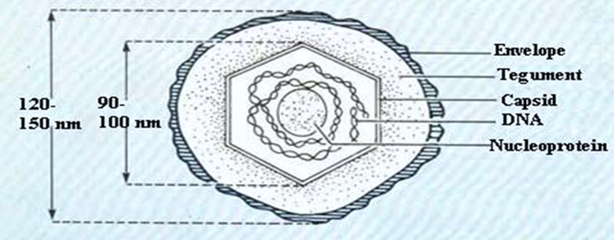
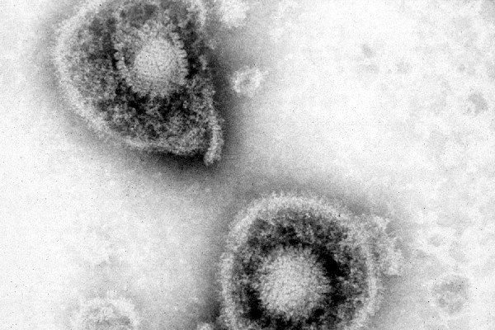
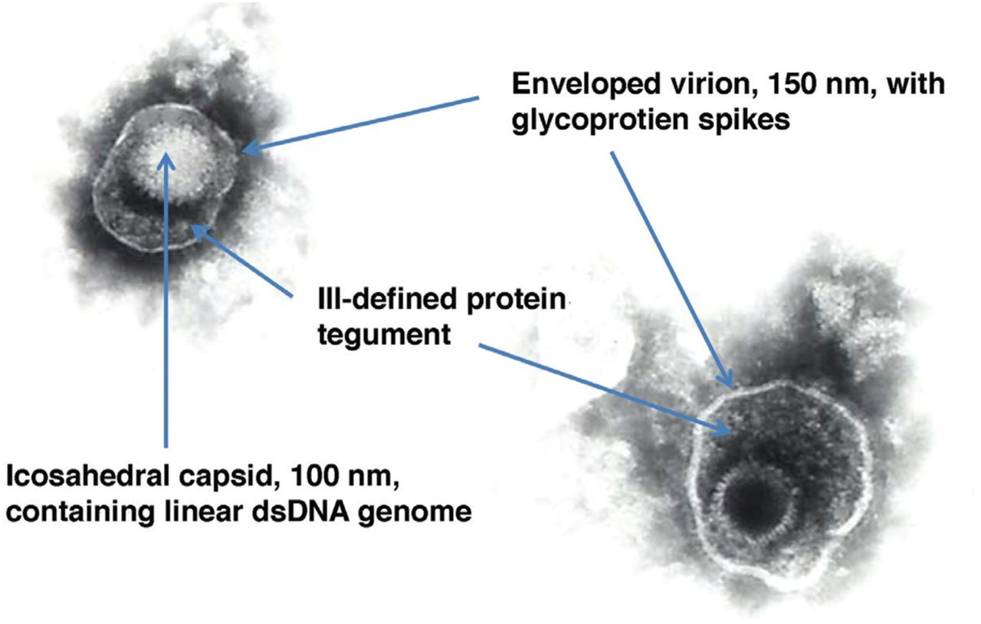
Properties of Herpesviruses
Structure and Composition
Spherical iscoahedron, 150-200 nm
Double-stranded DNA, linear
More than 35 proteins
Enveloped
Replication from nucleus (budding)
Features
Encode many enzymes
Establish latent infections
Lifelong persistence
Significant cause of death in immunocompromised hosts
Some can cause cancers
Source: Etienne Thiry

Slide 7
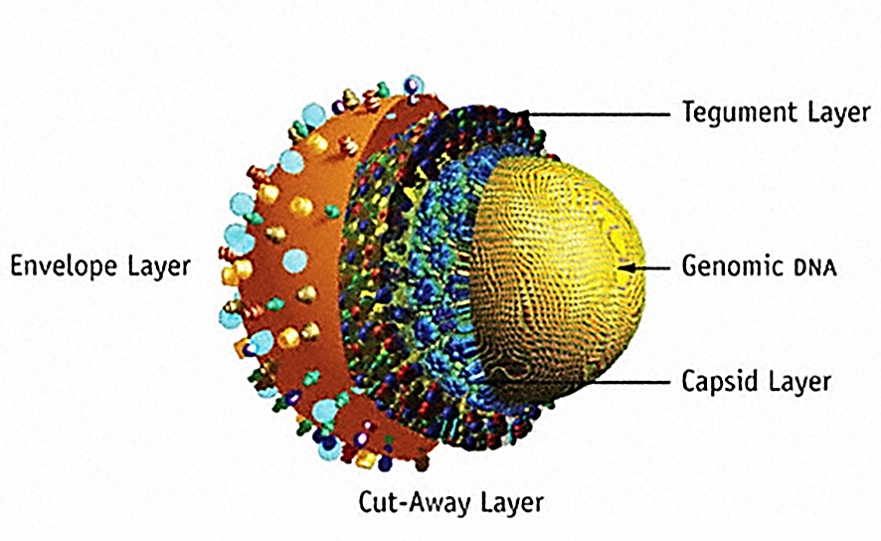
All herpesvirus virions have four structural elements.
Envelope. The envelope is the outer layer of the virion and is composed of altered host membrane and a dozen unique viral glycoproteins. They appear in electron micrographs as short spikes embedded in the envelope.
Tegument. Between the capsid and envelope is an amorphous, sometimes asymmetrical, feature named the tegument. It consists of viral enzymes, some of which are needed to take control of the cell's chemical processes and subvert them to virion production, some of which defend against the host cell's immediate responses, and others for which the function is not yet understood.
Capsid. Surrounding the core is an icosahedral capsid with a 100 nm diameter constructed of 162 capsomeres.
Core. The core consists of a single linear molecule of dsDNA in the form of a torus.

Slide 8
MORPHOLOGY

Slide 9
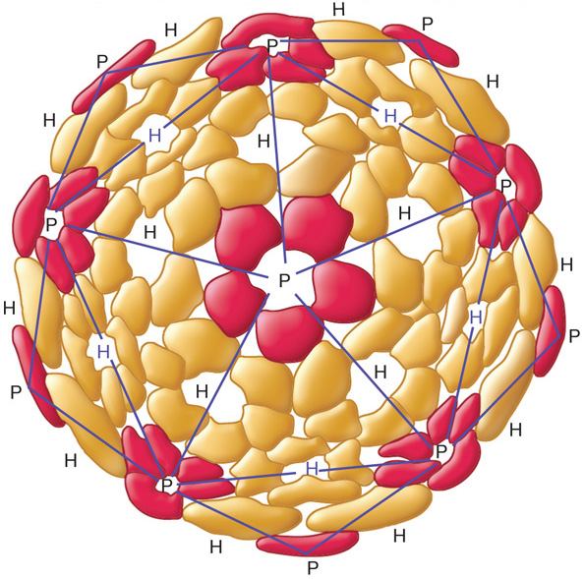
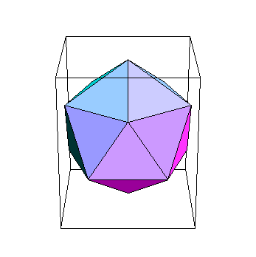
ICOSAHEDRAL CAPSID
A polyhedron with 20 equilateral faces and 12 vertices
capsomers
ring or knob-shaped units made of 5 or 6 protomers
pentamers (pentons) – 5 subunit capsomers
hexamers (hexons) – 6 subunit capsomers
Notes:
9

Slide 10
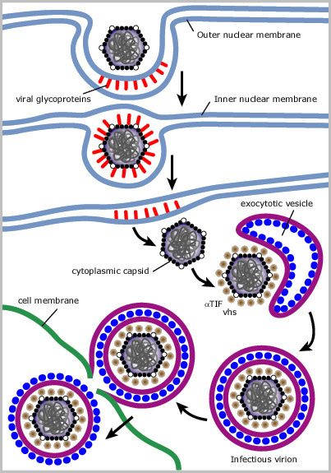
Replication of Herpesviruses
Nuclear escape
Viral proteins induce budding of the capsid through both nuclear membranes
Thus, capsid escapes into the cytoplasm
Viral proteins associate with the cellular vesicles
These proteins have affinity for the capsid proteins and cause the vesicle to wrap around the virus, providing it with an double-layered envelope
Virus traverses the ER then Golgi prior to release from the cell
The outer membrane fuses with the plasma membrane
This permits the virus to leave the cell while retaining the inner membrane

