Slide 1
Mechanism of
General Anaesthesia
Dr.Kumari Anjana Assistant Professor Deptt. of Veterinary Pharmacology & Toxicology
Bihar Veterinary College, Bihar Animal Sciences University, Patna

Slide 2
Theories of General Anaesthesia (Mode of action)
MOA of GA has been studied for many decades but still there is no clear explanation.
GA belong to different chemical classes and can produce anaesthesia in variable ways.
Anaesthetics appear to act principally on the cell membrane.
Theories of General Anaesthesia focus primarily on the interaction of anaesthetics with component of cell membrane - Lipids, Proteins

Slide 3
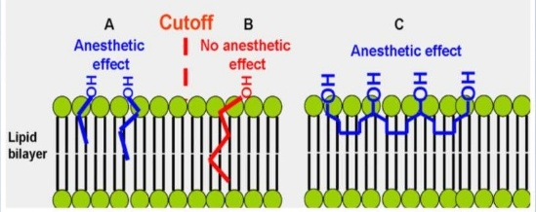
Lipid solubility theory of Overton and Meyer (1901)
Compounds with high lipid solubility easily penetrate the CNS, being rich in lipids, and alter the function of nerves.
Theory: Potency of an anaesthetic is directly proportional to its affinity and solubility in lipid portion of the nerves.
Higher the partition coefficient, higher the potency of anesthetics
Solubility in Fat / Solubility in Water = Partition Coefficient.
Figure: Interpretation of the cut-off effect in the frame off lipid hypothesis of anesthetic mechanism.

Slide 4
Surface Tension or Adsorption Theory of Traube (1904)
Ability of the agent to reduce the surface tension of the neuronal membrane by adsorption.
Alters the transmembrane ionic permeability across the neuronal membrane and interfere with nerve function (generation of AP), resulting into anesthesia.
Warbung (1921, 1930) : Accumulation of narcotic agent on cell surface caused alteration of metabolic processes, permeability and neuronal transmission resulting in anaesthesia.
Elements and Wilson (1962) : Nitrous oxide, cyclopropane, halothane and chloroform lower the surface tension.

Slide 5
Microcrystal Theory of Pauling and Miller (1961)
Anesthetics facilitate formation of microcrystals or iceberg/clathrates: (anesthetics hydrate crystals) ice crystals within the nerve cells and thus disrupt conductance of impulses.
Impede ionic mobility, electrical charge, and chemical and enzymatic activity of the brain, (produce depression and unconsciousness).
This theory does not explain anesthesia produced by barbiturates and some other anesthetics.

Slide 6
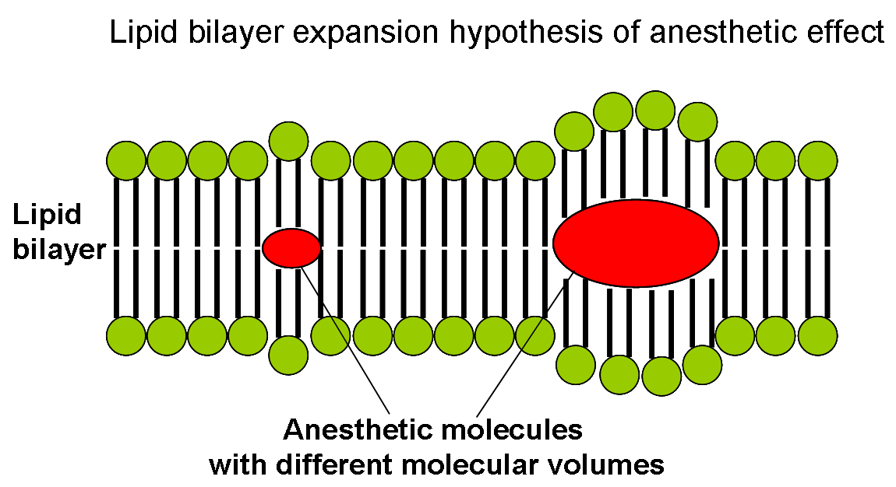
Protein Binding Theory of Frank and Lieb (1982)
Anaesthetics act by reversibly binding to a hydrophobic domain of a protein or by concentrating at the lipid-protein interface in the nerve cell membrane.
The binding causes expansion of the nerve membrane and thus interferes with the function of nerve membrane proteins.

Slide 7
Bulky and hydrophobic anaesthetic molecules accumulate inside the neuronal cell membrane causing its distortion and expansion (thickening) due to volume displacement.
Membrane thickening reversibly alters function of membrane ion channels thus providing anaesthetic effect.
Actual chemical structure of the anaesthetic agent was not important, but its molecular volume plays the major role: the more space within membrane is occupied by anaesthetic - the greater is the anaesthetic effect.

Slide 8
Receptor Theory
Anaesthetics act by interacting with the NT receptors (as agonists of inhibitory transmitters, GABA and glycine or antagonist of excitatory transmitter, glutamate, Ach and 5-HT,) in the CNS.
Anaesthetic agents affect synaptic transmission rather than axonal conduction.
GABA_{A} receptors - Halogenated anaesthetics (halothane, enflurane, isoflurane & sevoflurane) and some injectable anaesthetics like barbiturates, propofol, etomidate and neurosteroids.
Glycine receptors - Propofol, Barbiturates.
NMDA (N-methyl-D- aspartate) receptors -Ketamine, N₂O.

Slide 9
Ion Channel Theory
Anaesthetic bind to voltage-gated ion channels and reduce excitability or promote inhibition of nerve membrane.

Slide 10
Thank You

