Slide 1
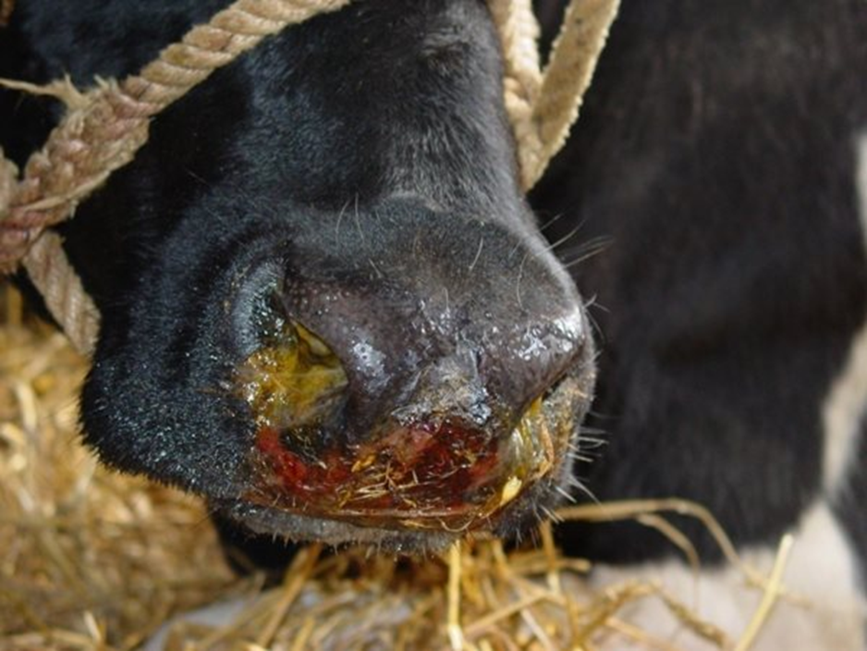
Bovine Herpesvirus 1 (BoHV 1)
INFECTIOUS BOVINE RHINOTRACHEITIS
Vetstream

Slide 2
BOVINE HERPESVIRUS 1

Slide 3
BOVINE HERPESVIRUS 1
VMC 605

Slide 4
Classification (ICTV)
Order: Herpesvirales
Family: Herpesviridae
Subfamily: Alphaherpesvirinae
Genus: Varicellovirus
Species: BOVINE HERPESVIRUS 1

Slide 5
BOVINE HERPESVIRUS 1
Genome –
double-stranded DNA
encodes for about 70 proteins (33 structural and more than 15 nonstructural proteins).
The viral glycoproteins, which are located in the envelope on the surface of the virion, play an important role in pathogenesis and immunity.
BHV-1 has two subtypes, subtype 1 and 2 (characterized by the restriction endonuclease profiles of viral DNA)
BoHV-1 can be differentiated into subtypes 1.1, 1.2a and 1.2b.
The BoHV-1.2 subtypes may be less virulent than subtype 1.1
BoHV-1 shares antigenic and genetic close relationships with other ruminant alphaherpesviruses

Slide 6
Infectious bovine rhinotracheitis
Etiology: - BoHV1 is the aetiological agent of infectious bovine rhinotracheitis (IBR), and infectious pustular vulvovaginitis (IPV) or infectious pustular balanoposthitis (IPB), is a disease of domestic and wild cattle.
Transmission :
Through infected feed , water, ocular, nasal, secretion and excretion of infected cattle
Droplet infection
Veneral transmission

Slide 7
Pathogenesis:
In primary infections, BoHV1 has potential ports of entry in the nasal cavity, oropharynx, eyes and genital tract.
Replication normally takes place in the epithelial cells, and high titres of BoHV1 are excreted at those ports of entry within 4 – 5 days post - infection.
BoHV1 shows little systemic spread and is often restricted to the local ports of entry in primary infections.
BoHV1 can spread by association with mononuclear blood cells and reach the digestive tract, ovaries and fetus, where it can lead to abortion.
A strong humoral and cell - mediated response develops within 5 days post - infection, with maximum antibody titres around days 10 – 12 days post - infection.
Residual antibody titres can be detected for up to 2 to 3 years post - infection.
Besides the viral lytic cycle, in which active replication takes place, BoHV1 can become latent when viruses migrate to the CNS ganglia (e.g. TG or sacral ganglia) and enter a dormant stage.
Different stimuli such as transport stress, calving, and other concurrent infections may lead to reactivation of BoHV1, with the virus returning to the port of entry or spreading to other organs and replicating. Although reactivation can lead to re - excretion,

Slide 8
Clinical symptoms:
IBR occurs in following forms in cattle
Respiratory form :
Clinical signs such as high fever, anorexia, coughing, excessive salivation, nasal discharge, conjunctivitis, dyspnoea and nasal lesions that often consist of clusters of necrotic lesions on the mucosa. Respiratory infection can result in abortion or neonatal death. Infections with BoHV1 alone do not usually cause death in healthy mature cattle, unless in situations where the virus causes a generalized, systemic infection. Symptoms last for 5-10 days. Morbidity – 100%; Mortality – 10 %
Genital form (IPV/IPB form):
Infection occurs through coitus or AI. In the, clinical signs often start with fever, anorexia ,frequent urination and mild mucosal irritation, and can progress to swelling of the vulva with small papules or pustules, followed by erosion and ulcers on the mucosal surface of either the vagina or the penis and prepuce.,
Occular form-
Unilateral or bilateral conjunctivitis associated with excessive lacrimation , hyperaemia of conjunctival membrane , keratitis opacity and ulceration .
Mastitic form : Symptoms of Mastitis ,
Figure : Cattle showing symptoms of nasal discharges
Figure : Cattle showing ocular discharges and corneal opacity.

Slide 9
Encephalitic from :
Occurs in calves associated with symptoms of encephalomyelitis, high fever, incoordinated movement, tremor, circling, falling, coma and ultimately death
Enteric form :
Diarrhoea in calves and enteritis in adult cattle
Epidemiology
The virus is present in secretion and excretion of infected animals .
Transmission is through contact of infected animal , which excrete virus for prolong period.
Herd becomes infected after introduction of new animal carrying virus.
BoHV-1 established latent infection in recovered animal
Virus transmit through semen of infected bull.

Slide 10
Diagnosis
Identification of the agent
a) Collection and processing of samples
Nasal swabs -mucopurulent nasal discharge are collected from several (from five to ten) affected cattle in the early phase of the infection.
In cases of vulvovaginitis or balanoposthitis, swabs are taken from the genitals.
The prepuce can also be washed with saline; the washing fluid is then collected.
The specimens are suspended in transport medium (cell culture medium containing antibiotics and 2–10% BoHV-1-free fetal bovine serum to protect the virus from inactivation), cooled at 4°C, and rapidly submitted to the laboratory.

Slide 11
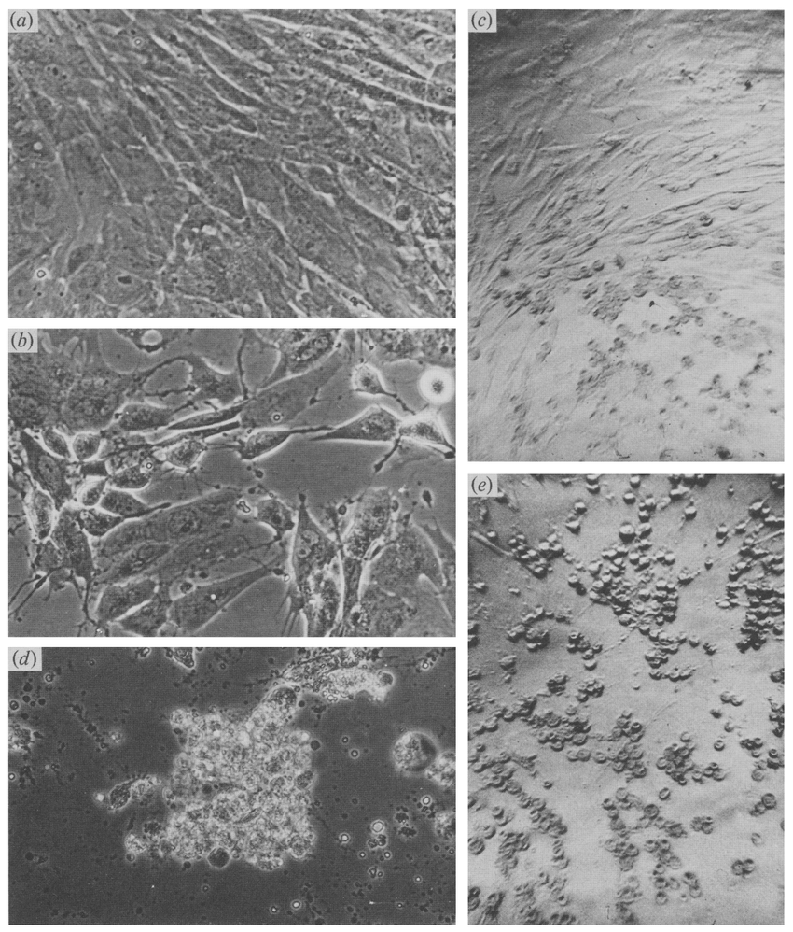
b) Virus isolation and identification
For virus isolation, bovine cells of various origins can be used.
Primary or secondary bovine kidney, lung or testis cells,
Cell strains derived from bovine fetal lung, turbinate or trachea, and established cell lines, such as the Madin–Darby bovine kidney cell line (MDBK), BHK-21 are suitable for BoHV-1 propagation.
CPE- rounding of cells, syncytia formation, Large intranuclear inclusion bodies
BoHV-1 does not grow in embryonated egg.
Cytopathic effect caused by BH V-6 (E/CH) and BHV-1 (IBR 'LA'). (a) Uninfected bovine foetal lung cells; (b) 12 h after infection with E/CH; (c) 24 h after infection with IBR "LA'; (d) 36 h after infection with E/CH; (e) 48 h after infection with IBR 'LA'. (Magnifications : a, b, d x 560; c, e x 224.) BHV-6-infected cells (b, d) show swelling and vacuolization, followed by detachment in clumps, whereas BH'q-l-infected cells (c, e) round off and detach.
Source: Hans R. Gelderblom

Slide 12
C) Immunological test :
Immunohistochemistry or electron microscopy.
gB - based serological assays to identify the presence of BoHV1 infections, especially as antibody titres raised against gB tend to persist for long periods after infection,
Seroneutralization Test (SNT)
ELISA
d) PCR based diagnosis
Definitive diagnosis is achieved by viral isolation, detection of viral DNA by specific PCR or restriction endonucleases analysis.

