Slide 1
Drugs acting on Respiratory System
Presented by:-
Dr.Archana
Assistant Professor_cum_Jr.Scientist
Deptt.Of Pharmacology & Toxicology
Bihar Veterinary College, Patna

Slide 2
DRUGS ACTING ON RESPIRATORY SYSTEM
* Antitussive
* Expectorant
* Respiratory stimulants
* Bronchodilators
* Mucolytics

Slide 3
Antitussive
Antitussive are drugs that suppress coughing, by reducing activity of cough center in brain.
Antitussive agents are used to relieve dry cough.
These are of 2 types :
Peripherally acting
Centrally acting

Slide 4
Continue…
Peripherally acting –
It depress tracheal & bronchial afferent sensory nerves and pulmonary stretch receptors, thus prevents activation of medullary cough center.
Example –
Ephedrine – it is an alkaloid obtained from Chinese herb Ma huang, it has been employed in Chinese indeginous medicine. It relaxes the bronchial smooth muscle.
Benzonatate – It is structurally related to local anaesthetic tetracaine, it exerts local anesthetic effects on cough receptors in respiratory tract.

Slide 5
Continue…
2. Centrally acting –
Suppress cough by direct depression of medullary cough center.
Examples-
Codeine Pholcodeine Dextromethorphan
Butorphanol hydrocodone Noscapine

Slide 6
Expectorants
Drugs which increases fluidity & volume of bronchial secretions
Helps in easy expulsion through coughing
Also helps in promoting pulmonary drainage during inflammation
there are 4 types –
Inhalation Expectorants
Sedative Expectorants
Stimulant Expectorants
Anodyne Expectorants

Slide 7
Continue…
Inhalation Expectorants – Increase bronchial secretion by local action Eg.- Eucalyptus Oil, Turpentine Oil.
Sedative Expectorants – stimulate mucus secretion in bronchi, protects & reduce acute inflammation in Respiratory passage.
a. Saline Expectorants – increase mucus from GIT.
Eg. Ammonium Chloride, Potassium Iodide
b. Demulcent Expectorants soothening action in upper respiratory tract.
Eg. Balsam of Tolu, Vasaka syrup.
c. Nauseant Expectorants – increase respiratory secretions by nausea,
Eg. Ipecac

Slide 8
Stimulant & Anodyne Expectorants
3. Stimulant Expectorants – stimulate & promote repair of chronic inflammatory process.
Eg. Guaiacol, Guaifensin, Eucalyptus Oil, Turpentine Oil
Anodyne Expectorants – Extensively increase respiratory secretion through GIT.
Eg. Camphorated tincture of opium(Paregoric).

Slide 9
Bronchodilators
Drugs that relax Bronchial smooth muscles, dilate respiratory passage & relive bronchial spasm.
Classification based on mode of action –
β2-adrenoceptor agonists –– salbutamol, terbutaline bambuterol.
Xanthines/Methylxanthines – Direct relaxant action on bronchial smooth muscles – caffeine, aminophylline & theophylline.
Anticholinergic – act by blocking cholinergic muscarinic receptors – Ipratropium

Slide 10
Continue…
D. Antihistamines (H1 Antagonists)
– Promethazine, Diphenhydramine.
E. Cromolyn – inhibit histamine & leukoriene release
F. Cysteinyl-Leukotriene Receptor antagonists – act by preventing Leukotriene induced bronchoconstriction – Zafirlukast, Montelucast
G. Anti-inflammatory agents – Act by reducing formation of cytokines,
Eg. – Prednisolone.

Slide 11
Respiratory Stimulant (Analeptics)
Drugs which cause stimulation of depressed respiration
Doxapram – drug of choice in emergency cases, act by stimulation of respiration.
Nikethamide – First respiratory stimulant.
Methyl Xanthines – Caffeine, Aminophylline.

Slide 12
Mucolytics
These are the drugs which loosen or break viscous or inspissated pulmonary secretion to facilitate expectorations.
Eg- Bromhexine (Adhatoda Vasica)
Acetyl cysteine

Slide 13
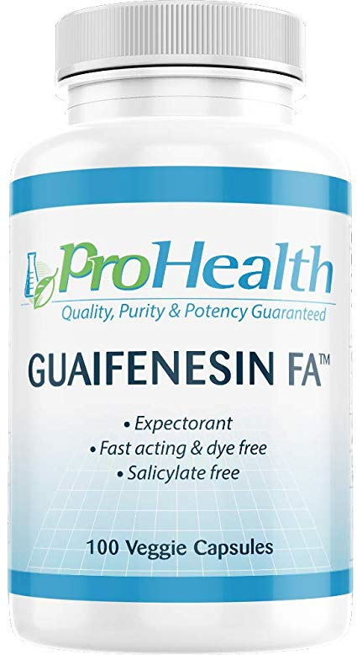

Slide 14
THANKS

