Slide 1
Drugs that affect the Urrogenital System
Presented by:-
Dr.Archana
Assistant Professor_cum_Jr.Scientist
Deptt.Of Pharmacology & Toxicology
Bihar Veterinary College, Patna

Slide 2
Drugs acting on Urogenital System
Diuretics
Classification of Diuretics
Urinary Acidifiers
Urinary Alkalizes
Urinary Antiseptics
Fluid Therapy
Ecbolics
Tocolytics

Slide 3
Diuretics
These are drugs or agents that increase the volume of urine.
Indications:
(i) In the treatment of oedema due to cardiac failure.
(ii) Renal disease
(iii) Cirrhosis of the liver.
(iv) In the treatment of hypertension

Slide 4
Classification of diuretics :-
Osmotic Diuretics : Mannitol, Glycerol
Carbonic Anhydrase Inhibitors : Acetazolamide , Methazolamide
Thiazide Diuretics : Hydrochlorthiazide, Metolazone, Chlorthalidon
Potassium Sparing Diuretics : Amiloride, Triamterene
Aldosterone antagonist : Spironolactone, Canrenone
Mercurial Diuretic : Calomel, Mersalyl
Loop Diuretic (High Ceiling ): Furosemide Bumetanide, Ethacrynic Acid
Xanthine derivatives : Theophylline, Aminophylline, Caffeine
(

Slide 6
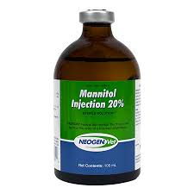
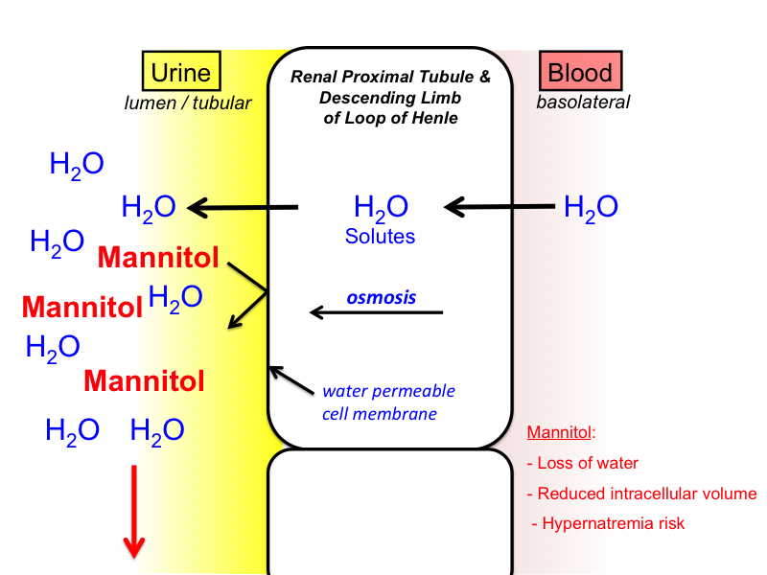
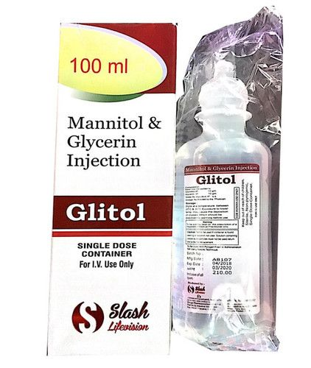
Osmotic diuretic

Slide 7
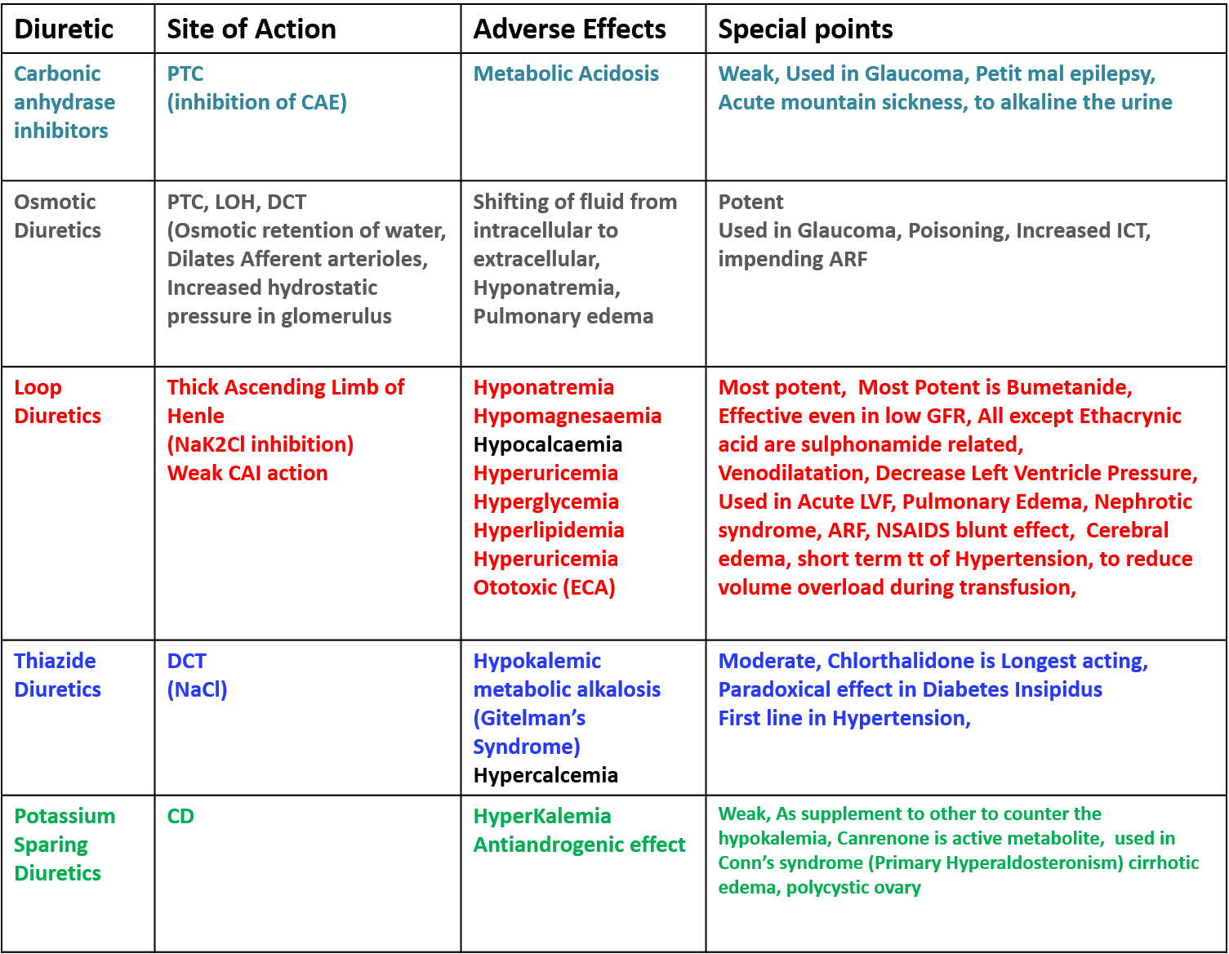
Continue….

Slide 8
URINARY ACIDIFIERS
Urinary acidifiers are drugs which cause acidification of urine.
* They help in increased excretion of basic drugs
* They enhance the antibacterial action of urinary antiseptics like hexamine and certain antibiotics (Penicillins and Tetracyclines).
Eg- Sodium acid phosphate, Ascorbic acid, Methionine

Slide 9
URINARY ALKALIZERS
Urinary Alkilizers are basic agents for alkalinization of urine.
* Alkalinization of urine promotes antibacterial action of certain antibiotics (Aminoglycosides).
* It helps in excretion of acidic drugs.
* It increasing the solubility and reducing the risk of sulfonamide renal toxicity (crystalluria) especially in carnivores.
Eg – Sodium bicarbonate
3.

Slide 10
Urinary antiseptics
Urinary antiseptics are oral agents that exert antibacterial activity in the urinary tract.
* It has little or no systemic antibacterial effects.
* It’s usefulness is limited to lower urinary tract infections
Eg – Nitrofurantoin, Methenamine , Nalidixic acid, calcium Mandelate

Slide 11
Fluid therapy
D. Fluid therapy consist of administration of isotonic fluids to correct body’s fluid imbalance.
Indication : Haemorrhage, Vascular shock, Anaemia, Haemolysis
Different fluids used are : whole blood, Blood plasma Blood serum, Plasma Volume Expanders

Slide 12
Continue….
Condition | Electrolyte Solution
Mild acidosis | 1.3% sodium bicarbonate in saline or 5% dextrose
Severe Acidosis | 5 % sodium bicarbonate or Ringer’s lactate
Acidosis and Hyponatremia | Ringer’s lactate + sodium bicarbonate @5gm/litre
Alkalosis & Hypokalemia | Potassium acidifying solution
Acidosis, Alkalosis, Dehydration, Loss of Electrolytes | Balanced electrolyte solution

Slide 13
Ecbolics or Oxytocics
An ecbolic is an agent which stimulates contraction in the uterus at term, esp. in the treatment of atonic or hypotonic parturient uterus. Ecbolics are used at term, usually when parturition has commenced. Their action is to increase the contractile activity of uterine muscle.
E.g. Oxytocin, Ergot alkaloids, prostaglandins.

Slide 14
Tocolytics
The drugs which relax or inhibit the smooth muscles of the gravid uterus are called as tocolytic agents or uterine spasmolytics or uterine relaxants. The tocolytics inhibit both the spontaneous and oxytocin induced contractions of the pregnant uterus. Their clinical applications include prevention of premature labour or to delay parturition for managemental convenience.
E.G :- Isoxsuprine, Salbutamol, Terbutaline, Ritodrine and Orciprenaline etc.

Slide 15
Classification of drugs acting on the uterus
Uterine stimulant:-
1. Posterior pituitary hormone – Oxytocin
2. Ergot alkaloid- Ergometrine, Methylergometrine
3. Prostaglandins- PGE2, PGF2α
4. Miscellaneous – Quinine, Ethacridine
B. Uterine relaxant:-
1.Adrenergic agonist- Salbutamol, Terbutaline, Ritodrine
2. Calcium channel blocker – Nifedipine
3. Prostaglandin Synthesis inhibitors- Aspirin, Ibuprofen, other NSAIDS
4. Miscellaneous – Progesterone, Ethyl alcohol Anticholinergics.

