Slide 1
PARVOVIRIDAE
VMC 311

Slide 2
Canine Parvovirus
Canine parvovirus (CPV-2) appears to be a mutant strain of feline parvovirus
Some breeds are more sensitive to CPV infection
The virus is considered ubiquitous in the environment
It is a hardy virus
Can survive for extended periods on fomites
Transmitted through oral-fecal route
Symptoms: dehydration, vomiting, bloody diarrhea
Vaccine is available

Slide 3
Family: Parvoviridae
classified into two subfamilies:
a). Parvovirinae- contains viruses of vertebrates,
b). Densovirinae- requires helper viruses for productive infection
Subfamilies: Parvovirinae
Genus:
Parvovirus - Canine parvovirus (CPV)
Erythroparvovirus
Dependoparvovirus

Slide 4
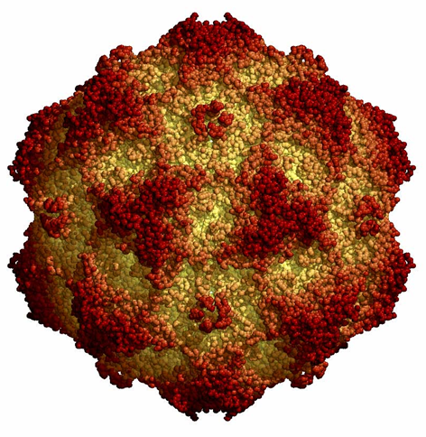
Properties of Parvoviruses
Structure
Icosahedral
18-26 nm diameter
Single-stranded DNA, 5.6 kb
Two proteins
Nonenveloped
Classification
Parvoviridae (vertebrates)
Parvovirus
Erythrovirus
Dependovirus (requires helper virus, such as an adenovirus)
Densovirinae (insects)

Slide 5
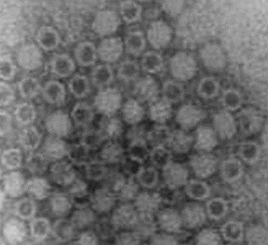
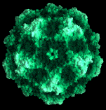
Parvoviruses parvus = small (latin)
Parvoviruses parvus = small (latin)
Type species of famly Parvoviridae- Parvovirus B19
Key Features:
Icosahedral capsid (20 nm) [no envelope]
Small, linear ssDNA genome (5 kb)
Infect and kill dividing cells
Persist for long periods in the environment (extremely resistant to heat and to high or low pH)
Cross placenta, causing infection of the foetus
Generally species-specific (but interspecies transmission between carnivores)
Generally cause disease in YOUNG animals

Slide 6
Morphology:
Virions : enveloped.
Capsids: isometric.
Nucleocapsids : 18-22 nm in diameter, or 20-26 nm in diameter.
Symmetry: icosahedral.
Nucleocapsids appear to be round.
Capsomers: 60 capsomers per nucleocapsid (each a quadrilateral 'kite-shaped' wedge).
Peplomers: Surface projections of nucleocapsid small (surface appears rough) and distinct; spikes.
Virions only of one kind, or may occur together with a dependent virus.

Slide 7
'kite-shaped' wedge
Virions not enveloped. Capsids isometric. Nucleocapsids sometimes penetrated by stain. Nucleocapsids 18-22 nm in diameter, or 20-26 nm in diameter. Symmetry icosahedral. Nucleocapsids appear to be round. 60 capsomers per nucleocapsid (each a quadrilateral 'kite-shaped' wedge). Surface projections of nucleocapsid small (surface appears rough) and distinct; spikes. Virions only of one kind, or may occur together with a dependent virus.

Slide 8
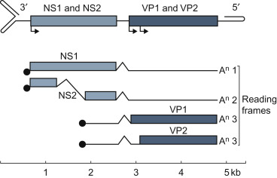
Properties of Genome
DNA. Single stranded.
Linear
genomic nucleic acid negative sense, or negative sense and positive sense
Genome monopartite
Total genome 5000 nucleotides long
Genome sequence has terminal repeated sequences; repeated at one end, or repeated at both ends. 5'-terminal sequence with inverted repeat of the 3'-terminus, or palindromic repeats forming a hairpin structure (if distinct from 3'-terminal sequence)
Terminal repeats at the 5'-end 120-300 nucleotides long (and longer). Nucleotide sequences of 3'-terminus complementary to similar regions on the 5' end, or unrelated to 5'-terminus; conserved nucleotide sequences; the same in species of same genus
3'-terminal sequence has palindromic arrangement (interrupted by two smaller internal palindromic sequences), or palindromic repeats folding into a T- or Y-shaped structure
Terminal repeats at the 3'-end 120-300 nucleotides long (and longer)
Genome divided among more than one type of particle (in some cases); that is 2 different types (one containing the minus strand and the other the plus strand in up to 50% of the population).

Slide 9
Source: X-ray crystallography from the Institute for Molecular Virology - Wisconsin.

Slide 12
Members of veterinary importance
Feline panleukopaenia virus (FPV)
Canine parvovirus (CPV)
Goose parvovirus (GPV): lethal in young goslings causing hepatitis and myocarditis.
Bovine parvovirus: diarrhoea in calves
Infect dividing cells – generalised disease in fetus/newborn, enteritis, leukopaenia

Slide 13
Canine parvoviruses
Canine parvovirus (CPV-2) appears to be a mutant strain of feline parvovirus
Some breeds are more sensitive to CPV infection
The virus is considered ubiquitous in the environment
It is a hardy virus
Can survive for extended periods on fomites
Transmitted through oral-fecal route
Symptoms: dehydration, vomiting, bloody diarrhea
Vaccine is available

Slide 15
Properties of Parvoviruses
Replication
Attachment and entry
Translocation of viral DNA into nucleus
Transcription and translation of viral nonstructural protein and nucleocapsid
DNA replication
Virus assembly (nucleus)
Release from the cell through lysis

Slide 16
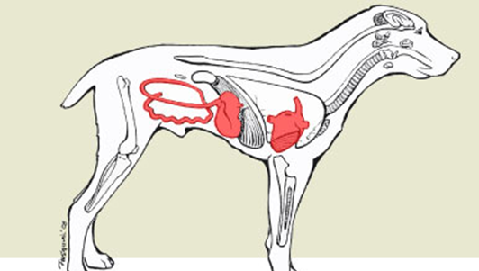
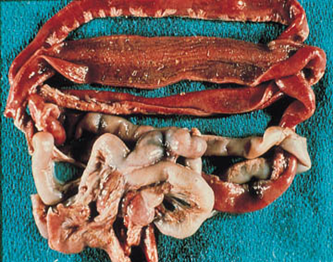
Canine parvovirus 2
Pathogenesis: infection of rapidly dividing cells
Enteritis [blunted villi]
Leukopenia
Myocarditis in neonatal puppies
Cause of ‘fading puppies’

Slide 17
Clinical Symptoms
Develop within 3-7 days of infection; virus is shed in feces within 4-5 days of infection (may not be sick before spreading the virus)
Initial signs: Depression, lethargy, fever, anorexia
Abdominal pain, vomiting, diarrhea (often bloody), dehydration, hypothermia (shock)

Slide 18
Canine parvovirus infection Heart failure due to myocarditis (inflammation of heart muscle
Grossly dilated ventricles
CPV infected
(unvaccinated mother)
Normal

