Slide 1
Plague

Slide 2
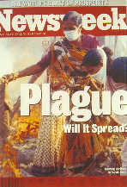
Plague (Metazoonoses type I)
Also K/as
Mad rat disease
Black death
Mahamari
Pestilential fever
Buboes
Pest
"Black death" inspired one of the most enduring nursery rhymes in the English language, “Ring a Ring O'Roses, a pocket full of posies / Ashes, ashes (or ah-tishoo ah-tishoo), we all fall down”.

Slide 3
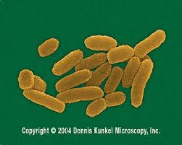
Etiology
Yersinia pestis
Family: Enterobacteriaceae
A gram negative,
Non-spore forming,
Non-motile,
Coccobacillus
looks like "safety pin" (i.e. bipolar)
(Staining: methylene blue stain or Giemsa's stain or Wayson's stain)
Forms capsule: In living tissues
Not very resistance to physical & chemical agents

Slide 4
Etiology
Coagulase a protein secreted Yersinia pestis
Clot the blood
Coagulase is inactive at high temperatures: Cessation of plague transmission during very hot weather
Pathogenicity is determined by:
Fractions (F1), V, W, endotoxin & exodoxin (cardiotoxin)
F1 is a capsular heat labile protein (used in serological tests)
F1, V & W fractions: Make resistant to phagocytosis
Cardiotoxin: lethal to mice & rats

Slide 5
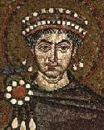
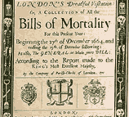
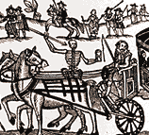
Epidemiology: Pandemics
The first pandemic: Justinian’s Plaque
Started in 542 AD in Egypt
Spread to Asia & Europe
100 million deaths
The second pandemic: Black Death
Started in 1347-1352 AD from Jaffa
Spread to China, India & Europe
25 million victims
The third pandemic:
Started in 1894Yunnan in China
Spread to India and to Europe, Asia & Africa
Killed more than 12 million people in India &
China alone in the period from 1898-1918
Justinian the Roman Emperor

Slide 6
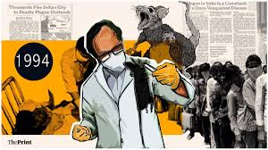
Outbreaks: In India
Human plague
In 1966: Kolar district (Maharastra)
In 1994 (August to September): two outbreaks
Beed district (Maharashtra) & Surat (Gujarat)
Outbreaks suspected to be of plague were reported from Bihar & HP
Sylvatic foci of the disease are located in the Deccan plateau, foothills of Himalayas & the watersheds of Vindhya, Bhanier & Maikal ranges (MP)

Slide 7
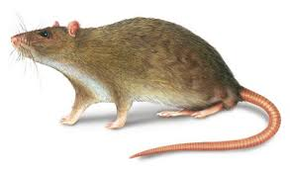
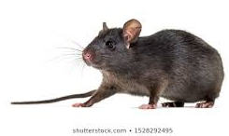
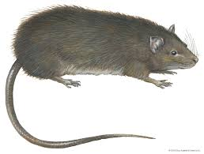
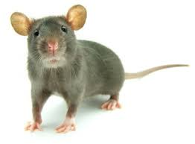
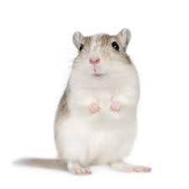
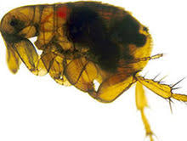
Epidemiology: Host range & reservoir
Primary host: Rodents
Reservoir of infection:
Fleas may remain infected for months R. rattus
Other host: cats, pigs, cattle, sheep, goat, horse, deer etc.
Dogs: No overt clinical signs Sentinel animals
R. norvegicus
R. rattus
Bandicota
Rat fleas
(Xenopsylla cheopis)
Rodents
Gerbil

Slide 8
Source & Transmission
In Animals
In rats : By the bite of infected flea
Camel: Infection by ingestion of contaminated hay
Cats: Feeding on infected rodents
Y. pestis: enter in to the body through skin, conjunctiva, oral route & inhalation route
Contact with infected rat fleas (X. cheopis) or rodents
Pulmonary form spread by airborne or droplet infection
Human infections
From non-rodent species
Direct contact with infected tissues
By scratch or bite injuries
Handling of infected animals
Man to man transmission is mainly air-borne

Slide 9
Source & Transmission
The main routes of infection in man are:
Domestic rat-rat flea-man (bubonic plague)
Wild rodent-flea/ contact-man
Wild rodent-flea-domestic rodent-flea-man
Man-human flea-man
Man-man by droplet (pneumonic plague)
By handling of infected rodents
Ingestion of contaminated animal tissue
Bites of infected cats
Bites of ticks, lice and bed bugs
Use of clothes infected with flea
In India vector of the disease three species of
Rat flea: X. cheopis, X. astia & X. brasiliensis
The gerbil flea: Nosapsyllus nilgeriensis

Slide 10
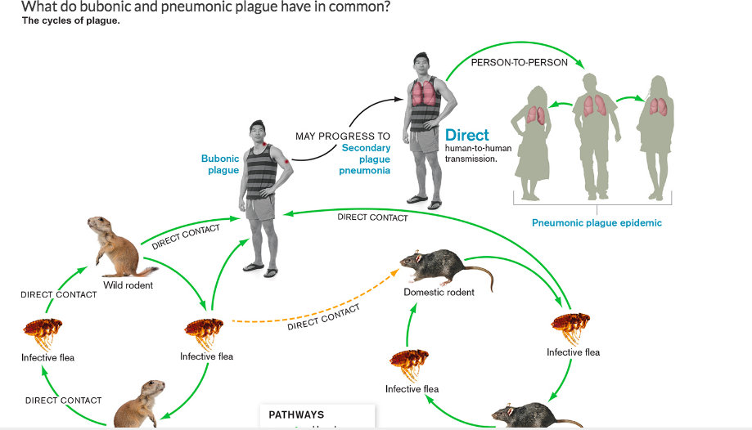

Slide 11
Manner in which fleas transmit plague
Flea feeds on Y. pestis infected blood
Y. Pestis enters flea’s midgut & multiplies logarithmically
Clump of Y. pestis forms in the midgut, blocking fleas foregut
During next meal, blood cannot enter the midgut & flea gets very hungry
Flea bites vigorously & regurgitates the contents of its midgut into the next wound
Coagulase by Y. pestis
"Blocked flea condition".

Slide 12
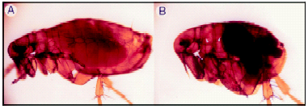
Importance of flea blockage
(A) Unblocked, uninfected flea (B) blocked, infected flea on the right
http://www.asm.org/ASM/files/CCLIBRARYFILES/FILENAME/0000000467/nw20030086p.pdf
Experiments indicate that only blocked fleas effectively transmit plague to mammals

Slide 13
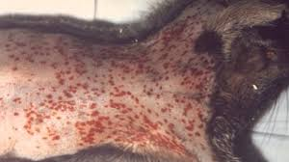
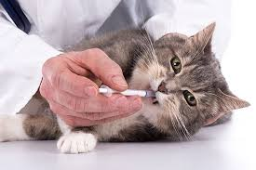
Disease in animal
Primarily effects: Animal of order Rodentia
(Effect both wild & domestic rodents)
Lesser degree: Rabbits & hairs
Infection: Acute, Chronic & Inapparent
Domestic rats: more susceptible, Rattus rattus die in large number during to epizootic
Acute cases: Haemorrhages with buboes & spleenomegaly, without other internal lesions
Sub acute cases: Buboes (caseous), & Punctiform necrotic foci are found in spleen, liver, lung
In dogs: Illness is self-limiting,
In cats: Severe
Often fatal infection, characterized by formation of abscess, lymphadenitis, lethargy, & fever.
Kittens: Secondary pneumonia

Slide 14
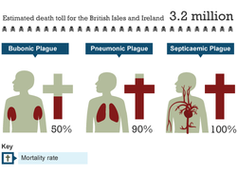
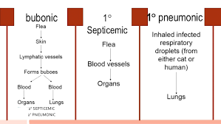
Disease in man
Incubation period: 2-6 days
The Three clinical forms:
Bubonic plague
Septicemic plague
Pneumonic plague
All three clinical forms start with:
Fever, chills cephalgia, nausea,
Generalized pain, diarrhoea or constipation,
Toxemia, shock, arterial hypotension,
Rapid pulse, anxiety, staggering gait,
Slurred speech, mental confusion, &
prostration

Slide 15
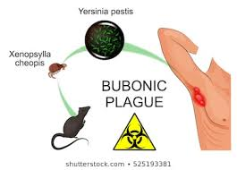
Disease in man
Bubonic plague:
The most common form
Incubation period: Few hrs -12 d (2-7 d after flea bite)
Small vesicle at the site of flea bite
Symptoms:
Fever
Swollen, tender lymph nodes, "Buboes".
The bubo: 1 to 2 cm
Extremely painful &
surrounded area become odematous
More common: Inguinal, groin & axial region
Inguinal buboes: the pain in abdomen, vomiting & diarrhoea, which may be bloody
Fatality rate: 25% to 60% (in untreated cases)

Slide 16
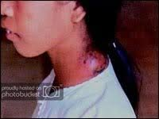
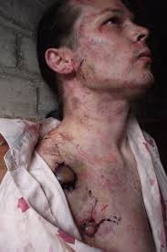
Bubonic plague

Slide 17
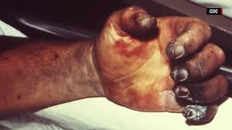
Disease in man
Systemic plague / Septicemic plague:
The bubonic form spreads into the blood
Onset of disease: rapid (death in 2 days)
Case fatality rate: 100%
Develops nervous & cerebral symptoms
Symptoms are:
Epistaxis
Cutaneous petechiae
Hematuria
Involuntary bowel movements

Slide 18
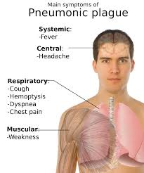
Disease in man
Pneumonic plague:
The incubation period : 3 to 5 days
The most serious form
Primary: by direct inhalation of bacteria
Secondary: Derived from bubonic/
Systemic form
Symptoms:
High fever, chills & often severe headache
Cough develops in 24 hours
The sputum: Clear at first,
Later foamy/haemorrhagic
Rapid progressive pneumonia (no pleurisy)
Death occurs in 2 days
Mortality may exceed 50%
Complication: Meningitis

Slide 19
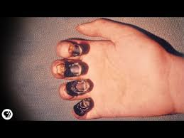
Disease in man
Pestis minor:
It is a mild form of plague
Usually occurs: in endemic area
Symptoms are: swollen lymph nodes, fever, headache & exhaustion, which subside within a week
Plague is also called the "black death" because disseminated intravascular coagulation takes place & areas of skin undergo necrosis

Slide 20
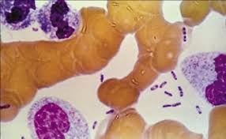
Diagnosis
History & clinical presentation:
Bubos, subcutaneous & generalized congestion, granular liver, congested spleen & pleural effusion
Demonstration of plague bacilli:
Impression smears of aspirates from buboes or blood or sputum
Safety pin like morphology
Gram staining
Wayson staining
(Bipolar stainning)

Slide 21
Diagnosis
Isolation of organism: On cefsulodin-Irgasan-novobiocin (CIN) agar , blood agar
On blood agar
On CIN agar
Grey white translucent colony after 24 h
Smooth, round opaque, irregular edges, raised center, flat periphery (Fried egg appearance)

Slide 22
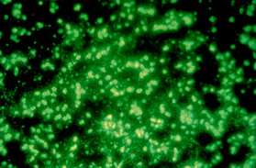
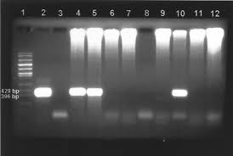
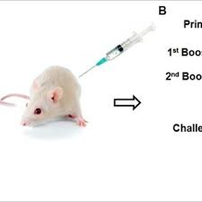
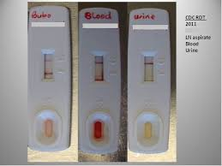
Diagnosis
FAT: Antibodies against F1 antigen
Serology:
CIE, ELISA, CFT, PHA, Dot-ELISA
Molecular diagnosis: PCR
Animal inoculation
Rapid diagnostic Kit:

Slide 23
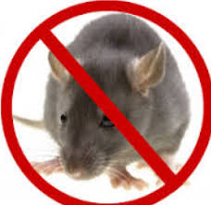
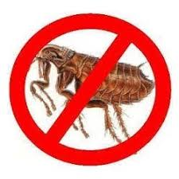
Treatment & Control
Treatment:
Streptomycin with tetracycline or chloramphenicol is effective
Continuous surveillance:
Sentinel animal programmes should be used in endemic areas
Prompt diagnosis and medical care
Chemoprophylaxis to the exposed group
Rodent control
By use of rodenticides like warfarin, zinc phosphate
Fumigation with carbon disulphide, SO₂, methyl bromide
Proper disposal of garbage
Proper storage of food grains
Trapping
Elimination of fleas:
BHC as 3% dust or 3% malathion

Slide 24
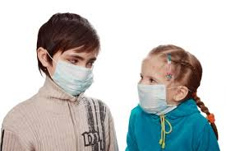
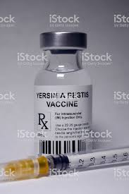
Treatment & Control
Disinfection:
Masks, gowns and gloves should be worn when handling cats suspected to be infected.
All contaminated surfaces with sputum, discharges & dead rats by sanitation
Vaccination:
Two doses of formalin killed whole bacteria vaccine are given at interval of 7 to 14 days.
Immunity starts one week after vaccination
Confers immunity for 6 months
Isolation of plague affected people must be done

