Slide 1
Intravenous Anaesthetics
Dr.Kumari Anjana Assistant Professor Deptt. of Veterinary Pharmacology & Toxicology
Bihar Veterinary College, Bihar Animal Sciences University, Patna

Slide 2
INTRAVENOUS ANESTHETICS
Barbiturates Anaesthetics- Thiopentone, Thiamylal, Thialbarbitone, Methohexitone and Pentobarbitone
Non – BarbituratesAnaesthetics -
Phenol derivatives- propofol
Imidazole derivatives- etomidate and metomidate
Steroidal anesthetics- saffan (alphaxalone-alphadolone)
Chloral derivatives- chloral hydrates.
Benzodiazepines- midazolam and diazepam.
Opioid and neurolept analgesics-fentanyl, fentanyl- droperidol combination.
Miscellaneous anesthetics- chloralose and urethane.
Dissociative anaesthetics- ketamine, tiletamine, Phencyclidine.

Slide 3
Advantages
Easy, rapid and smooth induction of anaesthesia.
Smooth recovery with no complications as seen in inhalational anaesthesia.
Vomiting absent during induction.
No interference in operations of head region.
Minimum equipment is required.
Can be used with thermocautery and diathermy.
Respiratory complications are not aggravated.
Surgeon alone can manage anaesthesia and perform surgery.

Slide 4
Disadvantages
Level of anaesthesia not readily controllable.
No adequate skeletal muscle relaxation.
Contraindicated in hepatic and renal diseases.
Unsuitable (barbiturates) for caesarean section (depression of foetal respiration).

Slide 5
Barbiturates
Derivatives of melonyl urea.
A condensation product of urea and malonic acid.
Synthesized by-Conrad and Gutzeit in 1882.
Fisher and Von Mering prepared diethyl barbituric acid and discovered its hypnotic activity.
They named it as Veronal from the Latin word vera (true) having real hypnotic effect.
Baeyer named malonylurea as barbituric acid, which formed the key molecule for a series of hypnotics.

Slide 6
Barbiturates Classification
Based on duration of action:
Long acting-(4-6 hr) - Barbitone,
Phenobarbitone
Intermediate acting (2-4 hr) - Pentobarbitone,
Butobarbitone
Short acting (1-2 hr) - Secobarbitone
Ultra Short acting (20-40 min.) Thiopentone,
Thiamylal

Slide 7
Structure activity relationship
Barbituric acid itself has no CNS depressant effect.
Substitution of alkyl, allyl groups at carbon 5, on its structure results in sedative-hypnotic-anaesthetic effect.
Short chain substitution at R1 and R2 resists oxidation results in compounds having long duration of action.
Long chain substitution at R1 and R2 promotes oxidation – short acting compounds.

Slide 8
S.A.R. contd…
Replacement of carbonyl oxygen at C2 by sulphur atom makes the compounds highly vulnerable to oxidative metabolism rendering the compounds very short acting.
Replacement of carbonyl oxygen at C2 by an HN= group (guanidine derivatives) destroys CNS depressant activity.
Substitution at C5 should not be less than 4 and not more than 8 for optimal CNS depression.
Substitution at C5 with long chain having more than 9 carbon atoms makes the compound convulsant.

Slide 9
MOA of Barbiturates
Barbiturates appear to act primarily at the GABA:BZD receptor – Cl⁻ Channel complex and potentiate GABAergic inhibition by increasing the lifetime of Cl⁻ Channel opening induced by GABA.
They do not bind to the BZD receptor, but bind to another site (probably the picrotoxin) on same macromolecular complex to exert the GABA facilitatory action.
The barbiturate site appears to be located on α or β subunit.
They also enhance BZD binding to its receptor.

Slide 10
MOA of Barbiturates contd…
At high concentrations, barbiturates directly increase Cl⁻ conductance (GABA- mimetic action; contrast BZD which have only GABA facilitatory action) and inhibit Ca++ dependent release of neurotransmitter.
In addition they depress glutamate induced neuronal depolarization through AMPA receptors.
At very high concentrations, barbiturates depress voltage sensitive of Na⁺ and K⁺ channels.

Slide 11
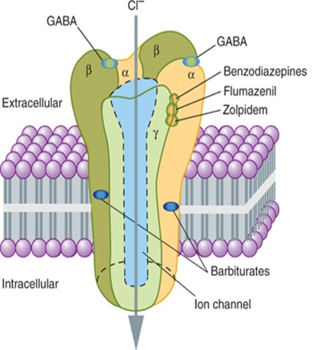
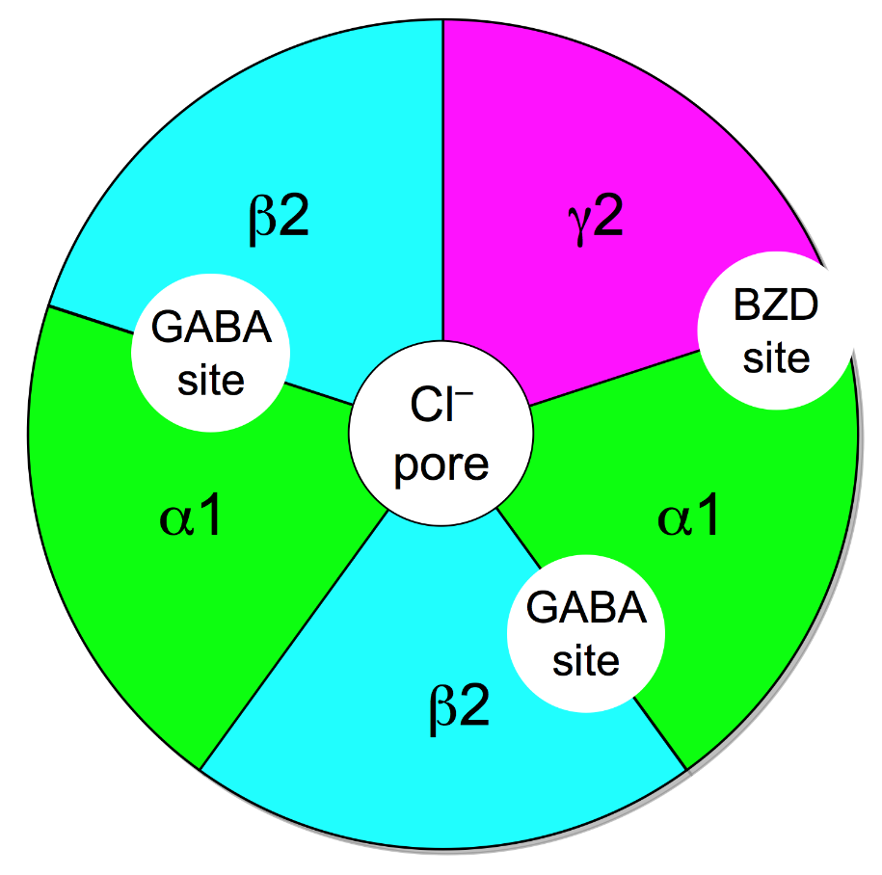
Fig: GABA Receptor chloride channel complex
Fig: GABA Receptor chloride channel complex.
(linear view)
Fig: GABA Receptor (front view)

Slide 12
Drugs affecting GABA_{A} receptor – Cl⁻ Channel complex
GABA: Endogenous agonist at GABA_{A} receptor– promote Cl⁻ influx
Mucimol: agonist at GABA_{A} site
Bicuculline: competitive antagonist at GABA_{A} receptor
Picrotoxin: Blocks Cl⁻ Channel noncompetitively; acts on picrotoxin sensitive site

Slide 13
Drugs affecting GABA_{A} receptor – Cl⁻ Channel complex contd…
Barbiturates: Agonist at an allosteric site; prolong GABA action; open Cl⁻ Channel
Alcohol, Inhalational anaesthetics, Propofol: open Cl⁻ Channel directly.
Benzodiazepines: Agonist at an allosteric BZD site - facilitate GABA action.
β – carboline : inverse agonist at BZD site- impede GABA action
Flumazenil: competitive antagonist at BZD site

Slide 14
THERAPEUTIC USES
As Hypnotic & Sedatives
Antiepileptic
Anticonvulsant
As IV general Anesthesia
For euthanasia

Slide 15
Major pharmacological effects
CNS: Dose dependent depression: mild sedation to deep hypnosis and surgical anaesthesia. Depress both sensory and motor cortex.
Respiratory system- slight depression at anaesthetic dose, but respiration failure at high dose.
CVS- Rapid IV injection causes sharp, but transient fall in BP.
High doses cause prolonged fall in BP (due to vasodilatation and depression of vasomotor centre and heart).

Slide 16
Major pharmacological effects contd…
Kidney: No significant effect at anaesthetics doses, but high doses causes oliguria/anuria.
Uterus and foetus: depress parturient uterine contractions. Also cross placenta causes depression of foetal respiration and death of foetus in utero.
Skeletal muscle: No relaxation.
Smooth muscle: No significant effect, except in GIT where tone and motility are slightly reduced.

Slide 17
Pharmacokinetics
Barbiturates are readily absorbed from GIT and widely distributed in the body.
The rate of entry of barbiturates into CNS depends on their lipid solubility.
Plasma protein binding varies with compound, thiopentone- 75% phenobarbitone-20%.
Barbiturates readily cross placenta and enter foetus and also are secreted in milk.

Slide 18
Pharmacokinetics contd…
The action of barbiturates are terminated by three process:
Redistribution (high lipid soluble thiopentone)
Hepatic microsomal metabolism.
Renal excretion (drugs with low lipid solubility : long acting)
Barbiturates induce hepatic microsomal enzymes – increase the rate of their own metabolism and other drugs.
Toxicity of barbiturates:
High doses – death due to respiratory failure followed by cardiac arrest.

Slide 19
Thiopentone (Pentothal/ Intraval)
Dog &cat---20-25 mg/kg
Pig-10-12mg/kg
Calf/goat– 15-20 mg/kg
Horse- 10mg/kg
It is administered as 2.5% solution in small animals and as 5-10% aqueous solution in large animals.
½ dose –fast IV then slow IV
NOT SC or IM

Slide 20
Pentobarbital sodium
As anaesthetic- dog & cat – 25-30 mg/kg IV 3.6% solution.
Thiamylal sodium
Dog– 15-20 mg/kg for induction 4%

Slide 21
Chloral hydrate
Low margin of safety
Poor analgesic effect
Satisfactory hypnotic effect
95% - trichloroethanol after oral administration
It is used with adequate dilution.
Due to antiChE property –antagonises the curariform effect.
Pre-anaesthetic, sedative and hypnotic in large animal.
10-20gm/adult as 7% solution IV
125-200 ml or 5 gm/45kg orally in one litre of water.

Slide 22
Chlormag anaesthesia
As i.v. anaesthesia of large animal : Curariform effect (skeletal muscle relaxation) of MgSO₄ and hypnotic effect of Chloralhydrate forms a satisfactory anaesthetic combination and has been used for anaesthesia in horses and cattle.
Horse and cattle : The combination is used as 300 to 400 ml of Chloralhydrate (12%) and MgSO₄ (6%) slow iv
Camel : Chloralhydrate (12%) and MgSO₄ (12%) is given i.v.
So, The solution prepared should be used within an hour.

Slide 23
Chlorpent anaesthesia
[Chloral hydrate + MgSO₄ + Pentobarbital Sodium]
Produces satisfactory anaesthesia without the toxic effect of individual drug.
3% Chloralhydrate + 1.5% mag.sul + 0.66% pentobarbitone
Large animal - 500-700 ml slow i.v.

Slide 24
Thank You

