Slide 1
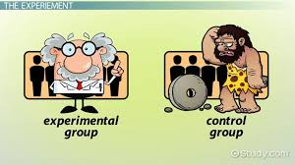
AHE 606 (RESEARCH METHODOLOGY IN VETERINARY AND ANIMAL HUSBANDRY EXTENSION)
Department of Veterinary & Animal Husbandry Extension Education, BVC

Slide 2
Topics covered
Concept, nature and scope of research in social sciences. Types of research fundamental, applied and action research, experimental and non- experimental research.
Variables, types and their measurement. Selection and formulation of research problem.
Hypothesis– importance, selection criteria (quality of workable hypothesis), formulation and testing of hypothesis.

Slide 3
Idea behind this lecture
To increase understanding of key concepts related to data. ..
To enhance idea of data analysis quantitatively.
To make statistical thinking popular.
To increase understanding of theoretical concept of statistics without fear of complex formula.
To enhance idea of data analysis by software.
Consequently, to develop interest in reading of research articles.

Slide 4
Data
Data: Facts, especially numerical facts, collected together for reference or information.
Data: Set of observations collected on variable is called data.
A dictionary defines data as facts or figures from which conclusions may be drawn.
It is a collective noun or plural noun.Datum is the singular form of the noun data.

Slide 5
Type of Data
1. Qualitative : Nonnumeric
2. Quantitative : Numeric
Qualitative Classification of Data
One way classification
Two way classification
Class | Number
Rural | 65
Urban | 35
Total | 100
Faculty | Boys | Girls | Total
Arts | 350 | 200 | 550
Science | 175 | 125 | 300
Commerce | 100 | 50 | 150
Total | 625 | 375 | 1000

Slide 6
Cont.
Three way classification
Multi way classification
Caste Sex Class- Level | Hi Boys | ndu Girls | Mu Boys | Slim Girls | Si Boys | Kh Girls | Chr Boys | istan Girls | Total
U. G. | 2000 | 1700 | 900 | 400 | 600 | 240 | 200 | 160 | 6200
P. G. | 800 | 200 | 70 | 80 | 80 | 50 | 85 | 35 | 1400
Ph. D. | 200 | 100 | 30 | 20 | 20 | 10 | 15 | 05 | 400
Total | 3000 | 2000 | 1000 | 500 | 700 | 300 | 300 | 200 | 8000

Slide 7
Cont.
Quantitative Classification of Data
Ascending Order : 22,34,37,46,48,49,50,53,56,59,67,69,70,73.
Descending Order: 73,70,69,67,59,56,53,50,49,48,46,37,34,22.
Discrete Data: are numeric data that have a finite number of possible values.
Continuous Data: have infinite possibilities .
Grouped Data: Organised data ( in certain groups )
Ungrouped Data : Raw data
Notes:
Exclusive, inclusive, Real Limits method

Slide 8
Variables-
Variable: Any phenomenon which takes more than one different values is called variable.
or
A characteristic, number, or quantity that increases or decreases over time, or takes different values in different situations.
EX. Height, weight, income, sex, mob. No., blood pressure, Blood group … are some example.
Qualitative Variable
Quantitative Variable
1. Discrete Variable
2. Continuous Variable

Slide 9
Types of Measurement Scales
Nominal
2. Ordinal
3. Interval
4. Ratio

Slide 10
Comparison of Various Levels of Measurement
Level of Measurement | Nominal | Ordinal | interval | Ratio
Magnitude | No | Yes | Yes | Yes
Equal Intervals | No | No | Yes | Yes
Absolute Zero | No | No | No | Yes
Possible Mathe. Operation | Count = | Count < > | + _ | + --- * /
Nature of Results of Measurement | Classification in equal groups | Classification in groups with hierarchy | Allotment of scores having equal interval | Allotment of scores having equal interval with absolute 0
Statistical Techniques | Frequency distribution, Mode | Frequency distribution, Mode Median, Quartiles Correlation ( R D ) | Mean , S D , Product Moment Correlation | Harmonic and Geometric Mean

Slide 11
Types of Data and Level of Measurement
Types of Data | Level of Measurement | Examples
Qualitative / Categorical | Nominal ( No inherent order in categories ) | Faculty- Arts, Science, Law Ethnicity , Caste
 | Ordinal ( Categories have inherent order ) | Job Grade , Age Group
 | Binary ( 2 categories- special case of above ) | Gender , Rural /Urban
Discrete Quantitative Continuous | Ratio ( Have absolute zero ) | No of class room in a school No of children in a family
 | Interval ( No absolute zero ) Ratio | Temperature ⁰C/⁰F Height , Age , Weight

Slide 12
Data Analysis
Data analysis
An attempt by the researcher to summarize collected data.
Turning raw data into useful information.
Purpose is to provide answers to questions being asked at a program site or research questions.
Even the greatest amount and best quality data mean nothing if not properly analyzed—or if not analyzed at all.
Analysis does not mean using computer software package.
Analysis is looking at the data in light of the questions you need to answer ( Hypothesis Testing ).
Data Interpretation
Attempt to find meaning

Slide 13
Contd.
The analysis of data serves the following main function:
To make raw data meaningful.
To test hypotheses / null hypotheses.
To obtain the significant result.
To draw some inferences or make generalization.
To estimating parameters.

Slide 14
Why is it important to know statistics
To make data meaningful.
There is a daily deluge of quantitative /qualitative observations &
individuals need to be able to make sense of these observations.
The statistics provides tools by which we can filter sensible information from observations.
It also protects individuals from the misleading practices of “miss interpretation of data”.

Slide 15
What is Statistics? Where does this Data come from?
Statistics
Data
Information
Data: Facts, especially numerical facts,
collected together for reference or information.
Information: Knowledge communicated concerning some particular fact

Slide 16
Meaning of Statistics
Statistics is the science of counting.
Statistics is the science of estimates and probabilities.
Statistics is a way to get information from data.
Statistics is a tool for creating new understanding from a set of numbers.
Statistics deals with collection, classification, and interpretation of data obtained by the conduct of surveys and experiment.

Slide 17
Nature of Statistics
Statistics:
present data in short.
generally deals with group not individual.
deals with the variability of the group.
deals with the quantification aspect of the problem.
Inductive in nature (From specific to general ).
Result is not 100% accurate but it is predicted or expressed in the terms of probabilities.
The interpretation of the result is always reference based.
Variables which are affected by random factors are generally studied by the statistics. Variables governed by mathematical equation are not the field of statistics.

Slide 18
Statistical Methods
Theoretical Statistical Method
Applied Statistical Method
Descriptive Statistical Method
Inferential Statistical Method
Frequency Distribution
Measures of Central Tendencies
Positional Statistics
Measures of Variability
Graphical Representation
Coefficient of Correlation
Parametric Statistics
Non –Parametric Statistics
Significance of Statistics
Significance Of Difference between Mean & other Statistics
ANOVA
Regression & Prediction
Co- Variance
Median Test
Sign Test
U-Test
K-S Test
Friedman Test
Run Test
Chi-Square Test

Slide 19
Contd.
Parametric Data : Measured Data
Non- Parametric Data : Counted or Ranked Data
Level | Scale | Data Treatment | Some Appropriate Test
1. | Nominal | Non-Parametric | Correlation (R D) Mann- Whitney Chi- Square Test Median Test Sign Test Wilcoxan Test
2. | Ordinal
3. | Interval | Parametric | Correlation ( PM ) ‘t’ Test Anova Ancova Factor Analysis Regression & Prediction
4. | Ratio

Slide 20
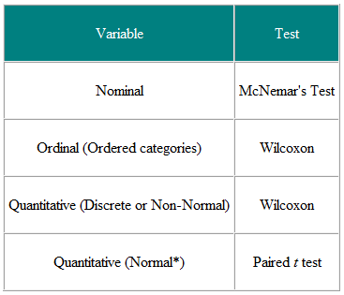
Choice of statistical test from paired or matched observation

Slide 21
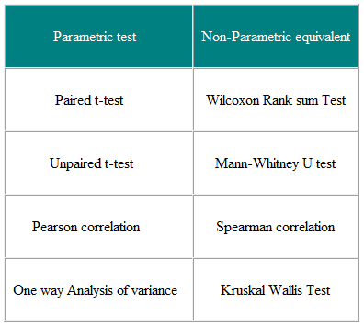
Parametric and Non-parametric tests for comparing two or more groups

Slide 22
Parametric Vs Non- Parametric
. Parametric Non-parametric
Assumed distribution Normal Any
Assumed variance Homogeneous Any
Typical data Ratio or Interval Ordinal or Nominal
Data set relationships Independent Any
Usual central measure Mean Median
Benefits Can draw more conclusions Simplicity; Less affected by outliers
Tests
Choosing Choosing parametric test Choosing a non-parametric test
Correlation test Pearson Spearman
Independent measures, 2 groups Independent-measures t-test Mann-Whitney test
Independent measures, >2 groups One-way, independent-measures ANOVA,Kruskal- Wallis test
Repeated measures, 2 conditions Matched-pair t-test Wilcoxon test
Repeated measures, >2 conditions One-way, repeated measures ANOVA Friedman's test

Slide 23
Research is a journey not a destination…..
Thanks

