Slide 1
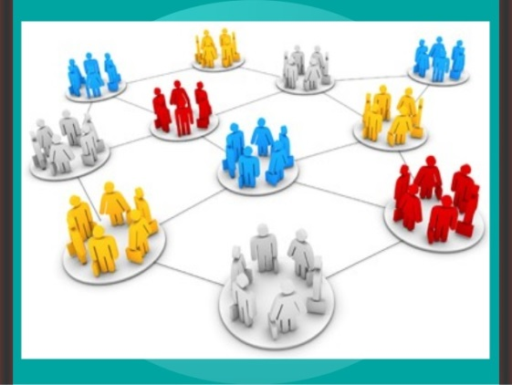
AHE 607 (SOCIAL PSYCHOLOGY AND GROUP DYNAMICS)
Department of Veterinary & Animal Husbandry Extension Education, BVC

Slide 2
Topics covered
Concept and types of groups; Typology and importance in rural development
Group structures - attraction, coalition, communication and power.
Processes in group development and group identity.
Factors affecting group performance; Conflicts in groups; Group belongingness.

Slide 3
What is a Group dynamics?
Group dynamics refers to the attitudinal and behavioral characteristics of a group.
Group dynamics concern how groups form, their structure and process, and how they function.

Slide 4
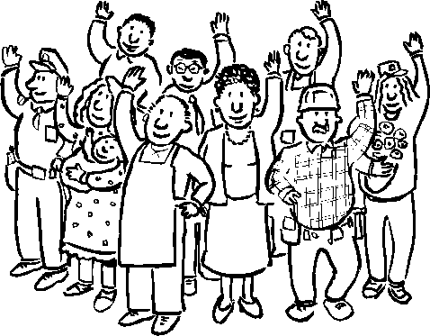
Rural development
Development is the process of improving the quality of life and economic well-being of people living in relatively isolated and sparsely populated areas.
Rural development actions are mainly and mostly to development aim for the social and economic development of the rural areas
(moseley & malcolm, 2003)

Slide 5
Need: It is the gap between what is and what ought to be. Change: Refers to an alteration in the social order of a society. Social change may include changes in nature, social institutions, social behaviours, or social relations.
Why Group is necessary for Change Kurt Lewin’s law of change: “It is usually easier to change individuals formed into a group than to change any one of them separately”

Slide 6
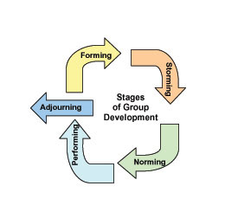
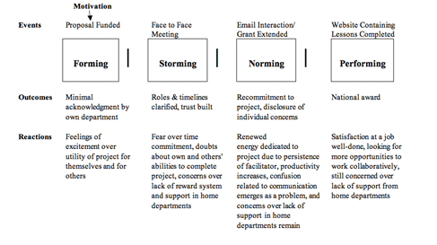
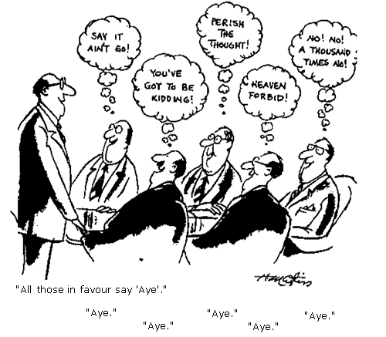
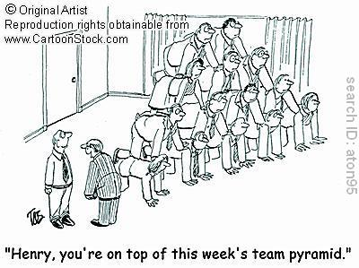

Slide 7
Why Do People Join Groups?

Slide 8
Security:
Joining groups reduces insecurity of “standing alone”
Status:
Inclusion in a group viewed important by others provides recognition and status to its members
Self-esteem:
Groups can provide people with feelings of self worth.
Affiliation:
Groups fulfill social needs through regular interaction.
Power:
Group actions enable in achieving what one can’t individually.
Goal Achievement:
Pooling talent, knowledge and power is needed to accomplish particular tasks.

