Slide 1
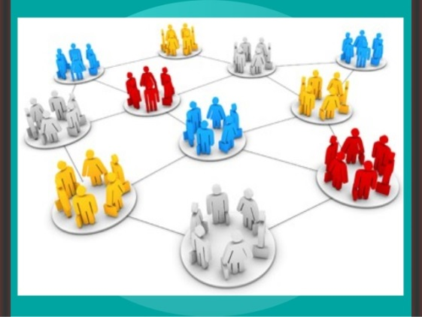
AHE 607 (SOCIAL PSYCHOLOGY AND GROUP DYNAMICS)
Department of Veterinary & Animal Husbandry Extension Education, BVC

Slide 2
Topics covered
Concept and types of groups; Typology and importance in rural development
Group structures - attraction, coalition, communication and power.
Processes in group development and group identity.
Factors affecting group performance; Conflicts in groups; Group belongingness.

Slide 3
Typology of Deviant Workplace Behavior
Category Examples Production Leaving early Intentionally working slowly Wasting resources
Property Sabotage Lying about hours worked Stealing from the organization
Political Showing favoritism Gossiping and spreading rumors Blaming coworkers
Personal Aggression Sexual harassment Verbal abuse Stealing from coworkers
Source: Adapted from S.L. Robinson, and R.J. Bennett. “A Typology of Deviant Workplace Behaviors: A Multidimensional Scaling Study,” Academy of Management Journal, April 1995, p. 565.

Slide 4
Group Structure - Status
Status
A socially defined position or rank given to groups or group members by others.
Group Norms
Status Equity
Group Member Status
Culture

Slide 5
Group Structure - Size
Social Loafing The tendency for individuals to expend less effort when working collectively than when working individually.
Performance
Other conclusions:
Odd number groups do better than even.
Groups of 7 or 9 perform better overall than larger or smaller groups.
Expected
Actual (due to loafing)
Group Size

Slide 6
Group Structure - Cohesiveness
Cohesiveness
Degree to which group members are attracted to each other and are motivated to stay in the group.
Increasing group cohesiveness:
Make the group smaller.
Encourage agreement with group goals.
Increase time members spend together.
Increase group status and admission difficultly.
Stimulate competition with other groups.
Give rewards to the group, not individuals.
Physically isolate the group.

Slide 7
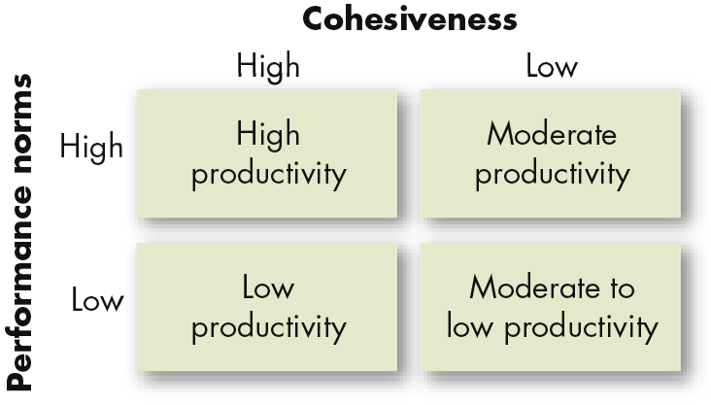
Relationship Between Group Cohesiveness, Performance Norms, and Productivity
E X H I B I T 8–6

Slide 8
Group Decision Making (cont’d)
Groupthink
Phenomenon in which the norm for consensus overrides the realistic appraisal of alternative course of action.
Groupshift
A change in decision risk between the group’s decision and the individual decision that member within the group would make; can be either toward conservatism or greater risk.

Slide 9
Symptoms Of The Groupthink Phenomenon
Group members rationalize any resistance to the assumptions they have made.
Members apply direct pressures on those who express doubts about shared views or who question the alternative favored by the majority.
Members who have doubts or differing points of view keep silent about misgivings.
There appears to be an illusion of unanimity.

Slide 10
Symptoms Of The Groupthink Phenomenon
Group members rationalize any resistance to the assumptions they have made.
Members apply direct pressures on those who express doubts about shared views or who question the alternative favored by the majority.
Members who have doubts or differing points of view keep silent about misgivings.
There appears to be an illusion of unanimity.

