Slide 1
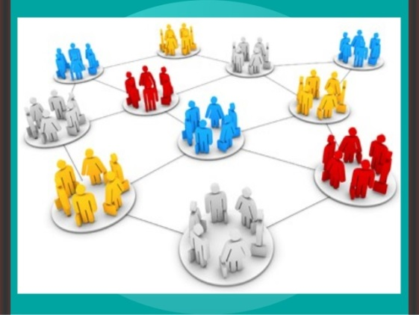
AHE 607 (SOCIAL PSYCHOLOGY AND GROUP DYNAMICS)
Department of Veterinary & Animal Husbandry Extension Education, BVC

Slide 2
Topics covered
Concept and types of groups; Typology and importance in rural development
Group structures - attraction, coalition, communication and power.
Processes in group development and group identity.
Factors affecting group performance; Conflicts in groups; Group belongingness.

Slide 3
Typology of Deviant Workplace Behavior
Category Examples Production Leaving early Intentionally working slowly Wasting resources
Property Sabotage Lying about hours worked Stealing from the organization
Political Showing favoritism Gossiping and spreading rumors Blaming coworkers
Personal Aggression Sexual harassment Verbal abuse Stealing from coworkers
Source: Adapted from S.L. Robinson, and R.J. Bennett. “A Typology of Deviant Workplace Behaviors: A Multidimensional Scaling Study,” Academy of Management Journal, April 1995, p. 565.

Slide 4
Group Structure - Status
Status
A socially defined position or rank given to groups or group members by others.
Group Norms
Status Equity
Group Member Status
Culture

Slide 5
Group Structure - Size
Social Loafing The tendency for individuals to expend less effort when working collectively than when working individually.
Performance
Other conclusions:
Odd number groups do better than even.
Groups of 7 or 9 perform better overall than larger or smaller groups.
Expected
Actual (due to loafing)
Group Size

Slide 6
Group Structure - Cohesiveness
Cohesiveness
Degree to which group members are attracted to each other and are motivated to stay in the group.
Increasing group cohesiveness:
Make the group smaller.
Encourage agreement with group goals.
Increase time members spend together.
Increase group status and admission difficultly.
Stimulate competition with other groups.
Give rewards to the group, not individuals.
Physically isolate the group.

Slide 7
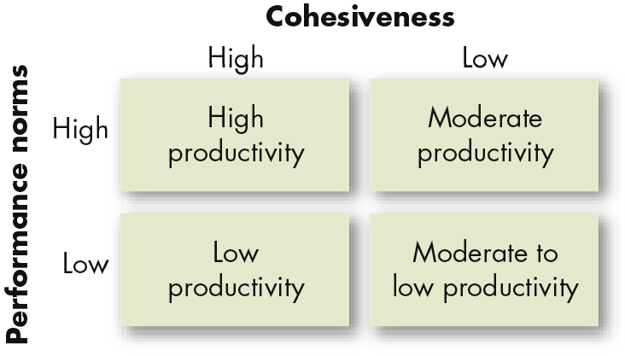
Relationship Between Group Cohesiveness, Performance Norms, and Productivity
E X H I B I T 8–6

Slide 8
Group Decision Making (cont’d)
Groupthink
Phenomenon in which the norm for consensus overrides the realistic appraisal of alternative course of action.
Groupshift
A change in decision risk between the group’s decision and the individual decision that member within the group would make; can be either toward conservatism or greater risk.

Slide 9
Symptoms Of The Groupthink Phenomenon
Group members rationalize any resistance to the assumptions they have made.
Members apply direct pressures on those who express doubts about shared views or who question the alternative favored by the majority.
Members who have doubts or differing points of view keep silent about misgivings.
There appears to be an illusion of unanimity.

Slide 10
Symptoms Of The Groupthink Phenomenon
Group members rationalize any resistance to the assumptions they have made.
Members apply direct pressures on those who express doubts about shared views or who question the alternative favored by the majority.
Members who have doubts or differing points of view keep silent about misgivings.
There appears to be an illusion of unanimity.

Slide 11
Components of Group Antagonism
Stereotyping: generalisations about the "typical" characteristics of members of a certain group
Prejudice: attitude toward the members of a group based solely on their membership in that group (can be positive or negative)
Discrimination: positive or negative actions/behaviour, often based on prejudiced beliefs

Slide 12
Patterns of Intergroup Relations
Discrimination and prejudice are common features of the minority group experience worldwide.
Discrimination can occur at a societal level, as legal discrimination and institutional discrimination, and at an individual level.
Prejudice is supported by the use of stereotypes, simplified, exaggerated, and unfavorable generalizations about groups of people.

Slide 13
Definition of Prejudice
The evaluation of a group or an individual based mainly on group membership
An opinion formed beforehand without informed knowledge
An opinion which is likely to be sustained even in the face of evidence to the contrary
Intolerance of or dislike for people of a specific ethnicity, religion or group

Slide 14
Prejudice in Action
Someone who is prejudiced holds certain attitudes and beliefs - commonly known as stereotypes - about a person, group of people or a thing.
This attitude, often negative, is usually fixed in a way that the person is reluctant to change.

Slide 15
The Source of Prejudice
Prejudice is more likely to occur and persist where:
Groups have different or conflicting key values
Others are seen as different
People see their identity in terms of belonging to particular groups
Their groups discriminate against each other
Fear that other groups pose a threat

Slide 16
Sources of Discrimination and Prejudice
Sociological Explanations
Prejudices are embedded in social norms.
Psychological Explanations
Prejudiced people have an authoritarian personality type.
Prejudice may be the result of frustration and anger.
Scapegoating occurs when an innocent person or group is blamed for one’s troubles.
Economic Explanations
Prejudice arises out of competition for resources.
Dominant group may encourage competition between minority groups in order to maintain its dominant status.

Slide 17
Forms of Prejudice
Sexism : prejudice based on a person’s biological gender
Racism: prejudice based on a person’s ethnicity
Sectarianism : prejudice based on a person’s religious background and/or political beliefs
Homophobia : prejudice based on a person’s sexual orientation
Disability Prejudice: Prejudice based on a person’s physical or mental abilities
Ageism: prejudice based on a person’s age

Slide 18
Institutional Prejudice
Prejudice is often linked to power known as “Institutional discrimination”.
In some countries laws segregated public places into white and non-white areas.
There has also been religious segregation
E.g.- For many years black Americans fought for an end to racial segregation, it officially ended in the USA in 1965

Slide 19
Causes of Prejudices
Prejudices can be created by many factors:
Fear, such as xenophobia
Shame
Guilt
Inadequacy/insecurity
Ignorance
Negative experiences of a certain group

Slide 20
Race, Ethnicity, and the Social Structure
Ethnicity is a social category based on a set of cultural characteristics, not physical traits.
Sociologists acknowledge that a society’s dominant groups enjoy a position of power and privilege in comparison to minority groups, or groups who are singled out and treated unequally.

Slide 21
Race as Myth and Reality
Race as a Myth
Many people think that humankind can be sorted into biologically distinct groups called races. This idea suggests that there are “pure” examples of different races and that any person can belong to only one race.
Biologists, geneticists, and social scientists reject this view of race.
All people belong to the human species.
There are greater differences within racial groups than between racial groups.

Slide 22
Race as a Reality
Racial differences become important because people believe them to be.
In sociological terms, “race” is a category of people who share observable physical characteristics and whom others see as being a distinct group.

Slide 23
Ethnicity
Ethnicity is the set of cultural characteristics that distinguishes one group from another group.
People who share a common cultural background and a common sense of identity are known as an ethnic group.
Ethnicity is based on characteristics such as national origin, religion, language, customs, and values.
Ethnic groups must pass cultural beliefs and practices from generation to generation.
Ethnic identity can cross racial or national boundaries.
Ethnicity is based on cultural traits, while race is based on physical traits.

Slide 24
Minority Groups
Although no particular physical feature or ethnic background is superior or inferior to any other, many sociologists recognize that people may place an arbitrary value on specific characteristics.
Minority Group
A minority group is a group of people who—because of their physical characteristics or cultural practices—are singled out and treated unequally.
In this sense, the term minority has nothing to do with group size, but with the unequal standing in society in relation to a dominant group.
Dominant Group
The dominant group is the group that possesses the ability to discriminate by virtue of its greater power, privilege, and social status in a society.
The dominant group in American society is white people with northern European ancestry.

Slide 25
Patterns of Minority Group Treatment
Cultural Pluralism
Cultural pluralism is a policy that allows each group within society to keep its unique cultural identity
Switzerland is an example with three official languages.
Assimilation
Assimilation is the blending of culturally distinct groups into a single group with a common culture and identity
American idea of “melting pot”
Can happen informally or by force

Slide 26
Patterns of Minority Group Treatment (cont.)
Extermination
Most extreme; goal is elimination
Genocide is the goal of complete destruction of a minority group.
Holocaust and Rwanda are examples
Ethnic cleansing is the combination of extermination and transferral.
Serbia and Sudan are examples

