Slide 1
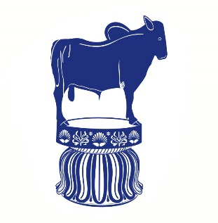
Anticholinergic Drugs (Parasympatholytics)
Dr. Nirbhay Kumar
Asstt. Professor & Head
Deptt. of Veterinary Pharmacology & Toxicology
Bihar Veterinary College, Bihar Animal Sciences University, Patna

Slide 2
Anticholinergic (Parasympatholytic) Drugs
These drugs block muscarinic receptors only, so better known as antimuscarinic agents.
Mechanism of action of antimuscarinic agents:
Atropine and related drugs block the cholinergic muscarinic receptors by acting as competitive antagonists of ACh or other direct acting cholinergic drugs.

Slide 3
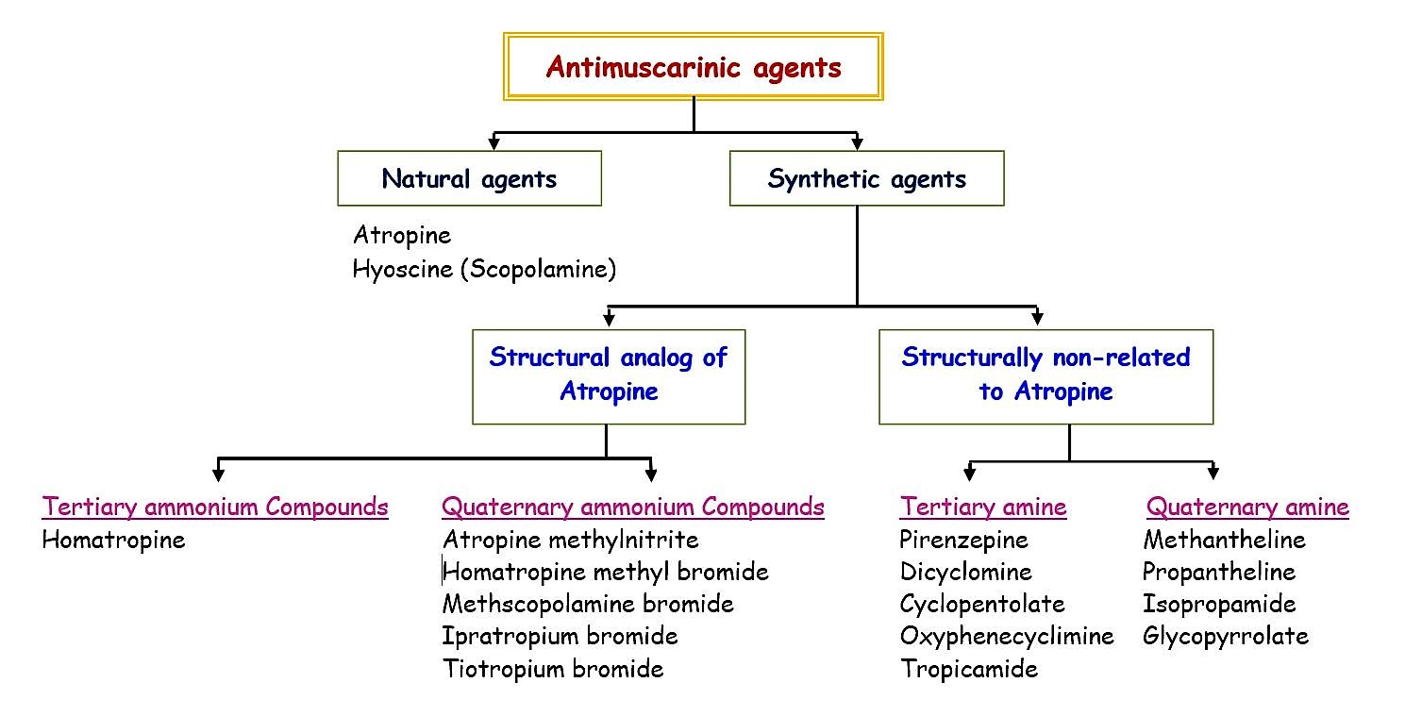
Classification of Parasympatholytic Drugs
Classification based on Origin & Structure:

Slide 4
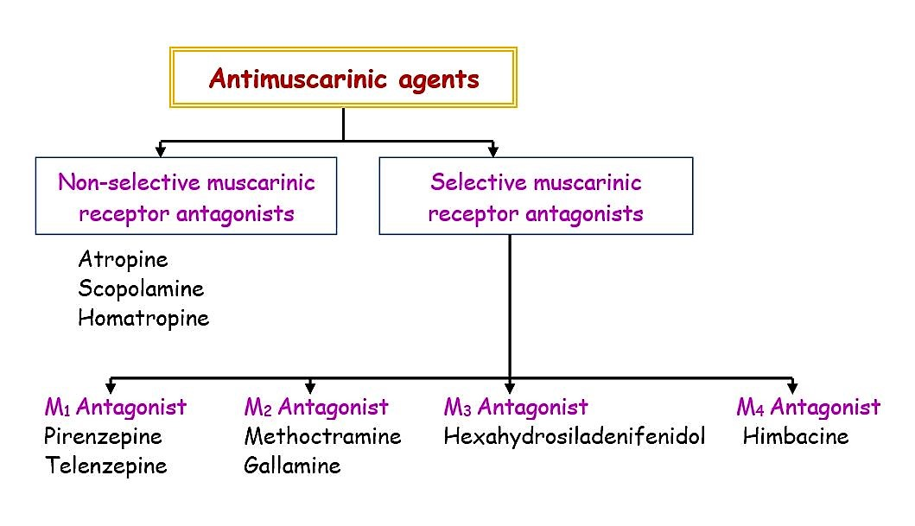
Classification of Parasympatholytic Drugs
Classification based on Mode of Action:

Slide 5
Pharmacological Actions of Parasympatholytics
CVS:
Small doses of atropine cause an initial temporary bradycardia (agonistic action due to vagal stimulation and/ or momentary stimulation of cardiac muscarinic receptors prior to their blockade).
High doses cause tachycardia.
Atropine like drugs antagonize the fall in blood pressure caused by choline esters.
Atropine alone does not affect blood pressure.
2. GIT:
Smasmolytic effect on GI smooth muscles by preventing the effect of endogenous ACh.
Block the increase in tone and motility of GIT caused by cholinergic drugs.
Rumen motility is reduced.
GI secretions including salivation are blocked.
3. RT:
Inhibition of bronchial secretions and dilatation of bronchi (temporary relief of dyspnoea/ asthma/ heaves in horses).

Slide 6
Pharmacological Actions of Parasympatholytics continued…
4. Eye:
Mydriasis and cycloplegia (paralysis of accommodation) following local or systemic use.
Mydriasis is due to blockade of cholinergic influence and dominance of adrenergic effect.
Cycloplegia is due to paralysis of ciliary muscle of the lens.
5. UT:
Spasmolytic effect on ureters (useful in the treatment of renal colic) and urinary retention (relaxation of bladder).
6. Skin:
Anhydrotic action in man (cholinergic) and consequently rise in body temperature but does not prevent sweating in horses (adrenergic).
7. CNS:
Atropine has no significant effect. Scopolamine in small doses produces depression & excitement and delirium at high doses in cats and dogs.

Slide 7
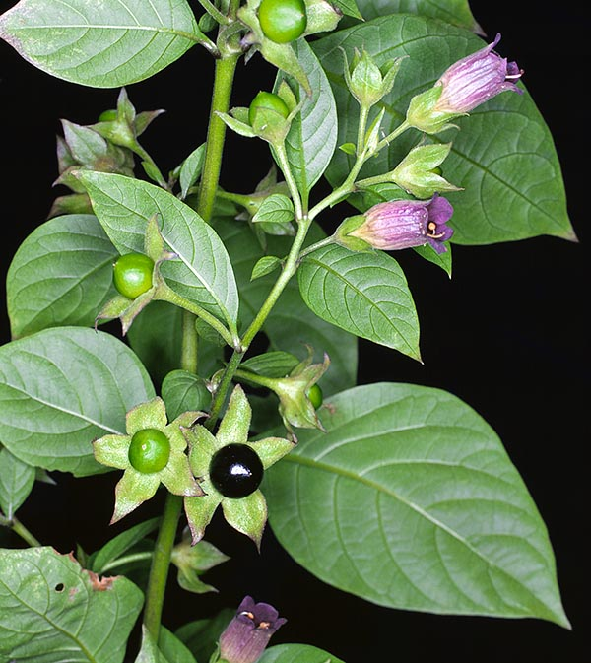
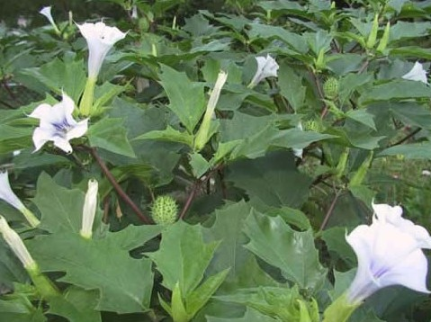
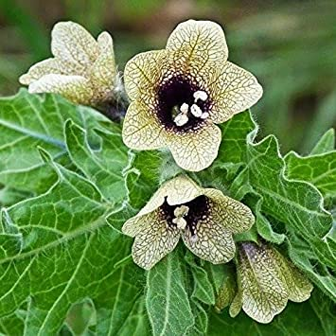
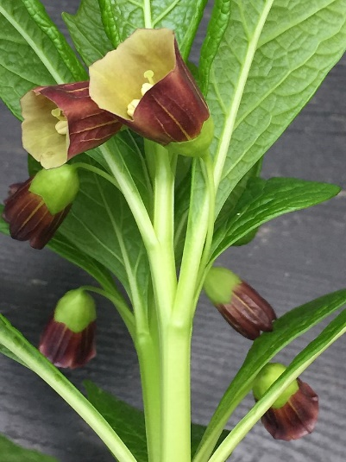
Atropine & Scopolamine
Atropine is an alkaloid extracted from the leaves of belladonna plants Atropa belladonna (deadly nightshade), Datura stramonium (Jimson weed) and Hyoscyamus niger (Henbane).
Scopolamine is also an alkaloid extracted from the leaves Hyoscyamus niger and Scopolia carniolica
Atropa belladonna
Datura stramonium
Hyoscyamus niger
Scopolia carniolica

Slide 8
Atropine continued …
The name “Atropa belladonna”: During the time of the Roman Empire and in the Middle Ages, the deadly nightshade shrub was frequently used to produce an obscure and often prolonged poisoning, prompting Linnaeus to name the shrub Atropa belladonna, after Atropos, the oldest of the three Fates (goddesses) in Greek mythology, who cuts the thread of life. The name belladonna derives from the alleged use of this preparation by Italian women to dilate their pupils; modern-day fashion models are known to use this same device for visual appeal.
Atropine is a racemic mixture of d-hyoscyamine and l-hyoscyamine. The laevo form of hyoscyamine is biologically active.

Slide 9
Atropine continued …
Atropine poisoning: Physostigmine is used as it is better able to enter CNS than other parasympathomimetics. It is the central effects of atropine which is lethal.
Rabbits possess an esterase (atropinase) which hydrolyses atropine and is thereby able to feed on deadly nightshade with freedom without showing any toxic symptom.
The laevo isomer of hyoscine is called scopolamine which is the active form. Its main difference from atropine is its slight sedative effect on the CNS at therapeutic dosage.

Slide 10
Atropinization
Effects of atropine in relation to dose:
Dose | Effects
0.5 mg/kg | Slight cardiac slowing; some dryness of mouth; inhibition of sweating.
1 mg/kg | Definite dryness of mouth; thirst; acceleration of heart, sometimes preceded by slowing; mild dilation of pupils.
2 mg/kg | Rapid heart rate; palpitation; marked dryness of mouth; dilated pupils; some blurring of near vision.
5 mg/kg | All the above symptoms marked. Difficulty in speaking and swallowing; restlessness and fatigue; headache; dry, hot skin; difficulty in micturition; reduced intestinal peristalsis.
10 mg/kg or more | Above symptoms more marked, pulse rapid & weak; iris practically obliterated; vision very blurred; skin flushed, hot dry & scarlet; ataxia; restlessness, excitement, hallucinations and delirium; coma and finally death.

Slide 11
Therapeutic Uses of Parasympatholytics
Atropine:
As preanaesthetic
As antidote in organophosphate and carbamate poisoning (0.2 to 0.5 mg/kg : 1/4th of the total dose should be given i.v. and rest by i.m. route).
For relief of heaves in horses.
Eye drops (1%) – during eye examination.
Homatropine: 2 – 5 % solution topically in the eye for ophtalmological use (mydriatic or cycloplegic). Its effects are of shorter duration as compared to those of atropine which causes persistent mydriasis and cycloplegia.
Glycopyrrolate: Preanaesthetic.
[NB: Alternate use of a mydriatic (e.g. atropine) and a miotic (e.g. physostigmine 0.5%) can be used to prevent adhesions involving the iris.]

Slide 12
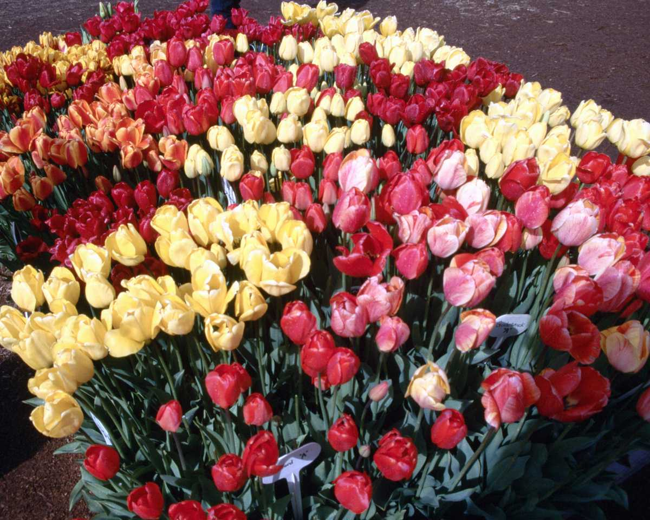
Thank You

