Slide 1
Lecture – 03 Applied endocrinology of pregnancy

Slide 2
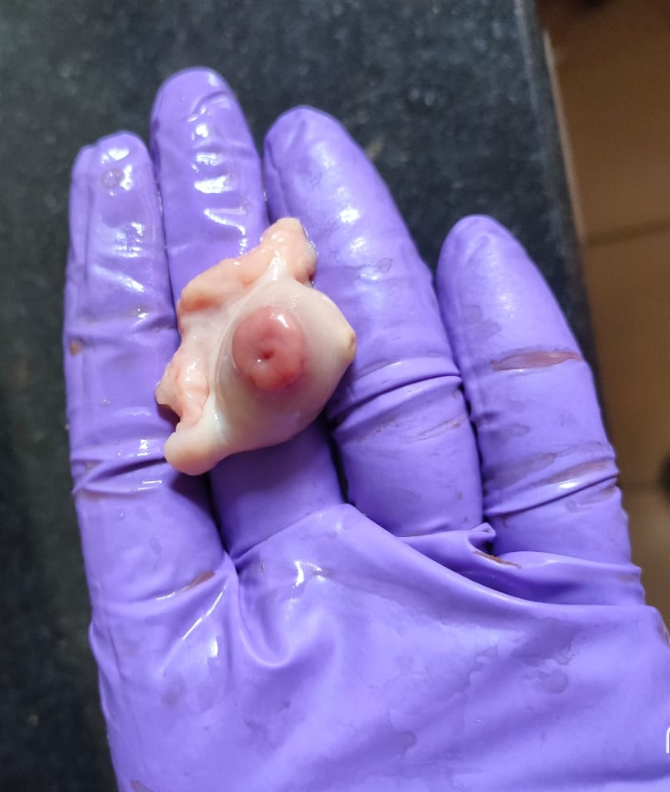
Endocrinological structures during pregnancy
Carpus luteum
Placenta
Both structures act as temporary endocrine organ.
Perform steroidogenic activity
Steroidogenic activity of placenta is observed in majority of mammals except DOG

Slide 3
Hormones of pregnancy
1. Progesterone
Principal hormone for pregnancy maintenance
During initial stage of pregnancy, functional CL releases progesterone
CL persist throughout pregnancy in all species except in mare
Cow, Doe and Sow – primary source of progesterone is CL
Mare and Ewe derives their progesterone from placenta at later half of pregnancy known as luteo-placental shift
Serum progesterone level remains constant throughout pregnancy in cow and ewe but in Sow, its high level is observed during early stage of pregnancy

Slide 4
Role of progesterone during pregnancy
It controls various essential functions during gestation period
Endometrial differentiation
Myometrial quiescence
Closure of the cervix
Local immunotolerance in the pregnant uterus

Slide 5
2. Placental estrogens
Estradiol-17β is the most relevant form of estrogen found in dam blood
In sheep and cattle Estrone and sulphonated form of estrogen remains high during gestation period
Ruminanats and camelids, the maternal estrogen rises at uniform rate
Sudden peak of estrogen during mid gestation is physiological in Equines
Species specific placental estrogens in equines is termed as equilin and equilenin

Slide 6
Placental synthesis of estrogens
Bovine placenta synthesizes estrogen from cholesterol (precursor)
Equine placentae can not synthesize estrogen like bovine, due to its dependency on fetal gonads for C₁₉ precursor
Steroidogenesis associated with pregnancy in horse is a dependent process involving placenta and fetus which led to the terminology - feto-placental unit

Slide 7
Functions of placental estrogens
Ruminants including the role of placental estrogens
Preparation of the birth canal for
parturition
Myometrial excitability at advance stage
Mammary gland development during late
gestation
Maternal estrogen levels start to increase significantly between days 120-150.
In ruminants sulphonated estrogen level remains higher throughout pregnancy exept immediate pre or intrapartal period

Slide 8
Androgens
C₁₉ steroids
Androstenedione
Dehydroepiandrosterone (DHEA)
Sulfonated DHEA (DHEAS)
C₁₉ steroids act as precursors for the synthesis of bioactive androgens
C₁₉ steroids serves as precursor for placental estrogen synthesis in equines

Slide 9
Pregnancy-associated prolactin and growth hormones
In rodents and ruminants these substances named as
Placental lactogen (PL)
PRL-like proteins (PLPs)
PRL-related proteins (PRPs)
Proliferin (PLF).
Functions
In ruminants associated with
Development of uterus and mammary gland
Transport of nutrients from the dam to the fetal compartment

Slide 10
Relaxin/insulin-like family peptides
Commonly denoted by – RLNs
Source of RLNs
Placenta – Horse, cat, dog, rabbit and camel
Carpus luteum – Pig and rodents
.

Slide 11
RLNs functions
Function of RLNs are different in various species
Decidualization
Immunomodulation
Quiescence of the myometrium
Maternal circulatory adaptations of pregnancy
Stimulation of angiogenesis
uterine and vaginal growth
Development of the mammary gland and/or nipples
During prepartal period
Relaxation of the pubic ligament
Preparation of the vaginal canal for
parturition.

Slide 12
Endocrinology of pregnancy in mare
A different species to deal with

Slide 13
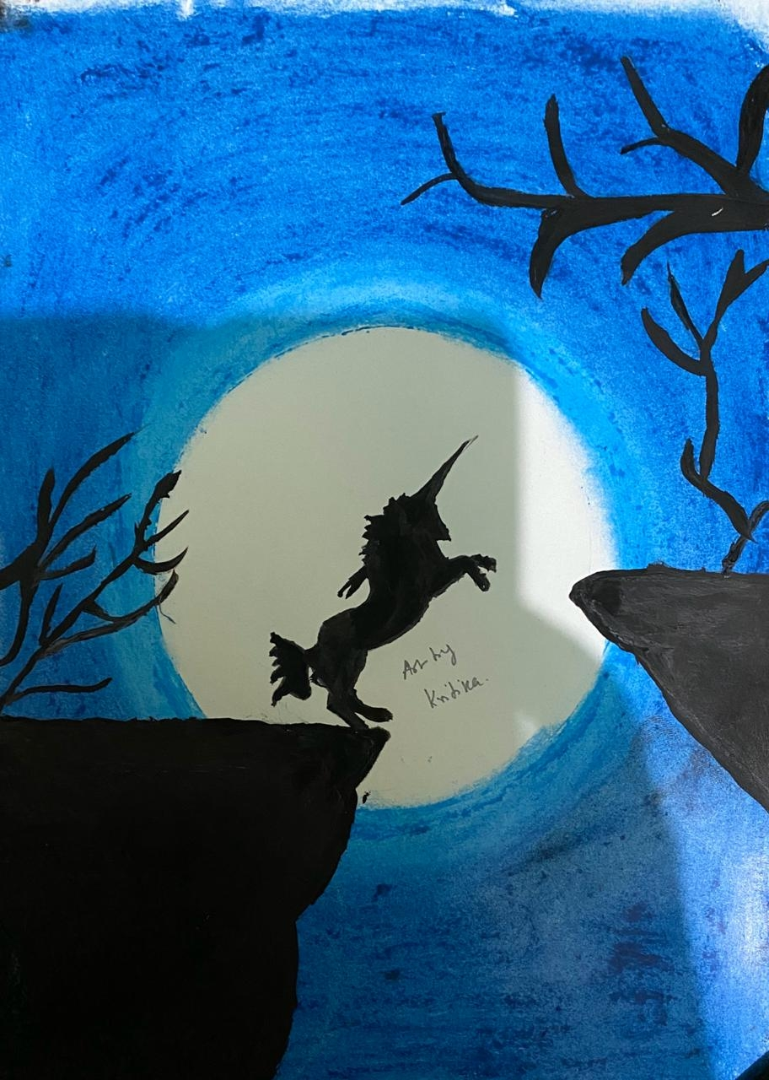
Maintenance of progesterone concentration during pregnancy
Early stage of pregnancy, Primary corpus luteum secrets progesterone followed by secondary carpora lutea
Post day 150 matured placenta takes up secretion of progesterone sufficient for physiological need of pregnancy, phenomena is termed as luteo-placental shift
Estrogen during pregnancy
Plasma estrogen concentration remains low during first trimester, gradually increases to peak between 9th to 11th month, thereafter declines near foaling
Courtesy - Kritika’s drawing

Slide 14
Endocrinology of pregnancy in mare
Hormones | source | Days of pregnancy
Progesteroe | Primary corpus luteum | 01 - 35
 | Secondary carpora lutea | 36 - 150
 | Placenta | 151 – till foaling
Equine chorionic Gonadotropin | Endometrial cups | 36 - 140
Estrogen | Placenta | 100 - 330

Slide 15
Thanks!
Any questions?
You can find me at:
alok9alright@gmail.com
Dr Alok Kumar
Assistant Professor cum jr. Scientist
Veterinary Gynaecology and Obstetrics
Bihar Veterinary College, BASU. Patna

