Slide 1
VETERINARY ANATOMY, - UNIT- 6, TOPIC-II- Description of Bones along muscles of with of Acetabulum, pelvic diameter, Pelvic inlet, bony pelvis and coccygeal vertebrae
Instructor- DR. SANJAY KUMAR BHARTI
HOD, VETERINARY ANATOMY

Slide 2
Description of Bones along muscles of with of Acetabulum, pelvic diameter, Pelvic inlet, bony pelvis and coccygeal vertebrae
Acetabulum
Acetabulum is a cotyloid cavity formed on the ventro-lateral aspect of the os coxae by the meeting of its three components.
It consists of an articular and a non-articular part.
The former is nearly circular and articulates with the head of the femur. The rim of the cavity presents on its postero-medial spect the acetabular notch, which transmits the round ligament of the hip joint.
The non-articular part, the acetabular fossa is situated in the depth of the acetabulum.
Another small notch may be seen antero-medially, though sometimes it is replaced by a foramen or is absent.

Slide 3
OBTURATOR FORAMEN & PELVIC CAVITY
Obturator foramen
The obturator foramen is a largest foramen of body, elliptical opening on the floor of the pelvis and is circumscribed by the ischium and the pubis.
It is covered in life by the obturator muscles.
Pelvic cavity
The pelvic cavity is the smallest and the most posterior of the three visceral cavities of the body.
The bony pelvis composed of the os coxae laterally and ventrally. The sacrum and the first three coccygeal vertebrae dorsally. The lateral vacuities are closed up by the sciatic ligaments in life.
The pelvic inlet is bounded by the terminal line or brim which is composed of the base of the sacrum dorsally, ilio-pectineal lines laterally and the anterior borders of pubis ventrally.
The pelvic outlet is much smaller and is very incomplete in the skeleton. The third coccygeal vertebra bound it dorsally and ventrally by the ischial arch and the sacro-sciatic ligament and semimembranosus muscle completes it laterally.

Slide 4
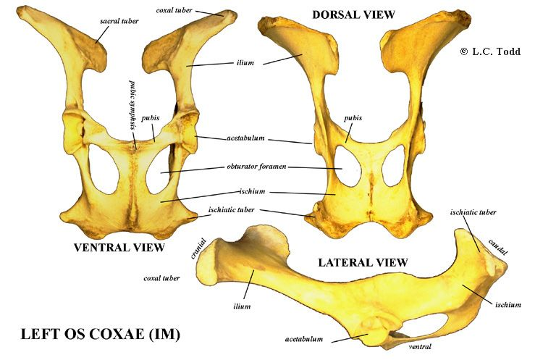
Pelvic Girdle - Ox

Slide 5
SEXUAL DIFFERENCES
Sexual differences
The ischial arch is wider and the outlet is larger in the female than in the male.
The conjugate (vertical) and transverse diameters are greater in the female so that the cavity is roomier.
The pubis and the ischium of the opposite sides meet at a more open angle in the female than in the male.

Slide 6
Differential point of Ilium, Ischium, and Pubis of Ox, Buffalo, Sheep, Goat, Horse, Pig, Dog and Fowl.
Sheep and Goat
1.The long axis of the ilium is almost in straight line with that of ischium.
2. Greater ischiatic spine is low and everted.
3. Ischial symphysis is not ossified even in old animals.
4. Acetabulum is large and deep.
5. The pelvic brim is elliptical in outline.

Slide 7
HORSE- Pelvic Girdle
1. The gluteal line is very faint.
2. The tuber coxae is large and compounded four tuberosities arranged in pairs.
3.The pelvic surface of the ischium is less concave and meets its fellow at a more open angle.
4. The ischial arch is wide and shallow.
5. The ridge on the inferior face of the ischium is absent.
6. The symphyseal ridge is also absent.
7. The tuber ischii is not trifid and its lower border forms the ventral ischiatic spine.
8. The ventral face of the pubis crossed near the anterior border by the pubic groove which leads to the acetabular notch which transmits the pubo-femoral or the accessory and round ligaments of the hip to femur.
9. The acetabular notch is on the medial part of the rim.

Slide 8
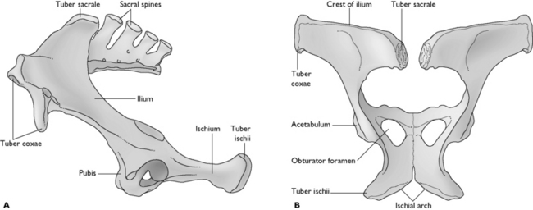
Horse – Pelvic Girdle Cont….

Slide 9
PIG-PELVIC GIRDLE
1. Os coxae is long and narrow.
2. The ilium and ischium are almost in line with each other.
3. The gluteal surface is divided into two fossa by a ridge which is continuous with the greater ischiatic spine behind.
4. The iliac crest forms the highest point of the bone.
5. There is a crest or tubercle on the ventral surface of the ischium.
6.The ilio-pectineal line is prominent and the psoas tubercle is well marked.
7. Pelvic inlet is elliptical in outline.

Slide 10
DOG- Pelvic Girdle
1. The ilium is nearly in a vertical plane.
2. The gluteal surface is concave.
3. The crest of the ilium is strongly convex.
4. The ischium has a twisted appearance.
5. The lesser ischiatic notch is absent.
6. The acetabulum is deep.
7. The symphyseal part of pubis is thick and fuses late with the opposite bone.

Slide 11
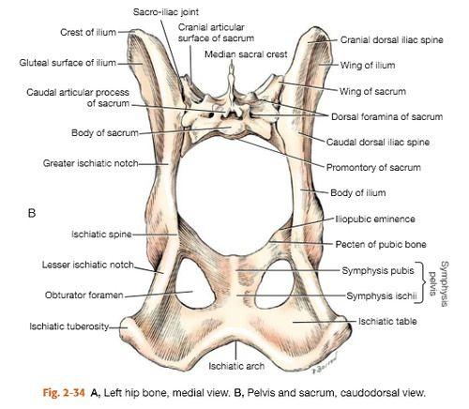
Dog- Pelvic Girdle, Conti…..

Slide 12
FOWL-PELVIC GIRDLE
1. The ilium is elongated and extends over the entire length of the hipbone. It is firmly fused to the transverse processes of the lumbo-sacral mass. The pelvic face is concave for the lodgment of kidney. The lateral border is free in its anterior half but is fused with the ischium behind.
The ischium is smaller and lies below and lateral to the posterior part of the ilium is triangular. The sciatic foramen is formed by the adjacent borders of the ischium and ilium behind the acetabulum. The ventral border forms the obturator foramen with the pubis.
The pubis is a long and slender rod running along the ventral border of the ischium. The anterior end has a muscular process.
The acetabulum is large and perforated and presents at its supero-posterior part process - anti-trochanter for articulation with the great trochanter of the femur.

Slide 13
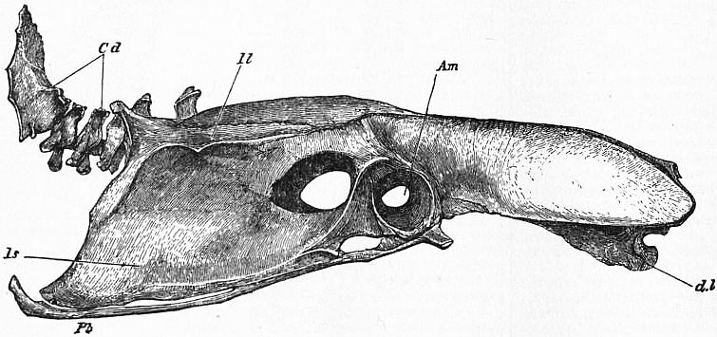
FOWL-PELVIC GIRDLE

Slide 14
BONY PELVIS / BONE OF HIP (PELVIC) REGION
Bony pelvis consist of sacrum, 1st three coccygeal vertebrae and two Os-coxae. Each formed by the ilium, ischium and pubis.
Sacrum
S. No. Mare Cow
1. It consist of 5 sacral segments, 1. It consist of 5 sacral segments.
base and apex.
2. It is shorter than the cow 2.It is longer than the mare.
3. Triangular in shape. 3. Roughly triangular in shape.
4. Dorsal surface presents 5 sacral spines 4. Dorsal surface presents spines fuse
which have tuberous summits and to form median sacral crest
4 pairs of dorsal sacral foramina. Articular processes fuse to form
lateral sacral crest and 4 pairs
of dorsal sacral foramina.

Slide 15
BONY PELVIS / BONE OF HIP (PELVIC) REGION,CONTIN…..
SACRUM
S.N. MARE COW
5. Ventral surface lodges 4 5. Ventral surface presents 4
transverse lines. transverse groove and 4
pairs of foramina
6. Pelvic surface presents transverse line 6. Concave in both direction
having groove for medial sacral artery
7. Smooth notch are present 7. Absent
8. Articular surface directed 8. Articular surfaces are concave
dorso-laterally
9. It is rough, irregular and articulate 9. emicylindrical in curvature medially
with ilium.

Slide 16
Diameters of Pelvic inlet
Sacro-pubic (Conjugate) diameter :- It is measured from sacral promontory to the anterior margin of pubis symphysis.
Transverse (Bis-iliac) diameter :- Measured at its greatest width just above psoas tubercle.
Superior bis-iliac diameter :- It is measured at upper 3rd of pelvic inlet and receives greatest width of the fetus at shoulder in anterior presentation and hip in the posterior presentation.
Inferior bis-iliac :- It is measured at the lower 4th of pelvic inlet at elbow of fetus in anterior presentation and stifle in posterior presentation.
Vertical diameter of inlet :- It is measured between anterior end of symphysis pubis and articulation of sacral 3rd and 4th vertebra.
Oblique / sacro-iliac / ilio-sacral diameter of inlet :- It is measured from sacro-iliac joint of one side through the center of pelvic cavity to the psoas tubercle of opposite side. It is intermediate between sacro-pubic and superior bis-iliac diameter

Slide 17
Diameter of Pelvic outlet
Superio-inferior (Vertical) diameter :- It is measured between the summit of ischial arch and articular of coccygeal 1st and 2nd vertebrae.
Transverse diameter :- It is measured between two ischiatic spines.

Slide 18
Coccygeal vertebrae :
Each vertebra consist of body, spinous and transverse processes.
S.No. Cow Mare
1. 18-20 in numbers 1. 15-21 in number
2. 1st Vertebrae, well developed 2 . Having groove medially
3. Ventrally groove for median 3. For coccygeal artery
saccral artery.
4. First 5-6 vertebare having 4. Less Developed
complete arches and spinous
process.

