Slide 1
CANINE BEHAVIOURAL PROBLEMS AND MANAGEMENT
Prof. Sushovan Roy
Former Dean, Veterinary College, Tripura
Former Director, Wildlife Health and Forensic Science
Chhattisgarh Kamdhenu Vishwavidyalaya, Durg

Slide 2
Introduction
Dog- Man’s Best friend
Behaviour is a physiological process that is closely related to the environment
A “behavioural problem” refers to behaviour exhibited by an animal that is unacceptable to the owner, regardless of its level of abnormality
The presence of behaviour problem often leads to the threat of breaking the bond

Slide 3
Now a days, with the modern living specially in cities with more artificial environment dogs assuming a greater role in the physical and mental well being
An important concept for both practitioners and clients is to determine whether behaviour is normal or abnormal
Behaviour is modulated or adjusted to fit condition on two different time scales: short term; moment to moment change and long term; over seasons
Canine behaviour is influenced by genetic, social, situational, hormonal and environmental factors

Slide 4
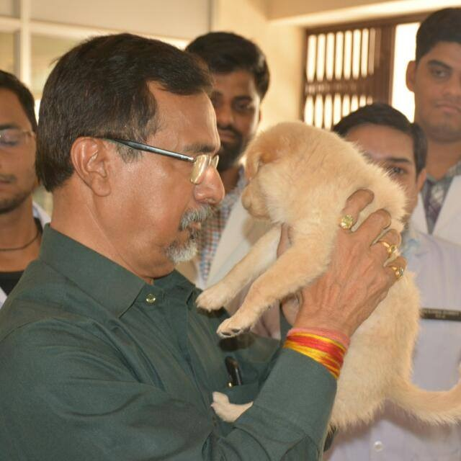
Canine behaviours are often misunderstood and mishandled by dog owners
It is important to watch the dog, owner and their interactions at
the time of interview
If the clinician appears judgemental the client is unlikely to reveal a complete description of events.

Slide 5
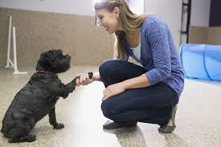
Detailed history is of utmost importance for proper diagnosis
Many behavioural problems can be corrected by pooling knowledge from etiology, psychology and medicine
Animal behavioural counselling:
Determining the cause of behavioural problem
Recommending techniques for resolving the problem
Follow-up of the progress towards resolution

Slide 6
Canine behaviours have been classified as normal or abnormal
Normal behaviours are species specific behaviour and learned behaviour
Abnormal behaviours can be genetic or acquired
Sometimes learning can lead to abnormal behaviours such as phobias
Fear of noises is highly prevalent in dogs and represents a significant welfare concern, with up to half of the pet dog population affected
(Storengen and Lingas 2015)

Slide 7
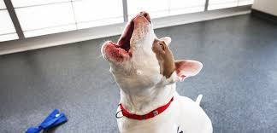
Here is a list of some common behavioural problems
Aggression
Fears and phobias
Separation anxieties
Barking
Compulsive behaviour
Urine marking
Miscellaneous (destructive, unruly, mounting, hyperactivity etc)

Slide 8
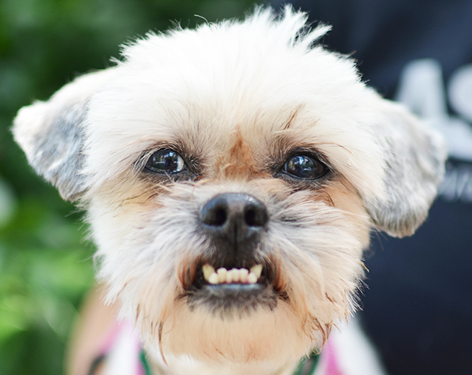
AGGRESSION
Most common and serious behavioural problem in dogs
The number-one reason why pet parents seek professional help from behaviorists, trainers and veterinarians
Classification
Fear-related Aggression
Redirected Aggression
Possessive Aggression (Resource Guarding)
Play aggression
Territorial/Protective Aggression
Predatory Aggression
Pain-induced and Medical Causes of Aggression
Maternal aggression
Irritable/Conflict/Impulse Control Aggression
Aggression Toward Other Dogs

Slide 9
Are Some Breeds More Aggressive Than Others…….?
YESSSSSS……
Most dog breeds once served specific functions for humans
Some were highly prized for their guarding and protective tendencies, others for their hunting prowess, others for their fighting skills, and others for their “gameness” and tenacity
Even though pet dogs of these breeds rarely fulfill their original purposes these days, individuals still carry their ancestors’ DNA in their genes, which means that members of a particular breed might be predisposed to certain types of aggression
Far better predictors of aggressive behavior problems are a dog’s individual temperament and her history of interacting with people and other animals
You should always search breeds to be sure that the breed or breed mix you’re interested in is a good fit for you and your lifestyle

Slide 10
Can Aggression Be Cured…..?
Always Work with a Professional Behaviour Expert
With Behaviour modification techniques the incidence and frequency of some types of aggression can be reduced and sometimes eliminated.
However, there’s no guarantee that an aggressive dog can be completely cured.
In many cases, the only solution is to manage the problem by limiting a dog’s exposure to the situations, people or things that trigger her aggression.
Pet parents of aggressive dogs should be prudent and always assume that their dog is NOT cured so that they never let down their guard.

Slide 11
FEARS AND PHOBIAS
Fear is a complex system having interactions of behaviours, emotions and physiology
Phobias are probably qualitatively and quantitatively different from fears
Fear and phobias can occur at any age
Sensory decline, cognitive dysfunction and anxiety can all contribute to fears and phobias
Older dogs can suffer from fears and phobias of noise and thunderstorms and, less commonly, of going outdoors, entering certain rooms or walking on certain types of surfaces

Slide 12
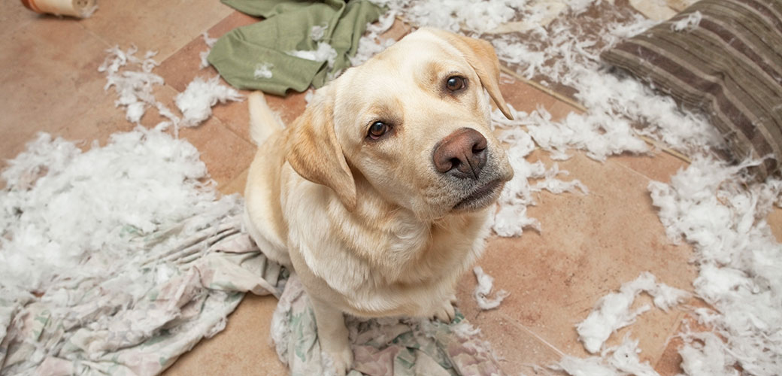
SEPARATION ANXIETY
Dogs suffering from separation anxiety become anxious, depressed or agitated when their guardians prepare to leave
Some try to prevent their guardians from leaving
Dogs might urinate, defecate, bark, howl, chew, dig or try to escape
The problem often indicate that a dog needs to be taught polite house manners, they can also be symptoms of distress

Slide 13
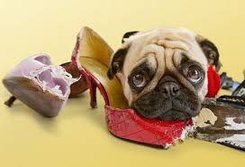
Common Symptoms of Separation Anxiety
Urinating and Defecating
Barking and howling
Chewing, Digging and Destruction
Escaping
Pacing
Coprophagia

Slide 14
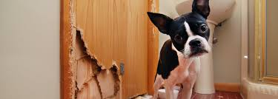
Why Do Some Dogs Develop Separation Anxiety?
Change of Guardian or Family
Change in schedule
Change in Residence
Change in household membership

Slide 15
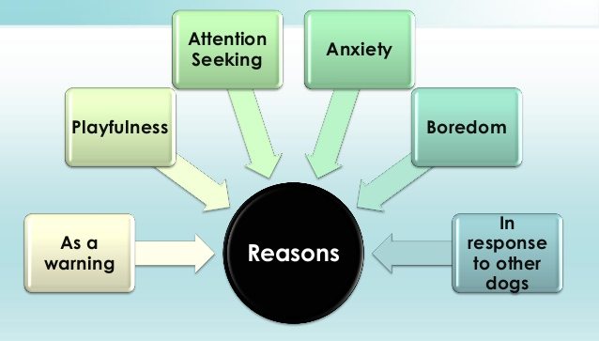
BARKING
An example of natural behavior encouraged in terms of guarding purpose
Excessive barking can be a behavioural issue

Slide 16
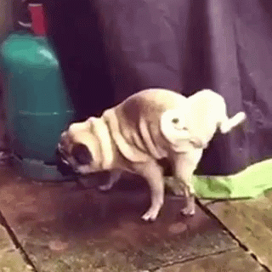
URINE MARKING
Territorial behaviour, facilitated by testosterone in intact males or in response to anxiety
Deposition of small amount of urine in specific places
The strongest stimulus is environmental competition of other males and freshly voided urine from other dogs
Behavioural modification for urine marking involves constant
supervision

Slide 17
Compulsive and stereotypic behaviour
Ritualized, repetitive behaviors that have no apparent goal or function
Stereotypic licking or overgrooming that results in self-injury (“hot spots,”, spinning or tail chasing, pacing and jumping, air biting or fly snapping, staring at shadows or walls, flank sucking and pica (eating inedible objects, like rocks)
Compulsive disorders often arise from situations of conflict or anxiety
Things or situations that make dog feel conflicted, stressed or anxious can lead him to engage in displacement behaviours, which can then become compulsive over time

Slide 18
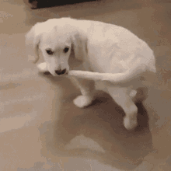
TAIL CHASING

Slide 19
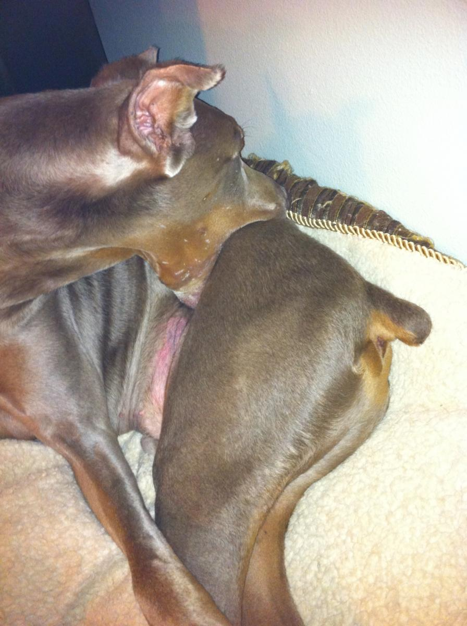
FLANK SUCKING

Slide 20
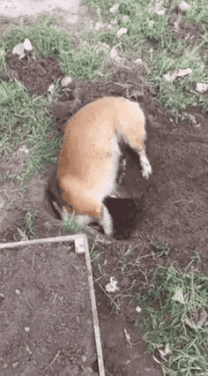
DIGGING

Slide 21
THERAPEUTIC MANAGEMENT

Slide 22
DRUG | USES
TRICYCLIC ANTIDEPRESSANTS
Amitriptyline | Anxiety, compulsive disorders
Clomipramine | Anxiety, aggression, compulsive disorders
SELECTIVE SEROTONIN REUPTAKE INHIBITORS
Fluoxetine | Anxiety, aggression, compulsive disorders
Paroxetine | Anxiety, aggression, compulsive disorders
AZAPIRONES
Buspirone | Anxiety
BENZODIAZEPINES
Alprazolam | Thunderstorm, anxiety, phobia
Diazepam | Anxiety, noise phobia
MONOAMINO OXIDASE INHIBITORS
Selegiline | Must not be combined with serotonin reuptake inhibitors or tricyclic drugs due to adverse drug interactions

Slide 23
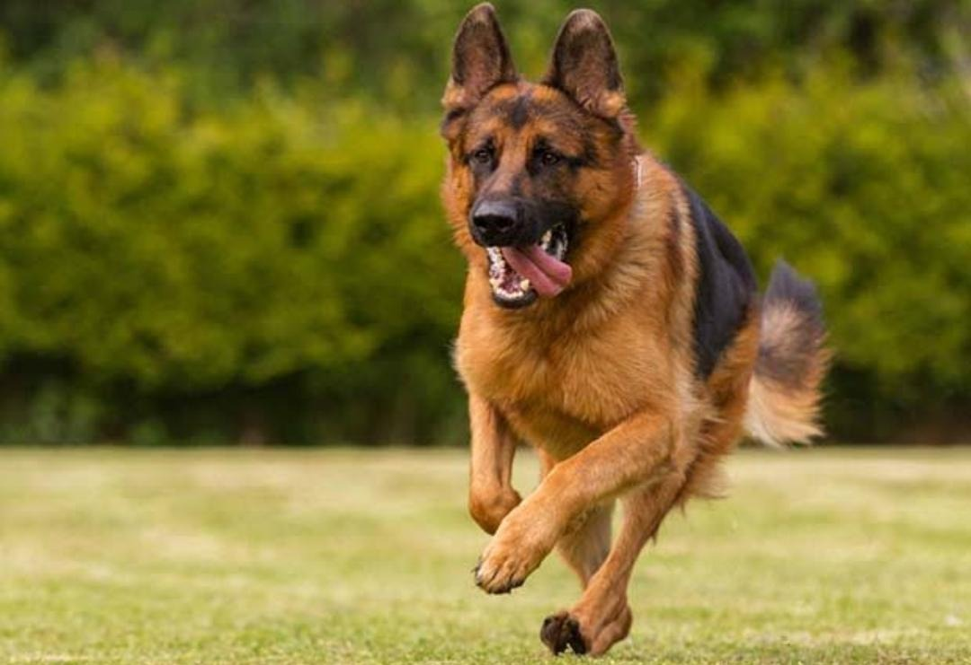
An ounce of prevention is worth a pound of cure

