Slide 1
CONTAGIOUS CAPRINE PLEUROPNEUMONIA
Anil Kumar
Asst. Professor
Dept. of VCC
UNIT-5

Slide 2
Introduction
severe contagious and frequently fatal diseases
Etiology
Mycoplasma capricolum subsp. Capripneumoniae (Mccp).
More fragile does not survive outside the animal or in the external environment for long time
Host Range
Goats are the primary hosts, but Sheep may be affected
In wild ruminants kept in a wildlife
Affects the respiratory tract
Recorded from all states of India
Not transmissible to cattle and sheep
Transmission
Close contact ( inhalation of respiratory droplets).
Outbreaks often occur after heavy rains (e.g. after the monsoons in India).
Carrier animals
Infected objects, vectors, fomites and animal products.

Slide 3
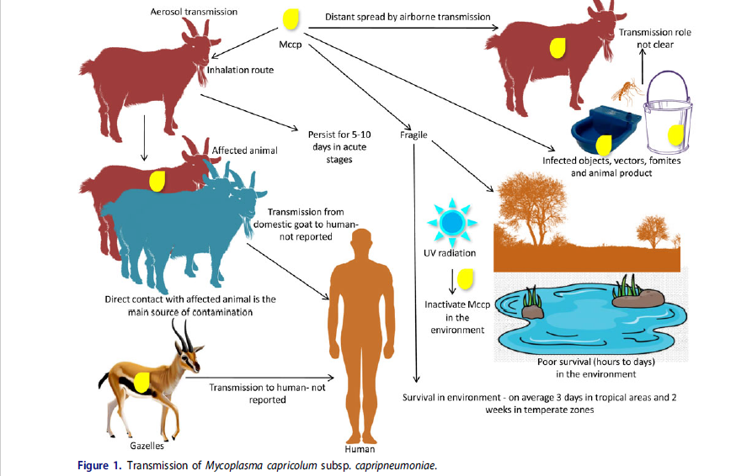
(M. IQBAL Yatoo et al., 2019)

Slide 4
Pathogenesis: (Presented in Fig. 2) can be summarized as below:
Inhalation is the commonest route of infection through aerosol transmission
colonization
ciliostasis of epithelia, serofibrinous pleuropneumonia, vasculitis, and fibrinocellular exudation
Mycoplasmal antigens (polysaccharides, galactan, lipoprotein) activate immune system
stimulation of inflammatory and oxidative cascade
Mycoplasma capricolum subsp. capripneumoniae may also affect other organs like joints, eyes, and udder.

Slide 5
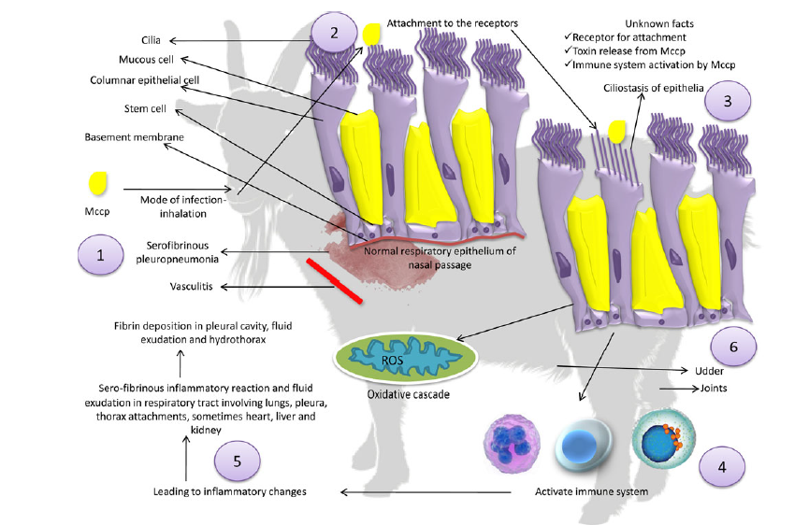
Figure 2. Pathogenesis of Mycoplasma capricolum subsp. capripneumoniae

Slide 6
Clinical findings
IP, 6-10 Days, Mortality-100%
Diagnosis
Clinical and PM findings.
Isolation and identification of agent
Treatment &Control
Macrolides (Tylosin @ 10 mg/Kg, IM for 3 days )is considered to be the drug of choice against Mccp
Oxytetracycline @ 15mg/Kg IM for 6-8 days and Other antibiotics like fluoroquinolone (Enrofloxacin).
Anorexia, dullness, depression, nasal discharge, abdominal respiration, fever and painful cough
Dyspnoea, open mouth breathing, protrusion of tongue and frothy salivation
CFT (Carrier animals)
Tube precipitation test (Very sensitive, for confirmatory diagnosis )
Immunobinding assay (Rapid test for field diagnosis)
Isolate the animal
Strict Hygienic measure
Vaccination:
Longley’s formalized/carbolized vaccine
Attenuated live culture vaccine @ 0.2 ml intradermal at ear tip, 15 month immunity

