Slide 1
CANINE DISTEMPER
VMD-422(Old VCI Syllabus&
UNIT-6 (New VCI Syllabus
Anil Kumar
Asst. Professor
Dept. of VCC

Slide 2
CANINE DISTEMPER
Canine distemper virus (CDV), belongs to the genus Morbillivirus (family, Paramyxoviridae).
CDV is closely related to human measles virus and rinderpest virus
Dogs and other Canidae such as coyotes, foxes, and wolves; Procyonidae (raccoons, pandas); Mustelidae (ferrets, mink, skunks, otters). Large wild Felidae can also be affected
Infection of dogs can lead to a severe, multisystemic disease that primarily affects the gastrointestinal, respiratory, and neurologic systems
Brachiocephalic dogs have a lower prevalence than dolichocephalic breeds.
World wide
ETIOLOGY
HOST AFFECTED
DISTRIBUTION

Slide 3
Fig: Anatomic sites
targeted by virus

Slide 4
Oronasal contact with virus in secretions or excretions, droplet nuclei, and large particle aerosol transmission
MODE OF TRANSMISSION
PATHOGENESIS
Virus
Monocytes within lymphoid tissue
in the upper respiratory tract and tonsils
Lymphatics and Blood
Entire RE System

Slide 5
Viral haemagglutinin
+Host Receptor (SLAM, Signalling lymphocytic activating molecules SLAM is expressed by immature thymocytes, activated lymphocytes, macrophages, and dendritic cells
Direct viral destruction of the lymphocyte population (CD4+ T cells), which occur within the blood, tonsils, thymus, spleen, lymph nodes, bone marrow, mucosa-associated lymphoid tissue, and hepatic Kupffer cells
Initial Lymphopenia and Transient Fever
Subsequently, 8-9 days post infection,
there is a second stage of cell-associated viremia and fever
After that it infects, respiratory, GIT, CNS, SKINS &additional Lymphoid cells
In this stage, CDV infects a variety of cell lineage
(Epithelial, mesenchymal, neuroendocrine, and hematopoietic cells, and forms intracytoplasmic but also intranuclear inclusions)
Shedding of virus from all secretions and excretions at 5 days post infection, Before clinical singns

Slide 6
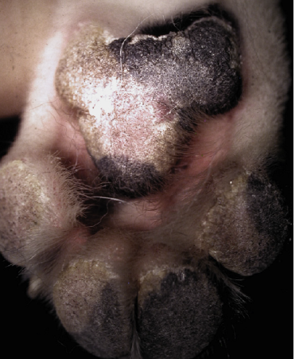
CLINICAL SIGNS
The clinical signs depends on:
virus strain, the age and immune status of the host, as well as concurrent infections with other viruses and bacteria
Respiratory form: fever, bilateral serous and nasal ocular discharges, conjunctivitis, and a non-productive cough and Secondary bacterial infection due to secondary bacterial infection lead to the development of mucopurulent nasal and ocular discharges and bacterial bronchopneumonia, with tachypnea, productive cough, lethargy, and decreased appetite.
GI form: It lead to inappetence, vomiting, diarrhea, electrolyte abnormalities, and dehydration.
Hyperkeratosis of nasal planum
Hyperkeratosis of foot pad

Slide 7
Nervous form: the neurologic signs are often progressive due to neuronal necrosis and atrophy, and generally do not resolve, so dogs that recover often have residual neurologic deficits.
“Old dog encephalitis” is a misnomer, poorly characterized progressive immune-mediated demyelinating leukoencephalomyelitis , which occurs weeks to years after recovery from the acute infection and is difficult to diagnose.
A Myoclonus (involuntary twitching of isolated muscle groups) or chorea is common, when affected puppies are at rest.
A “chewing gum” seizures, which localized to the head and jaw, with accompanying foamy hypersalivation.
Other neurologic signs include obtundation, seizures, tremors, opisthotonos, tetraparesis, paraparesis, delayed placing reactions, ataxia, and, less commonly, behavioral abnormalities, compulsive pacing, and vestibular signs such as a head tilt, nystagmus, strabismus, and circling
Ocular form : include blepharospasm, photophobia, uveitis, chorioretinitis, keratoconjunctivitis sicca (KCS), keratitis, and optic neuritis, which may be associated with blindness.

Slide 8
Enamel and dentin hypoplasia in recovered animal.
Cutaneous form: There is hyperkeratosis in the regions of footpad and nasal planum epithelium. Puppies with hyperkeratosis, also known as “hardpad,” have thickened, crusty footpads that resemble those of adult dogs.
The most common secondary infections in distemper are secondary bacterial infections that contribute to bronchopneumonia is Bordetella bronchiseptica.
The transplacental infections may cause h infertility, stillbirth, or abortion and with neurologic signs in puppies that are less than 4 to. 6 weeks of age
Dogs that have recovered from CDV infection may develop enamel hypoplasia/chorea/keratoconjunctivitis Sicca/gold medallion lesions(healed chorioretinitis, a hyperreflective circular lesions).

Slide 9
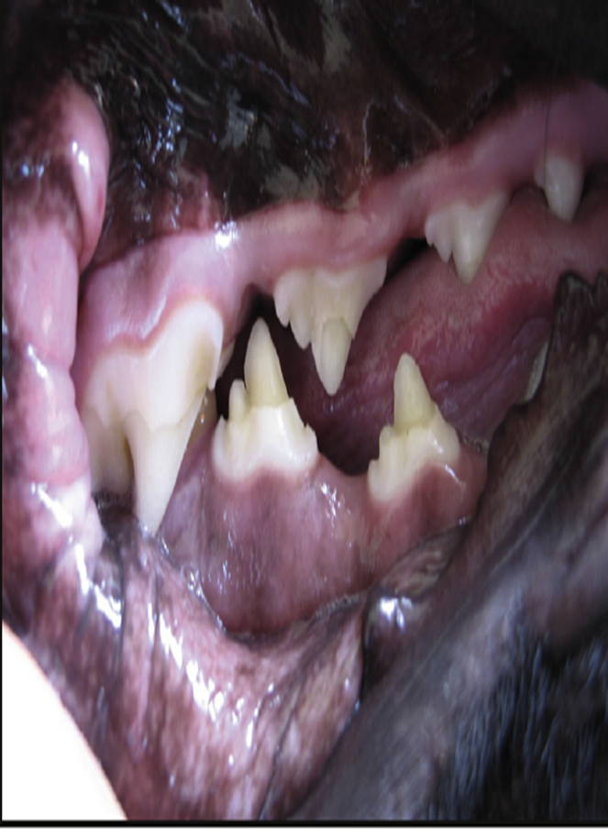
DIAGNOSIS:
Clinical signs and sypmtoms, especially myoclonus.
In dogs with respiratory signs, the presence of conjunctivitis, blepharospasm, and ocular discharge should raise suspicion for distemper.
Distemper should always be considered as a diagnosis in young dogs with neurologic signs
Microbiologic Tests: This includeVirus Isolation, Cytologic Demonstration of CDV Inclusions, ELISA assays, Serology, RT-PCR.
Enamel hypoplesia

Slide 10
TREATMENT and PROGNOSIS:
Dogs with severe respiratory and gastrointestinal disease require:
IV fluids
Antimicrobial drugs/antimicrobial drug combinations, such as ampicillin and a fluoroquinolone
Antiemetics
A single IV dose of dexamethasone or tapering anti-inflammatory doses of glucocorticoids has been advocated to halt or reduce the severity of progressive CNS signs.
Oral vitamin A and C may be advocated
Anticonvulsants such as diazepam and, for chronic management, potassium bromide or phenobarbital can be used to treat seizures and prevent the spread of a seizure focus.
Note:The prognosis for dogs with severe neurologic signs is poor.

Slide 11
Immunity and Vaccination
Immunity to CDV requires antibodies as well as cell-mediated immunity
Disease can be prevented through immunization with attenuated live or recombinant vaccines
Attenuated live vaccines should be given >than 6 weeks of age
For dogs older than 16 weeks of age that are brought to the veterinarian for their first vaccination, two doses of vaccine should be given 3 to 4 weeks apart.
Notes to be remember:
Attenuated live CDV vaccine virus can cause encephalitis when administered to immunocompromised dogs and puppies less than 6 weeks of age.
Postvaccinal encephalitis usually occurs 3 to 20 days after vaccinationassociated with certain batches of vaccines that contain the Rockborn strain.
Attenuated live CDV vaccines to dams immediately after whelping has been associated with the development of encephalitis in the puppies

