Slide 1
Department of Veterinary Medicine Bihar Veterinary College, Patna – 800 014 (Bihar Animal Sciences University, Patna)
CALF PNEUMONIA
Dr. Ranveer Kumar Sinha Assistant Professor cum Junior Scientist

Slide 2
CALF PNEUMONIA
Calf pneumonia is a Important calf diseases
Diagnosing, treating and preventing this diseases is very important for every cattle industry.
It is a multifactorial disease and most common in calves between one to five months of age.

Slide 3
TYPES of CALF PNEUMONIA
Chronic Pneumonia:
It is more gradual in nature with no distinct ill phase & animal still eat but have a slight nasal discharge with an increased respiratory rate and cough.
Acute Pneumonia:
It is usually more sudden in onset.

Slide 4
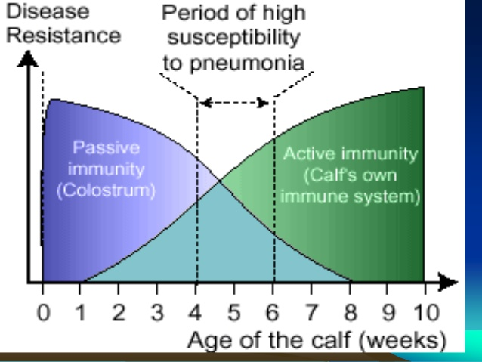

Slide 5
CAUSES OF CALF PNEUMONIA
Environmental Factors:
Low environmental temperature
High Humidity
Poor Ventilation
Infectious Agents:
Viral -Bovine Respiratory syncytial Virus (RSV)
Bacterial
Parasitic
Mycoplasma

Slide 6
SYMPTOM OF CALF PNEUMONIA
By auscultation of the anterior ventral lung crackles and wheezes & an increase in bronchial sounds especially on inspiration.
Dull and depressed
High temperature
Raised breathing due to lung damage
Nasal discharge
Coughing
Reduced food intake
Weight Loss

Slide 10
CONSEQUENCES OF PNEUMONIA
Short-term consequences:
Reduced dry matter intake, delayed weaning and higher risk of an additional pneumonia event at weaning.
Long-term Consequences:
Delayed breeding, higher age at first calving and compromised milk production.

Slide 11
Treatment of calf pneumonia
Removal of primary etiology:
Antibiotics:
Enrofloxacine
Marboflxacine
Cephalosporion .
Sulfa &Trimethoprime
Antihelmintics:
Anti-inflammatory (St & Non St):
SupportiveTreatment:
Injection of vitamin C and A to increase body immunity
Mucolytics & Bronchodilator Antihistaminic
Correct anemia if present.
Easily digestible and palatable food

Slide 12
PREVENTION OF CALF PNEUMONIA
Removal of the cause of diseases
Clean environment
Proper ventilation. If ammonia can be smelled it is a sign of poor ventilation.
Swabbing of the navel with tincture iodine
Removal of the newborn from the infected environment
Feeding calves inadequately will reduce calf growth and their immune system response which helps fight diseases.
Ingestion of colostrums from dam within four to six hours of birth to receive adequate immunity.
Special nutritional and housing requirements. Isolation of newborn calf in calf – rearing unit within few days after birth.

