Slide 1
status & scope of cheese in india & abroad

Slide 2
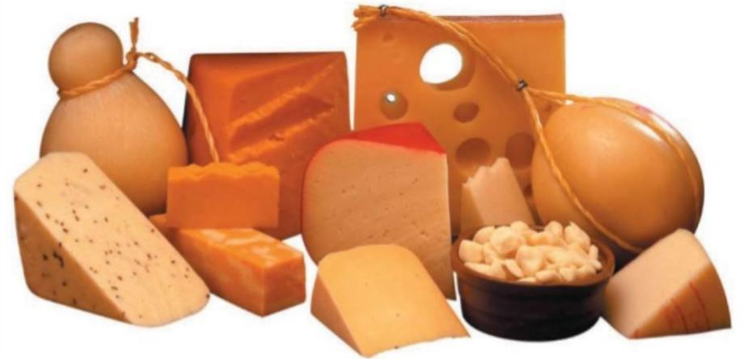
Introduction
Introduction
Cheese is an ancient food.
Derived from milk by coagulation of the milk protein.
Highly diversified product.
Rich source of fat, calcium and phosphorus.
Protein is persent in pre digested form.

Slide 3
Introduction of dairy industry
Top five milk processing country in the world
1)USA
2) Germany 3) China 4) France 5) India
India about 46% of the total milk produced ----
consumed in liquid form and
47% is converted in to traditional products like cottage butter, ghee , Paneer, Khoa, malai ,etc.
Only 7% of the mik goes into the production of western products like powders, processed butter, Mozzerala cheese, Cheddar cheese and processed cheese.

Slide 4
CURRENT STATUS OF CHEESE IN ABROAD
About 40% of total world milk production converted into cheese. But European Union united state accounted for more than 50.
In 2019 , world production of cheese ----20380 (1000 Metric tonnes)
Per capita consumption even among the cheese – consuming household is a poor 2.4 kg. in USA.

Slide 5
Top five cheese producing country
Rank | Country name | Production (metric tonne)
1. | United State | 5,163,564
2. | Germany | 2047453
3. | France | 1942375
4. | Italy | 1133756
5. | Netherland | 746263

Slide 6
Top five cheese exporter country
S.No. | Country | Cheese exports | %World total
1. | Germany | US $ 3.8 billion | 14.4%
2. | France | $ 3.3 billion | 12.7%
3. | Netherland | $ 3.1 billion | 12%
4. | Italy | $ 2.5 billion | 9.6%
5. | United States | $ 1.5 billion | 5.3%
6. | India | $ 18.5 billion | 0.1%

Slide 7
Top five best cheese in the world
S.No. | Name of the cheese | Country | Type of cheese
1. | Halloumin cheese | Cyprus | Semi- soft
2. | Emmental cheese | Switzerland | Hard
3. | Danablu cheese | Denmark | Semi- soft
4. | Stilton cheese | England | Semi - soft
5. | Nettle cheese | England

Slide 8
Current status of cheese in INDIA
Mostly used cheese in India :-
Cheddar cheese
Emmental cheese
Processed cheese & cheese spread
Mozzarella cheese
Less than 1% of total dairy products production .
Cheese --- first marketed under the brand name 'AMUL' in the late 1970s.

Slide 9
Current status of cheese in India...
Growth rate --- estimated at about 10-12% per year in terms of volume and 16-17% per year in value terms.
60% of the market is dominated by processed cheese.
AMUL owns about 65% of the cheese market .
BRITANNIA has ~ 25% share.

Slide 10
Conti---
AMUL introduced a low calorie cheese called 'SLIM CHEESE'.
Processed cheese market which contributes about 2,000 tonnes a year is dominated by AMUL with a 75% share .
The market for cheese in India is worth RS 1250 crores currently
Organized cheese market ~
RS. 4.5 billion in which Processed cheese at 60% of the
overall market --- worth RS. 2.7 Billion.
.

Slide 11
Cheese brands of India
AMUL
Britannia
Mother dairy
Go cheese

Slide 12
Future scope of cheese
Market expected to grow nearly 18% by 2020.
Total cheese production of world----20380 ( 1000 Metric ton)
(2019)
Research ---- continuing to reduce the rate of addition of both NaCl as well as the emulsifying salts in Processed cheese manufacture.
More focus on buffalo milk cheese, low sodium cheese, CLA enriched cheese.

