Slide 1
CHEMICAL MEDIATORS OF INFLAMMATION
Dr. SANJIV KUMAR
ASSTT. PROFESSOR,
DEPTT. OF PATHOLOGY, BVC, PATNA

Slide 2
Definition:
Any messenger that acts on blood vessels, inflammatory cells, or other cells to contribute to an inflammatory response.
May be in present in Cell or Plasma
In Cell they are either preformed or newly synthesized
In plasma present as precursor or inactive form.

Slide 3
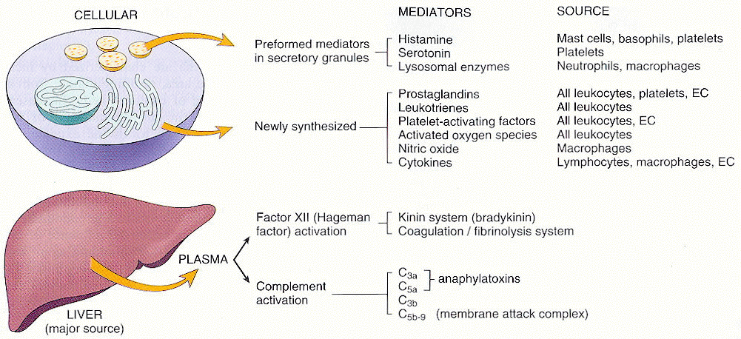
DIFFERENT MEDIATORS

Slide 4
VASOACTIVE AMINES
Histamine and Serotonin (Histamine is formed from amino acid histidine by histidine decarboxylase )
Increase Vascular Permeability and Vascular Permeability
Mediators in the immediate active phase of increased permeability
Promotes contraction of smooth muscle
*Serotonin found in rodent mast cells

Slide 5
PLASMA PROTEASES
COMPLEMENT SYSTEM
KININ SYSTEM
CLOTTING SYSTEM

Slide 6
Activation Pathway
Classical pathway- By antibody, antigen complex
Alternate pathway- By microbial surface polysaccharides
Common pathway

Slide 7
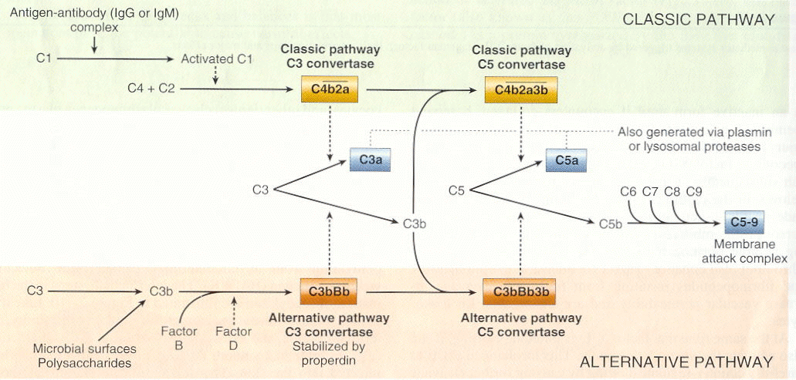

Slide 8
Important inflammatory mediators
C3a and C5a (anaphylatoxins)
Cause release of histamine from mast cells
Lysosomal enzyme release in inflammatory cells
C5a
Activates lipoxygenase pathway
Chemotactic many inflammatory cells
Increases adhesion of leukocytes
C5b-9 membrane attack complex (MAC)
Lyses cells
Stimulates arachidonic acid metabolism
Produces reactive oxygen metabolites
C3b act as opsonin

Slide 9
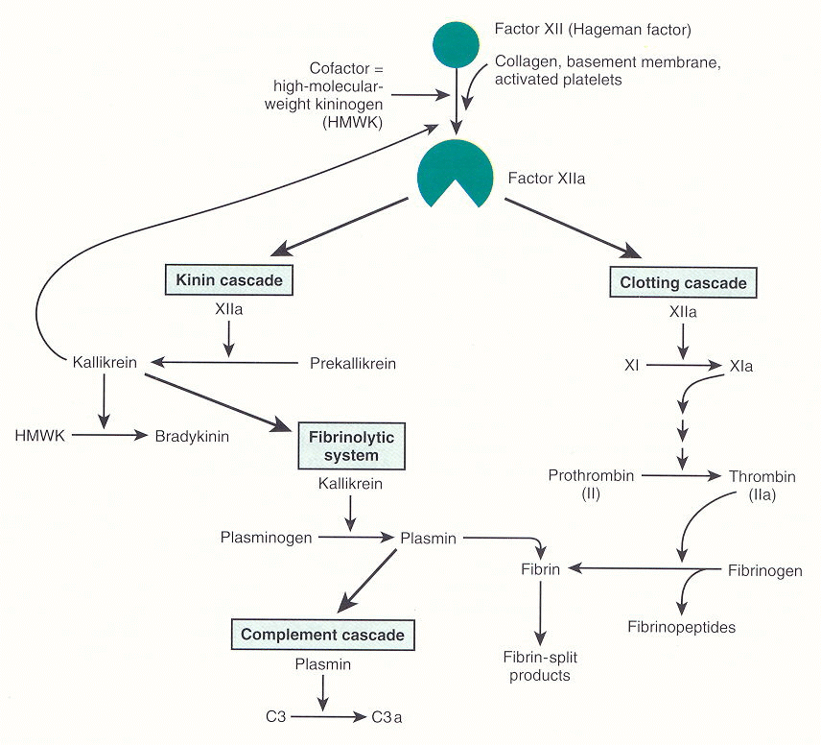
KININ AND CLOTTING SYSTEM

Slide 10
KININ SYSTEM
Activated by Hageman factor (XIIa)
BRADYKININ (Vasoactive nanopeptide)
Potent vasodilator
Increased vascular permeability
Contraction of smooth muscle
Produce pain
Stimulates release of histamine
Activates the arachidonic acid cascade

Slide 11
COAGULATION SYSTEM Clotting system/fibrinolytic system
Plasma proteins
Can be activated by Hageman factor
Thrombin converts fibrinogen to fibrin
↑vascular permeability
Chemotactic for leucocytes
Plasmin is important in lysing fibrin clots,
Activates Hageman factor (XII) ⇨ bradykinin
Cleaves C3 ⇨ C3a
"fibrin-split products" formed from fibrin breakdown
↑ vascular permeability

Slide 12
HAGEMAN FACTOR
Factor XII of intrinsic coagulation cascade
Causes
Coagulation
Activation of fibrinolytic system
Produces bradykinin
Activates complement
Provides an amplification system

Slide 13
ARACHIDONIC ACID METABOLITES
20-carbon polyunsaturated fatty acid (4 double bonds)
Derived directly from dietary sources or by conversion of essential fatty acid linoleic acid
Undergo 2 major pathways
Cyclooxygenase pathway (COX)
Lipoxygenase pathway (LOX)

Slide 14
CYCLOOXYGENASE PATHWAY
3 important products
Thromboxane A2
Aggregates platelets and causes vasoconstriction
Prostacyclin (PGI₂)
Endothelial cells inhibits platelet aggregation and causes vasodilation
Prostaglandins PGE₂, PGF_{2-alpha} and PGD₂
Variety of actions on vascular tone and permeability
Pain and fever

Slide 15
LIPOXYGENASE PATHWAY
Leukotrienes and lipoxins
Leukotriene B4 is a potent chemotactic agent
Leukotrienes C4, D4, E4
Potent vasoconstrictors
Potent mediators of increased vascular permeability on venules only
Up to 1000 times as potent as histamine in producing increased vascular permeability
Lipoxins cause vasodilation, inhibit neutrophil i.e. reverse of leukotrienes.

Slide 16
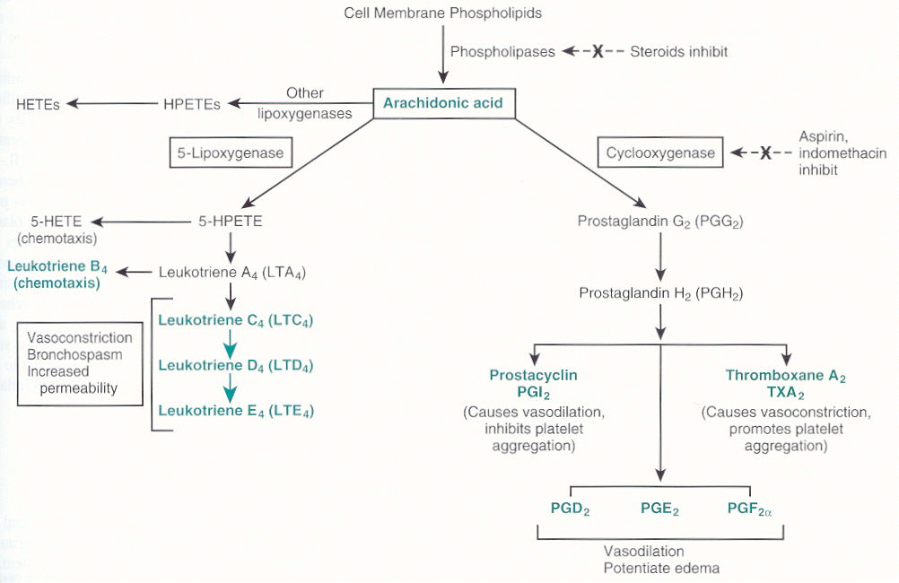

Slide 17
PLATELET ACTIVATING FACTOR from mast cells, neutrophils, macrophages, platelets, endothelium etc. as AA metabolites
Aggregate platelets and cause release
Bronchoconstriction and Vasoconstriction
At low concentration Vasodilation and ↑ vascular permeability
↑ leukocyte adhesion
Leukocyte chemotaxis

Slide 18
CYTOKINES
Transmitters for cell-to-cell chatting
Primarily from activated macrophages and lymphocytes

Slide 19
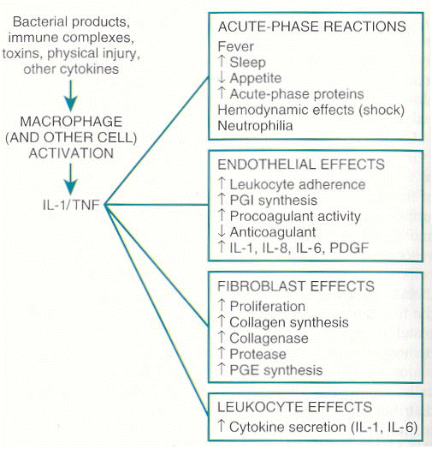
IL-I and TNF
Master Cytokines

Slide 20
Other Cytokines
IL-5
Eosinophils
IL-6
B and T cells
IL-8
Neutrophils
Lesser degree monocytes and eosinophils

Slide 21
GROWTH FACTORS
Platelet derived growth factor
Transforming growth factor β
Chemokines
Important in regeneration and repair

Slide 22
NITRIC OXIDE (NO) Formed from arginine along with citrulline
3 effects
Physical mediator of vascular tone
Host defense
Reduces platelet aggregation and adhesion
Inhibits several features of mast cell induced inflammation
Uncontrolled NO production
Can lead to massive peripheral Vasodilation and Shock

Slide 23
LYSOSOMAL CONSTITUENTS
Neutrophils, Monocyte/Macrophages
Smaller, specific or secondary granules like lysozyme, collagenase, histminase.
Large, azurophil or primary granules like myeloperoxidase, acid hydrolases, elastase etc.
Cationic proteins
↑ vascular permeability
Chemotactic
Neutral proteases degrade ECM while acid proteases degrade bacteria, neutral proteases cause anaphylotoxins.

Slide 24
OXYGEN-DERIVED FREE RADICALS
Cause endothelial damage
Protein destruction by inhibiting antiproteases
Injury to variety of cells
Don’t forget the antioxidants
Ceruloplasmin
Transferrin
Superoxide dismutase
Catalase
Glutathione peroxidase

