Slide 1
Cholinergic Drugs (Parasympathomimetics)
Dr. Nirbhay Kumar
Asstt. Professor & Head
Deptt. of Veterinary Pharmacology & Toxicology
Bihar Veterinary College, Bihar Animal Sciences University, Patna

Slide 2
Cholinergic (Parasympathomimetic) Drugs
Drugs which mimic the effects of parasympathetic post-ganglionic nerves or those of acetylcholine.
Also called as cholinergics, cholinergic agonists or cholinomimetics.
These have agonistic action on cholinergic receptors at autonomic ganglia, neuromuscular junction etc.

Slide 3
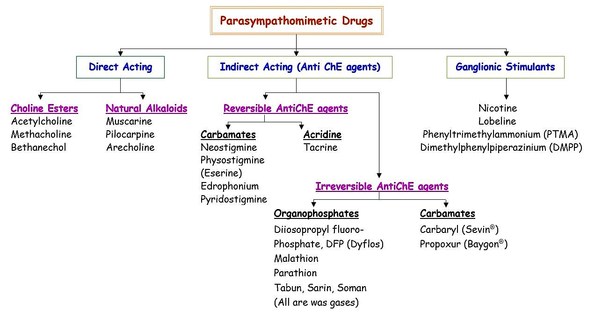
Classification of Parasympathomimetic Drugs

Slide 4
I. Choline Esters
1. Acetylcholine (ACh):
Although is essential for maintenance of body homeostasis, it is not used therapeutically for two important reasons:
It acts simultaneously at various tissue sites and no selective therapeutic response can be achieved.
Its duration of action is quite brief because it is rapidly inactivated by the cholinesterases.

Slide 5
I. Choline Esters continued …
2. Methacholine (Acetyl-β-methylcholine):
Synthetic choline ester used occasionally in human therapeutics but infrequently (rarely) employed in veterinary medicine.
Methacholine causes muscarinic effects on cardiovascular function similar to those produced by ACh, but it is considerably less active on GI system. Methacholine lacks nicotinic action.
Methacholine is a cholinomimetic of choice for controlling tachycardias of atrial origin. It will cause slowing of heart, reduction of the force of contraction & generalized vasodilatation. Main site of action of methacholine is the pacemaker.

Slide 6
I. Choline Esters continued …
3. Carbachol (Carbamoylcholine):
Extremely potent choline ester active at both muscarinic and nicotinic receptors.
Carbachol is sometimes used for the emergency treatment of colic in the horse and ruminal stasis in cattle. Administration of carbachol is done with great care and the drug is given in repeated small doses of 1-2 mg subcutaneously.
4. Bethanechol (Carbamoylmethylcholine):
It is somewhat similar to methacholine and carbachol, however it is primarily a muscarinic agonist, and has little stimulant effects on nicotinic receptors.

Slide 7
I. Choline Esters continued …
Table: Showing properties of choline esters
Choline esters | Hydrolyzed by |  | actions |  | Selective actions on
 | AChE | BuChE | muscarinic | nicotinic
ACh | ++ | + | + | + | Non-selective
Methacholine | + | – | + | ± | cvs
carbachol | – | – | + | + | git, bladder
Bethanechol | – | – | + | – | git, bladder

Slide 8
I. Choline Esters continued …
Therapeutic uses of choline esters
(i) Methacholine and bethanechol are not used frequently in clinical veterinary medicine. Methacholine has been used in human medicine to control tachycardia of supraventricular origin.
(ii) Bethanechol, 1 mg administered subcutaneously b.i.d. has been used to treat urinary bladder atony in cats after incidence of urolithiasis.
(iii) Carbachol has been used in the treatment of colic and impactions of the intestinal tract. It is also used in the treatment of ruminal atony and impaction in cattle.

Slide 9
II. Natural Alkaloids
1. Pilocarpine:
Obtained from the leaves of Brazilian shrubs Pilocarpus jaborandi and P. microphyllus.
Prominent muscarinic actions.
Stimulates flow of secretions from exocrine glands, including salivary, mucous, gastric & digestive pancreatic secretions.
Causes contraction of GI smooth muscle & increases smooth muscle tone and peristaltic activity.
Has a potent constrictor effect on the pupil.
Penetrates cornea and promptly causes miosis, ciliary muscle contraction and fall in intraocular tension lasting 4-8 hours.

Slide 10
II. Natural Alkaloids continued …
2. Arecholine:
An alkaloid found in the beetle nut, the seed of the beetle palm (Areca catechu).
Has muscarinic as well as nicotinic actions including those on skeletal muscle end plate.
Is similar to Pilocarpine in scope of activity but is considerably more potent.
It stimulates secretion of the glands of the digestive tract and increases peristaltic movement of the gut.
Increased flow of the saliva occurring within 5 minutes following a subcutaneous injection and lasting for an hour is particularly noticeable.
Arecholine contracts the urinary bladder.

Slide 11
II. Natural Alkaloids continued …
2. Muscarine:
Found in the poisonous mushrooms Amanita muscaria, and has only muscarinic actions.
It is not used therapeutically, but, is of toxicological importance.

Slide 12
II. Natural Alkaloids continued …
Therapeutic uses of Cholinomimetic Natural Alkaloids:
Clinically, solutions of 0.5 to 2% of pilocarpine are used for instillation into the conjunctival sac for treatment of glaucoma.
Other uses of pilocarpine as a miotic are – to counteract mydriatics after they have been used for testing refraction and to prevent or break adhesions of iris with lens or cornea by alternating it with mydriatics.

Slide 13
III. Cholinesterase Inhibitors
These are indirect acting parasympathomimetic agents.
They inactivate or inhibit AChE and pseudoChE and thereby intensify the activity of endogenous ACh.
Acetylcholinesterase (AChE):
Anionic site: Active region of AChE formed by tryptophan
Esteratic site: Formed by serine, glutamate and histidine

Slide 14
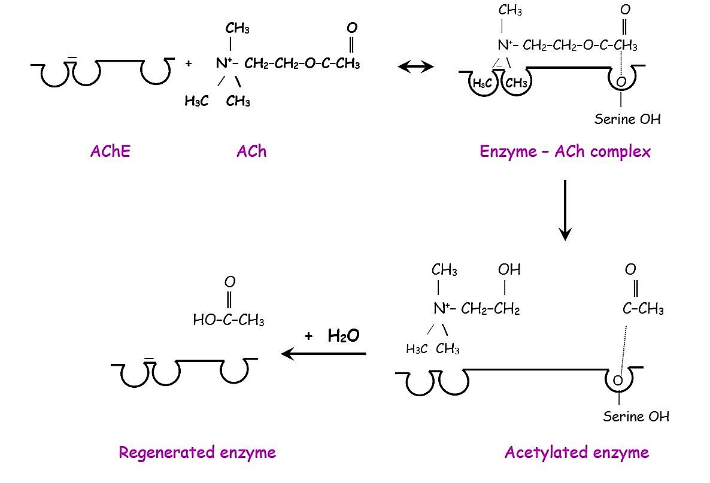
III. Cholinesterase Inhibitors continued…
Hydrolysis of ACh by AChE:
Involves electrostatic attraction of +ly charged N⁺ of ACh to the aromatic pocket and nucleophilic attack by serine –OH which is activated by the adjacent histidine leading to acetylation of the serine.
The acetylated enzyme reacts with water to produce acetic acid and choline.
The reaction is very fast.

Slide 15
III. Cholinesterase Inhibitors continued…
[A]. Reversible Cholinesterase Inhibitors:
Mechanism of action:
These agents reversibly bind to the active sites of the enzyme, as they serve as alternate substrates for AChE.
Edrophonium and Tacrine attach only to the anionic site of the enzyme and tacrine inhibited enzyme does not involve hydrolysis of the inhibitor, but only its diffusion – so action is brief.
Physostigmine and Neostigmine bind to both anionic and esteratic sites of the enzyme. So, the carbamylation of the enzyme (with neostigmine and physostigmine) is of longer duration than the inhibition by edrophonium.
Thus, during the period where the enzyme inhibitor complex exists, the enzyme will not hydrolyze its natural substrate ACh.

Slide 16
III. Cholinesterase Inhibitors continued…
[A]. Reversible Cholinesterase Inhibitors:
Physostigmine:
An alkaloid extracted from the dried ripe seeds of a vine, Physostigma venenosum which grows in tropical West Africa. It is also known as Calabar bean or “Ordeal bean”.
Now-a-days, physostigmine is used for its ability to constrict the pupil or as miotic and in the treatment of deadly nightshade poisoning.
2. Neostigmine:
It is the salt of a synthetically produced substance structurally related to physostigmine.
It is used as purgative and in the treatment of atony of urinary bladder.

Slide 17
III. Cholinesterase Inhibitors continued…
Comparative features of Physostigmine and Neostigmine:
 | Physostigmine | Neostigmine
1. Source | Calabar bean | Synthetic
2. Chemistry | Tertiary amine derivative | Quaternary ammonium compound
3. Oral absorption | Good | Poor
4. CNS actions | Present | Absent
5. Applied to eye | Penetrates cornea | Poor penetration
6. Direct action on cholinoceptors | Absent | Present
7. Prominent effect on | Autonomic effectors | Skeletal muscle
8. Important use | Miotic (in glaucoma) | Myasthenia gravis
9. Dose | 0.5 – 1 mg (man) oral or parenteral 0.1 – 1% in eye drops. | 0.5 – 2.5 mg (man) i.m./ s.c
10.Duration of action | Systemic - 4 to 6 hours Eye – 6 to 24 hours | 4 to 6 hours.

Slide 18
III. Cholinesterase Inhibitors continued…
[B]. Irreversible Cholinesterase Inhibitors:
Mechanism of action:
Organophosphates act as irreversible inhibitors of the cholinesterases in mammals.
These compounds irreversibly phosphorylate the esteratic site of both AChE and the non-specific or the pseudocholinesterase throughout the body.
Endogenous ACh is not inactivated and the resulting effects are due to the excessive preservation and accumulation of endogenous ACh.

Slide 19
III. Cholinesterase Inhibitors continued…
[B]. Irreversible Cholinesterase Inhibitors:
Effects & Toxicity:
Muscarinic effects: Profuse salivation, vomiting, defaecation, hypermotility of the GI tract, urination, bradycardia, hypotension, severe bronchoconstriction and excess bronchial secretions.
Nicotinic effects: Skeletal muscle fasciculations, twitching and subsequently muscle paralysis.
CNS symptoms: Convulsions and frequently death due to the penetration of the agents into the CNS and subsequent intensification of the activity of ACh at CNS sites.

Slide 20
III. Cholinesterase Inhibitors continued…
[B]. Irreversible Cholinesterase Inhibitors:
Treatment of organophosphate poisoning:
1st line of treatment : Atropine to counter muscarinic effects of ACh @ 0.2 to 0.5 mg/kg b.wt. (maximum dose = 1 mg/kg). It is administered as 0.15% solution of atropine in physiological saline.
2nd line of treatment : Oxime reactivators viz. diacetyl monoxime (DAM), 2-pyridine aldoxime methiodide (2-PAM or pralidoxime), obidoxime etc. which reactivate the phosphorylated AChE enzyme and greatly accelerates clinical recovery.
Ageing: The usefulness of oxime reactivators is limited to a short period (minutes or hours depending on the compound) because the enzyme phosphate complex becomes resistant when a further group is removed by hydrolysis, a change known as “ageing”.

Slide 21
III. Cholinesterase Inhibitors continued…
[B]. Irreversible Cholinesterase Inhibitors:
Therapeutic Uses of Cholinesterase Inhibitors:
The only drug indication is the relief of glaucoma where a single instillation of dyflos (di-isopropylfluorophosphate) or echothiopate acts for several weeks.
Organophosphates and carbamates are used as insecticides for the control of insect vectors and ectoparasites.

Slide 22
Thank You

